Slide 1
Eligibility Score Analysis (Prudential Life Insurance Assessment)

Slide 2
Objective
To develop a predictive model that generates risk score and determines the eligibility for insurance approval.
The following two algorithms are used for the prediction
Linear Regression
Decision Tree
Dataset: https://www.kaggle.com/c/prudential-life-insurance-assessment/data

Slide 3
Workflow
EXTRACTION
PRE-PROCESSING THE DATA
EXPLORATORY DATA ANALYSIS
FEATURE SELECTION
REGRESSION ALGORITHMS

Slide 4
Data Preparation
The input dataset contains different kind of columns which involves Categorical, Continuous and Discrete.
Categorical variables are converted to Numerical expression using 0-N transformations.
Identified Null values on each column and removed the columns with more than 50% of Null values.

Slide 5
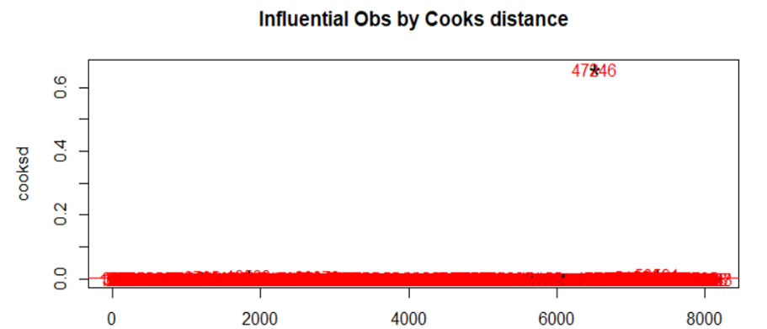
Data Preparation
Filled the missing values of the column using mean/median.
Removed outliers which are four times more than the mean value.

Slide 6
Data Preparation
The dimensions are reduced using Step AIC function for both forward and backward direction.
Removed the variables with near to zero variance using nearZeroVar function.
The input parameters are reduced to 32 for building the model

Slide 7
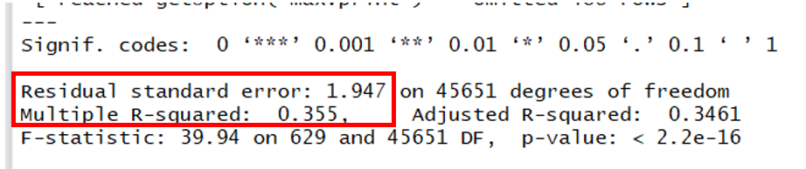
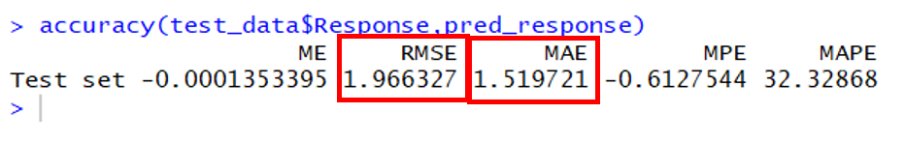
Method 1- Linear Regression
The Linear Regression model is build with reduced P values columns and predicted with the following values
R-Square value – 0.355
RMSE value – 1.966

Slide 8
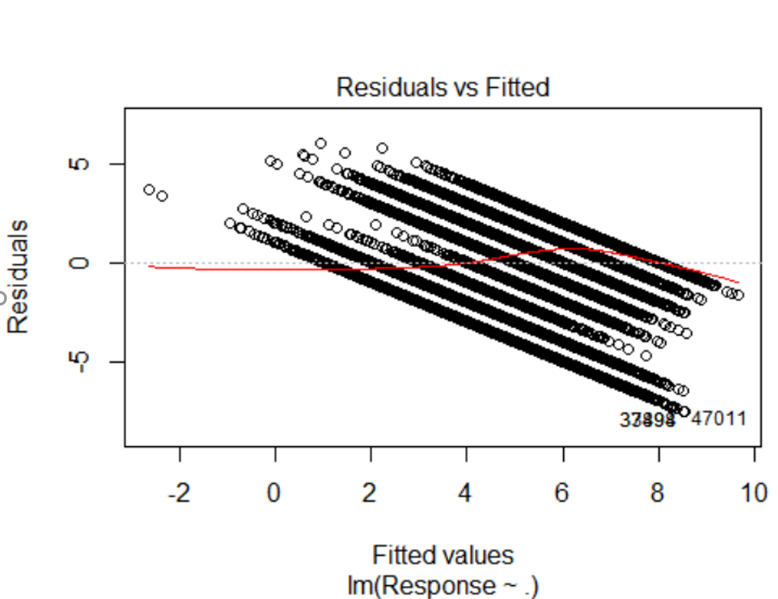
Method 1- Linear Regression

Slide 9
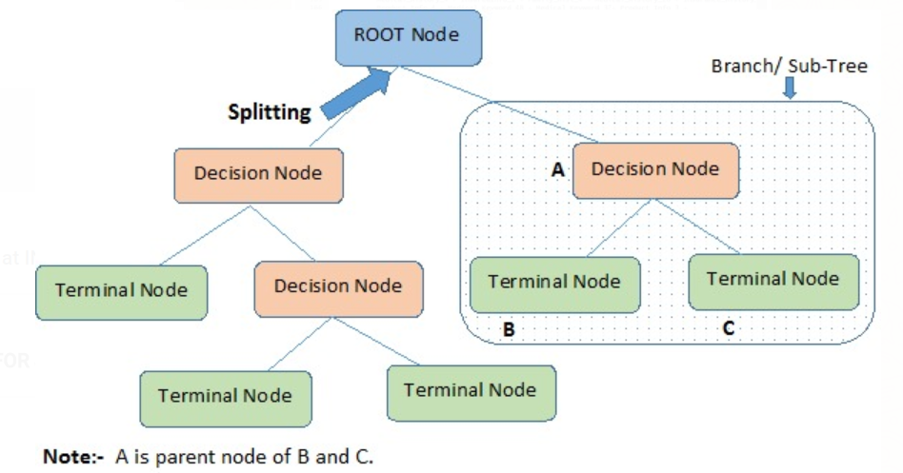
Method 2 – Decision Tree
A decision tree is a supervised learning algorithm that classifies data based on the values of information gain of each input variable. It identifies the most significant input variable and classifies data until it reaches the leaf node. It uses a tree-like graph or model of decisions.

Slide 10
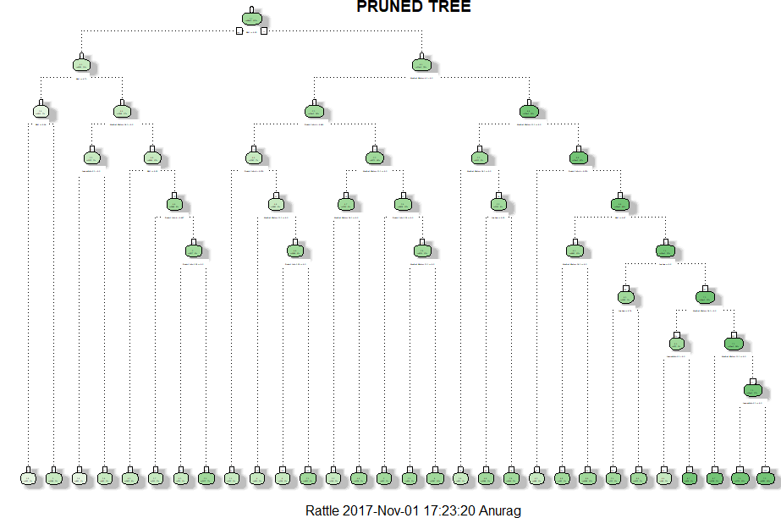
Method 2 – Decision Tree

Slide 11
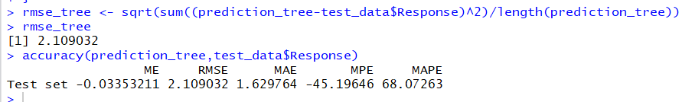
Method 2 – Decision Tree
The Decision tree is built using the reduced dimensions resulting in the RMSE value of:
RMSE value – 2.109

Slide 12
Conclusion
The results will help Prudential to accurately determine risk score and eligibility.
Based on our following RMSE results for each model:
Linear Model :- 1.96
Decision Tree :- 2.109
Linear Regression predictive model is best suited for the Prudential Insurance data.

Slide 13
Thank You ! ☺

