Slide 1

Summer Internship
Organization Name: Asha Kiran JHC Hospital
Guide: Dr Mansi Patil
Project Title : Prevalence of Depression,
Anxiety and Stress along HCPs in India.

Slide 2
Objective
Identify the prevalence of depression, stress, anxiety and burnout following coronavirus-19 pandemic among HCPs in India

Slide 3
Data Collection
Health care providers included “medical” (physicians, nurses) and “nonmedical” personnel (allied health professionals, pharmacists, technicians, administrators, clerical staff, and maintenance workers).HCPs in India who are 18 years old and above were only considered for the study.
Participants were approached via mail asking them to participate in the study and fill the questionnaire, data was collected using Google Forms.
·
·

Slide 4
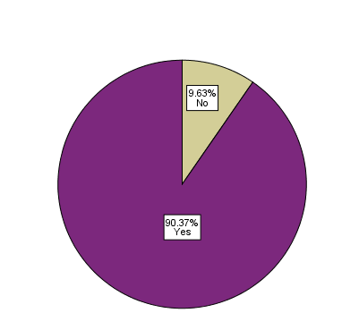

Covid Fear among HCPs in India
90.37% HCPs feared they will get affected by Covid during Covid 19 pandemic while only 9.63% responded they did not fear they might get covid.

Slide 5
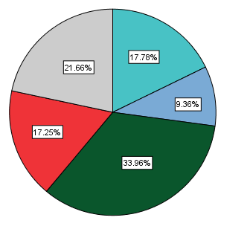

Burnout among HCPS in India
17.25% HCPs always felt burnout at work, 33.96% HCPs responded they sometimes felt burnout and 17.78% responded they never felt burnout at work during Covid 19 pandemic.

Slide 6
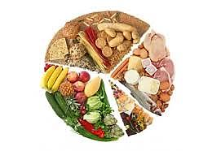
Diet Diversity Score
DDS was calculated by summing the number of unique food groups consumed during last 24 hour .
16 unique food groups were considered.
Food groups considered were cereals/roots, vegetables, fruits, legumes/lentils, meat/fish/egg & milk/dairy products.

Slide 7
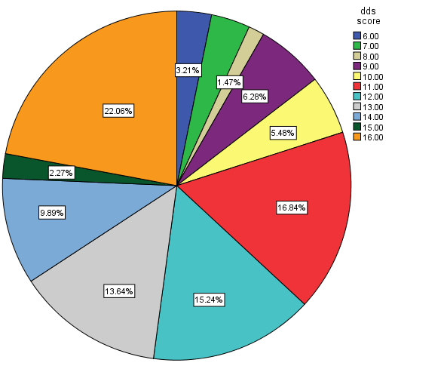
Diet Adequacy among HCPs in India
dds refers to diet diversity score
22.06% HCPS got a diet score of 16 (consumed all unique food groups),

Slide 8
DASS-21 Scale
The Depression, Anxiety and Stress Scale - 21 Items (DASS-21) is a set of three self-report scales designed to measure the emotional states of depression, anxiety and stress. Each of the three DASS-21 scales contains 7 items, divided into subscales with similar content
The main symptoms of depression are low self-esteem, hopelessness, devaluation of life, self-deprecation and inertia. The main symptom of anxiety is physiological arousal. The symptoms of stress are difficulty relaxing, tension, impatience, irritability and restlessness.
Scores for depression, anxiety and stress are calculated by summing the scores for the relevant items.
They are then categorized into: Normal, Mild, Moderate, Severe, Extremely Severe.

Slide 9
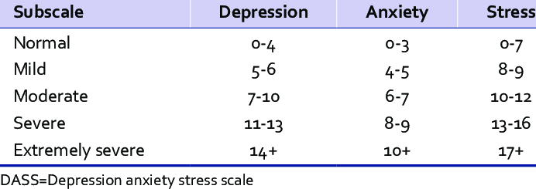
Levels of DASS-21 Scale
The rating scale is as follows: 0 Did not apply to me at all 1 Applied to me to some degree, or some of the time 2 Applied to me to a considerable degree or a good part of time 3 Applied to me very much or most of the time

Slide 10
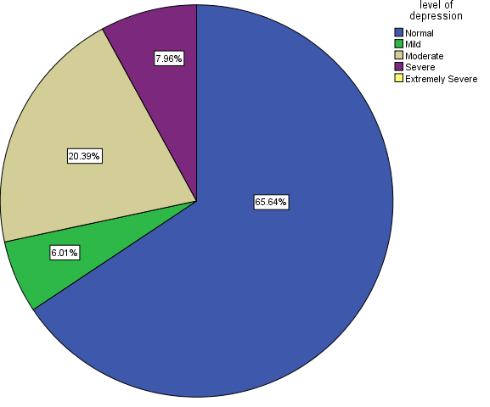
Level of Depression among HCPs in India
We found out 65.64% HCPs had normal level of depression, while 20.39% had a moderate level of depression

Slide 11
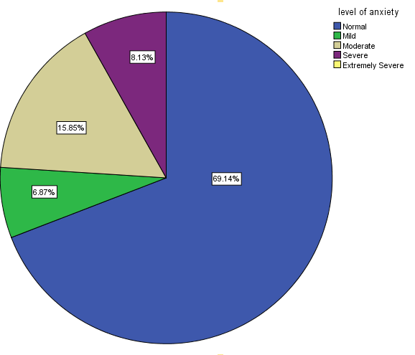
Level of Anxiety among HCPs in India
We found out 69.14% HCPs had normal level of anxiety, while 15.85% had moderate level of anxiety

Slide 12
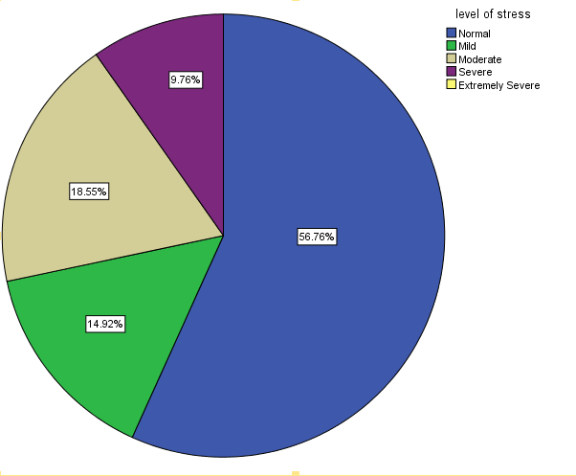
Level of Stress among HCPs in India
We found out 56.76% HCPs had normal level of stress, while 18.55% had moderate level of stress

Slide 13
Predictors for Depression, Anxiety and Stress level
Multinomial Logistic Regression Analysis was performed in order to find predictors of depression, anxiety and stress level.
Multinomial Regression is considered an extension of binomial logistic regression to allow for a dependent variable with more than two categories.
In case ordinal model does not meet the parallel regression assumption, the multinomial one can be used as an alternative.
For our model the Independent variables included : Gender, prior diseases, Covid history, availability of PPE, mental support given in clinic, vaccination, working hours per week and diet diversity score.

Slide 14
Dependent variable : Depression Level
We found that the full model is a significant improvement in fit over a null model [χ²(36)=524.687, p<.005].
pseudo-R-square value= .68
All the independent variables included were significant at alpha=0.05
Using odds ratio we will compare normal level of depression in HCPs to severe level of depression

Slide 15
Dependent Variable : Depression Level
Significant Variable | B( log odds ) | Exp(B)
Working hours | -.051 | .950
dds | .772 | 2.163
Gender | -1.949 | .142

Slide 16
We can infer the following from the previous table :
HCPs having higher working hours were less likely to have a normal level of depression and more likely to have a severe level of depression . The odds ratio of .950 indicates that for every one unit increase on working hours, the odds of HCP having normal level of depression changed by a factor of .950 (in other words, the odds were decreasing).
It was found out as diet diversity score increased, it was more likely that HCPs had a normal level of depression
Women were less likely to have normal level of depression as compared to men.

Slide 17
Dependent Variable : Anxiety Level
Significant Variable | B(log odds) | Exp(B)
Diabetes | -4.702 | .009
Working hours | .096 | 1.101
dds | .884 | 2.442

Slide 18
We inferred following from the previous table:
As working hours increased, it was less likely HCPs had a normal level of anxiety.
When diet diversity score was higher, it was more likely HCPs had a normal level of anxiety.
HCPs with higher blood sugar level are less likely to have normal level of anxiety.

Slide 19
Dependent Variable : Stress Level
Variable | B | Exp(B)
Vaccination | -1.597 | .560
Working hours | -.051 | 1.173
Dds score | .538 | 1.713

Slide 20
We inferred following from the previous table:
HCPs who were not vaccinated were less likely to have a normal stress level.
As working hours increased, it was less likely HCPs had a normal level of anxiety.
When diet diversity score was higher, it was more likely HCPs had a normal level of anxiety.

