Slide 1


National UFO Sightings Data Analysis
Group A
Team members :-
Anusha Manjappa
Nayana Brahmanahalli Venkataramanappa
Prathibha Gubbi Prakash

Slide 2
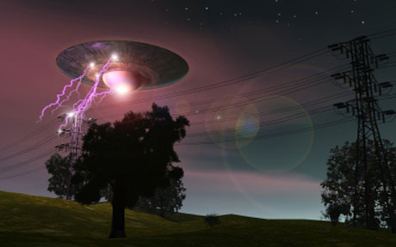
Table of Contents
Introduction
Specification of Dataset
Microsoft Azure HD Insight Cluster Details
Implementation
Visualization
Conclusion
References

Slide 3
Introduction
The National UFO Reporting Center is in Seattle, WA. The Center's primary function over the past two decades has been to receive, record, and to the greatest degree possible, corroborate and document reports from individuals who have been witness to unusual, possibly UFO-related events. Here, in this project we have extracted and analyzed some of the data updated in this website regarding various ufo sightings.

Slide 4
Prerequisites
All that we need to write scripts and execute queries is already provisioned with the IBM Bluemix cluster and Hortonworks Data Platform.
To export the analyzed data to Microsoft Excel, we must meet the following requirements:
We must have Microsoft Excel 2010,2013 or 2016 installed.
We must have Microsoft Hive ODBC Driver to import data from Hive into Excel. Select either the 32bit or 64-bit version based on your

Slide 5
SPECIFICATION OF DATASET
National UFO dataset is provided by USA government and is available on http://www.nuforc.org/webreports.html.
Sightings according to States, Shapes, Date appeared , Date Posted ,City are analysed till the year 2016.
File Size – 135.3MB.
Number of Files – 1.
File Format – CSV (Comma Separated Values).

Slide 6
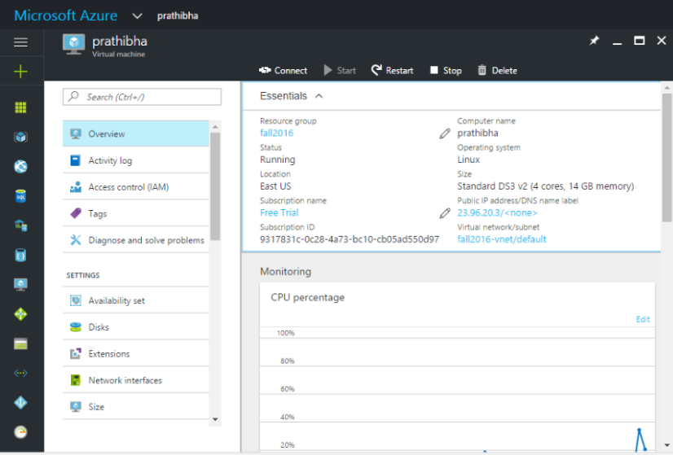
Virtual Machine with HDP Sandbox 2.4
Number of nodes : 2
Operating system : LINUX
Memory : 14 GB
CPU : 4 Cores

Slide 7
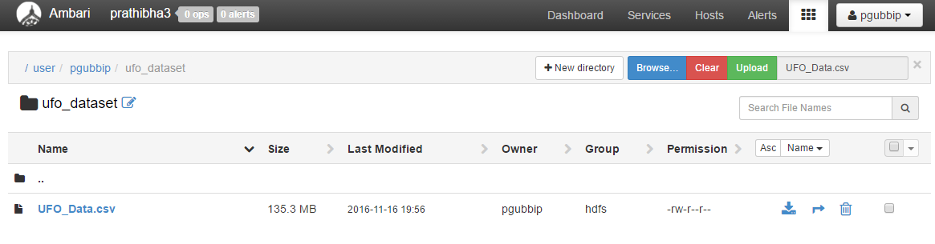
IMPLEMENTATION
Loading Data into Cluster:
The ufo data present in HTML files are converted into a single CSV file. Here, UFO_Data.csv is the input file which we need to upload to HDFS of the Hadoop cluster. A directory “ ufo_dataset” is created to place the dataset in it . UFO_Data.csv is uploaded into to the directory ufo_dataset in IBM Bluemix / AZURE cluster using Ambari .

Slide 8
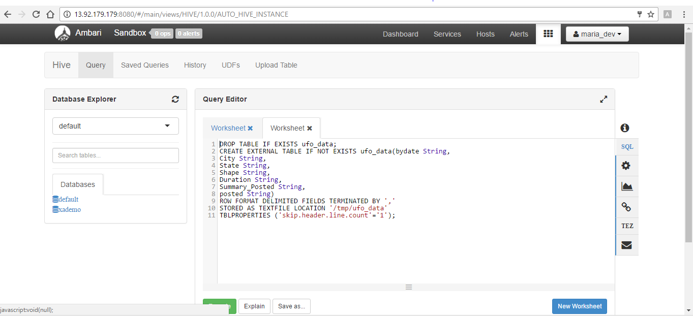
Table creation using Hive View of Azure
DROP TABLE IF EXISTS ufo_data;
CREATE EXTERNAL TABLE IF NOT EXISTS ufo_data(bydate String,
City String,
State String,
Shape String,
Duration String,
Summary_Posted String,
posted String)
ROW FORMAT DELIMITED FIELDS TERMINATED BY ','
STORED AS TEXTFILE LOCATION '/tmp/ufo_data'
TBLPROPERTIES ('skip.header.line.count'='1');

Slide 9
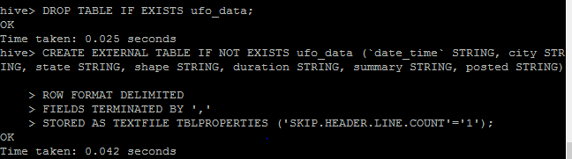
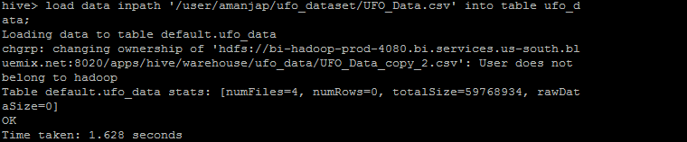
Table creation using IBM Bluemix
$ DROP TABLE IF EXISTS ufo_data;
$ CREATE EXTERNAL TABLE IF NOT EXISTS ufo_data (`date_time` STRING, city STRING, state
STRING, shape STRING, duration STRING, summary STRING, posted STRING)
ROW FORMAT DELIMITED
FIELDS TERMINATED BY ','
STORED AS TEXTFILE TBLPROPERTIES ('SKIP.HEADER.LINE.COUNT'='1');
$ LOAD DATA INPATH '/user/amanjap/ufo_dataset/UFO_Data.csv' INTO TABLE ufo_data;

Slide 10
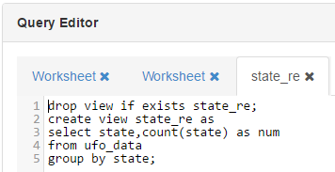
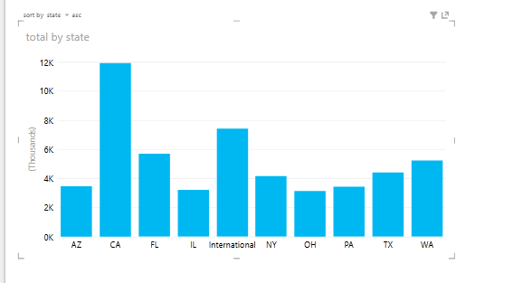
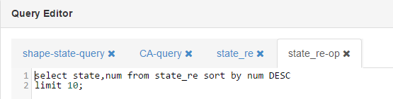
Visualizations and Queries 1)Query to find in which top ten states the UFO’s have appeared maximum number of times in

Slide 11
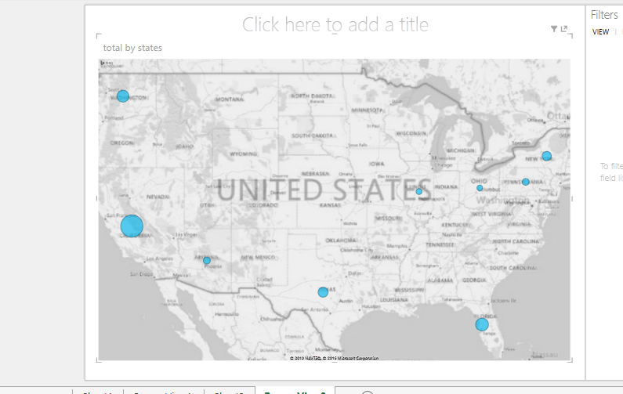
3D map to visualize in which top ten states where the UFO’s have appeared mostly

Slide 12
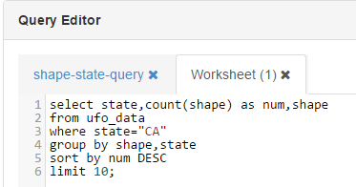
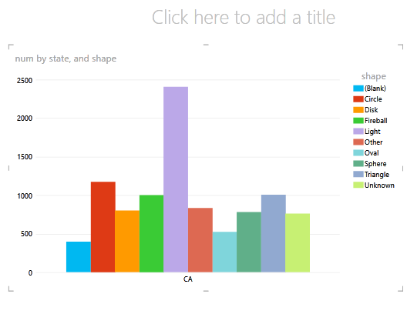
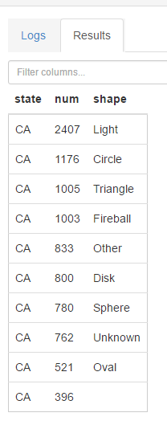
2) Query to represent the top 10 particular shapes that have occurred maximum in California state.

Slide 13
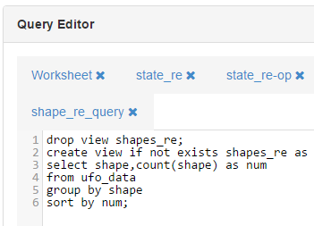
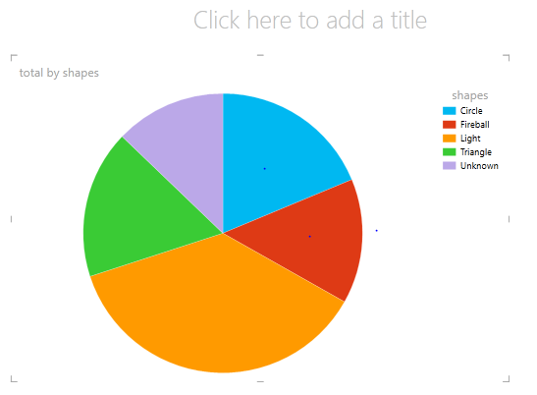
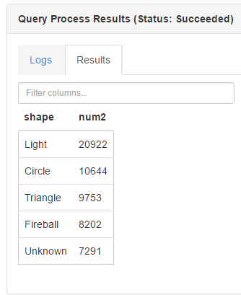
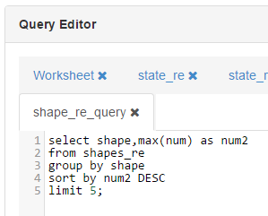
3)Query to show five UFO shapes appeared maximum and number of times it had appeared.

Slide 14
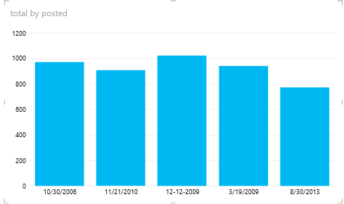
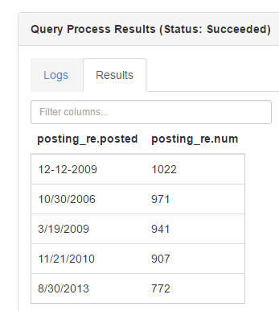
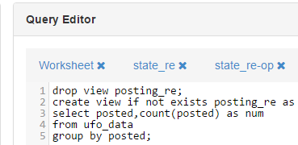
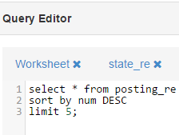
4)Query to retrieve five dates on which maximum postings are made by people based on UFO sightings appeared

Slide 15
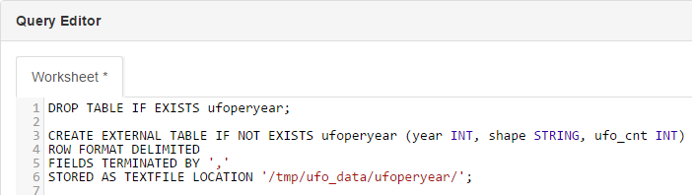
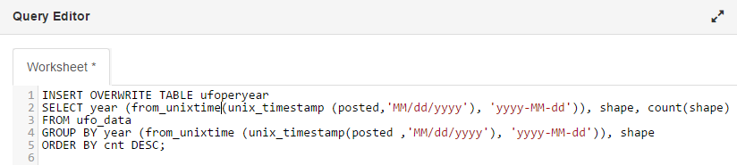
5)Table to analyze different UFO shapes and count of the shapes that occurred in the recent year .
the most recently occurred

Slide 16
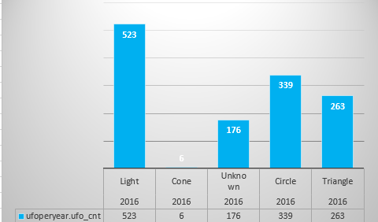
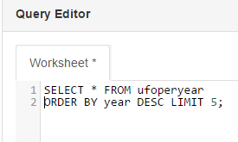
(continued)..

Slide 17
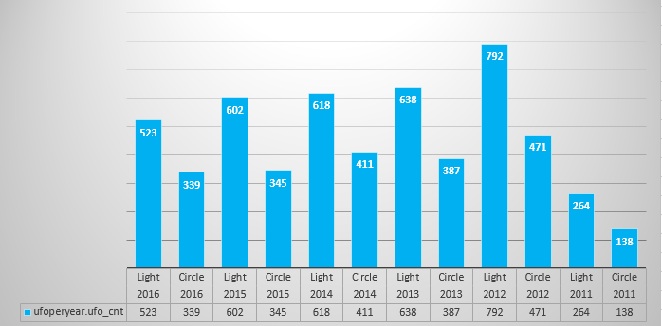
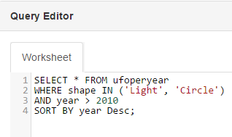
6)Query to analyze the light and circle shaped UFO and its count in the most recent 6 years .

Slide 18
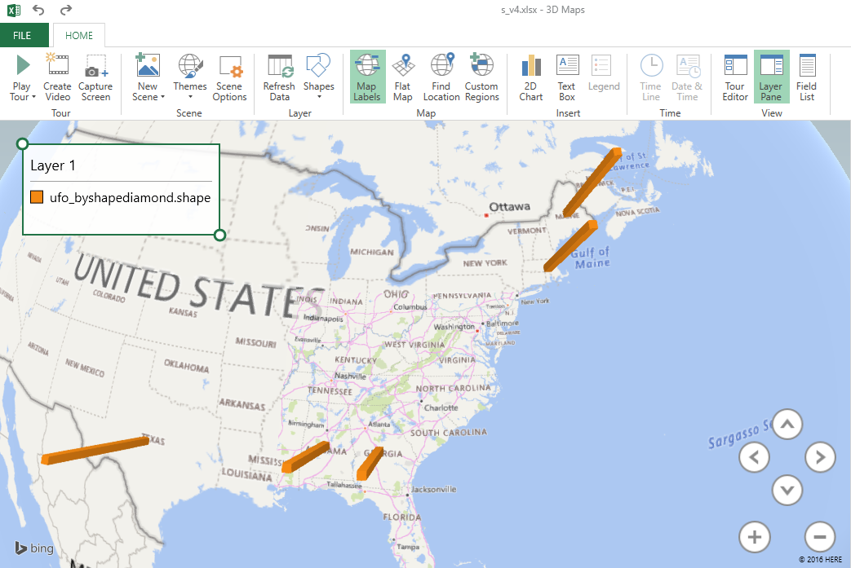
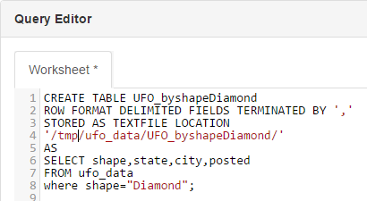
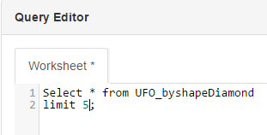
7)Table and Query to analyze the entities of the diamond shaped UFO.

Slide 19
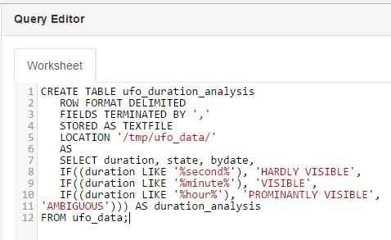
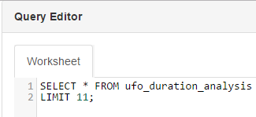
8)Table and respective query to analyze entire dataset based on the duration for which it was visible .
The data here is divided into 4 categories based
on the duration for which it was visible .
- Range of seconds : Hardly Visible
- Range of minutes : Visible
- Range of hours : Prominently Visible
- Other data : Ambiguous

Slide 20
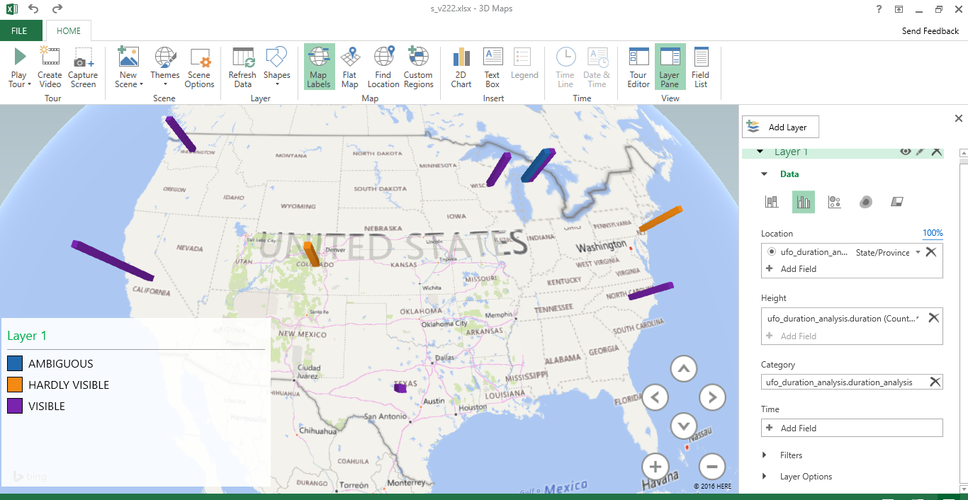
3-D Map representation to analyze entire dataset based on the duration for which it was visible .

Slide 21
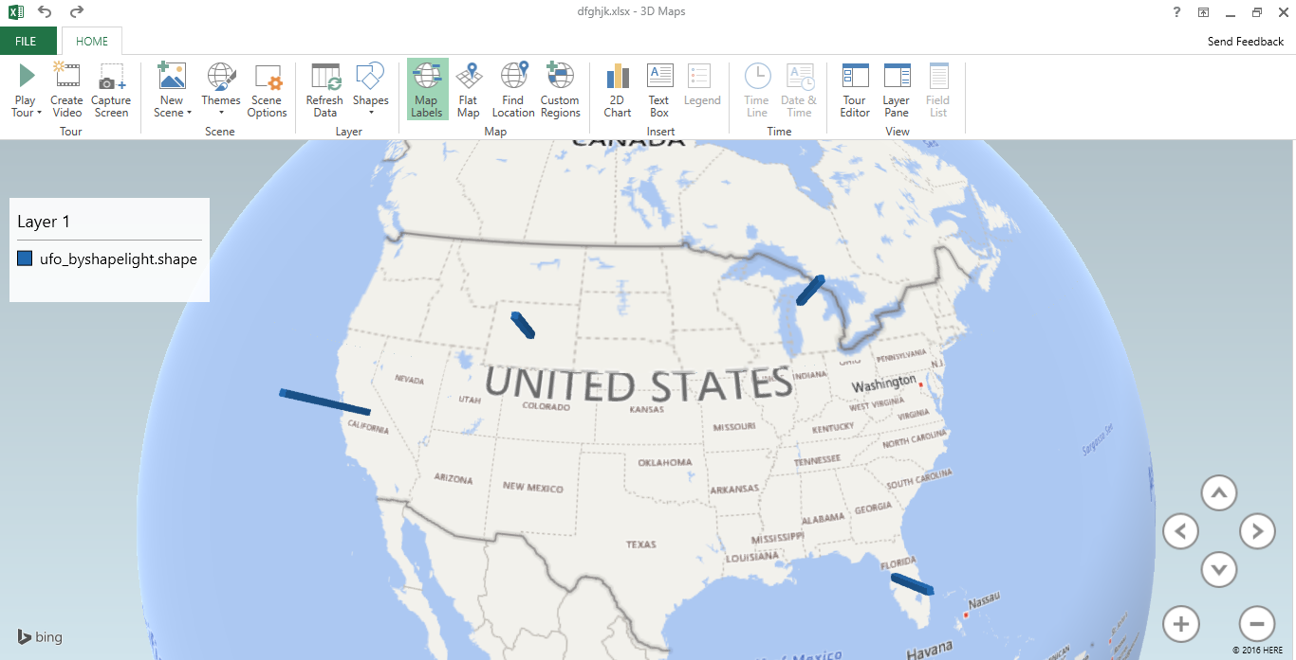
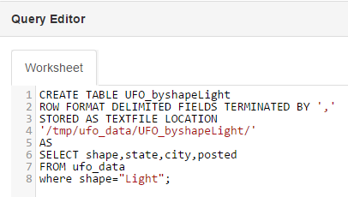
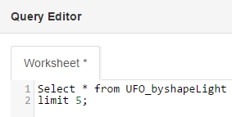
9)Table and Query to analyze the entities of the light shaped UFO.

Slide 22
GITHUB AND DATASET DETAILS
https://github.com/prathibhagubbiprakash/Hadoop
http://www.nuforc.org/webreports/ndxevent.html

Slide 23
Conclusion
The UFO sightings across USA was thus analyzed based on various aspects and documented accordingly in AZURE as well as IBM Bluemix using various tables and views .
3-D Maps and various chart representations were introduced for a better understanding of the Data Set .

Slide 24
References
http://www.nuforc.org/webreports/ndxevent.html
https://azure.microsoft.com/
https://bluemix.net

Slide 25


