Slide 1


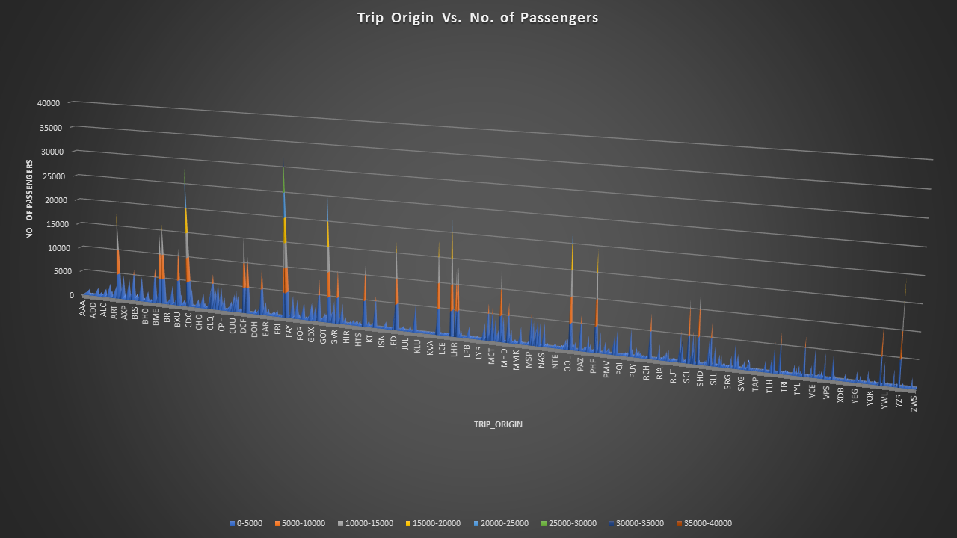
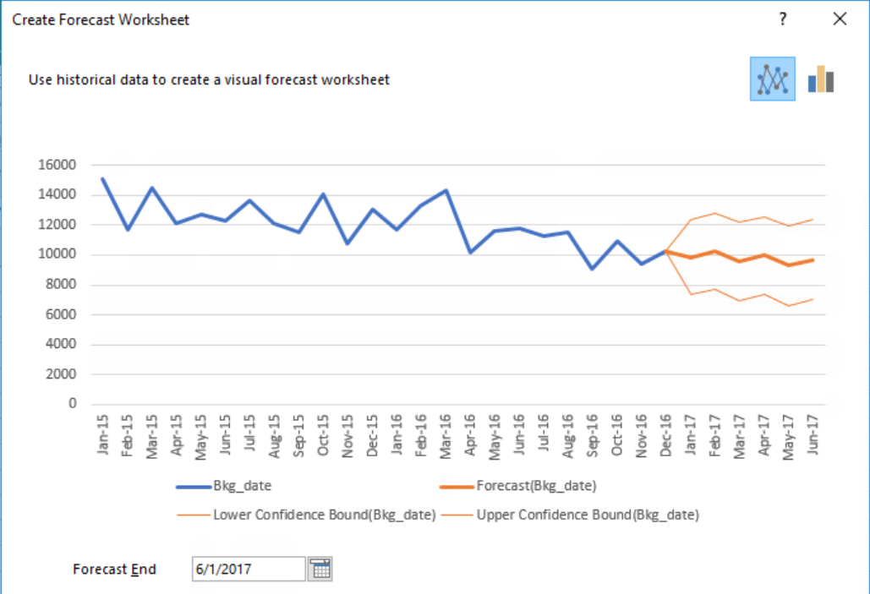
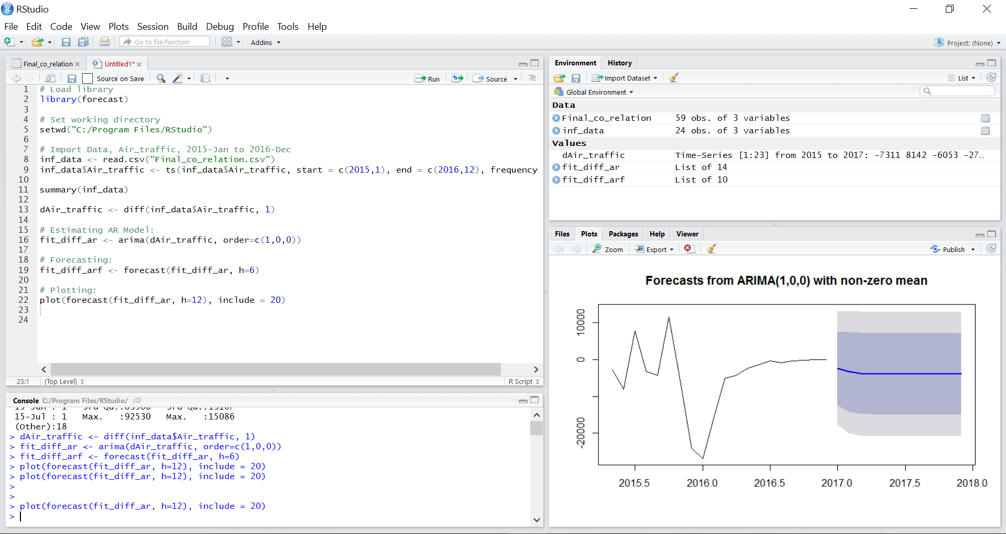
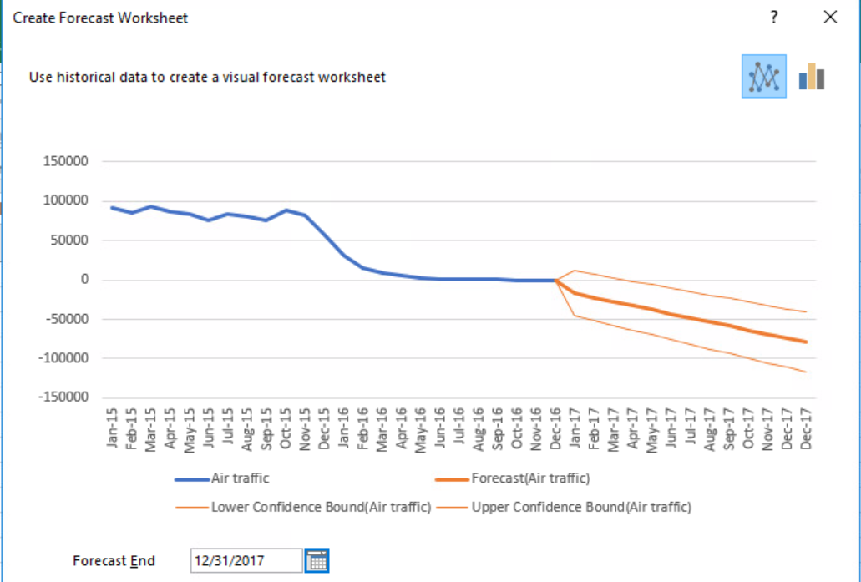
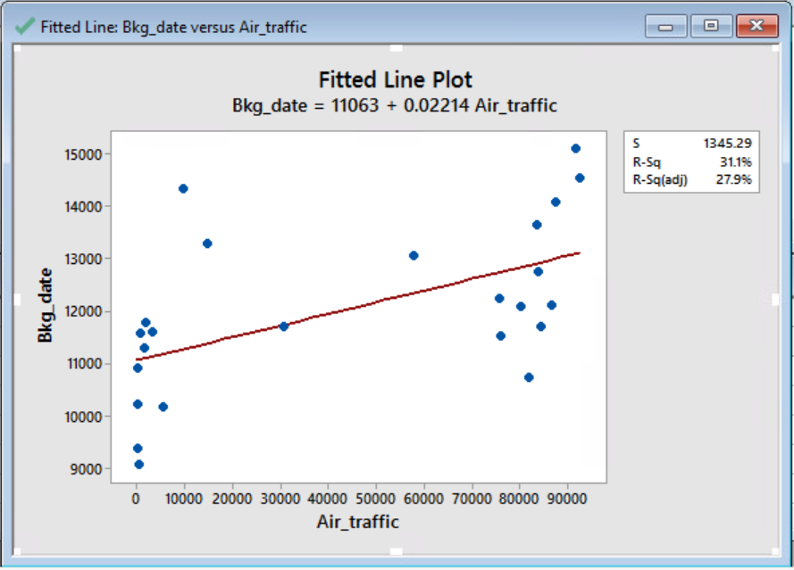
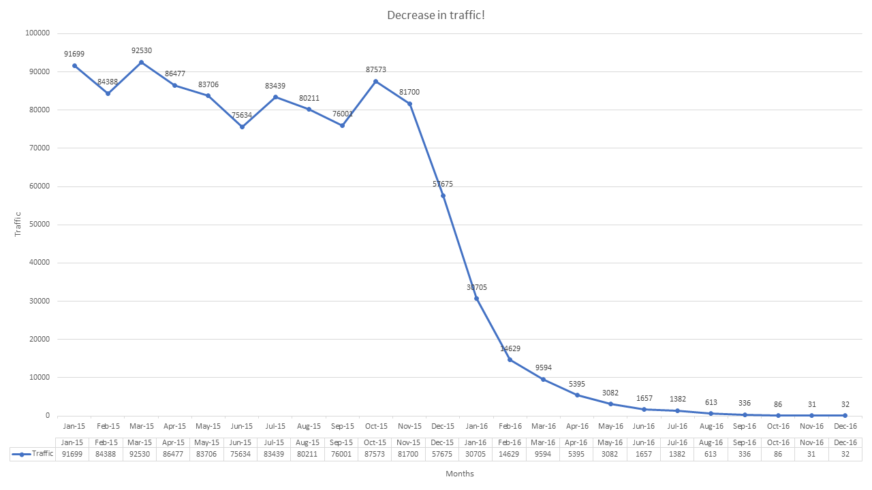
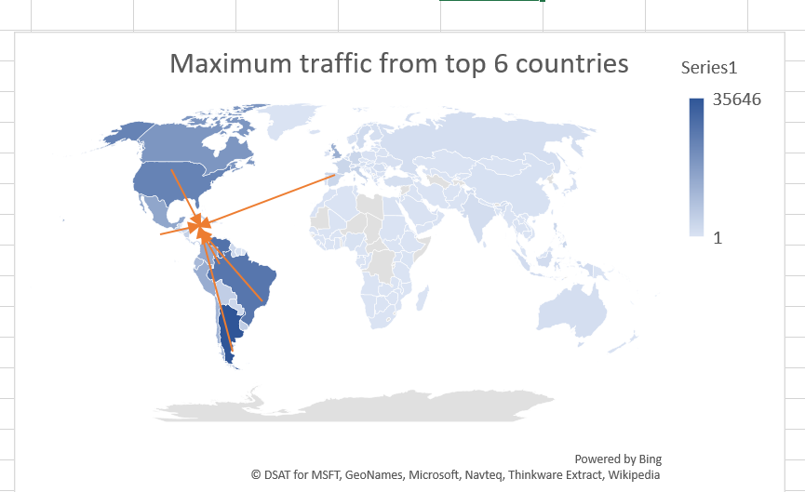
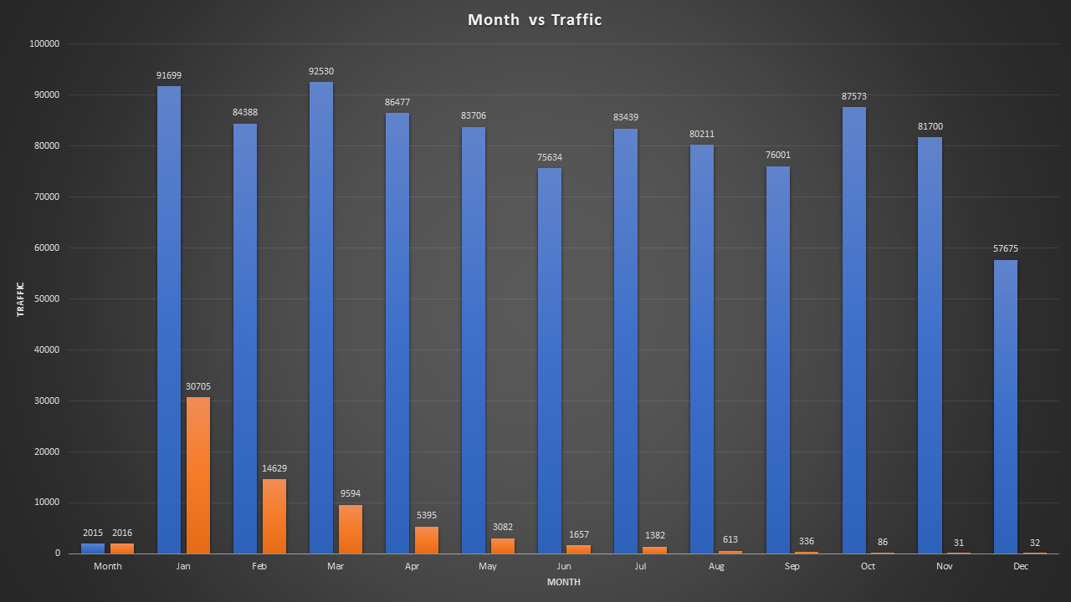
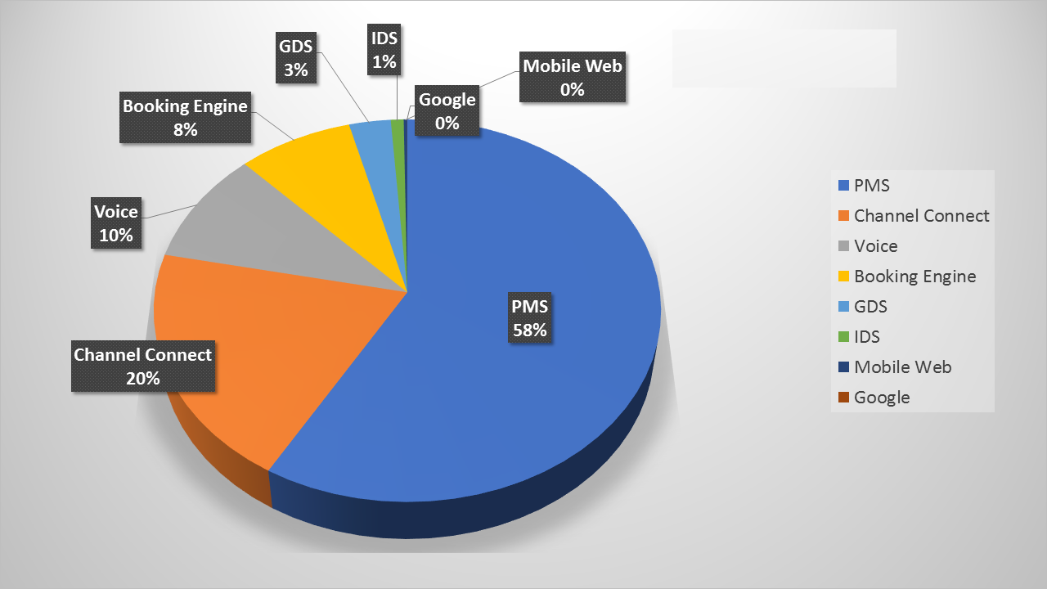
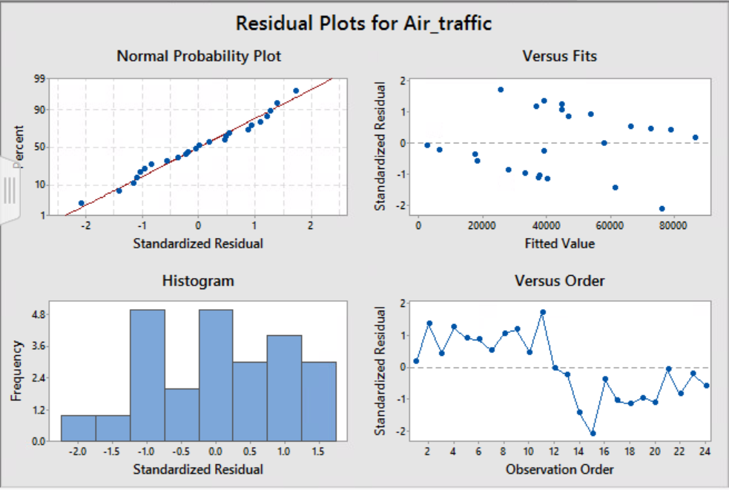
Big Data Challenge
VANGUARD
Trip_origin vs no. of passengers
Insights, Technology, Recommendations, Impact and Indication
Forecasting of the hotel booking for 2017
The best fitted model for Flight Travelling dates and Hotel Booking dates
Insights:
There is a steep decline in the airline graph from 2015 to 2016.
According to the permutation and combinations of all the 4 factors flight booking dates, flight travel dates, hotel booking dates and hotel booking dates, we got that there is a positive correlation between passenger travelling dates in flight and hotel booking dates. The R value is positive which is 0.557 for the combination of the complete check-ins in the hotels and nullifying the combination of the advance booking.
In the combination of rest of the parameters, it shows that the hotel industry is comparatively stable rather than the airline industry.
The major factor which played a key role in the steep decline of the airline industry is massive heat of Zika virus in Miami. And as a result many conferences and seminars have been shifted from Miami to other parts of USA and abroad also.
50% of the hotel customers are interested to stay more than one night.
With the help of data we could know that which channel people are using for booking hotels. So with the help of that we can know which channel is used the most. The study could be useful for other channels to know the most used channel that provides types of offers and facilities so that their business could improve. Because if the number of users are more and profit per user is less then also overall profit would be much better.
Technology:
Data parsing – Java
Data mining – SQL Server Management Studio & SQL Server Reporting Services
Data forecasting – R and MiniTab
Data visualization – Excel (XLSTAT) and R Studio
Recommendations:
We could find out from the data that how many users are traveling by flight and are staying at hotel or they are staying at their own apartment or at their relatives house.
From the data we have seen that there is downfall in airline booking but hotel booking is not much affected so from that study, airline could provide some good hotel offers so that customers can be attracted by it and that would improve their business.
Airline people could study about the data and know which airport has the maximum outflow to Miami and they could try to get more people from the places who has low outcome by providing better deals.
Airlines authority need to collaborative with the local health care providers to avoid certain disasters such as Zika virus occurred in Miami in 2016.
Insights:
13 out of 1409 airports contribute to 25.32% of the business. Among the 13, EZE, CCS, GRU and YYZ are in Latin America and Canada whereas LGA, ORD, PHL, EWR, LAX, ATL, JFK and BOS are in the United States.
Recommendations:
Targeted ancillary services tailored to fit customer preferences.
Forecasting of the airlines booking of 2017
Residual plot graph for fitted model
y=mx+c
Months vs Traffic
The analysis depicts data of airline traffic from January 2015 to December 2016. A steep decline was observed in Dec 2015. The total number of passengers decreased from 91,699 in Jan 2015 to 32 in Dec 2016 there by massively impacting the business.
Insights:
The declining trend may be due to the change in political scenario, Hiring freezes & Layoffs in IT industry and widespread Zika pandemic.
Recommendations:
Tailored messages & real-time updates to customers travelling to/from Miami and Collaboration with local health care providers.
y=mx+c
Where m is the slop, x is the predictor variable and y is the dependent variable
35646
% of Resources used for hotel bookings
Seasonal graph of Months vs Traffic
Correlation Graph between the Flight Travelling dates and Hotel Booking dates
“Information turns into insights in Data Science”

