Slide 1
Unstructured Text to Knowledge Graphs: Using NLP tools and Google KG APIs
Team : Anusha Manur, Nandita Srinivasan, Urmil Parikh

Slide 2
Objective
Develop an end-to-end solution for building a knowledge graph from text using NLP tools and interfacing with the knowledge graph using Google’s Knowledge Graph APIs

Slide 3
Project overview
Comparison with Google knowledge graph API
Building knowledge graph
Finding dataset
1
2
3
4
5
Data preprocessing
Named - entity recognition and relation extraction

Slide 4
Dataset
IMDB 5000 Movie Dataset
5000+ movie data scraped from IMDB website
We take a subset of features of the IMDB dataset

Slide 5
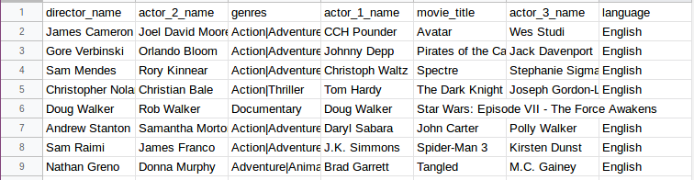
Dataset
Our dataset contains details of 5000 movies with the following features
Movie title , Genre , Director, Actors (3) , Language

Slide 6
Data preprocessing
The most relevant movie details are considered.
Missing values are handled.
Duplicates are removed.
Unicode characters removed.
Special characters are removed.

Slide 7
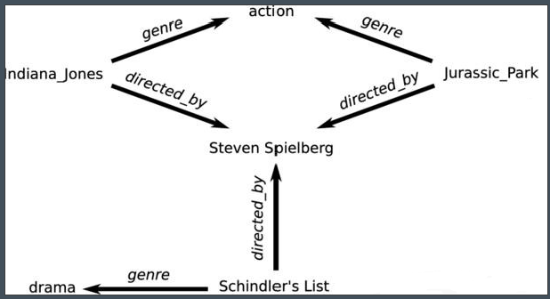
Building a knowledge graph
Each feature of the dataset is a node in the knowledge graph and the relation between the two features is represented by the edge between the two nodes.
Construction of a graph allows nodes to multiple relations and enables easy querying.
Credits - IOS press content library

Slide 8
Building a knowledge graph
We parse the dataset to build a graph using NetworkX library.
The image shows the graph constructed for 20 , 30 and 40 movies where each node has a unique node ID.

Slide 9
Querying the knowledge graph

Slide 10
Overview
Creation of query dataset
Named entity recognition
Relation extraction
Query the knowledge graph
Compare with Google knowledge graph API

Slide 11


Creation of query dataset

Slide 12
Project overview
Querying the graph for the unknown entity using the known entity and relation
Chunking to extract entities which are people
String Tokenization
1
2
3
4
5
POS Tagging
Recognizing query pattern

Slide 13
Tokenization and POS - tagging
Each query is first tokenized.
We then POS-tag (parts of speech) the tokens.
This allows us to establish a pattern for how to recognize the required entities based on context.

Slide 14
Chunking
Example :
"Barack Obama was the president of our country."
Chunking
['Barack Obama']
Chunking is done to extract the complete names of the actors/directors (instead of 2-3 words) as given in the knowledge graph
This is done to extract the complete name as a single entity.

Slide 15
Recognizing query pattern
Example :
"Steven Spielberg directed the movie Jurassic Park"
Recognizing query pattern
“Steven Spielberg directed the movie Jurassic Park”
We consider various tenses of nouns, pronouns, verbs and determiners for entity extraction.
We check with a predefined list of relations and the respective synonyms to extract relations.

Slide 16
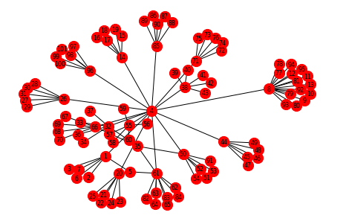
Querying the graph
Who stars in I am Legend
From the function, we get a tuple of the form [Entity, Entity_Name, Relation]
We then query the graph with the entity. That is, we find a node of the type “Entity”, whose value is the entity name, and follow the edge attributed with the relation to find the required nodes.
For example, if the question is, “Who stars in I am legend?” We find the “title” node(entity) whose value is “I am Legend”(entity_name) and follow the edge that goes to the “Actor”(relation=’acts’) node.
[‘will smith’,’willow smith’,’alice braga’]

Slide 17
Testing the NER function
The queries dataset contains some possible questions regarding the movies
Examples questions are - “Who are the actors in Iron Man 2?” or “Who is the director of Casino Royale?
Each of the queries are fed to a function to get the corresponding [entity,entity_name,relation] tuple
The graph is queried with the tuple, and the obtained result is stored in a list.
Our assumption is that, if the graph does not return an answer for an entity, then the NER process was not successful, and hence the model is given a score of 0 for that entity.

Slide 18
Querying the Google Knowledge graph
The queries dataset contains some possible questions.
Since we cannot use the entire sentence to query the Google knowledge graph and only an entity, we extract the main entity from the question and use it to query the Google Knowledge Graph.
We compare the results obtained from the Google knowledge graph with the generated graph.

Slide 19
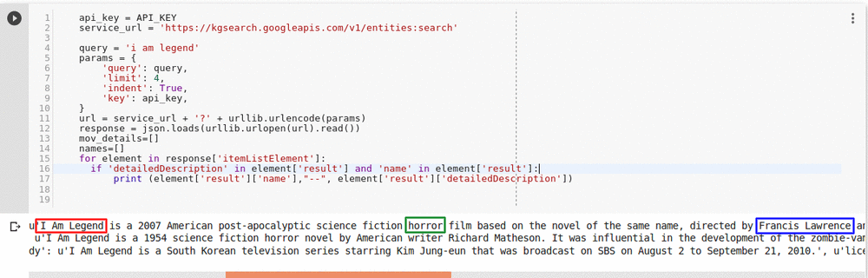
Results
Our knowledge graph detects entities and relations and returns correct answers to 61% of the queries.
The output of Google knowledge graph is as shown below

Slide 20
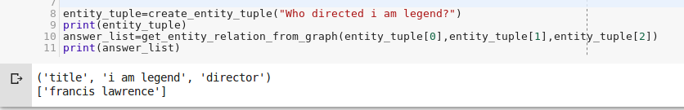
Results
Results from our knowledge graph
Results from the Google knowledge graph

Slide 21
Assumptions
No pre-trained model like spacy or StanfordNLP has been used for named entity recognition and relation extraction.
We have tested our model on the queries we manually generated.
To perform NER, we define a pattern-based context for the queries in the generated dataset. Hence, the queries we use to search the graph should conform to the same.

Slide 22
Conclusion
Our NER function and knowledge graph perform similarly to that of Google’s Knowledge Graph API, with respect to the context of Movies.
NER and knowledge graph creation can have diverse applications in being able to classify and summarize content, creating effective search engines and also in chat based applications.
Knowledge graphs prove to be very powerful in offering semantic context to otherwise unstructured, natural language text.

Slide 23
References
[1] Code for Continuous Chunking: https://stackoverflow.com/questions/48660547/how-can-i-extract-gpelocation-using-nltk-ne-chunk
[2] Google Knowledge Graph Search API https://developers.google.com/knowledge-graph/

