Slide 1
Missing Clinical Data Imputation
Group: 12
Anusha Manur (amanur@ncsu.edu)
Kartik Shah (kcshah@ncsu.edu)

Slide 2
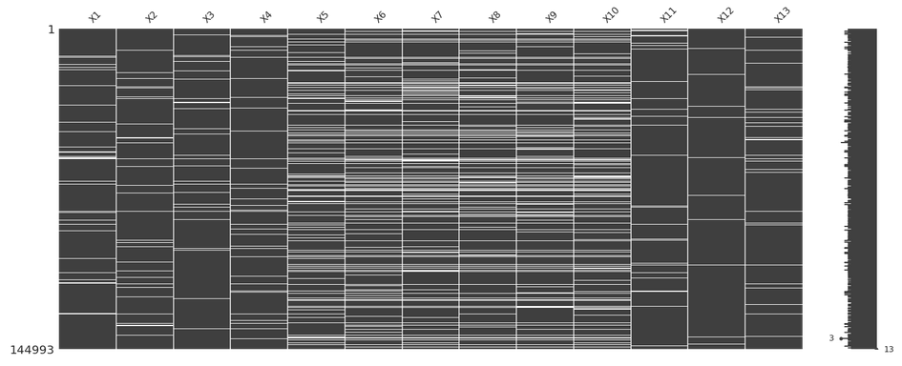
DATASET

Slide 3
DATASET
Analyte | % Missing Values
X1 | 5.31
X2 | 5.47
X3 | 5.53
X4 | 5.39
X5 | 16.53
X6 | 19.15
X7 | 19.29
X8 | 18.62
X9 | 18.84
X10 | 19.42
X11 | 4.88
X12 | 4.83
X13 | 6.85

Slide 4
Methods Used for Imputation:
Mean Imputation
Back Fill
Back Fill Front Fill
4Mean BackFrontFill
Multiple Imputation by Chained Equations with KNN Regressor and Linear Regressor
Deep Learning
K-Nearest Neighbors

Slide 5
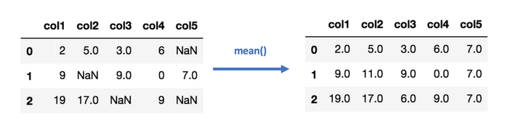
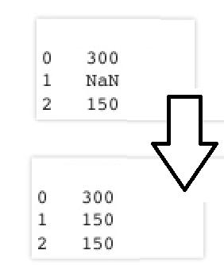
1) Mean imputation
2) Back Fill

Slide 6
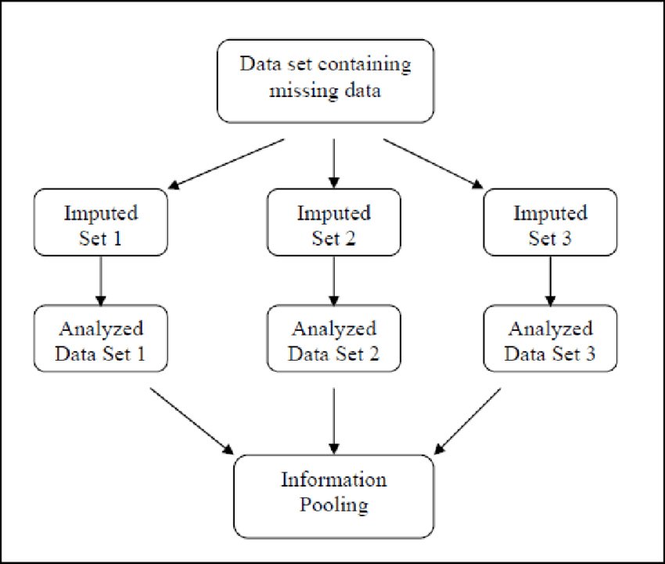
MICE
Notes:
Multiple imputation offers an alternative to overcome the disadvantages of single imputation approach. It allows the uncertainty, which is due to missing data, to be appropriately considered The basic idea is to treat each variable with missing values as the dependent variable in a regression, with some or all of the remaining variables as its predictors in a round robin fashion The main reason is that the replaced values are completely determined by a model applied to other variables and they tend to fit together “too well”, in other words, they contain no error. Also, one must also assume that there is a linear relationship between the variables used in the regression equation when there may not be one.

Slide 7
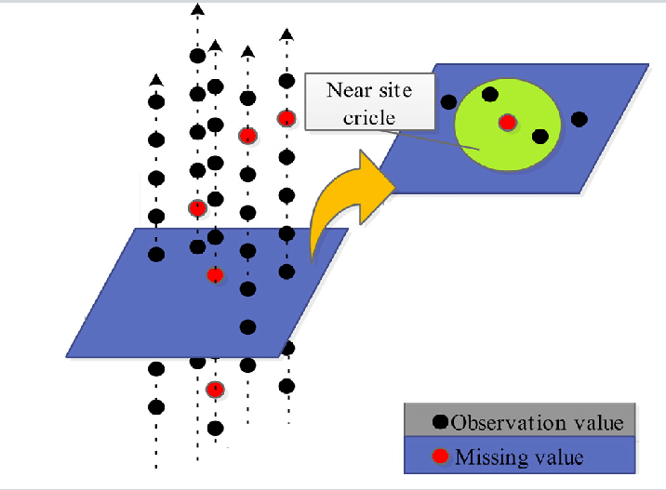
KNN
Notes:
KNN is an algorithm that is useful for matching a point with its closest k neighbors in a multi-dimensional space.The assumption behind using KNN for missing values is that a point value can be approximated by the values of the points that are closest to it, based on other variables.The number of neighbors to look for. Taking a low k will increase the influence of noise and the results are going to be less generalizable. On the other hand, taking a high k will tend to blur local effects which are exactly what we are looking for. It is also recommended to take an odd k for binary classes to avoid ties.

Slide 8
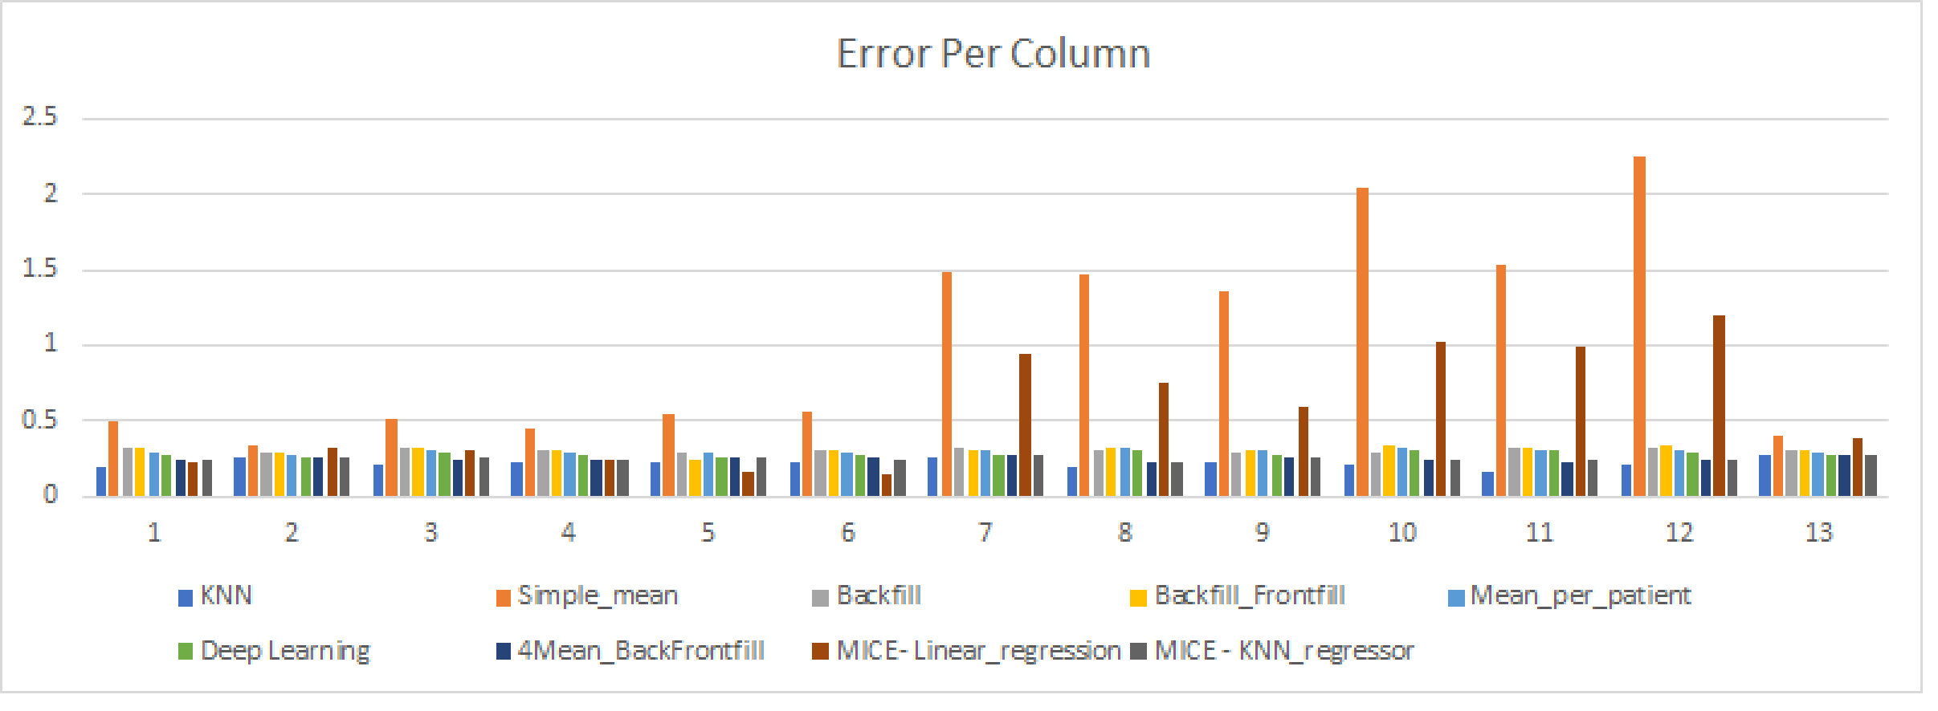
Error Results Per Column

Slide 9
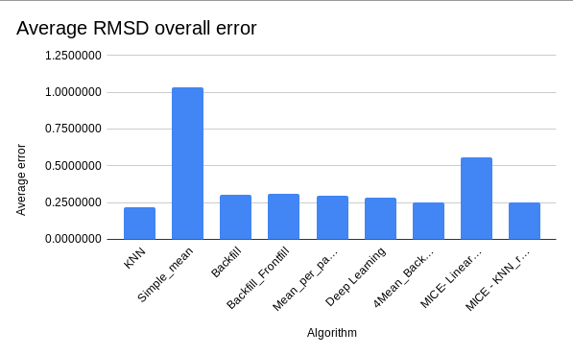
Overall error

Slide 10
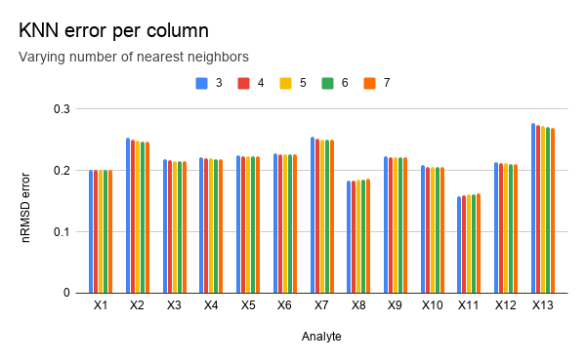
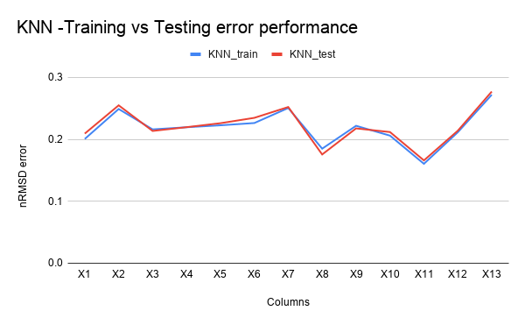
KNN Implementation analysis

Slide 11
Conclusion
In the training dataset, we vary K, the number of nearest neighbors to tune the KNN algorithm, using mean to impute missing values. We chose optimal value of K=5 which results in minimal error. The total error we got 0.2185.
In testing dataset we got an average nRSMD error of 0.2209.

Slide 12
Leaderboard Results
Our model performed better compared to 3D-MICE
We rank 8 on the leaderboard

