Slide 1

Report to the analysis of dataset 18
_{MSc}
_{Data Analysis Skill}
₂₀₂₁
Group 18
Anusha
Ben
Chu
Juwu
Jinzhuang

Slide 2

01
what is the dataset
CONTENTS
the characteristics what it concerns
02
what we want
the aim that we are interested in
03
what we do
which model we use
what figures and
summaries we get
04
what conclusions we draw
does the result fit our hypothesis
what does the results show
05
extended and further tasks
based on what we’ve got, can we modify the analysis
can we get more results in using different methods

Slide 3
The description of the dataset
/01
Do you like dogs and cats?

Slide 4
The description of data set
Animal_type
The type of animal admitted to the shelter.
Use the function of factor() and find that there are.
five catogories named BIRD CAT DOG LIVESTOCK WILDLIFE.
Month and Year
Datasets 18 comes from the Dallas animal shelter. It contains a variety of information relating to each animal admitted to the shelter. It contains many variables recorded by animal admission:
Month the animal was admitted, recorded numerically.
Year the animal was admitted to the shelter.
Intake_type
Reason for the animal being admitted ot the shelter.
Outcome_type
Final outcome for the admitted animal
Data set 18
Chip_Status
Did the animal have a microchip with owner information
Time_at_Shelter
Days spent at the shelter between being admitted and final outcome

Slide 5
The glimpse of the data set
Rows: 1,135
Columns: 7
$ animal_type <chr> "DOG", "DOG", "DOG", "DO~
$ month <dbl> 8, 7, 1, 6, 4, 7, 1, 1, ~
$ year <dbl> 2017, 2017, 2017, 2017, ~
$ intake_type <chr> "STRAY", "STRAY", "CONFI~
$ outcome_type <chr> "RETURNED TO OWNER", "EU~
$ chip_status <chr> "SCAN NO CHIP", "SCAN NO~
$ time_at_shelter <dbl> 2, 10, 13, 7, 5, 3, 5, 6~
# A tibble: 6 x 7
animal_type month year intake_type outcome_type
<chr> <dbl> <dbl> <chr> <chr>
1 DOG 8 2017 STRAY RETURNED TO~
2 DOG 7 2017 STRAY EUTHANIZED
3 DOG 1 2017 CONFISCATED ADOPTION
4 DOG 6 2017 OWNER SURR~ ADOPTION
5 DOG 4 2017 STRAY ADOPTION
6 DOG 7 2017 STRAY RETURNED TO~
# ... with 2 more variables: chip_status <chr>,
# time_at_shelter <dbl>
From the glimpse we know the type of dfferent variables and can overview the table.

Slide 6
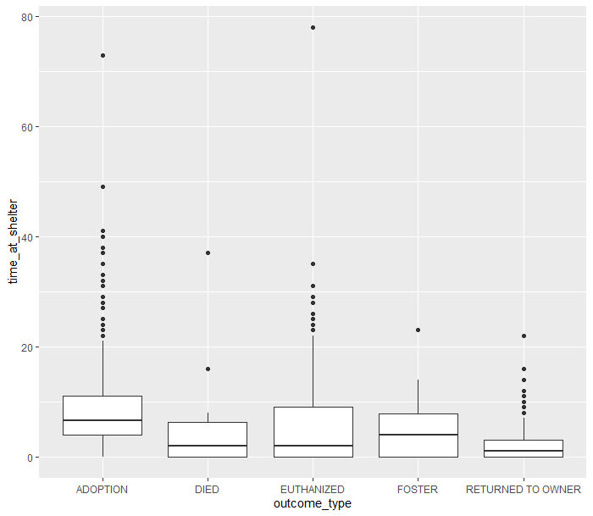
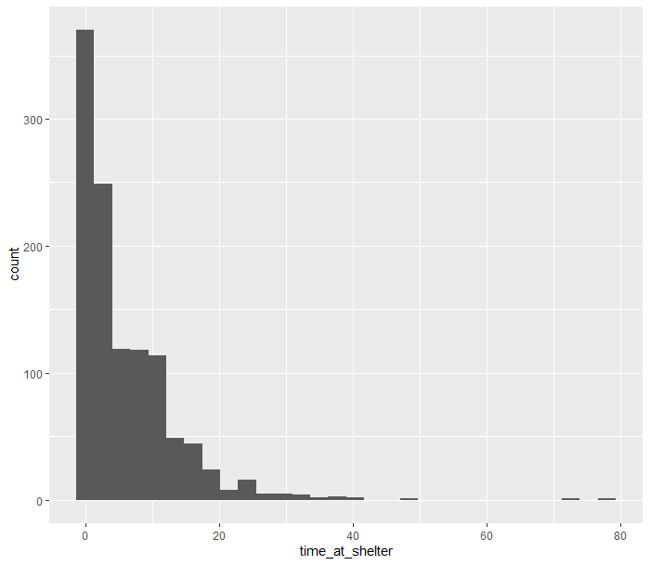
Some example plots
The general realisation of outcome_type
The counts of animals grouped by time_at_shelter

Slide 7
Data fitting analysis
/02
We will use General Poisson model, Quasi-Poisson model and Negative Binomial Distribution model

Slide 8
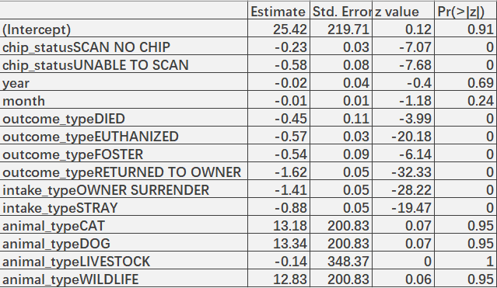
First step: Poisson Model with full features
By analysing the dataset, we found that what we want is the counts of time_at_shelter, and the most fitted model is Poission model, so we choose it.
01
What is Poisson model?
It is a kind of Generalised Linear Models.
Poisson regression is often used for modelling count data.
02
Table 1: The coefficients of Poisson Model with full features

Slide 9
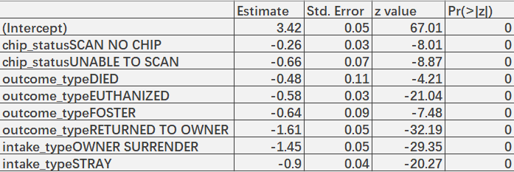
First step: Poisson Model- features selected
By observing the above Poisson model summary, we find that the p-values of the predictors namely, year, month and animal_type are much greater than 0.05, implying that they are highly insignificant. So, we shall now discard these three variables.
Table 2: The coefficients of Poisson Model – features selected
After removing the insignificant predictors, the p-values of all the other predictors seem to be good. We also find that for the Poisson model, D = 6111.3 and χ²(1124) = 1203.108, indicating a poor fit if Poisson is the correct model for the response.

Slide 10
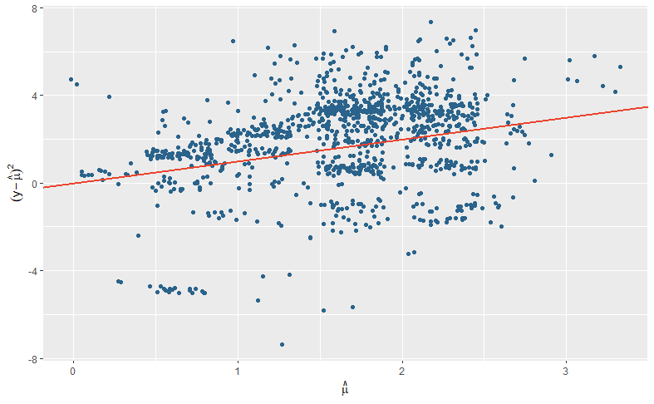
Scattered Fitting Plot
Overdispersion
The model after feature selection did not pass the chi-square test, indicating that the data is over-dispersed.

Slide 11
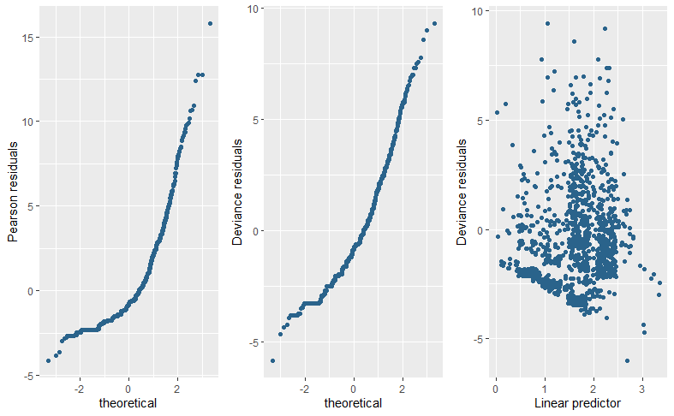
The first two plots below are normal probability plots, and we are using them here to spot any points that don’t follow the straight line. We can also plot the deviance (or Pearson) residuals against the linear predictor to look for non-linearity in the relationship between the fitted values and the residuals as shown in the third panel below. There is no obvious pattern here.

Slide 12
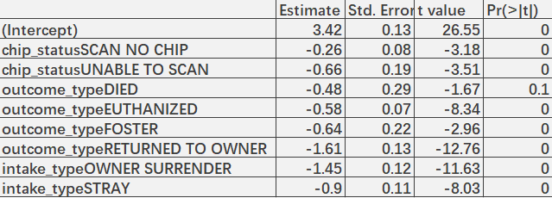
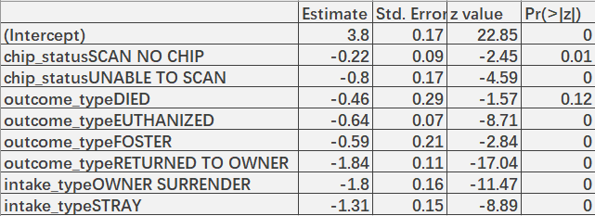
Second step: Quasi-Poisson model and Negative Binomial Model
For the Poisson distribution, when the data is overdispersion, in addition to using family="quasipoisson", we can also replace the family="poisson"" method part for fitting.
01
Table 3: The coefficients of Quasi-Poisson Model
In addition to using the Quasi-Poisson model, we can also use the Negative Binomial Model. Because they belong to the general linear model, they are often used in the general counting model.
02
Table 4: The coefficients of Negative Binomial Model
12

Slide 13

Third step:Model Comparisons & Model Selection
Let’s compare the deviances and AIC scores of the Quasi-Poisson and Negative Binomial models.
Based on the comparison between the Negative Binomial model and the Quasi-Poisson model, we can see that because the Quasi-Poisson model cannot calculate AIC, and the deviation comparison we find that the deviation of the Negative Binomial model is smaller than the Quasi-Poisson model, so we prefer to use the Negative Binomial model to predict the number of animals in animal shelters at a future point in time.
13

Slide 14
Model Equations & Conclusion
/03

Slide 15
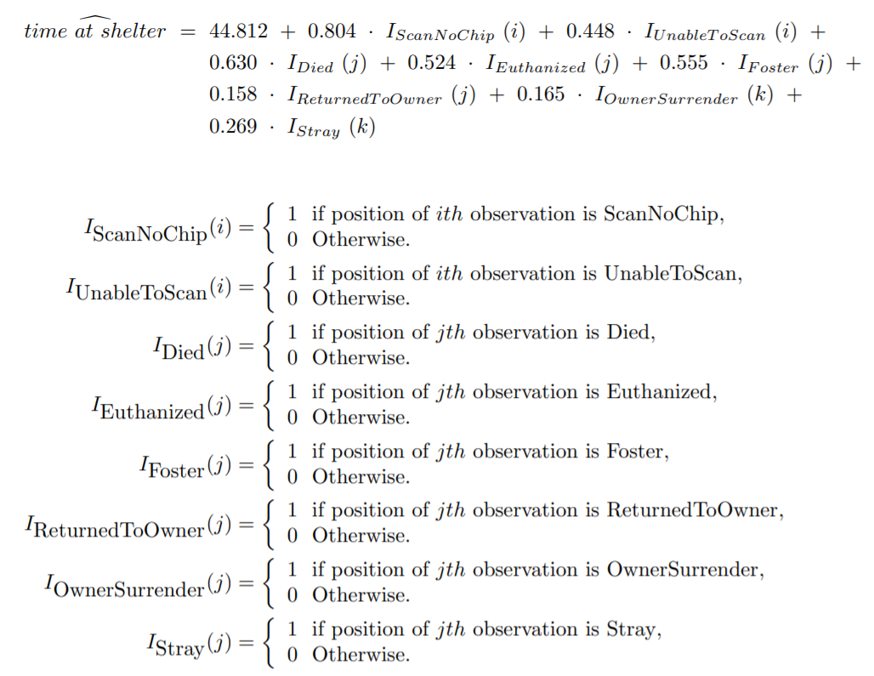
Model Equations
Based on the above analysis, we decided to use the Negative Binomial regression model to predict the number of animals in the animal shelter at each time period. The general mathematical formula of the model will be given below:

Slide 16
Conclusion

