Slide 1

Analysis on Animal Shelter Data
_{MSC}
_{DA}
₂₀₂₁
Group 18
Anusha Punnackal Anilkumar
Ben White
Chu Zhang
Juwu Pu
Jinzhuang Cheng

Slide 2

What is the dataset
01
CONTENTS
The description of the dataset
What we do
03
Which model we use
What figures and
Summaries we get
What conclusions we draw
04
Does the result fit our hypothesis
What does the results show
05
Extended and further tasks
Based on what we’ve got, can we modify the analysis?
can we get more results in using different methods?

Slide 3
The description of the dataset
/01
Do you like dogs and cats?

Slide 4
The description of data set
Animal_type
The type of animal admitted to the shelter.
Use the function of factor() and find that there are.
five catogories named BIRD CAT DOG LIVESTOCK WILDLIFE.
Month and Year
Datasets 18 comes from the Dallas animal shelter. It contains a variety of information relating to each animal admitted to the shelter. It contains many variables recorded by animal admission:
Month the animal was admitted, recorded numerically.
Year the animal was admitted to the shelter.
Intake_type
Reason for the animal being admitted ot the shelter.
Outcome_type
Final outcome for the admitted animal
Data set 18
Chip_Status
Did the animal have a microchip with owner information
Time_at_Shelter
Days spent at the shelter between being admitted and final outcome

Slide 5
The glimpse of the data set
Rows: 1,135
Columns: 7
$ animal_type <chr> "DOG", "DOG", "DOG", "DO~
$ month <dbl> 8, 7, 1, 6, 4, 7, 1, 1, ~
$ year <dbl> 2017, 2017, 2017, 2017, ~
$ intake_type <chr> "STRAY", "STRAY", "CONFI~
$ outcome_type <chr> "RETURNED TO OWNER", "EU~
$ chip_status <chr> "SCAN NO CHIP", "SCAN NO~
$ time_at_shelter <dbl> 2, 10, 13, 7, 5, 3, 5, 6~
# A tibble: 6 x 7
animal_type month year intake_type outcome_type
<chr> <dbl> <dbl> <chr> <chr>
1 DOG 8 2017 STRAY RETURNED TO~
2 DOG 7 2017 STRAY EUTHANIZED
3 DOG 1 2017 CONFISCATED ADOPTION
4 DOG 6 2017 OWNER SURR~ ADOPTION
5 DOG 4 2017 STRAY ADOPTION
6 DOG 7 2017 STRAY RETURNED TO~
# ... with 2 more variables: chip_status <chr>,
# time_at_shelter <dbl>
From the glimpse we know the type of dfferent variables and can overview the table.

Slide 6
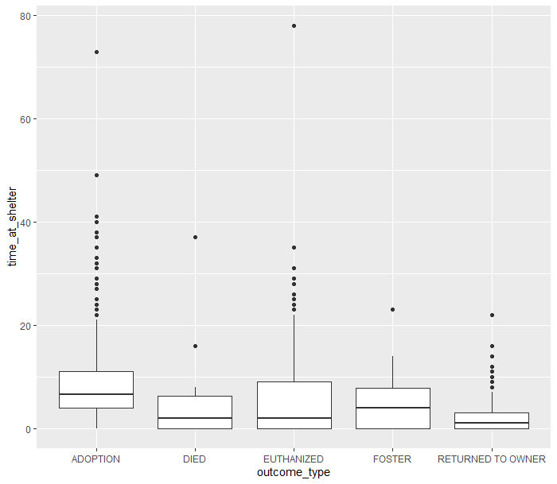
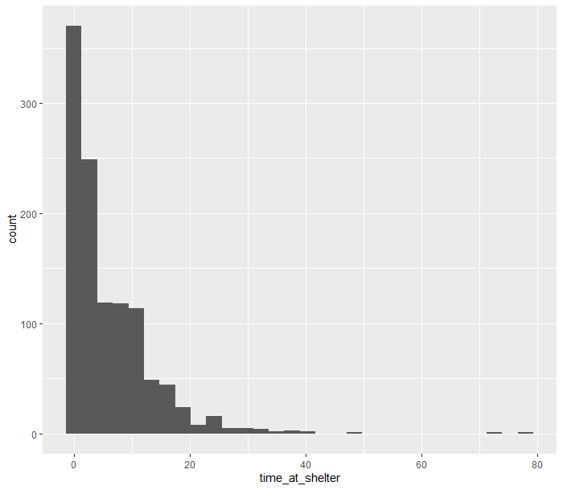
Some example plots
The general realisation of outcome_type
The counts of animals grouped by time_at_shelter

Slide 7
Data fitting analysis
/02
We will use General Poisson model, Quasi-Poisson model and Negative Binomial Distribution model

Slide 8
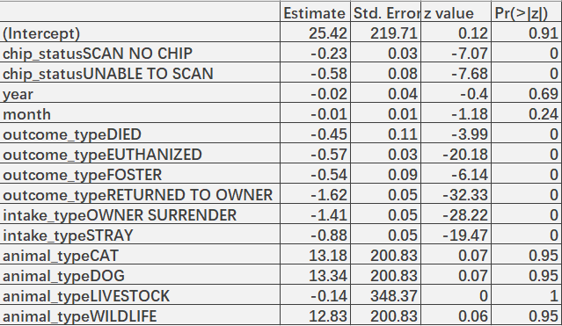
First step: Poisson Model with full features
By analysing the dataset, we found that what we want is the counts of time_at_shelter, and the most fitted model is Poisson model, so we choose it.
01
What is Poisson model?
It is a kind of Generalised Linear Models.
Poisson regression is often used for modelling count data.
02
Table 1: The coefficients of Poisson Model with full features

Slide 9
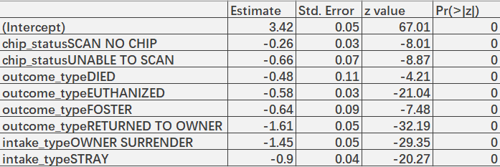
First step: Poisson Model- features selected
By observing the above Poisson model summary, we find that the p-values of the factors year, month and animal_type are much greater than 0.05, implying that they are highly insignificant. So, we shall now discard these three variables.
Table 2: The coefficients of Poisson Model – features selected
After removing the insignificant predictors, the p-values of all the other predictors seem to be good. We also find that for the Poisson model, D = 6111.3 and χ²(1124) = 1203.108, indicating a poor fit if Poisson is the correct model for the response.

Slide 10
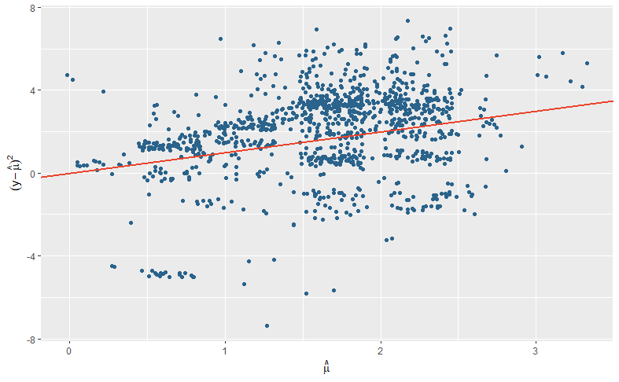
Scattered Fitting Plot
Overdispersion
The model after feature selection did not pass the chi-square test, indicating that the data is over-dispersed.

Slide 11
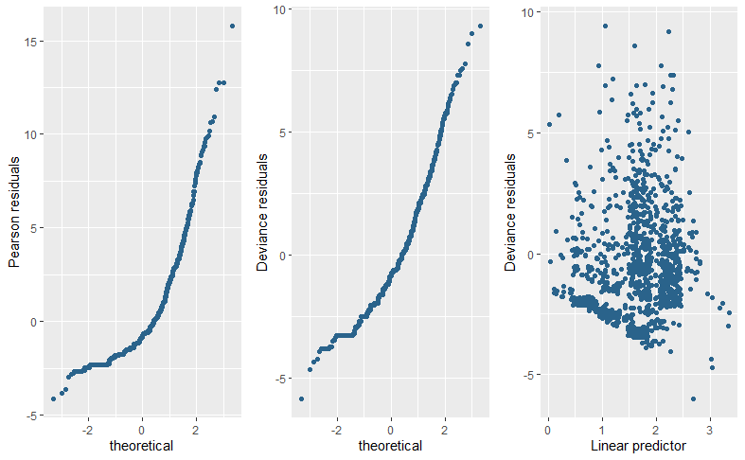
The first two plots on the right are normal probability plots, and we are using them here to spot any points that don’t follow the straight line. We can also plot the deviance (or Pearson) residuals against the linear predictor to look for non-linearity in the relationship between the fitted values and the residuals as shown in the third-panel last. There is no obvious pattern here.

Slide 12
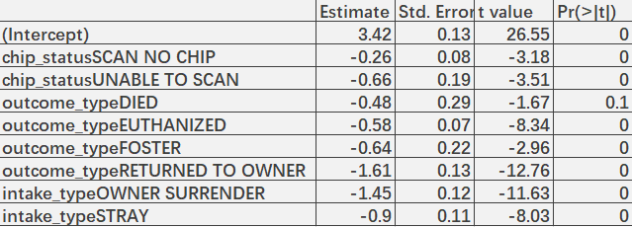
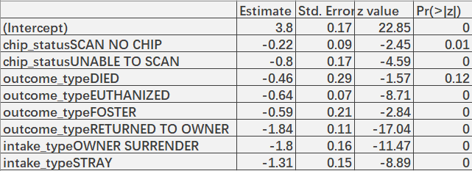
Second step: Quasi-Poisson model and Negative Binomial Model
For the Poisson distribution, when the data is overdispersed
, in addition to using family="quasipoisson", we can also replace the family="poisson"" method part for fitting.
01
Table 3: The coefficients of Quasi-Poisson Model
In addition to using the Quasi-Poisson model, we can also use the Negative Binomial Model. Because they belong to the general linear model, they are often used in the general counting model.
02
Table 4: The coefficients of Negative Binomial Model
12

Slide 13

Third step:Model Comparisons & Model Selection
Let’s compare the deviances and AIC scores of the Quasi-Poisson and Negative Binomial models.
Based on the comparison between the Negative Binomial model and the Quasi-Poisson model, we can see that because the Quasi-Poisson model cannot calculate AIC, and the deviation comparison we find that the deviation of the Negative Binomial model is smaller than the Quasi-Poisson model, so we prefer to use the Negative Binomial model to predict the time.
13

Slide 14
Model Equations & Conclusion
/03
The outcome of our work

Slide 15
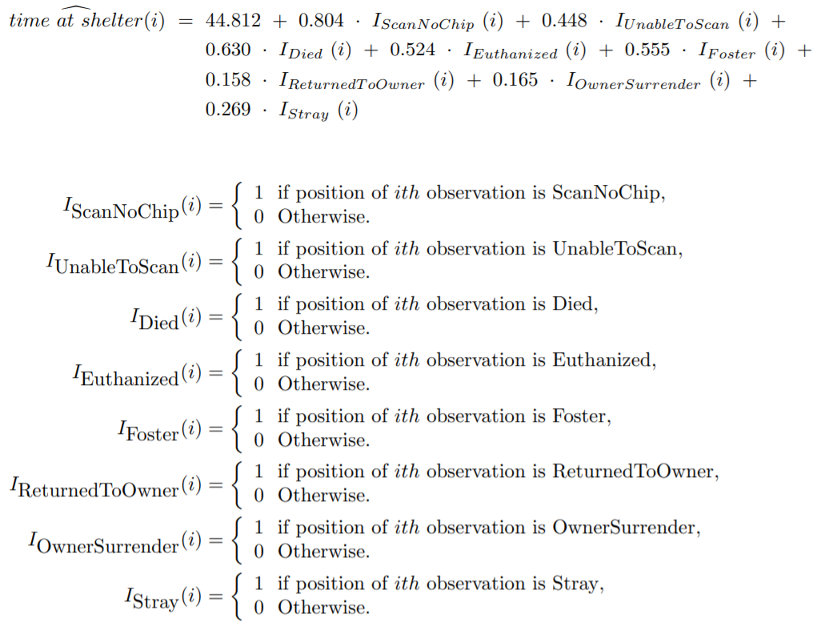
Model Equations & Conclusion
Based on the above analysis, we decided to use the Negative Binomial regression model to predict the time. The general mathematical formula of the log of the expected outcome for Negative Binomial regression model will be given:

Slide 16
Conclusion
First
Second
01
02
Have the basic idea of dataset and get a plan.
Select some models and
use them to analyse the dataset
Third
03
04
Fourth
Compare different models
and choose the best one
Use our model to predict and draw
some graphs to explain them explicitly

Slide 17
Extended and further tasks
/04
To make our analysis better

Slide 18

Extended & Further work
2. Expand the size of the data training set, which can make the fitted function more accurate.
1. We can further carry out feature engineering on the data set based on the current analysis. Filter out better data features from the original data to improve the training effect of the model.
3.In future work, we can conduct in-depth research on the problem of zero inflation of data, and choose some other models to try, such as zero inflated count model, zero-inflated poisson and zero-inflated negative binomial.

Slide 19
Thanks for watching
Group 18

