Slide 1
Report to the analysis of dataset 18
LOGO
_{PERSONAL}
_{RUESME}
₂₀₁₈
Subtitle here
Anusha
Ben
Chu
Juwu
Jinzhuang

Slide 2

01
what is the dataset
CONTENTS
the characteristics what it concerns
02
what we want
the aim that we are interested in
03
what we do
which model we use
what figures and
summaries we get
04
what conclusions we draw
does the result fit our hypothesis
what does the results show
05
extended and further tasks
based on what we’ve got, can we modify the analysis
can we get more results in using different methods

Slide 3
The description of the dataset
/01
Do you like dogs and cats?

Slide 4
The description of data set
Animal_type
The type of animal admitted to the shelter.
Use the function of factor() and find that there are.
five catogories named BIRD CAT DOG LIVESTOCK WILDLIFE.
Month and Year
Datasets 18 comes from the Dallas animal shelter. It contains a variety of information relating to each animal admitted to the shelter. It contains many variables recorded by animal admission:
Month the animal was admitted, recorded numerically.
Year the animal was admitted to the shelter.
Intake_type
Reason for the animal being admitted ot the shelter.
Outcome_type
Final outcome for the admitted animal
Data set 18
Chip_Status
Did the animal have a microchip with owner information
Time_at_Shelter
Days spent at the shelter between being admitted and final outcome

Slide 5
The glimpse of the data set
Rows: 1,135
Columns: 7
$ animal_type <chr> "DOG", "DOG", "DOG", "DO~
$ month <dbl> 8, 7, 1, 6, 4, 7, 1, 1, ~
$ year <dbl> 2017, 2017, 2017, 2017, ~
$ intake_type <chr> "STRAY", "STRAY", "CONFI~
$ outcome_type <chr> "RETURNED TO OWNER", "EU~
$ chip_status <chr> "SCAN NO CHIP", "SCAN NO~
$ time_at_shelter <dbl> 2, 10, 13, 7, 5, 3, 5, 6~
# A tibble: 6 x 7
animal_type month year intake_type outcome_type
<chr> <dbl> <dbl> <chr> <chr>
1 DOG 8 2017 STRAY RETURNED TO~
2 DOG 7 2017 STRAY EUTHANIZED
3 DOG 1 2017 CONFISCATED ADOPTION
4 DOG 6 2017 OWNER SURR~ ADOPTION
5 DOG 4 2017 STRAY ADOPTION
6 DOG 7 2017 STRAY RETURNED TO~
# ... with 2 more variables: chip_status <chr>,
# time_at_shelter <dbl>
From the glimpse we know the type of dfferent variables and can overview the table.

Slide 6
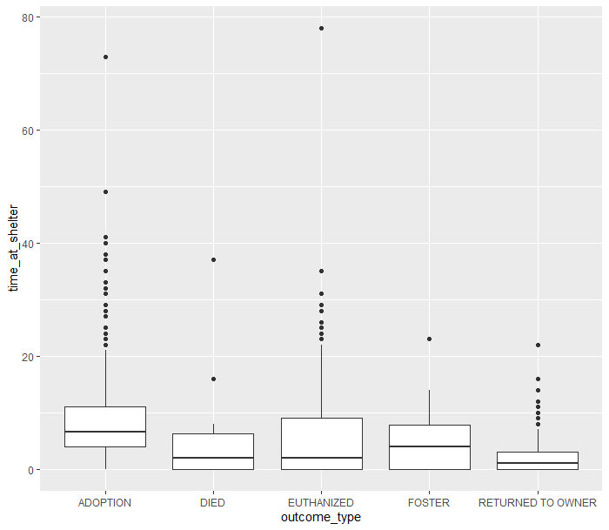
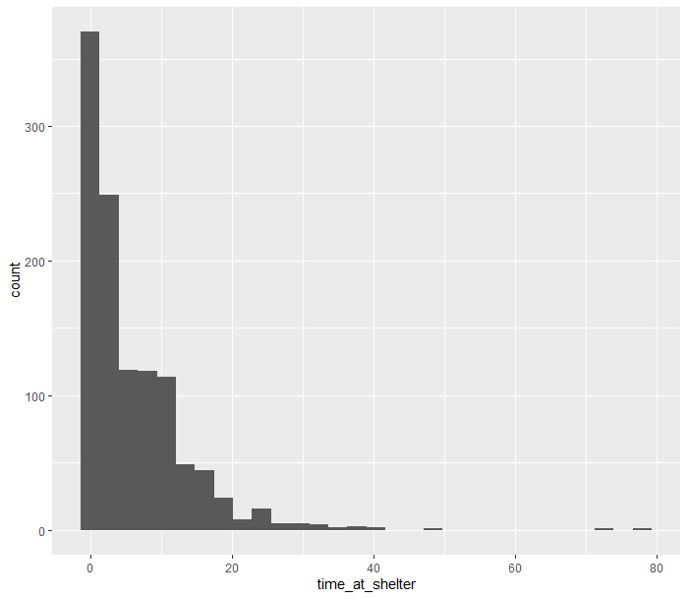
Some example plots
The general realisation of outcome_type
The counts of animals grouped by time_at_shelter

Slide 7
First step: Possion Model-1
By analysing the dataset, we found that what we want is the counts of time_at_shelter, and the most fitted model is Possion model, so we choose it.
01
What is possion model?
It is a kind of Generalised Linear Models.
Poisson regression is often used for modeling count data.
02
Table 1: The coefficients of Possion Model

Slide 8
First step: Possion Model-2
On upper analysis we draw the original model, but obviously there are many factors which are not significant enough, so we chould discard them and get a modified one.
Table 2: The coefficients of Possion Model-2
Now we get the exact and useful model, but does this model explains the dataset deliberatedly and explicitly? We found there are still many problems left to be solved .

