Slide 1
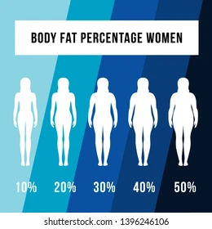


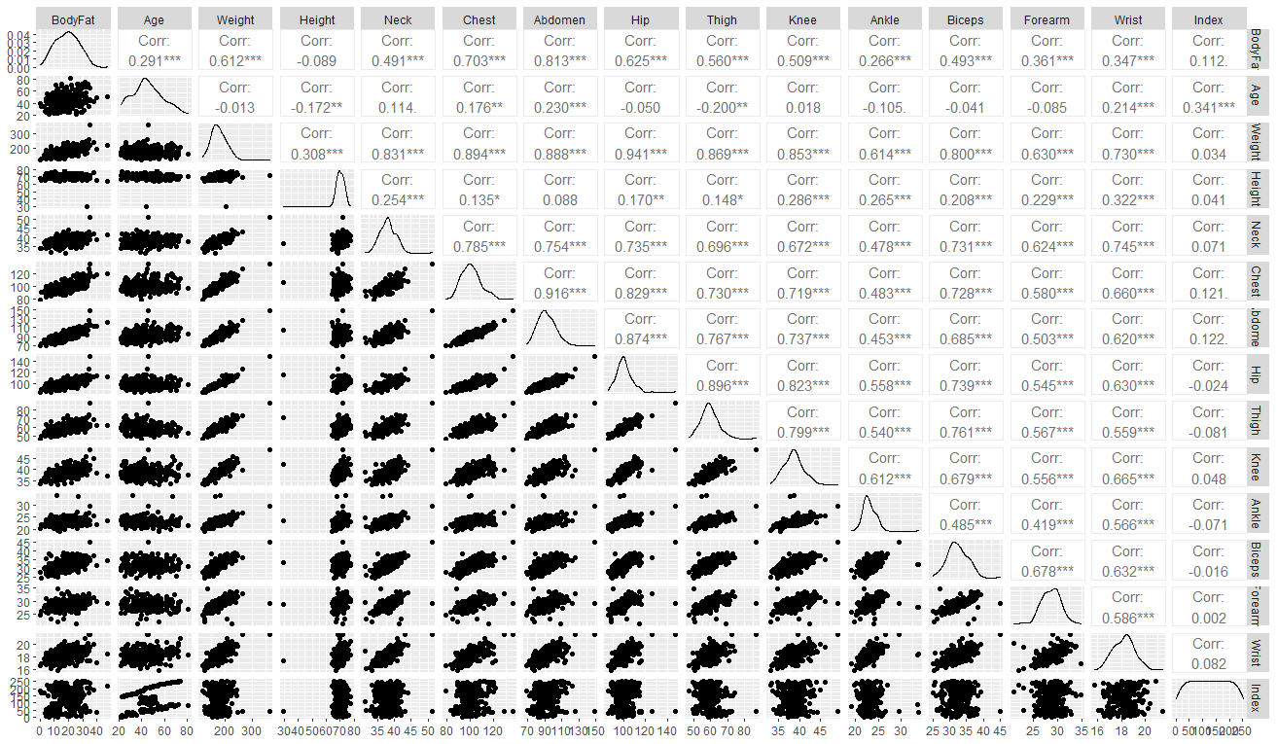
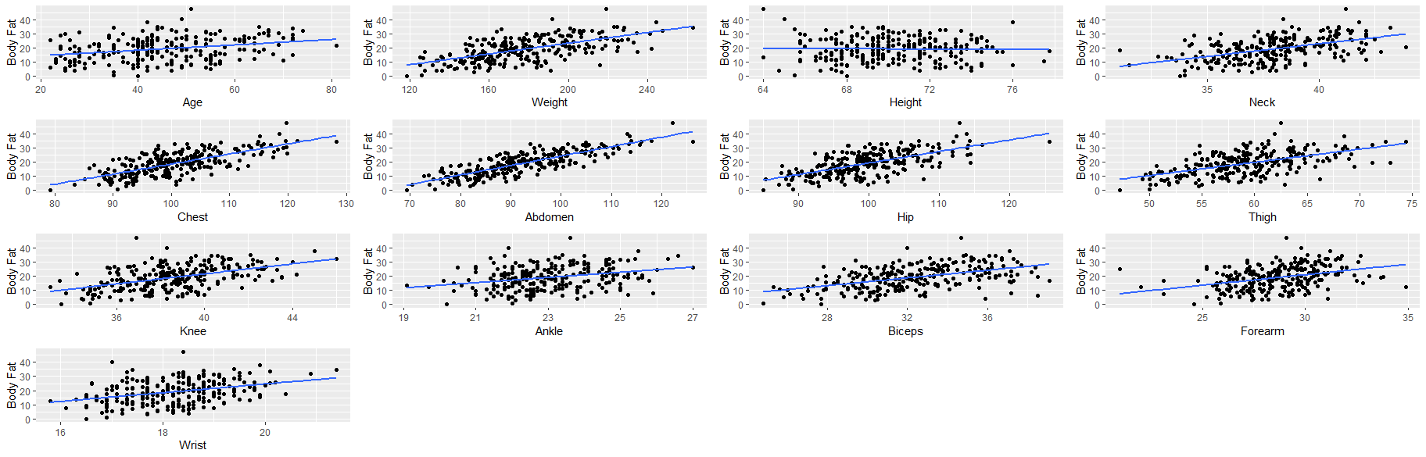
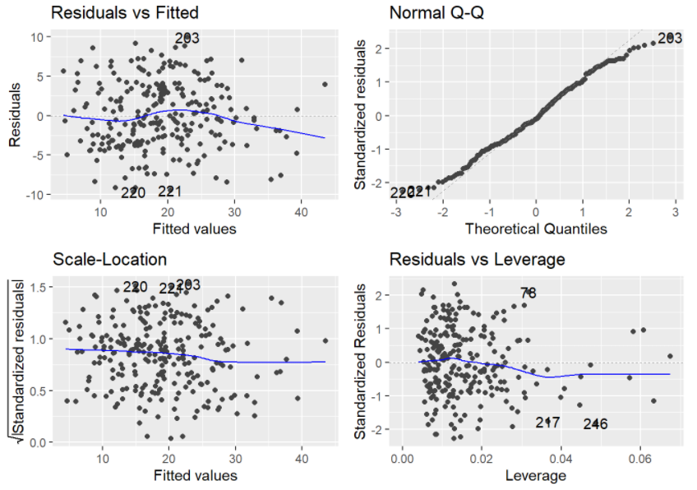
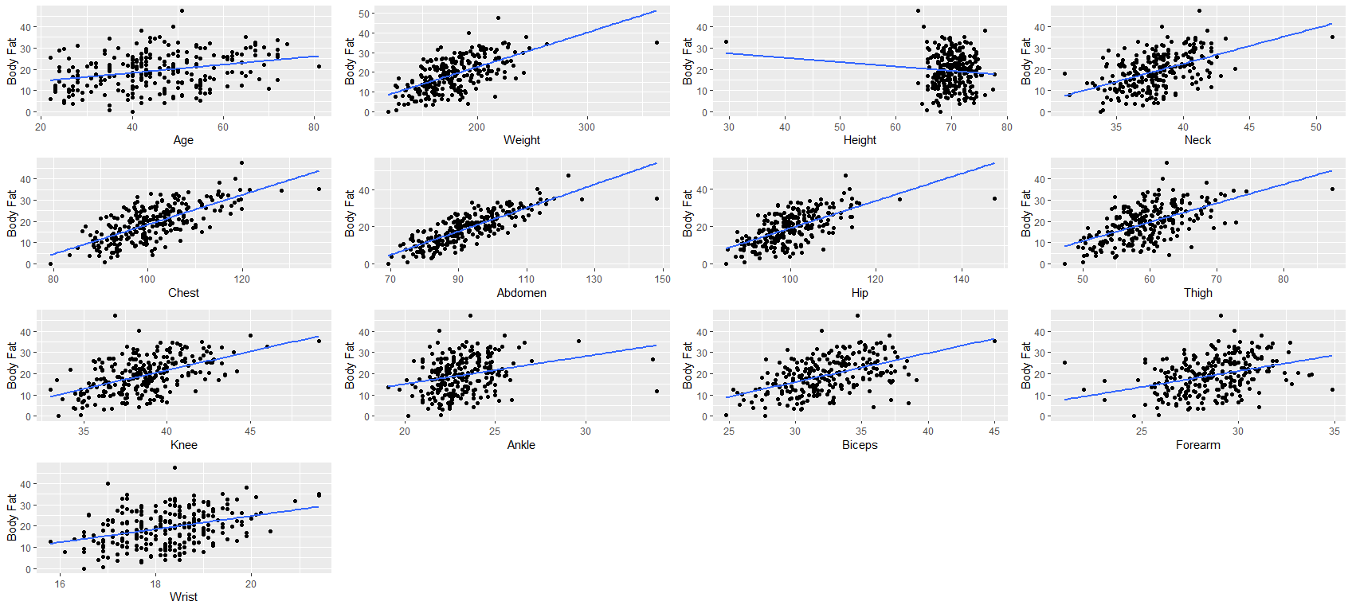
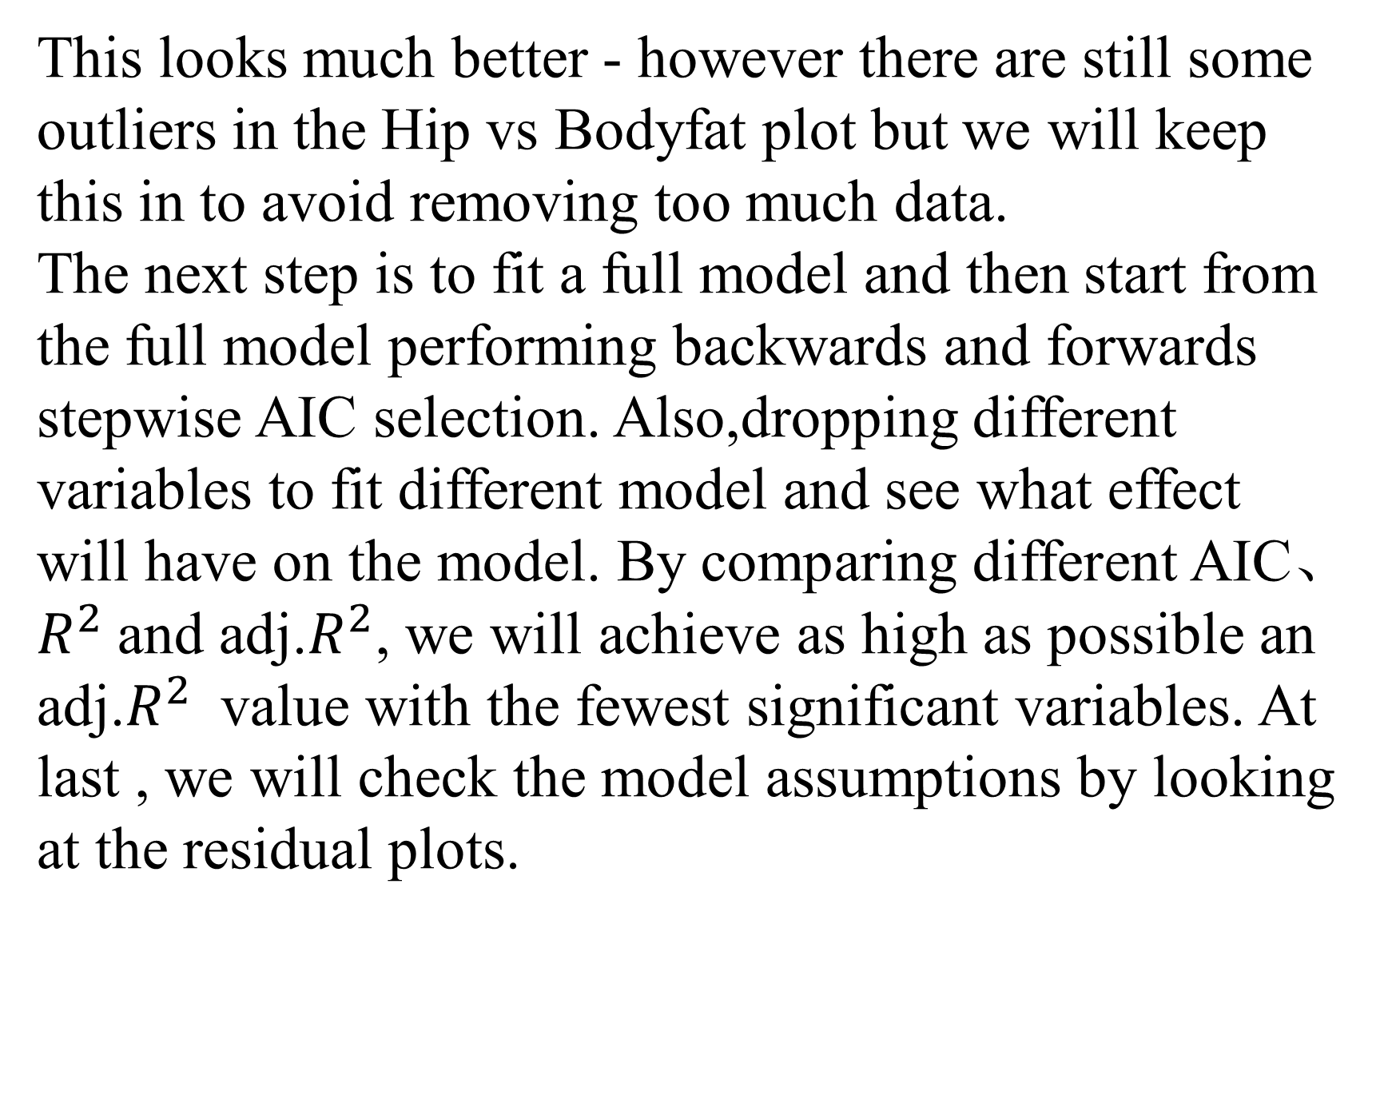
Estimating Bodyfat Percentage Using Practical Physical Measurements
Anusha Punnackal Anilkumar,Ben White,
Jinzhuang Cheng, Chu Zhang, Juwu Pu
Introduction
Methodology
Results
The aim of this project is to find a more accurate and convenient way to estimate the percentage of bodyfat by various practical physical measurements.
In order to estimate and predict bodyfat percentage , it is crucial to identify any potential predictors through plotting correlation diagrams between variables：
After plotting the relationship between the variables, it is obvious that there is indeed a good positive relationship between most of them except one of the explanatory variables. The plot between Height and BodyFat shows there is a very weak relationship between them.In addition,there are some clear outliers which we can identify and remove.Then, plotting again to see if this has had the desired effect of providing a cleaner data set:
First, perform linear fitting on all the cleaned data. The results show that Multiple R-squared = 0.7513 and Adjusted R-squared = 0.7375. It can be seen that 73.75% of body fat information can be explained by the above data.
Based on the AIC principle, the variables of the model were screened twice, and finally four variables: Abdomen, Weight, and Wrist were left. There are only three explanatory variables left in the model screening but Adjusted R-squared (0.7339) only reduces 0.0036. It shows that these three variables can fully explain the body fat percentage.
Data Summaries
The collected data contain 14 variables for 252 observations(men).These variables are Percent body fat from Siri‘s (1956) equation、Age (years)、Weight (lbs)、Height (inches)、Neck circumference (cm)、Chest circumference (cm)、Abdomen 2 circumference (cm)、Hip circumference (cm)、Thigh circumference (cm)、Knee circumference (cm)、Ankle circumference (cm)、Biceps (extended) circumference (cm)、Forearm circumference (cm) and Wrist circumference (cm). Summary statistics of these variables are presented in the following table:
Perform linear model hypothesis testing based on the three-variable model remaining above:
As shown in the figure above, there is a strong positive correlation between all the variables, which implies that there is high multicollinearity. Thus, it is important to choose appropriate variables carefully. Abdomen looks promising - however it looks like there may be some outliers relating to weight. We can view the plots of all the predictors individually against bodyfat.
Variable | n | Mean | SD | Q1 | Median | Q3
BodyFat | 252 | 19.15 | 8.37 | 12.47 | 19.20 | 25.30
Age | 252 | 44.88 | 12.60 | 35.75 | 43.00 | 54.00
Weight | 252 | 178.92 | 29.39 | 159.00 | 176.50 | 197.00
Height | 252 | 70.15 | 3.66 | 68.25 | 70.00 | 72.25
Neck | 252 | 37.99 | 2.43 | 36.40 | 38.00 | 39.42
Chest | 252 | 100.82 | 8.43 | 94.35 | 99.65 | 105.38
Abdomen | 252 | 92.56 | 10.78 | 84.57 | 90.95 | 99.33
Hip | 252 | 99.90 | 7.16 | 95.50 | 99.30 | 103.53
Thigh | 252 | 59.41 | 5.25 | 56.00 | 59.00 | 62.35
Knee | 252 | 38.59 | 2.41 | 36.98 | 38.50 | 39.92
Ankle | 252 | 23.10 | 1.69 | 22.00 | 22.80 | 24.00
Biceps | 252 | 32.27 | 3.02 | 30.20 | 32.05 | 34.32
Forearm | 252 | 28.66 | 2.02 | 27.30 | 28.70 | 30.00
Wrist | 252 | 18.23 | 0.93 | 17.60 | 18.30 | 18.80
It can be seen from the four test pictures that the model conforms to the basic assumptions of the linear model; the residual distribution appears to be random and conforms to the normal distribution, and there is no high leverage point. Looks very ideal!.
This looks much better - however there are still some outliers in the Hip vs Bodyfat plot but we will keep this in to avoid removing too much data.
The next step is to fit a full model and then start from the full model performing backwards and forwards stepwise AIC selection. Also,dropping different variables to fit different model and see what effect will have on the model. By comparing different AIC、 $R^{2}$and adj.$R^{2}$, we will achieve as high as possible an adj.$R^{2}$ value with the fewest significant variables. At last , we will check the model assumptions by looking at the residual plots.
Conclusion
The model selected 3 variables to predict the body fat percentage of adult men, namely Weight, abdominal circumference and wrist circumference. The analysis shows that the use of this model can be more economical and time-effective to get a rough adult men's body fat percentage.

