Slide 1
Application Engineering Design
Travel Agency Report

Slide 2
Problem Statement
A travel agency provide travel related services to the public on behalf of suppliers.
The main objective is to find out best deals through travel agency such as cheap flights, hotels and cars.

Slide 3
Solution
This assignment develops an online process which displays
Flight schedules
Manage Airliners
Manage Travel Agency
Allow customers to find best deals

Slide 4
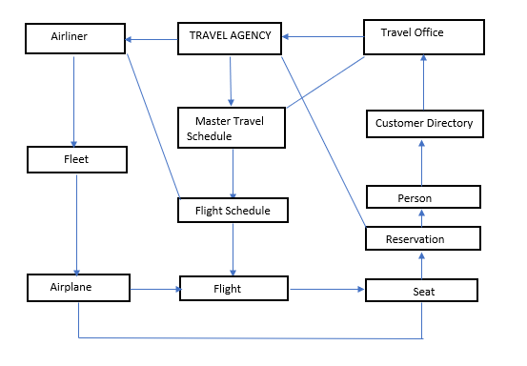
Object Model

Slide 5
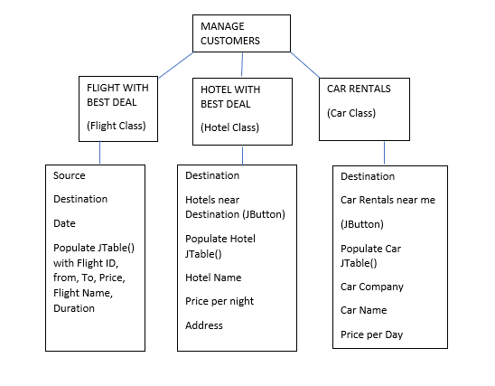
UML

Slide 6
Explanation
When we click FLIGHT WITH BEST DEAL JButton it asks user to enter source, destination, date of travel and after giving the details it will display a JTable showing flight details like FlightName, ID, Duration, Price.
After selecting the flight there will be an option to select a seat and once the seat booking is done. It will display Booking Successfully done Dialog box.
Proceed(Basically Hotels near destination) JButton will display another JPanel which allows user to choose the cheap hotel by displaying a jTable with attributes hotel name, address, price per night/day. If he books a hotel again display booked successfully.

Slide 7
Explanation cont..
Finally, After user selects the hotel, it will display another JButton RENT A CAR which on clicking will display Car Company with car name and price per day with a BOOK JButton.

