Slide 1
Predicting and Managing Credit Risk: A Data-Driven Framework for Smarter Lending Decisions
Analysis and Strategic Recommendations

Slide 2
The Core Challenge: Balancing Growth and Risk
Our primary goal is to grow the loan portfolio and increase revenue.
However, we must simultaneously minimize losses from clients who default.
A strategy that is too cautious rejects creditworthy applicants, leading to lost opportunity.
A strategy that is too lenient increases financial losses and puts capital at risk
RISK
GROWTH

Slide 3
Our Solution: A User-Friendly, Data-Driven Tool
We need to equip our loan officers with a tool that:
Provides a clear, quantitative Probability of Default (PD) score.
Offers qualitative context by matching applicants to historical customer profiles.
Suggests concrete, actionable next steps based on the level of risk.

Slide 4
The ultimate objective is to move from subjective assessment to consistent, data-informed decision-making.

Slide 5
What We Had to Work With
The analysis is based on a historical dataset of 1,000 previous loan applicants.
Key Features Available:
Demographics: Age, Gender, City
Financials: Loan Amount, Loan Term
Background: Education Level
Outcome: Default status (Did they default within 12 months?)
Initial Data Quality Issues
The raw data required cleaning before it could be used for modelling.

Slide 6
Data Challenges
Missing City Information: 52 applicants (5.2%) had no city listed.
Missing Loan Amount: 4 applicants (0.4%) were missing a loan amount.
Illogical Birth Year: 20 applicants (2%) had a birth year after their application year.
Class Imbalance: The dataset was not evenly split between outcomes.
Non-Defaulters: 633 (63.3%)
Defaulters: 367 (36.7%)

Slide 7
How were they addressed?
Used robust statistical methods (imputation) to handle missing data and specialized modelling techniques (SMOTE) to correct for the class imbalance.

Slide 8
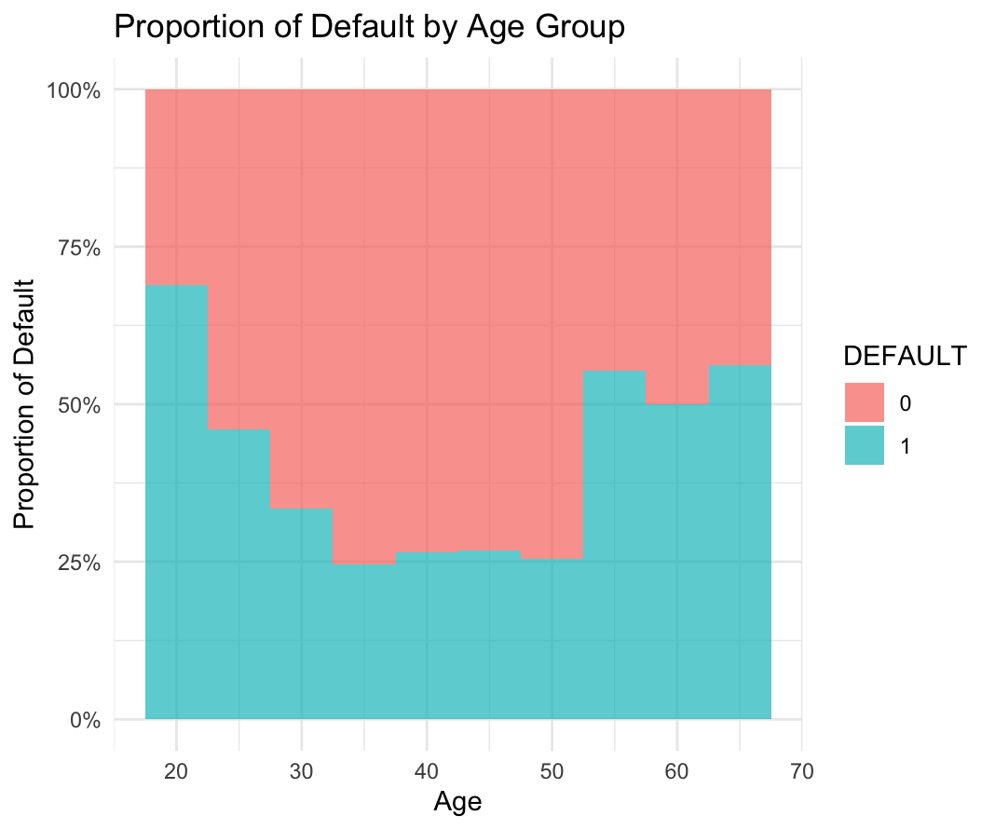
Insight 1: Younger Applicants Carry Higher Risk
The default rate is highest for clients in their 20s and steadily decreases with age.

Slide 9
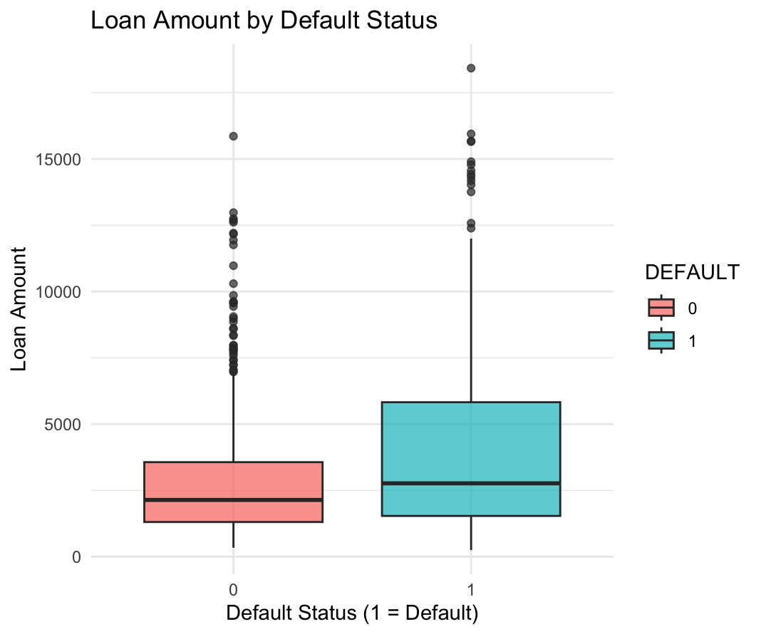
Insight 2: Defaulters Tend to Seek Larger Loans
The median loan amount for clients who defaulted is visibly higher than for those who did not.

Slide 10
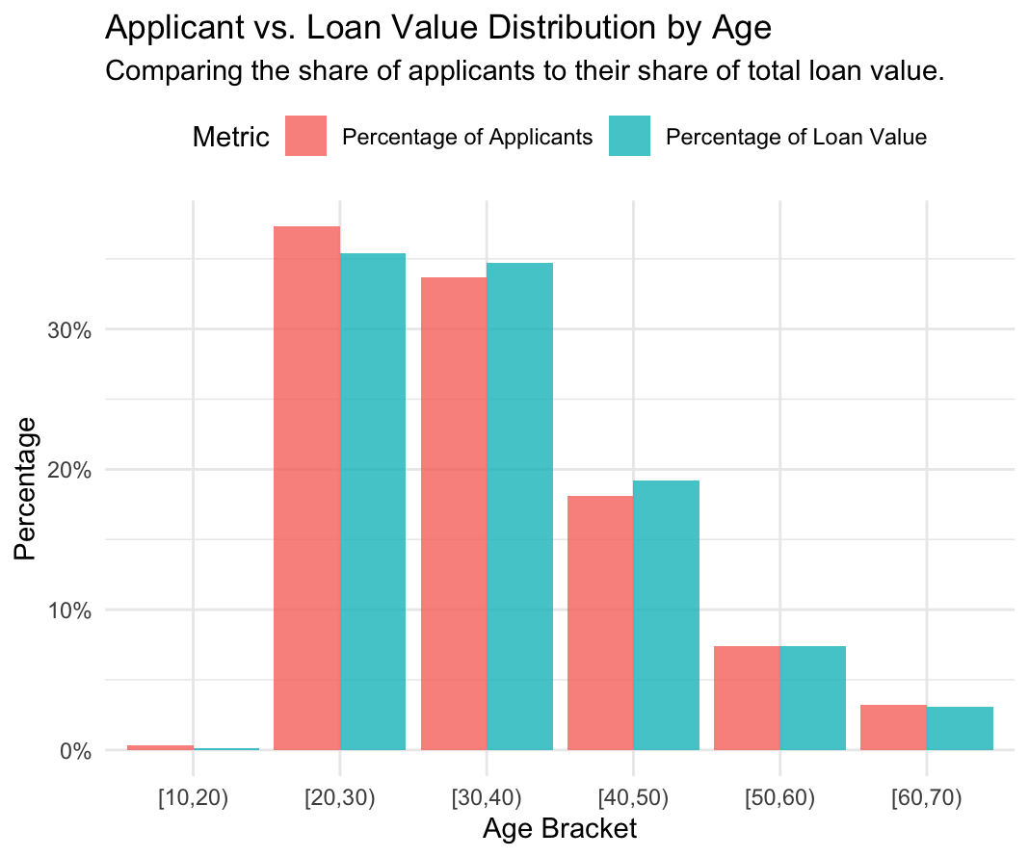
Insight 3: A Tale of Two Segments
Younger clients are high in volume but low in value; older clients are the opposite.

Slide 11
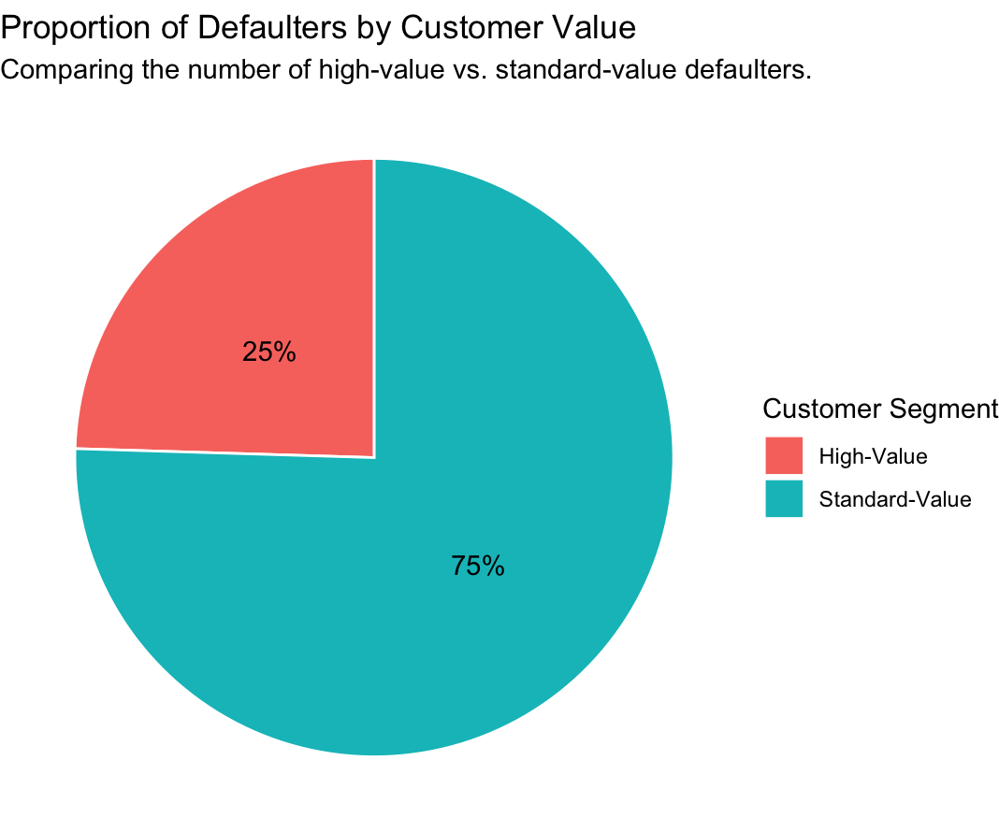
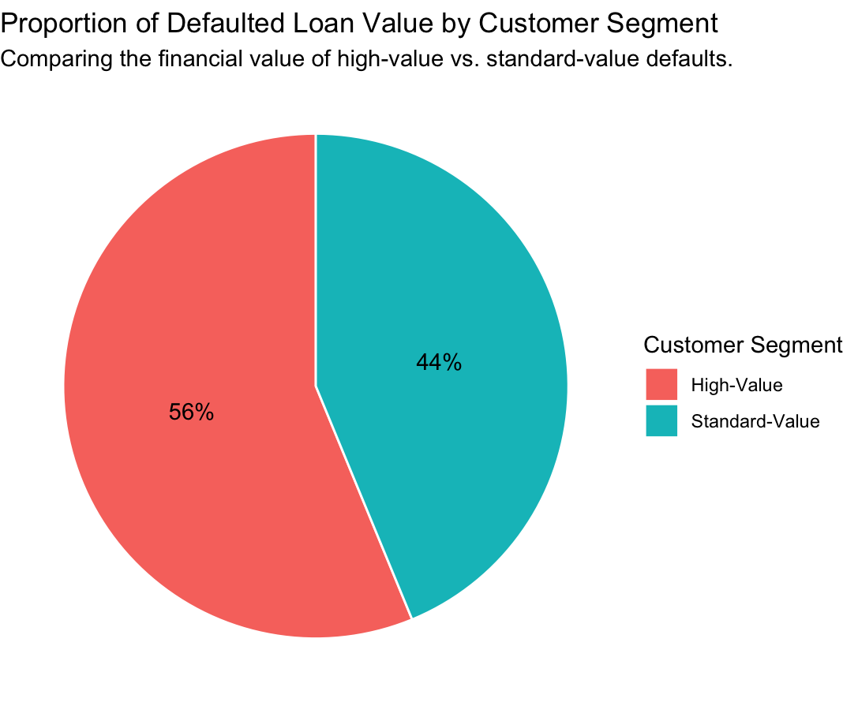
The Critical Finding: Concentrated Financial Risk
High-value clients are only 15% of the number of defaulters.
But they account for 38% of the money lost to defaults. Key Takeaway The financial impact of defaults is heavily concentrated. A single high-value default is far more costly than a standard one.

Slide 12
Our Methodology: Building a Model We Can Trust
We used an industry-standard, multi-step process to ensure our model is not only accurate, but also simple, robust, and fair.
1. Model Choice: Logistic Regression
Interpretable: We can see exactly what drives risk.
Provides a clear probability score (0-100%).
2. Feature Selection
Used automated stepwise selection to keep only the most impactful variables.
Result: A simpler, more robust model that is less prone to noise.

Slide 13
Our Methodology: Building a Model We Can Trust
3. Handling Imbalance: SMOTE
Problem: More non-defaulters than defaulters can bias the model.
Solution: SMOTE creates synthetic ”defaulter” examples during training to teach the model to recognize them effectively.
4. Rigorous Validation
80/20 Split: Trained on 80% of data, tested on a final, unseen 20%.
10-Fold Cross-Validation: Ensured
stable performance and avoided a ”lucky split”.

Slide 14
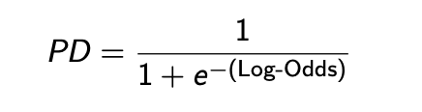
The Final Model Equation
The probability of default is calculated using the following formula:
Where Log-Odds is calculated as:
Log-Odds = 0.1118 + (0.0180 × Loan Term)
+ (0.000095 × Loan Amount)
− (0.0082 × Age)
+ (0.7526 × IsCityPrague?
− (1.6570 × IsEduSecondary?)
− (2.5800 × IsEduUniversity?)
Note: A positive coefficient increases risk; a negative coefficient decreases risk.

Slide 15
What Drives Default Risk?
The model tells us a clear story about what increases and decreases risk. A positive coefficient in the model means higher risk, and a negative one means lower risk.

Slide 16
What Drives Default Risk?
Risk INCREASES With...
📍 Living in Prague: This is the single strongest factor that increases risk.
💰 Larger Loan Amounts: Higher loan values are linked to a higher probability of default.
🗓️ Longer Loan Terms: The longer the repayment period, the higher the risk.
Risk DECREASES With...
🎓 Higher Education: This is the strongest factor that reduces risk. University level has the biggest impact.

Slide 17
A Key Insight: Education Matters More Than Age
While our initial analysis showed younger people default more, the final model reveals that education level is the true underlying driver. Once we account for education, age itself is not a significant risk factor. This means a young applicant with a university degree is a much safer bet than an older applicant with only a primary education.

Slide 18
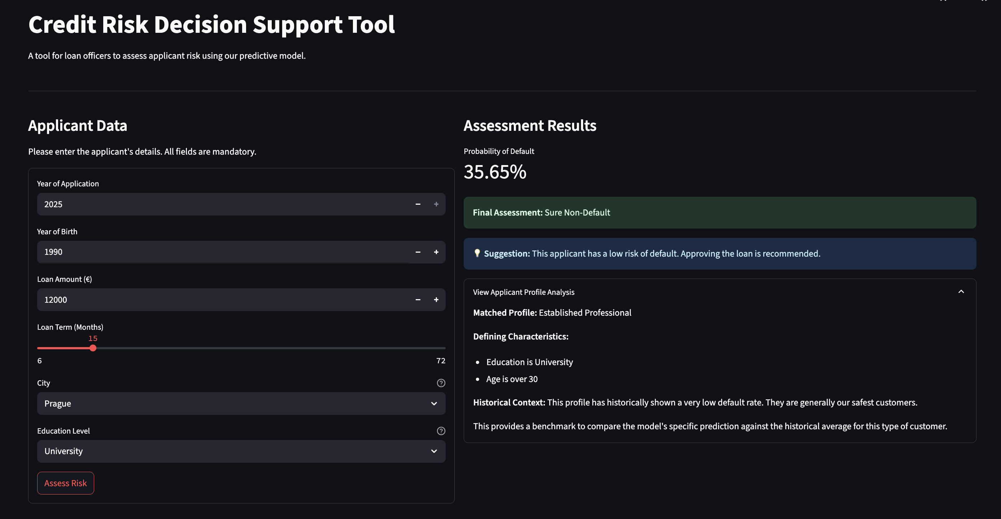
The Tool in Action: From Data to Decision
The loan officer inputs client data and receives a clear, three-part recommendation.
https://credit-risk-default-prediction.streamlit.app/

Slide 19
Understanding Our Applicant Profiles
The GUI matches each applicant to a historical profile to provide context for the PD score.

Slide 20
High-Risk Urban Applicant
Profile: Primary Education and lives in Prague.
Risk: Combines two high risk factors
Established Professional
Profile: Over 30 and University Education
Risk: Historically our safest customers.
Young & Aspiring Applicant
Profile: Under 28 years old.
Risk: Varies greatly, PD score is the primary guide.
High-Value Applicant
Profile: Loan amount over €20,000
Risk: Defaults are very costly; requires senior review

Slide 21
How Well Does The Model Perform?
We measured the model’s performance on the unseen test data. The results show it is highly effective.
Metric | Value | What it Means in Simple Terms
AUC | 0.81 | Excellent ability to distinguish be- tween clients who will default and those who won’t. A score of 0.5 is random chance; 1.0 is perfect.
Gini | 0.62 | Confirms the model has strong dis- criminatory power. It’s another way of looking at AUC (2 × AUC − 1).
KS-Statistic | 0.50 | Shows an excellent level of separation between the predicted default and non-default groups.

Slide 22
Performance in Practice: The Confusion Matrix
Out of 199 test customers, how did we do?
Correctly Identified Defaulters (Sensitivity) 71.2%
Correctly Identified Non-Defaulters (Specificity)
76.2%
We successfully caught 52 out of the 73 actual defaulters.
We successfully cleared 96 out of the 126 good
clients.

Slide 23
Actionable Risk Categories
We defined three risk tiers, with stricter rules for high-value clients whose defaults are more costly.
Standard-Value Clients
Safe: < 40% PD
Grey Area: 40% − 60% PD
Risky: > 60% PD
High-Value Clients
Safe (HV): < 30% PD
Grey Area: 30% − 55% PD
Risky: > 55% PD

Slide 24
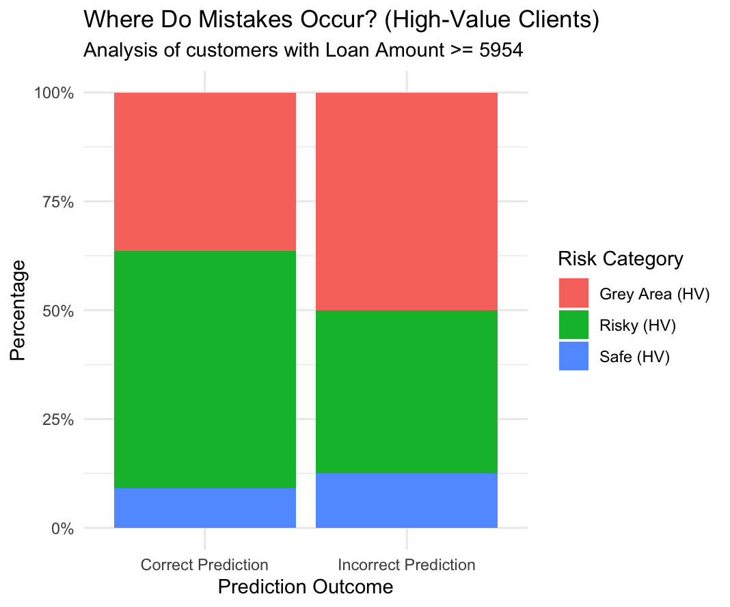
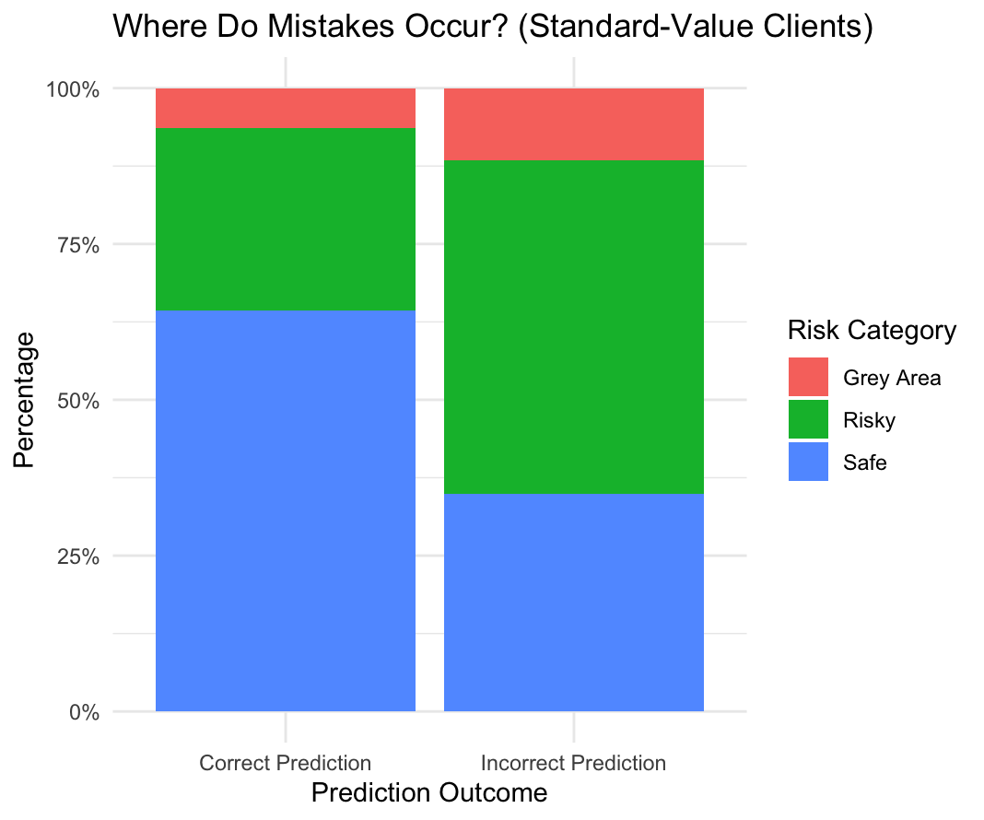
Where Do Model Mistakes Occur?
Insight: Most mistakes occur when the model is already uncertain (in the ”Risky” or ”Grey Area” categories), which is expected. This reinforces the need for manual review in these cases.

Slide 25
Recommendations: Operations
Mandate GUI for All Applications: Use the tool for every new applicant to ensure data integrity and consistent decisioning. The tool prevents illogical or missing data entry.
Standardize ”Grey Area” Protocol: Define a clear, consistent protocol for senior loan officers to follow when reviewing ”Grey Area” cases. This ensures fairness and reduces individual bias.

Slide 26
Recommendations: Business Strategy
Target Low-Risk Profiles: Analyse the model coefficients to understand the ”ideal” customer (e.g., established professionals with higher education). Create targeted marketing campaigns and incentives (e.g., low-collateral loans) for these segments.
Investigate the ”Why”: The model tells us what drives risk, but not why. Initiate further research to understand the underlying reasons. For example: Why do applicants from Prague have a higher default risk? Is it cost of living? Industry concentration?

Slide 27
Future Roadmap: Continuous Improvement
Dynamic Model Retraining: Enhance the GUI to save all new applicant data to a central database. This data should be used to retrain and update the model periodically (e.g., every 6 months).
Periodic Insight Review: Schedule a quarterly review of the model’s insights and performance to adapt to changing market conditions and customer behaviours.

Slide 28
Conclusion
This project delivers more than just a model; it provides a comprehensive framework for risk management.
By integrating this data-driven tool into our workflow, we can:
Reduce credit losses by accurately identifying high-risk applicants.
Increase operational efficiency through consistent, faster decision-making.
Drive profitable growth by confidently approving more creditworthy customers.

