Slide 1


Slide 2

PREDICTING HOSPITAL
READMISSION OF
DIABETIC PATIENTS AND FEATURE
ANALYSIS
PRESENTED BY
ISHAN CHOWDHURY
DEBASHIS DAS
ARAVIND RAJ C K
ANUSHA N
NIKHIL KUMAR SINGH
MENTORED BY
MS ANJANA AGRAWAL

Slide 3

INTRODUCTION

Slide 4
10 YEARS OF CLINICAL CARE AT 130 HOSPITALS AND INTEGRATED DELIVERY NETWORKS THROUGHOUT THE US
50 COLUMNS WITH 13 NUMERICAL AND 37 CATEGORICAL VARIABLES
DATASET INFORMATION
MISSING VALUES IN SOME FEATURES AND INAPPROPRIATE DATA IN SOME FEATURES
24 MEDICAL COLUMNS ALONG WITH 3 DIAGNOSIS COLUMNS

Slide 5
RESEARCH
Literature Survey
DATA WRANGLING
Cleaning inaccurate
& missing data
STAGES INVOLVED
DATA VISUALIZATION
Exploring some insights
from the data
DATA MODELING
Figuring out a solution by
building an appropriate model

Slide 6
TREATMENT OF "?" AS
MISSING VALUES
EXPIRED AND HOSPICE PATIENT
RECORDS HAVE BEEN REMOVED
REPLACEMENT WITH MODE
FOR CATEGORICAL VARIABLES
DUPLICATE VALUES FROM THE COLUMN
'PATIENT_NBR' HAVE BEEN REMOVED.
TREATING THE "READMITTEED“
COLUMN AS <30=1 WHILE
OTHERS AS 0.
REMAPPING OF THE DIAGNOSIS
COLUMNS
CREATING NEW FEATURE TO
ENCAPSULATE CHARACTERS OF
THE SOME FEATURES
REMAPPING OF VALUES IN
"A1C TEST", "GLUCOSE SERUM TEST"
AND 24 MEDICAL FEATURES.
REMOVAL OF REDUNDANT
FEATURES
DATA CLEANING

Slide 7
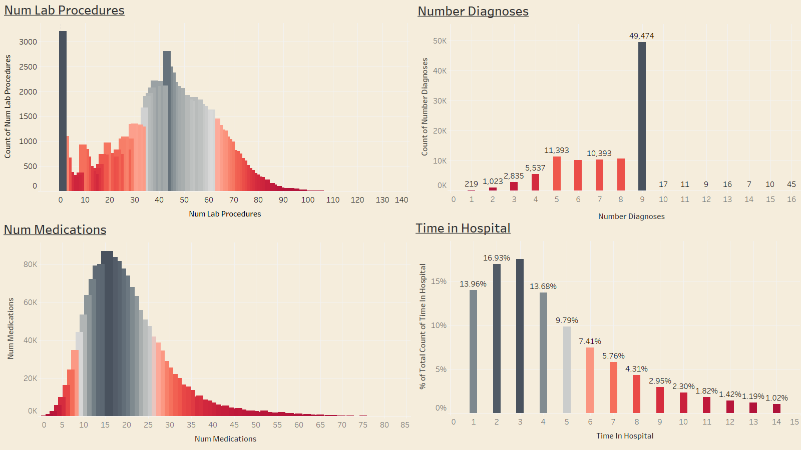
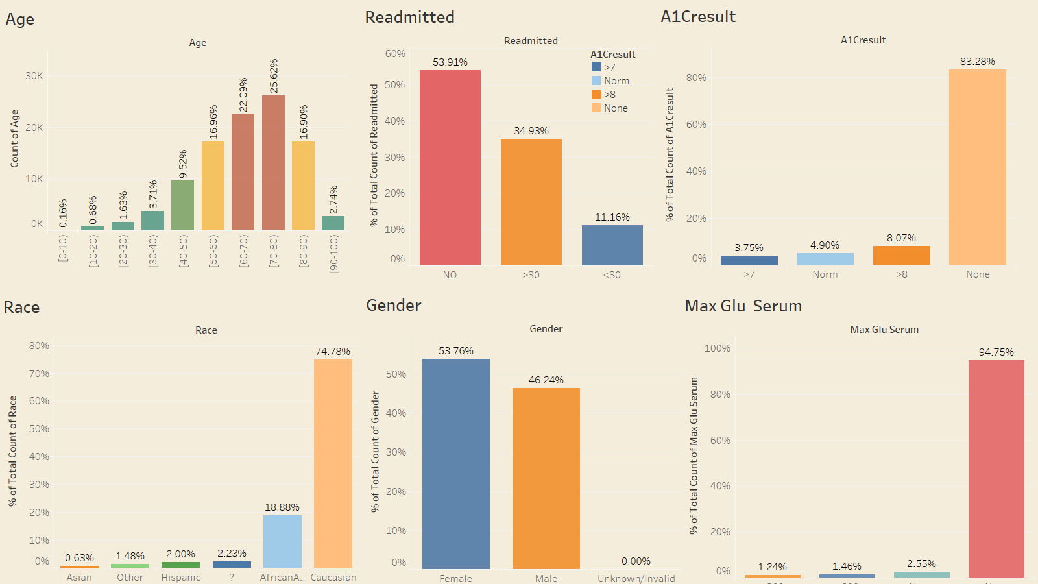
UNIVARIATE ANALYSIS
DATA VISUALIZATION

Slide 8
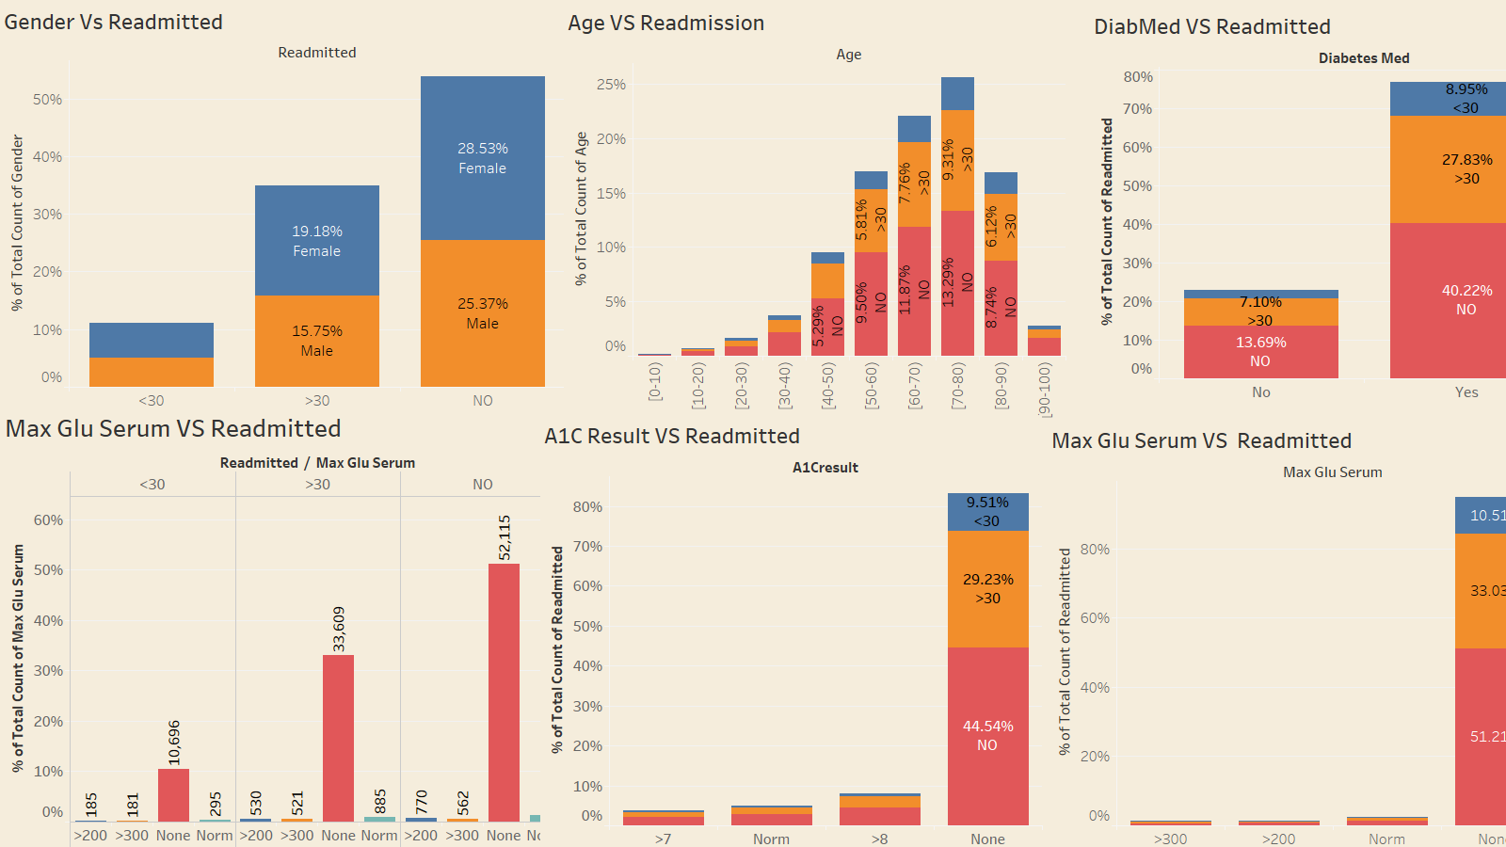
BIVARIATE ANALYSIS

Slide 9
CHI2-CONTINGENCY
Important Features | time_in_hospital, num_lab_procedures, num_procedures, num_medications, number_diagnoses, max_glu_serum, A1Cresult, readmitted, Age, total_visits, race_Caucasian, race_Other, diag_1_Digestive, diag_1_Injury, diag_1_Respiratory, diag_2_Diabetes, diag_2_Neoplasms, diag_3_Diabetes, diag_3_Genitourinary, diag_3_Neoplasms, diag_3_Respiratory, change_No, diabetesMed_Yes, treatment_insulin, treatment_no drug,
Applying Chi2_contingency which will help us to choose the best features
STATISTICAL ANALYSIS
FIG.: Important features applying chi-square

Slide 10
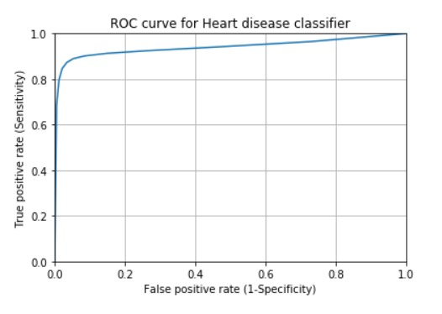
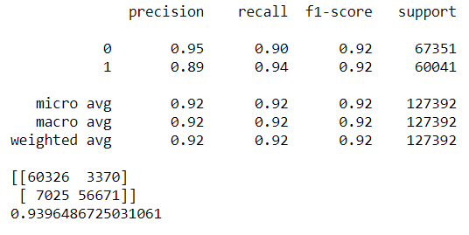
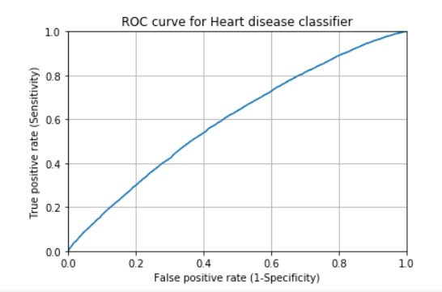
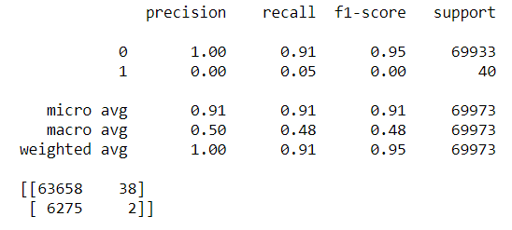
MODEL COMPARISON
Method | Precision-Micro | Recall-Micro | F1-Micro | ROC-Score
Logistic Regression | 0.91 | 0.91 | 0.91 | 0.60
KNN | 0.91 | 0.91 | 0.91 | 0.51
Decision Tree | 0.82 | 0.82 | 0.82 | 0.51
Random Forest | 0.91 | 0.91 | 0.91 | 0.53
Method | Precision-Micro | Recall-Micro | F1-Micro | ROC-Score
Logistic Regression | 0.56 | 0.56 | 0.56 | 0.56
KNN | 0.52 | 0.52 | 0.52 | 0.52
Decision Tree | 0.52 | 0.52 | 0.82 | 0.51
Random Forest | 0.53 | 0.53 | 0.53 | 0.54
Method | Precision-Micro | Recall-Micro | F1-Micro | ROC-Score
Logistic Regression | 0.86 | 0.86 | 0.86 | 0.90
KNN | 0.78 | 0.78 | 0.78 | 0.91
Decision Tree | 0.86 | 0.86 | 0.86 | 0.86
Random Forest | 0.92 | 0.92 | 0.92 | 0.93
With Smote Random Forest is giving best result with a F1 micro of 0.92 and Roc of 0.94 the model is performing best and classifying all the classes correctly.
DATA MODELING
FIG.: MODELS WITH UNDER SAMPLING
FIG.: MODEL WITH SMOTE
FIG.: BASE MODEL
Fig.: Classification Report of
Logistic Regression(Base model)
Fig.: ROC curve of Logistic Regression(Base Model)
Fig.: Classification Report of Random Forest Classifier(With SMOTE)
Fig.: ROC curve of Random Forest Classifier(With SMOTE)

Slide 11
The patients can receive effective treatment only if they are diagnosed correctly at the first level of diagnosis. This diagnosis can be effectively done when the patients undergo important test like the HbA1C test and glucose serum value test.
By recommending effective treatments the hospital can reduce the readmission rates which can save them millions of dollars while also improving the quality of care.
CONCLUSION
The important features found through the model must be monitored thoroughly for every patient to recommend the best treatment.

Slide 12
THANK YOU
QUESTIONS!

