Slide 1
Marriage of Figaro
UNIVERSITY OF IOWA LIBRARY CATALOG

Slide 2
Team members
ADVISOR -AMANDA XU – UNIVERSITY OF IOWA
ABHISHEK SINGH
ANUSHA RAMAMURTHY

Slide 3
Introduction
With the rapid change in technology and connectivity, it has become necessary for libraries to have a revamp.
A library is no longer just a catalogue of books, newspapers and other reading or viewing material.
We wish to create a connected website for a library that leverages the technology available today, a linked open data online library.

Slide 4
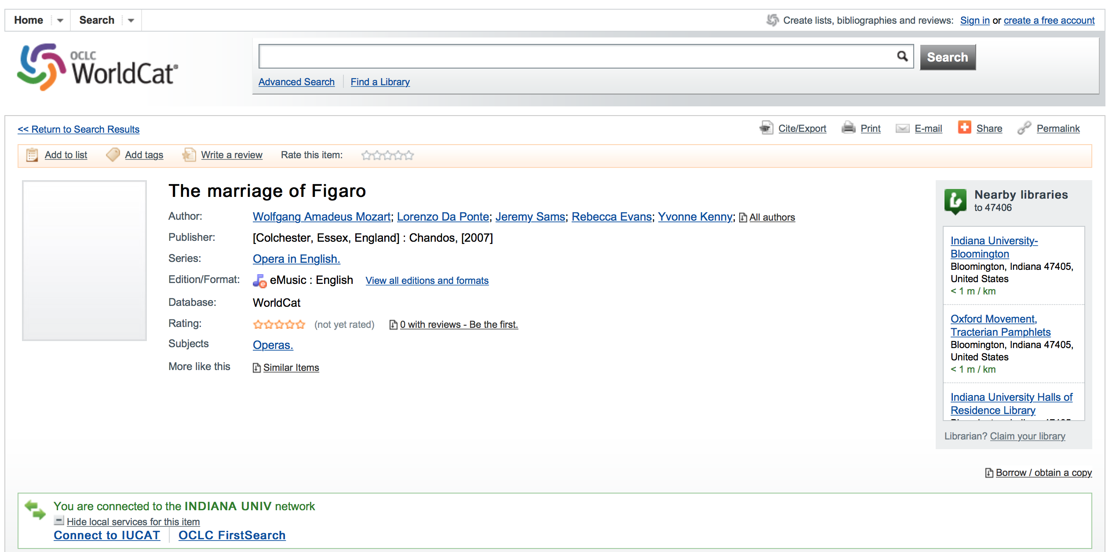
Motivation

Slide 5
Our Project
A website for University of Iowa Library
To create a Linked Open Data for Opera “Marriage of Figaro” based on BIBFRAME 2.0 framework specified by Library of Congress.
Tools/Technologies
BIBFRAME MODEL 2.0
Jena Fuseki 2.3.1
SPARQL Queries
RDF Graphs
Bootstrap, Javascript, HTML

Slide 6
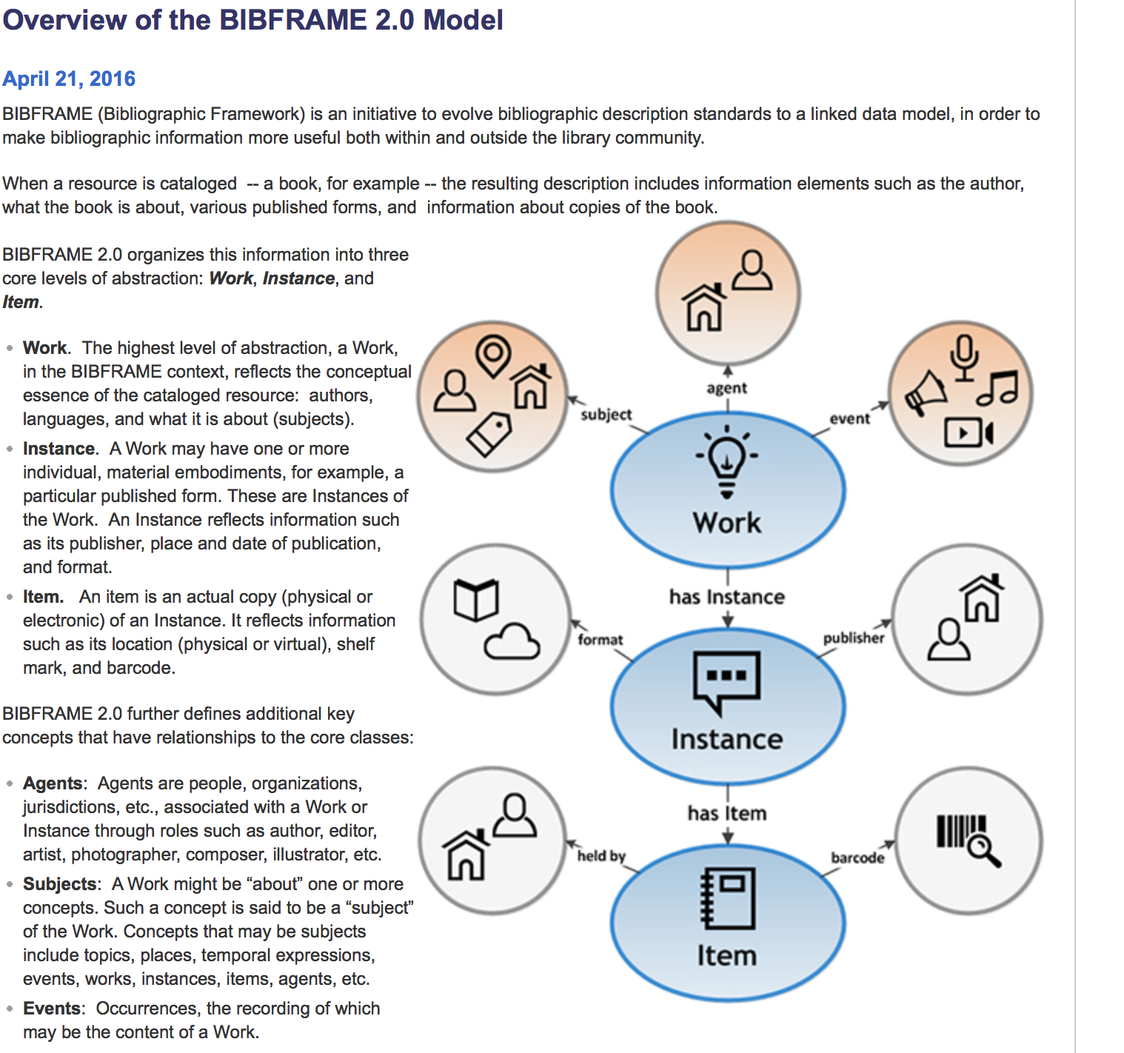
Bibframe 2.0

Slide 7
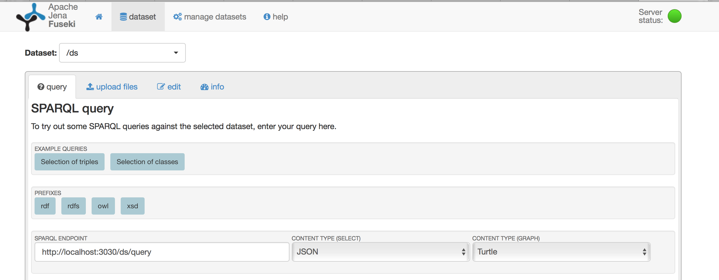
Jena fuseki

Slide 8
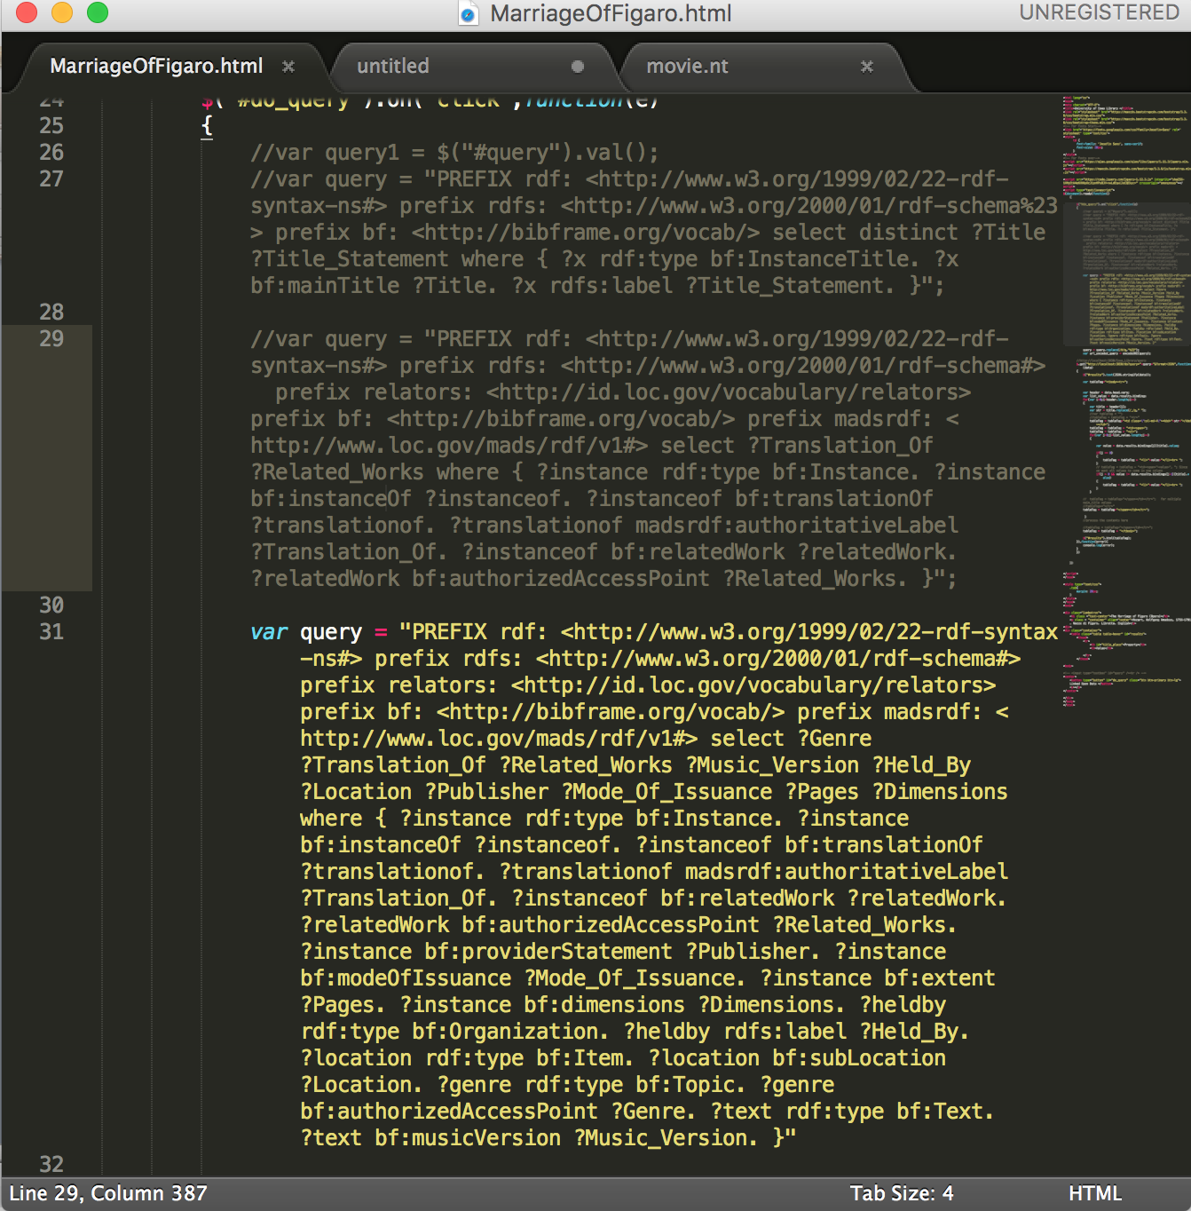
Sparql Queries
One query to fetch all details vs. multiple queries to fetch independent details

Slide 9
Existing Work
http://link.bu.edu/portal/Mozarts-The-marriage-of-Figaro-edited-by-Burton/EvMgjljaSlw/

Slide 10
Challenges
Understanding the BIBFRAME 2.0 RDF to write Sparql Queries.
Fetching results from Fuseki to display on the browser.
Playing around with javascript and jquery to display Sparql Query Results.

Slide 11
Future work
Incorporate data about videos, vocal, sound recordings, streaming audio, score etc. related to the opera.
Bring in more instances of publically available datasets like dbpedia, world cat etc.
Integrate with social networking websites, location services, Google custom search.
PHP and asynchronous server side implementations.
Visualizations to see associations, related works.

Slide 12
References
http://www.loc.gov/bibframe/pdf/marcld-report-11-21-2012.pdf
http://link.bu.edu/portal/Le-Nozze-di-Figaro--The-marriage-of-Figaro--Die/UTfBiY8o1DY/
http://jena.apache.org/documentation/fuseki2/
http://www.w3schools.com/js/

Slide 13
Acknowledgements
Amanda, Xu.
Professor Ying Ding.

Slide 14
Thank you

