Slide 1
MEMBERS:
ANUSHA SAAD 19K-0281
SAMAN KHAN 19K-0354
HAIDER ALI BAIG 19K-0
IBAD UR REHMAAN 19K-

Slide 2
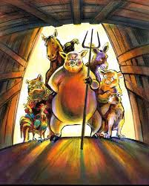
ANIMAL FARM
GEORGE ORWELL

Slide 3
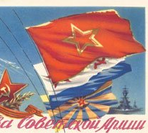
INTRODUCTION:
Animal Farm was written by George Orwell and published in 1946. This story is about the Manor Farm in England, around the time of the Russian revolution. One of Orwell's goals in writing Animal Farm was to portray the Russian Revolution of 1917 as one that resulted in a government more oppressive and deadly than the one it overthrew. Many of the characters and events of Orwell's novel parallel those of the Russian Revolution: In short, Manor Farm is a model of Russia, and old Major, Snowball and Napoleon represent the dominant figures of the Russian Revolution.

Slide 4
MAIN CHARACTERS

Slide 5
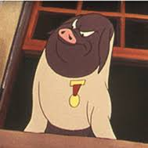
Napoleon = Joseph Stalin
Napoleon, the pig rules the farm through strong-arm tactics and cunning. He makes the farm prosperous but keeps most of the wealth for himself. He is ruthless toward his enemies, ordering the executions of those who dare to cross him. Napoleon represents Soviet leader Joseph Stalin, the communist dictator(1922-1953) who killed all who oppose him. He loved power.

Slide 6
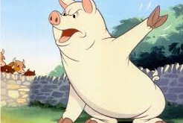
Snowball = Leon Trotsky
Snowball is a pig on an equal footing with Napoleon after the rebellion, and his intelligence and planning ability become assets to the farm. His popularity and his ability threaten Napoleon's ambitions, so Napoleon exiles him from the farm. Snowball represents Leon Trotsky, a pure communist leader who was influenced by the teaching of karl marx (Old Major).

Slide 7
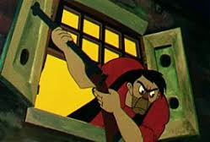
Mr. Jones = Tsar Nicholas II
Farmer jones in the novel is described as the irresponsible owner of the farm who lets his animals starve and beat them with a whip. He sometimes shows random kindness. Mr. Jones represents Tsar Nicholas II who was weak Russian soldier in 1900s. Often cruel and brutal to his subjects. He displays isolated kindness.

Slide 8
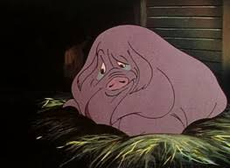
The Old Major = Karl Marx
The old boar who originates the principles of Animalism and encourages the rebellion. He dies shortly after presenting his vision to the animals, so he does not live to see how his fellow pigs corrupt his ideals over time. Old Major is often interpreted to represent Karl Marx. Karl Marx was the inventor of the communist. Died before Russian revolution.

Slide 9
SUMMARY

Slide 10
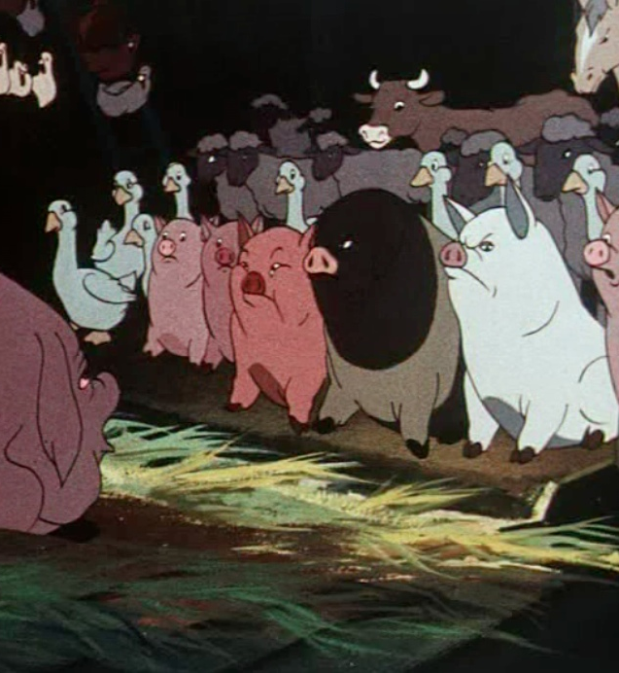
PLOT (1/N)
One night, all the animals at Mr. Jones' Manor Farm assemble in a barn to hear old Major, a pig, describe a dream he had about a world where all animals live free from the tyranny of their human masters. old Major dies soon after the meeting, but the animals — inspired by his philosophy of Animalism — plot a rebellion against Jones. Two pigs, Snowball and Napoleon, prove themselves important figures and planners of this dangerous enterprise. When Jones forgets to feed the animals, the revolution occurs, and Jones and his men are chased off the farm. Manor Farm is renamed Animal Farm, and the Seven Commandments of Animalism are painted on the barn wall.

Slide 11
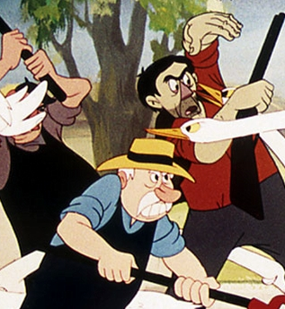
PLOT (2/N)
Initially, the rebellion is a success: The animals complete the harvest and meet every Sunday to debate farm policy. The pigs, because of their intelligence, become the supervisors of the farm. Napoleon, however, proves to be a power-hungry leader who steals the cows' milk and a number of apples to feed himself and the other pigs. Later that fall, Jones and his men return to Animal Farm and attempt to retake it. Thanks to the tactics of Snowball, the animals defeat Jones in what thereafter becomes known as The Battle of the Cowshed.

Slide 12
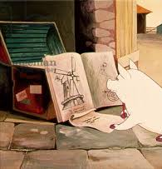
PLOT (3/N)
Snowball begins drawing plans for a windmill, which will provide electricity and thereby give the animals more leisure time, but Napoleon vehemently opposes such a plan on the grounds that building the windmill will allow them less time for producing food. On the Sunday that the pigs offer the windmill to the animals for a vote, Napoleon summons a pack of ferocious dogs, who chase Snowball off the farm forever. Napoleon announces that there will be no further debates; he also tells them that the windmill will be built after all and lies that it was his own idea, stolen by Snowball.

Slide 13
PLOT (4/N)
Much of the next year is spent building the windmill. Boxer, an incredibly strong horse, proves himself to be the most valuable animal in this endeavor. Jones, meanwhile, forsakes the farm and moves to another part of the county. Contrary to the principles of Animalism, Napoleon hires a solicitor and begins trading with neighboring farms. Napoleon's lust for power increases. He forces "confessions" from innocent animals and has the dogs kill them in front of the entire farm. He and the pigs move into Jones' house and begin sleeping in beds. The animals receive less and less food, while the pigs grow fatter.

Slide 14
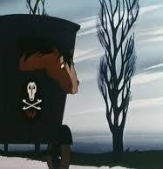
PLOT (5/N)
After the windmill is completed in August, Napoleon sells a pile of timber to Jones; Frederick, a neighboring farmer who pays for it with forged banknotes. Frederick and his men attack the farm and explode the windmill but are eventually defeated. As more of the Seven Commandments of Animalism are broken by the pigs, the language of the Commandments is revised. Boxer again offers his strength to help build a new windmill, but when he collapses, exhausted, Napoleon sells the devoted horse to a knacker (a glue-boiler).

Slide 15
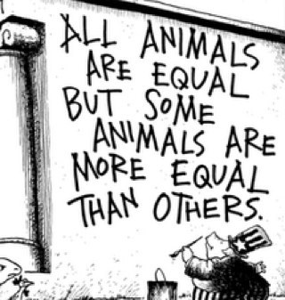
PLOT (6/N)
Years pass and Animal Farm expands its boundaries after Napoleon purchases two fields from another neighboring farmer, Pilkington. Life for all the animals (except the pigs) is harsh. Eventually, the pigs begin walking on their hind legs and take on many other qualities of their former human oppressors. The Seven Commandments are reduced to a single law: "All Animals Are Equal / But Some Are More Equal Than Others." The novel ends with Pilkington sharing drinks with the pigs in Jones' house. Napoleon changes the name of the farm back to Manor Farm and quarrels with Pilkington during a card game in which both of them try to play the ace of spades. As other animals watch the scene from outside the window, they cannot tell the pigs from the humans.

Slide 16
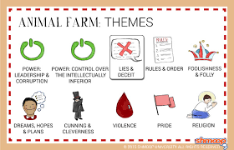
THEMES:

Slide 17
MORALE:
The moral is that revolutions only effect a radical improvement when the masses are alert and know how to out their leaders.

