Slide 1

Hawaiki Shop

Slide 2
Anusha
Doss
Rua
Back-End Engineer
Project Manager
Front-End Engineer
https://github.com/anushaselvan
https://github.com/gitme-waffles
https://github.com/rmnk-nz
Team

Slide 3
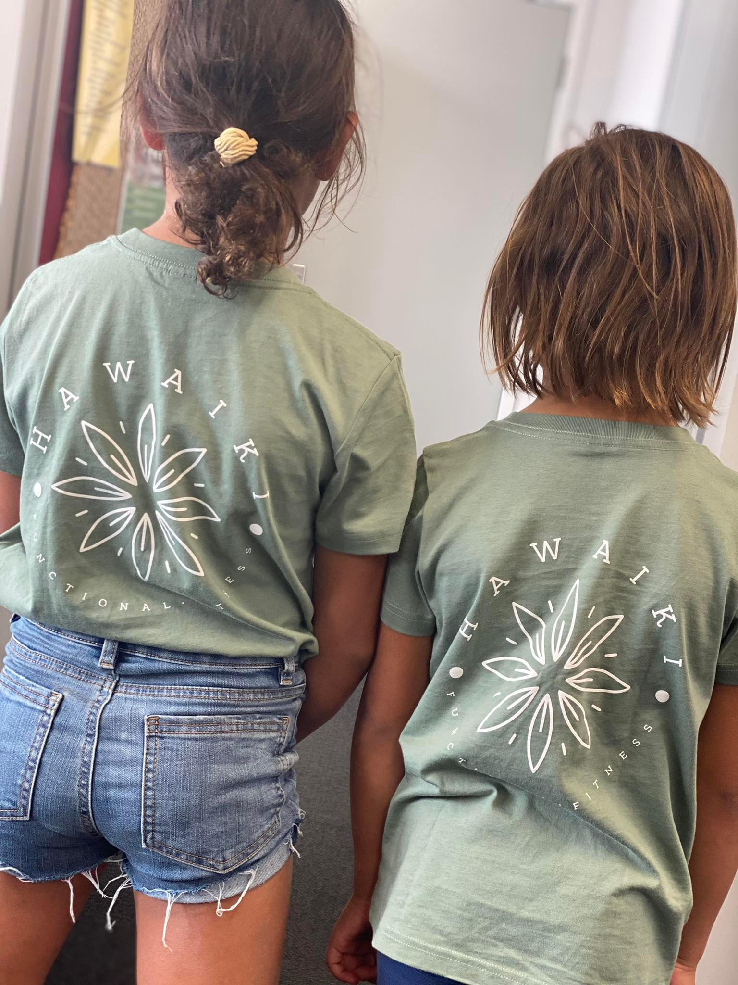
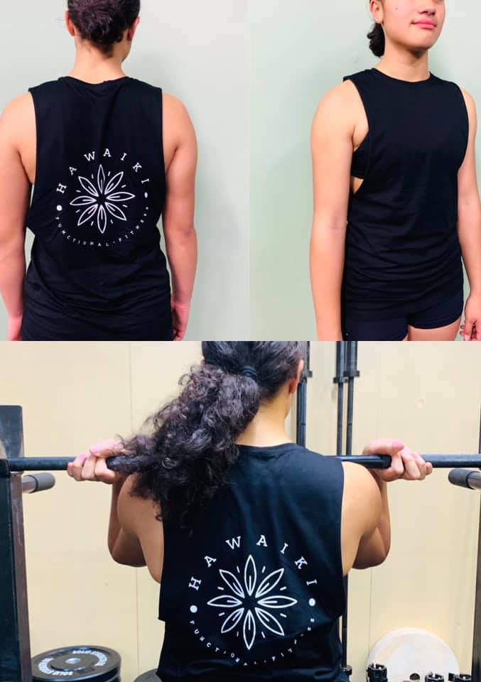
Concept
E-commerce
Online store for users to purchase merchandise from a Business

Slide 4
Consolidating code
Phase 1:
Wireframe the layout
Functionality of the website
User authentication
What technologies we apply to the website
Development Process
Phase 2:
Assign each member task
Front end:
CSS/HandleBars/Routes/izimodal
Backend:
Database/Authentication/ API Routes/ Event handling
Content needed for the website
Issues:
Manipulating data
Using Izimodal.js

Slide 5
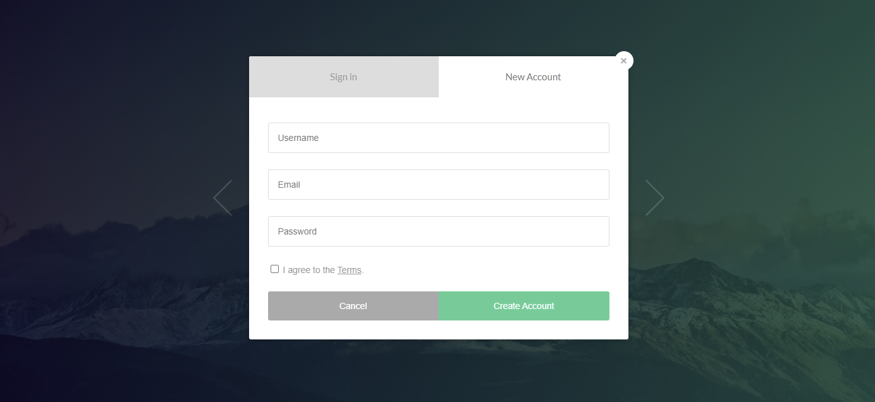
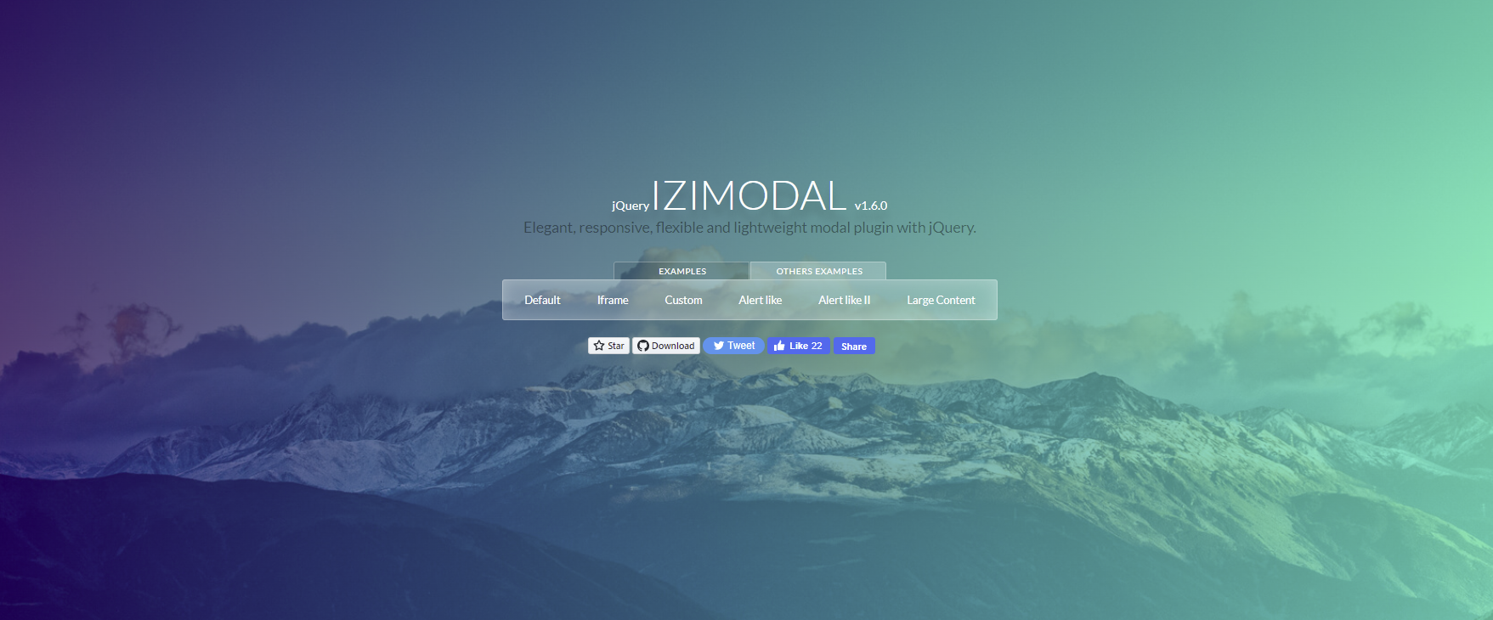
Technologies Used
Html, CSS, JS, express, mysql, sequelize, sessions, bcrypt
IziModal.js user authentication interface

Slide 6

Demo
Link:

Slide 7

Future Developments
Admin Login to update stock and add and remove items
Email order conformation to users
Process user payments
More time into CSS and JS to improve how products are displayed to user
Fully functioning user cart

Slide 8
THANK YOU FOR YOUR TIME
Questions?

