Slide 1

Research Experience for Undergraduate(REU)
Estimation of the State of Health of the Li-ion Battery for EV Applications
Research Experience for Undergraduate(REU)
Unlocking the Potential of Al₂O₃-CuO Binary Nanocomposite for supercapacitors
Presenter name
Anusha Arun Yaligar
USN: 01FE21BEE112
Under the Guidance of : Mr. Anoop Kumar Patil
Head of School: Dr. Saroja V Siddamal
Date: 01-03-2025
1

Slide 2
Overview
Introduction
Literature Review
Objective
Methodology
Implementation
Results
Conclusion

Slide 3
Introduction
Lithium-ion (Li-ion) batteries are widely used in electric vehicles, renewable energy storage, and portable devices due to their high energy density and long cycle life. However, their performance and safety depend on the State of Health (SoH), which indicates their ability to store and deliver energy efficiently as they age. Accurate SoH estimation is crucial for optimizing battery usage and ensuring safety.
Traditional SoH estimation methods, such as Coulomb counting and impedance spectroscopy, are limited by complex calculations and high computational costs. In contrast, data-driven machine learning approaches offer improved accuracy by modeling complex battery behaviors without relying on physical models. Techniques like Support Vector Regression (SVR), Long Short-Term Memory (LSTM) networks, and Feedforward Neural Networks (FNNs) have shown promising results.
This study proposes a Backpropagation Neural Network for Li-ion battery SoH estimation, leveraging temperature, voltage, and current data to capture non-linear aging patterns. The model is validated against existing methods, demonstrating superior accuracy and computational efficiency, contributing to more reliable battery health prediction systems.

Slide 4
Literature Review
SL.NO | TITLE | AUTHOR NAME | CONCLUSION
1. | State-of-charge estimation based on improved back-propagation neural network for lithium-ion batteries in energy storage power stations | XIAOHONG ZHUB, MINGWAN ZHUANG, WEIRONG YANG, XIUQUAN LI, HANG DAI | 1. Lithium-ion batteries are crucial for energy storage systems. 2. The IGA-optimized BP network improves SOC estimation accuracy.
2. | State of Health Estimation for Lithium-Ion Batteries Based on Charging Curve and Machine Learning | Sachin Patel Sushant Khade. | 1. The method accurately estimates SOH with over 99% accuracy. 2, It reduces estimation time using a specific voltage range.

Slide 5
Objectives
To Develop a Data Preprocessing Framework: Ensure accurate and reliable input data for neural network training by collecting and normalizing voltage, current, and temperature measurements under varying current rates using MATLAB.
To Estimate Battery Parameters Using ECM: Extract critical battery parameters (R0, R1, R2, C1, and C2) using an Equivalent Circuit Model to understand internal resistance and capacitance changes related to battery aging and degradation.
To Calculate State of Health (SoH) Using Formulas: Evaluate battery health by calculating SoH using different resistance combinations (R0, R0+R1, and R0+R1+R2), ensuring a comprehensive assessment of battery performance.
To Enhance SoH Prediction Accuracy Using Neural Networks: Design and train a Backpropagation Neural Network with multiple models and hidden layers to accurately predict SoH, comparing results with traditional methods for validation.
5

Slide 6
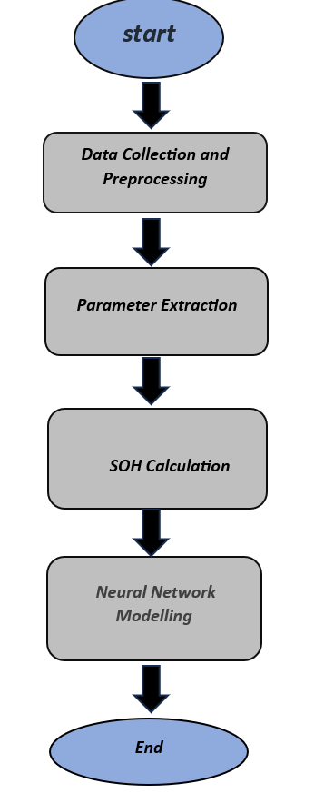
METHODOLOGY
6

Slide 7
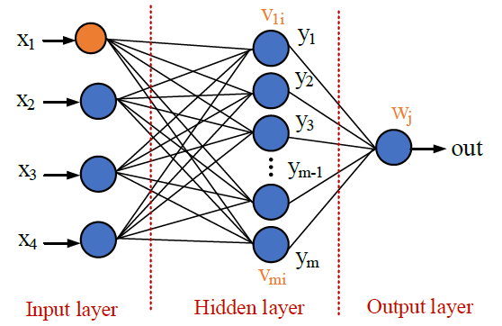
IMPLEMENTATION
3 MODELS
BY GIVING THE 3 INPUTS FOR R0 NN MODEL.
𝑅0𝑒𝑜𝑙. 𝑅0𝑖𝑛𝑖𝑡, 𝑅0𝑎𝑐𝑡
BY GIVING THE 6 INPUTS FOR THE R0+R1 NN MODEL
R0𝑒𝑜𝑙. 𝑅0𝑖𝑛𝑖𝑡, 𝑅0𝑎𝑐𝑡, R1𝑒𝑜𝑙. 𝑅1𝑖𝑛𝑖𝑡, 𝑅1𝑎𝑐𝑡
BY GIVING THE 9 INPUTS FOR THE R0+R1+R2 NN MODEL
R0𝑒𝑜𝑙. 𝑅0𝑖𝑛𝑖𝑡, 𝑅0𝑎𝑐𝑡, R1𝑒𝑜𝑙. 𝑅1𝑖𝑛𝑖𝑡, 𝑅1𝑎𝑐𝑡,R2eol.R2act,R2init
This structured methodology provided a comprehensive approach to estimating SOH using resistance parameters and neural network modeling, contributing to improved accuracy in battery health prediction.

Slide 8
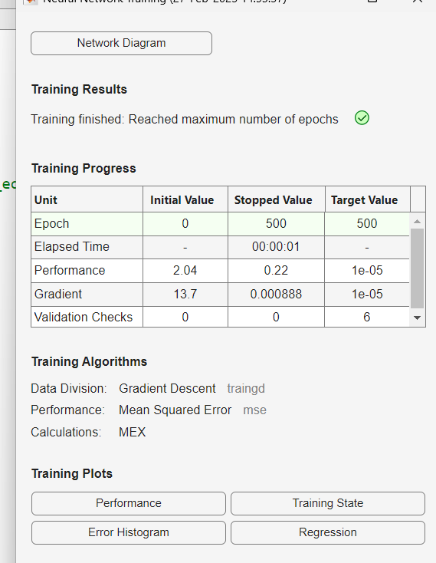
RESULTS
1.) Training and Convergence
The model was trained using the Gradient Descent algorithm (TRAINGD) with Mean Squared Error (MSE) as the performance metric. The training process was conducted for 500 epochs, and the network demonstrated good convergence behavior, as shown in
This figure illustrates the decreasing trend of the MSE throughout the training process, indicating effective learning and optimization.
8

Slide 9
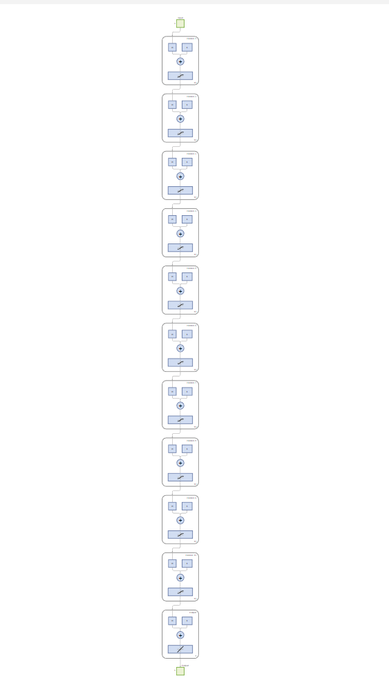
2.) Feed-Forward Network Output
)
This result showcases the model's ability to accurately generalize and predict the R0 parameter.
9

Slide 10
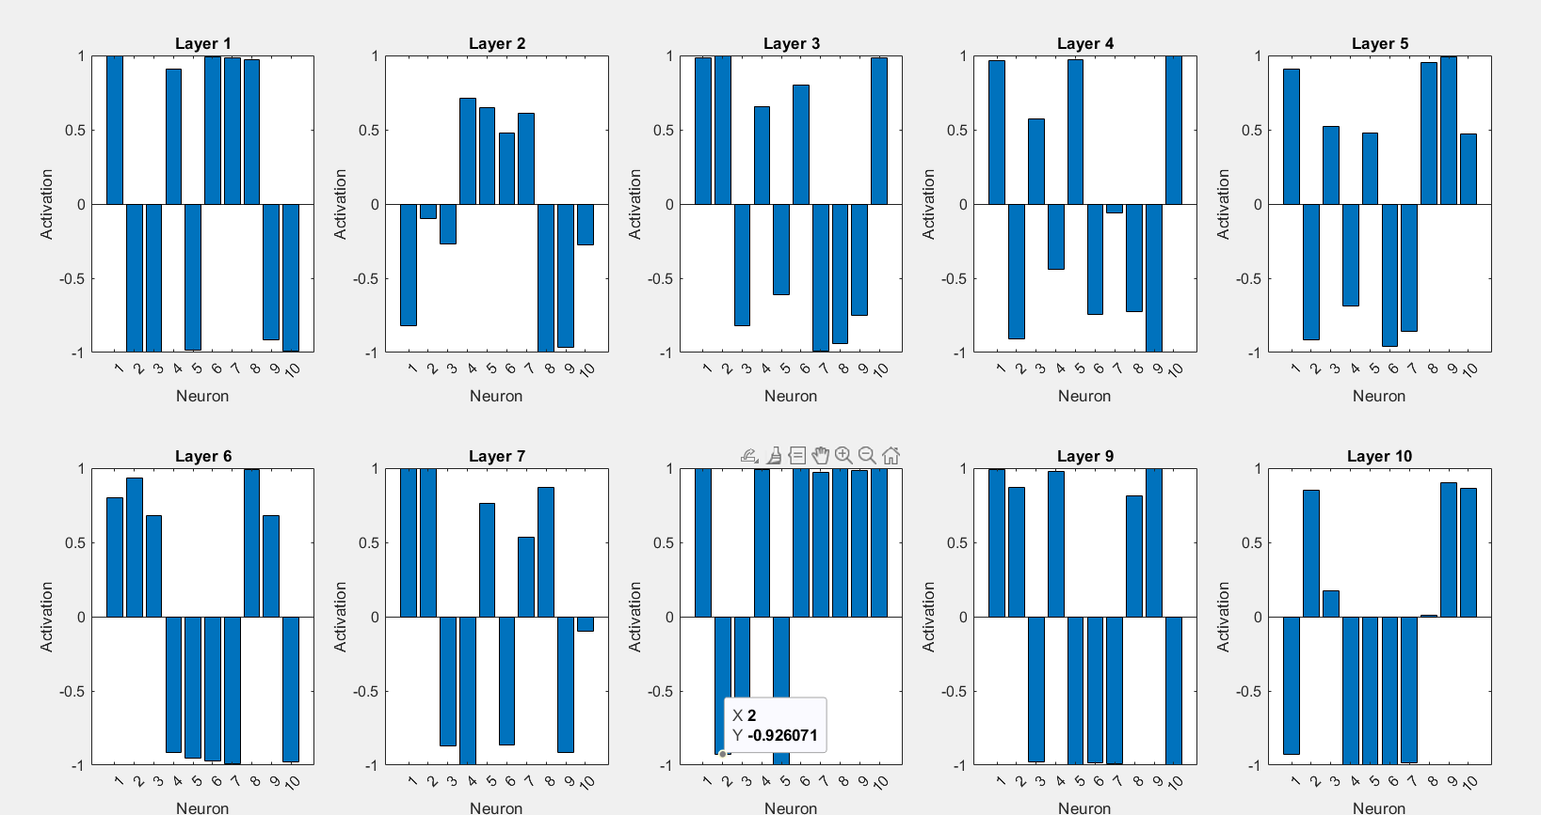
3.) Impact of Network Architecture
The performance of the network was also analyzed based on the hidden layer configuration
This architecture was found to be optimal for the R0 parameter prediction, ensuring a balance between model complexity and performance.
10

Slide 11
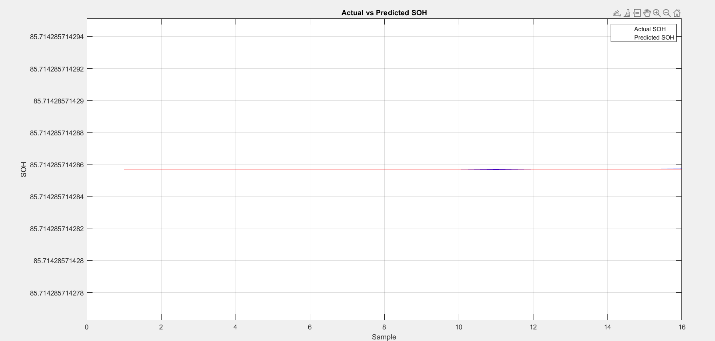
To validate the accuracy of the model, the predicted values were compared with the actual measured values
4.) Comparison of Predicted and Actual Value
The graph shows a close alignment between the predicted and actual values, confirming the model's effectiveness. The minimal deviation between the two curves indicates high prediction accuracy
11

Slide 12
Credits
We would like to convey our deepest gratitude to Dr. Gregory Plett, University of Colorado for the datasets provided as a part of Coursera training course.

Slide 13
Conclusion
This study presents an effective method for estimating the State of Health (SoH) of Li-ion batteries using Equivalent Circuit Model (ECM) parameters and Backpropagation Neural Networks. By leveraging key parameters (R0, R1, R2, C1, and C2), the proposed model achieves high prediction accuracy, capturing complex battery behaviors. This approach enhances SoH estimation compared to traditional methods, improving battery reliability and lifespan. The findings demonstrate the potential of integrating neural networks with battery management systems for advanced health monitoring..

Slide 14
THANK YOU
14

