Slide 1

COURSE PROJECT EVALUATION
Binomial Heap
PENDING QUEUE
Delivery Dispatch System:
An Algorithmic Approach to
High-Volume Logistics
BH
AVL Tree
ACTIVE TRACKING
AVL
TEAM
Treap
DRIVER FLEET
TR
Aryan Ballal
612415021
Aditya Lampuse
612415003
Heramb Agashe
612415006
Anush Bhandari
612415024
1

Slide 2
Introduction
PROJECT OVERVIEW
BACKGROUND & MOTIVATION
PROBLEM CONTEXT
1
2
3
  A highly optimized, memory-efficient C++ backend architecture designed to automate and optimize the dispatching of delivery truck fleets and drivers dynamically.
  The rapid boom in e-commerce and on-demand delivery services demands split-second decision-making.
  Standard linear processing approaches are too computationally expensive for real-time logistics.
  As daily order volumes scale into the tens of thousands, traditional queue management bottlenecks the entire supply chain.
  The result is extreme latency and degraded dispatch reliability.
Rapid volume scaling
turns traditional queue management into a major bottleneck for modern logistics.
Delivery Dispatch System
2

Slide 3
Problem Statement
THE CORE PROBLEM
TECHNICAL BOTTLENECKS
  Traditional linear data structures (like standard arrays and basic linked lists) cannot efficiently schedule priority orders, track active deliveries, and balance driver workloads simultaneously under peak load conditions.
  Searching for and updating active orders requires O(n) time complexity per operation.
1
  Dynamic merging of queues from multiple distribution hubs is mathematically inefficient, blocking main execution threads.
2
BUSINESS IMPACT
  Severe Service Level Agreement (SLA) breaches
  Delayed dispatch times
  Uneven driver exhaustion
  Complete failure to scale during high-traffic intervals
Delivery Dispatch System
3

Slide 4
Aim and Objectives
PROJECT AIM
MEASURABLE OBJECTIVES
  To engineer a centralized, highly optimized C++ dispatch backend by implementing self-balancing algorithmic trees and advanced heap structures to ensure strict O(log n) worst-case bounds.
1
Objective 1 BINOMIAL HEAP
  Implement a Binomial Heap to manage pending orders, enabling O(log n) priority extraction and flawless O(log n) dynamic hub merging.
2
Objective 2 TREAP
  Utilize a Treap (Tree + Heap) to dynamically assign drivers, factoring real-time availability and fatigue scores using Max-Heap properties.
O(log n)
3
Objective 3 AVL TREE
strict worst-case bound
  Maintain an AVL Tree for active deliveries, providing strictly balanced O(log n) time complexities for live order tracking and status updates.
Delivery Dispatch System
4

Slide 5









Scope and Requirements
FUNCTIONAL REQUIREMENTS
NON-FUNCTIONAL CONSTRAINT
Ingest orders
Priority 1 (High) to 3 (Low); urgent orders always dispatch first.
Raw C++ pointers only
No STL containers in the core logic, so every node and every O(log n) bound is under our direct control.
Register drivers
Availability score 0-100; the highest score gets the next job.
Operation | Structure | Target
Insert order | Binomial Heap | O(log n)
Extract top order | Binomial Heap | O(log n)
Merge hub queues | Binomial Heap | O(log n)
Find / close order | AVL Tree | O(log n)
Assign driver | Treap | O(log n)
Automate dispatch
Pair best order with best driver, then track it until delivery.
Delivery Dispatch System
1

Slide 6
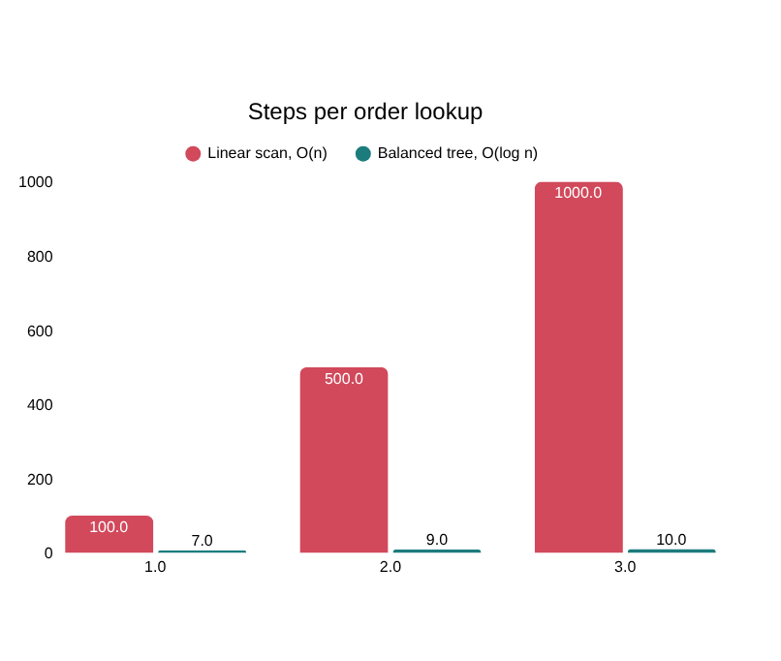





Why Existing Systems Fall Short
COMMON APPROACHES AND THEIR LIMITS
FIFO Queue
No priority: a medical delivery waits behind every earlier order.
Array / Linked List
Searching active orders costs O(n) on every lookup.
Standard BST
Can skew into a straight line, degrading search to O(n).
Binary Heap
Great for priority, but merging two hub queues takes O(n).
Our fix: Binomial Heap + AVL + Treap give O(log n) worst-case guarantees.
Delivery Dispatch System
2

Slide 7











Proposed System: Three Pillars
Binomial Heap
PENDING QUEUE
AVL Tree
ACTIVE TRACKING
Treap
DRIVER FLEET
    Keyed by order priority (1-3)
    Extract-min and hub merge in O(log n)
    Height-balanced, keyed by order ID
    Lookup, insert, complete in O(log n)
    BST on driver ID, max-heap on score
    Best driver found in O(log n)
DISPATCH WORKFLOW
New order enters Binomial Heap
Dispatch: extract-min order
Extract-max driver from Treap
Pair and insert into AVL Tree
Delivered: leaves AVL, driver returns to Treap
Delivery Dispatch System
3

Slide 8





Tools and Technologies
NODE LAYOUT IN RAW C++ (CONCEPTUAL)
BinomialNode
AVLNode
TreapNode
int id, priority;
int degree;
Node *parent, *child;
Node *sibling;
int orderId, driverId;
int height;
Node *left, *right;
int driverId; // BST key
int score; // max-heap
Node *left, *right;
TOOLCHAIN
MEMORY MANAGEMENT
C++17
Language standard
cpp httplib
For REST API integration
iostream
vector for data extraction only
    Nodes allocated with new, freed by destructors
    nullptr guards in every rotation and merge
    No garbage collector: predictable dispatch latency
Delivery Dispatch System
4

Slide 9
Design and Implementation
SYSTEM ARCHITECTURE & WORKFLOW
BH
Binomial Heap
PENDING QUEUE
AVL
AVL Tree
ACTIVE TRACKING
TR
Treap
DRIVER FLEET
  Handles incoming tasks grouped by urgency levels.
  Self-balancing state machine for instantly locating moving targets.
  Dual-property logic: Driver ID as BST key, Availability Score as Heap priority.
CORE IMPLEMENTATION DETAILS
  Custom Rotation Mechanics: Engineered Left-Left, Right-Right, Left-Right, and Right-Left node rotations entirely from scratch to maintain strict tree heights.
  Algorithmic Merging: Developed complex sibling-pointer logic for the Binomial Heap, allowing the union of multiple trees of equal degrees without memory fragmentation.
  Pointer Lifecycle: Implemented explicit pointer allocation and deallocation (new/delete) with rigorous nullptr guarding to eliminate memory leaks during node transfer.
Delivery Dispatch System
9

Slide 10
Results and Testing
TESTING PARAMETERS & OUTCOMES
KEY TEST CASES VERIFIED
  Stress-tested the C++ backend by injecting massive datasets of virtual nodes (drivers, high-priority orders).
TC-01
  Priority Queue: Extract-Min operation consistently retrieved the highest-priority medical/urgent order accurately.
1
  System successfully sustained zero memory leaks and prevented all segmentation faults during complex multi-node tree rotations.
TC-02
  Edge Case Handling: System gracefully aborted dispatch and threw appropriate internal flags when the Treap driver pool was artificially emptied.
2
TC-03
  State Migration: Validated that completing an AVL active order flawlessly removed the node and re-inserted the associated driver back into the Treap with a newly randomized fatigue score.
  Algorithmic bounds of O(log n) were mathematically and practically verified across all primary operations.
3
Delivery Dispatch System
10

Slide 11
Individual Contribution
1
Student 1
PRIORITY QUEUE ENGINEERING
2
Student 2
TRACKING & BALANCING
  Engineered the Binomial Heap for priority queuing and dynamic hub merging. Defined core struct models (Order/Driver).
  Implemented the AVL Tree and designed the strict node-balancing mathematical rotation algorithms.
3
Student 3
DRIVER FLEET LOGIC
4
Student 4
SYSTEM INTEGRATION
  Developed the Treap data structure, successfully mapping Driver IDs to BSTs while managing availability via Max-Heap rules.
  Built the overarching DispatchSystem controller. Managed data extraction vectors, integrated the REST API via cpp-httplib, and handled cross-structure memory routing.
Delivery Dispatch System
11

Slide 12
Challenges and Limitations
TECHNICAL CHALLENGES OVERCOME
CURRENT SYSTEM LIMITATIONS
1
Pointer Arithmetic
In-Memory Volatility
  Debugging catastrophic segmentation faults caused by missing nullptr checks during complex Left-Right AVL rotations.
  The system currently operates entirely within local RAM. If the C++ server crashes, active tracking states and pending queues are lost.
2
Heap Integrity
  Ensuring the Binomial Heap union function correctly mapped node degrees without accidentally overwriting child or sibling pointers.
Thread Safety
  Backend currently relies on sequential processing; concurrent multithreading for simultaneous regional dispatches is not yet supported.
3
Dynamic Rebalancing
  Maintaining Max-Heap properties dynamically in the Treap when a driver’s score naturally depletes or regenerates.
Delivery Dispatch System
12

Slide 13
Conclusion and Future Scope
CONCLUSION
FUTURE EXTENSIONS
  Successfully proved that replacing standard linear structures with advanced algorithmic trees (Binomial Heap, AVL, Treap) drastically reduces computational overhead for complex logistics routing.
  All initial objectives for O(log n) performance bounds were met and exceeded in localized testing.
DB
Persistent Storage
  Bridging the C++ backend to a robust relational database (e.g., PostgreSQL or MySQL) for crash recovery and state persistence.
UI
Web Dashboard Integration
  Finalizing a React/Vite frontend dashboard with real-time Axios polling for visual dispatch management.
3 / 3
MT
Concurrency
  Introducing standard <thread> libraries to handle simultaneous API requests globally.
objectives achieved
Delivery Dispatch System
13

Slide 14
References
CORE ALGORITHMIC TEXTS
TECHNICAL DOCUMENTATION
  Cormen, T. H., Leiserson, C. E., Rivest, R. L., & Stein, C. (2009). Introduction to Algorithms (3rd Edition). MIT Press.
  C++ Reference Documentation (cppreference.com) for memory management and standard library limits.
  Documentation for nlohmann/json and cpp-httplib for REST API serialization constraints.
Delivery Dispatch System
14

Slide 15
Questions
Questions
THANK YOU!
Q
Technical discussion
TD
We are now open for questions, technical discussion, and code review.
Code review
CR
Delivery Dispatch System
15

