Slide 1

SMART INDIA HACKATHON 2026
TITLE PAGE
Problem Statement ID- SIH26018
Problem Statement Title- Intelligent Land Record Digitization and Validation System
Theme- Smart Automation
PS Category- Software
Team ID-
Team Name- PrithviX

Slide 2
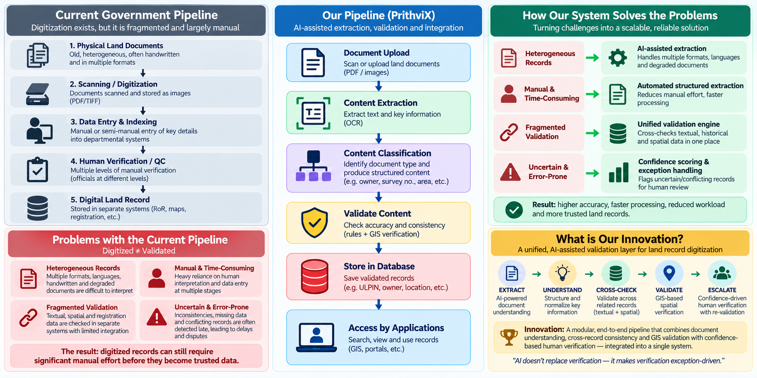
Intelligent Land Record Digitization and Validation System
PrithviX

Slide 3
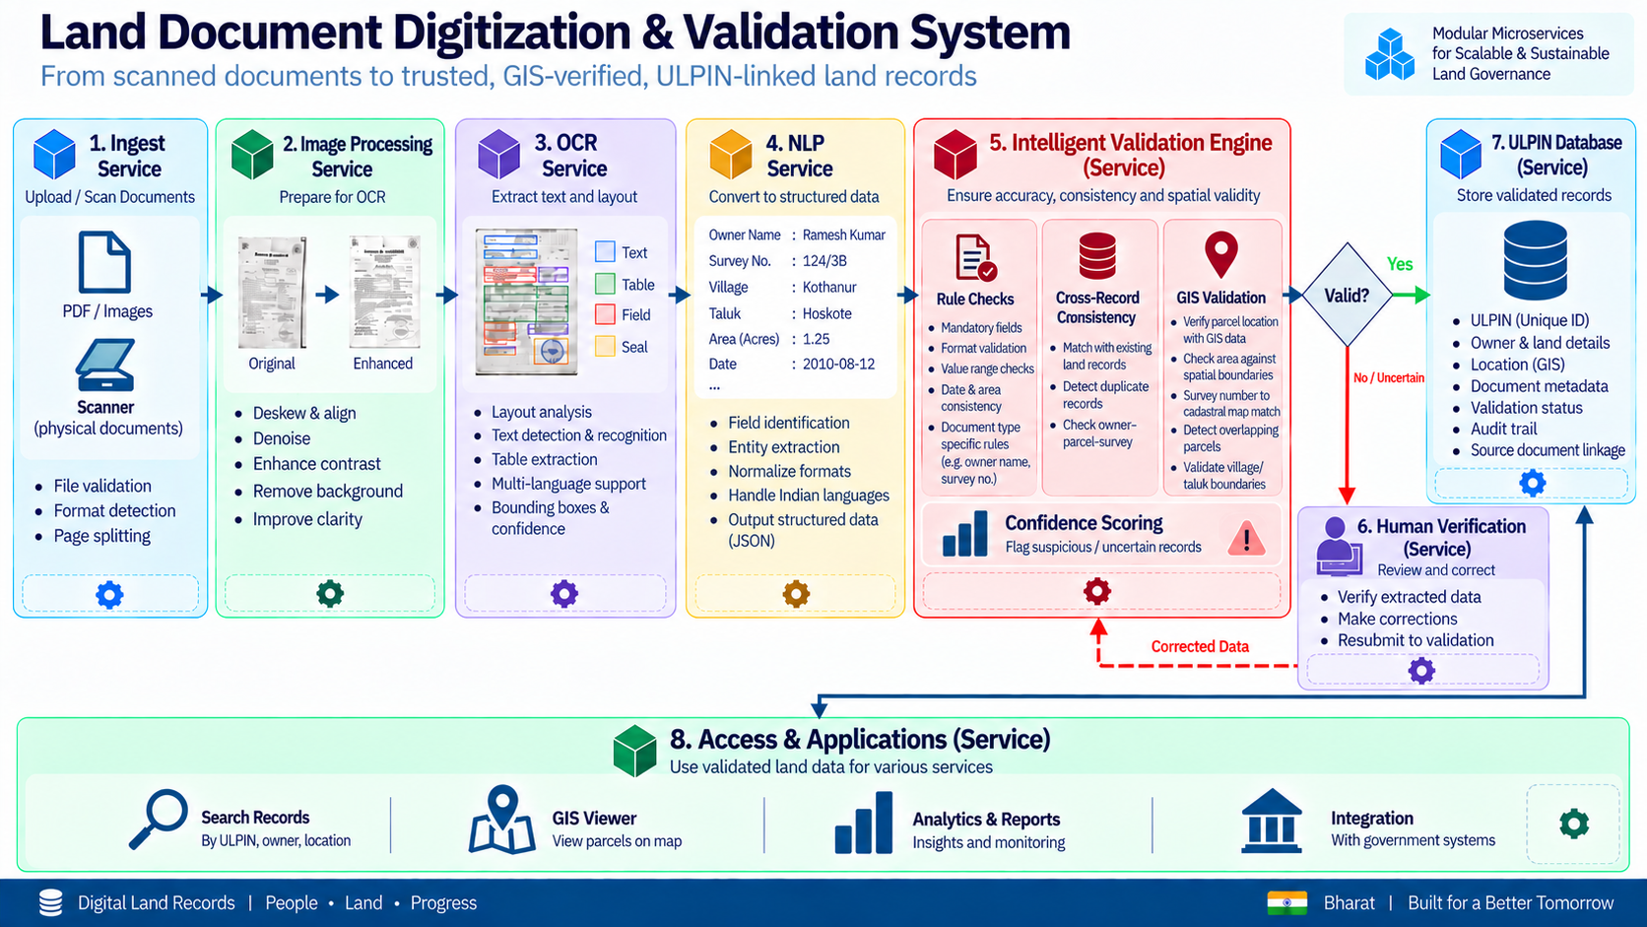
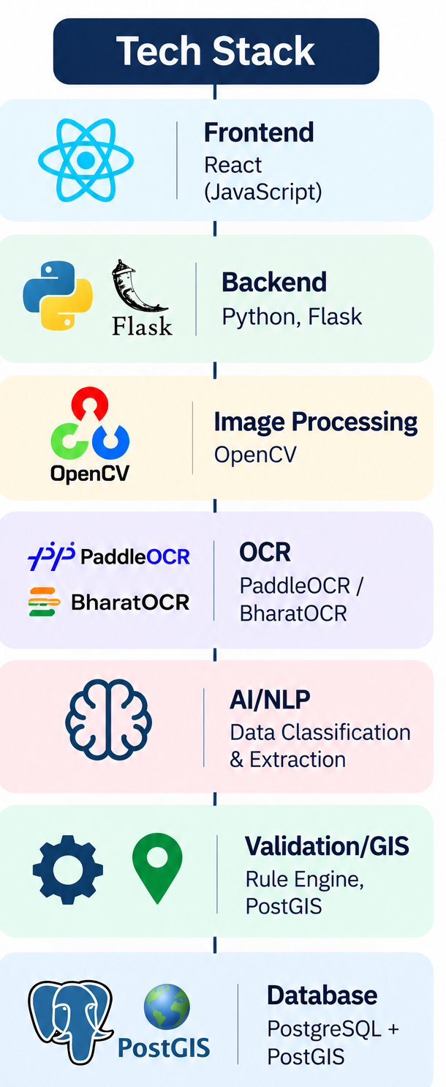
TECHNICAL APPROACH
PrithviX

Slide 4
FEASIBILITY AND VIABILITY
PrithviX
Analysis of
Feasibility
The proposed system uses mature technologies for OCR, document pre processing, NLP, GIS and database management. Its modular micro service architecture allows ingestion, extraction, classification, validation and storage to be independently developed, tested and scaled.
Existing government land-record initiatives such as DILRMP provide a practical ecosystem for future integration.
Potential Challenges & Risks
Legacy documents may be poor-quality and damaged, handwritten, multilingual, or inconsistently - formatted, which can reduce extraction accuracy.
Conflicting land information may also make automated - validation difficult, while large-scale digitization can increase processing and human-review requirements.
Strategies for Overcoming Challenges
Image pre processing can improve OCR quality, while AI-based classification combined with rule based and GIS validation can detect inconsistencies. Low confidence records can be routed for human verification.
The modular micro-service architecture allows individual components to be improved or scaled without redesigning the entire system.

Slide 5
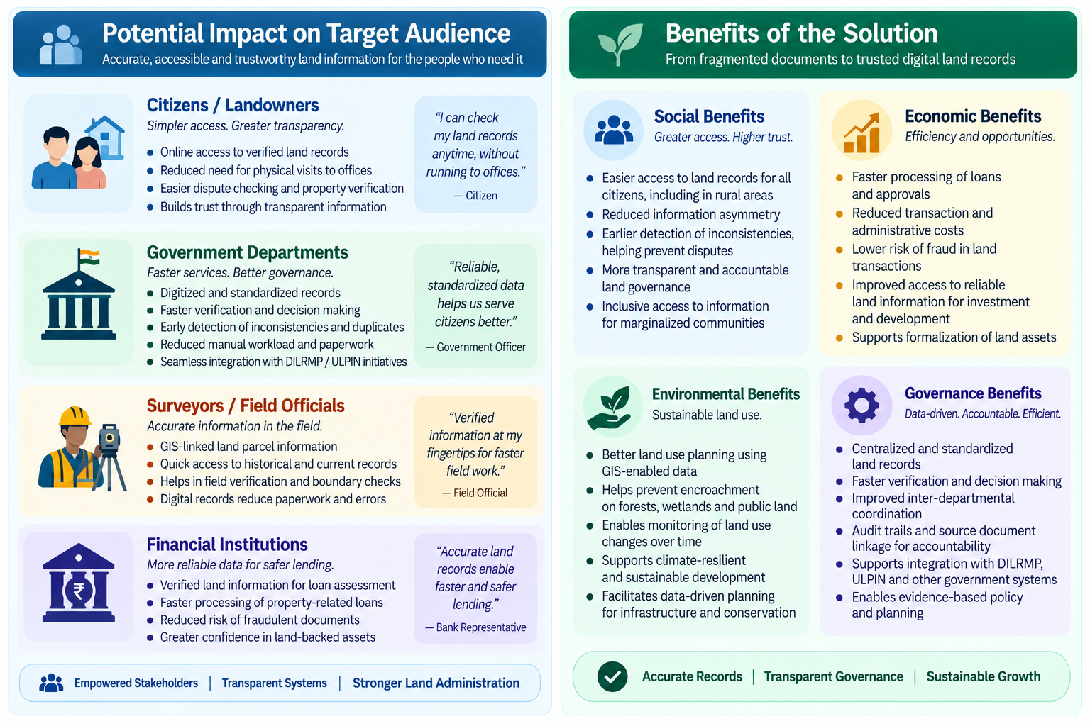
IMPACT AND BENEFITS
PrithviX

Slide 6
RESEARCH AND REFERENCES
PrithviX
Digital India Land Records Modernization Programme (DILRMP) dolr.gov.in/en/document-category/program-dilrmp
DILRMP MIS 4.0 dilrmp.gov.in
DILRMP 3.0 Operational Guidelines (2026–2031) cdnbbsr.s3waas.gov.in/s3d69116f8b0140cdeb1f99a4d5096ffe4/uploads/2026/08/20260827600317271.pdf
ULPIN / Bhu-Aadhaar Press relese www.pib.gov.in/Pressreleaseshare.aspx?PRID=1932867&lang=2&reg=48
Paddle OCR www.paddleocr.ai/main/en/index/index.html
Open CV github.com/opencv/opencv

