Slide 1

SMART INDIA HACKATHON 2026
TITLE PAGE
Problem Statement ID- SIH26018
Problem Statement Title-
Intelligent Land Record Digitization and Validation System
Theme- Smart Automation
PS Category- Software
Team ID-
Team Name- PrithviX

Slide 2
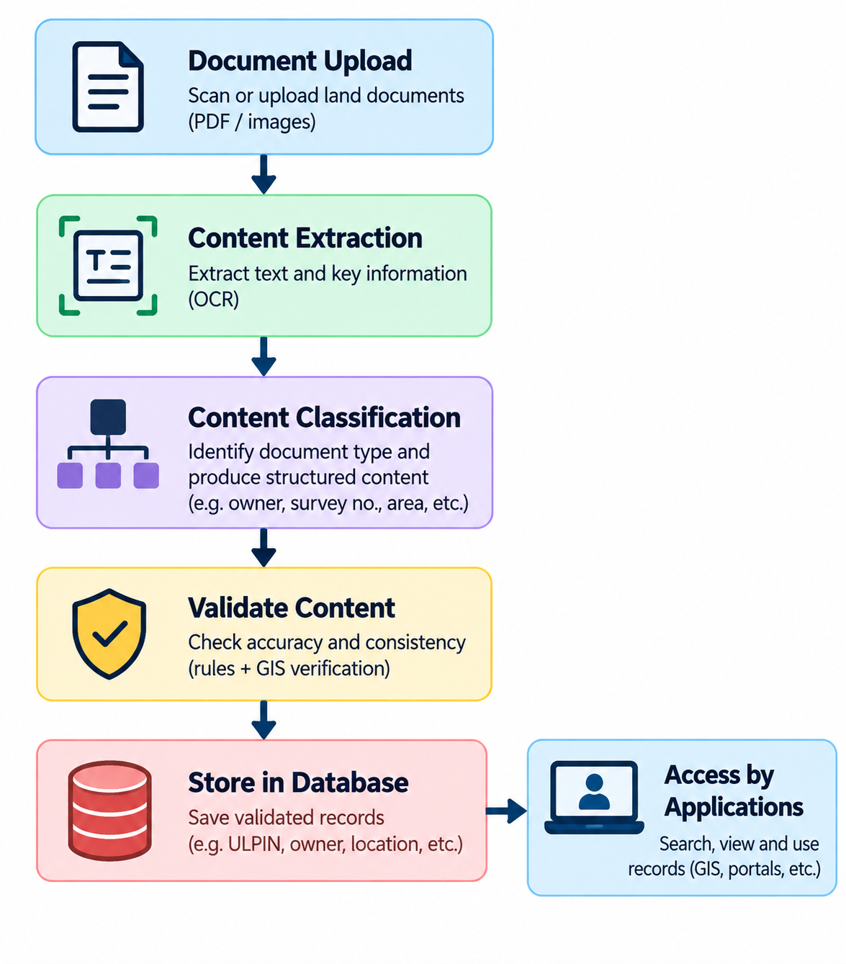
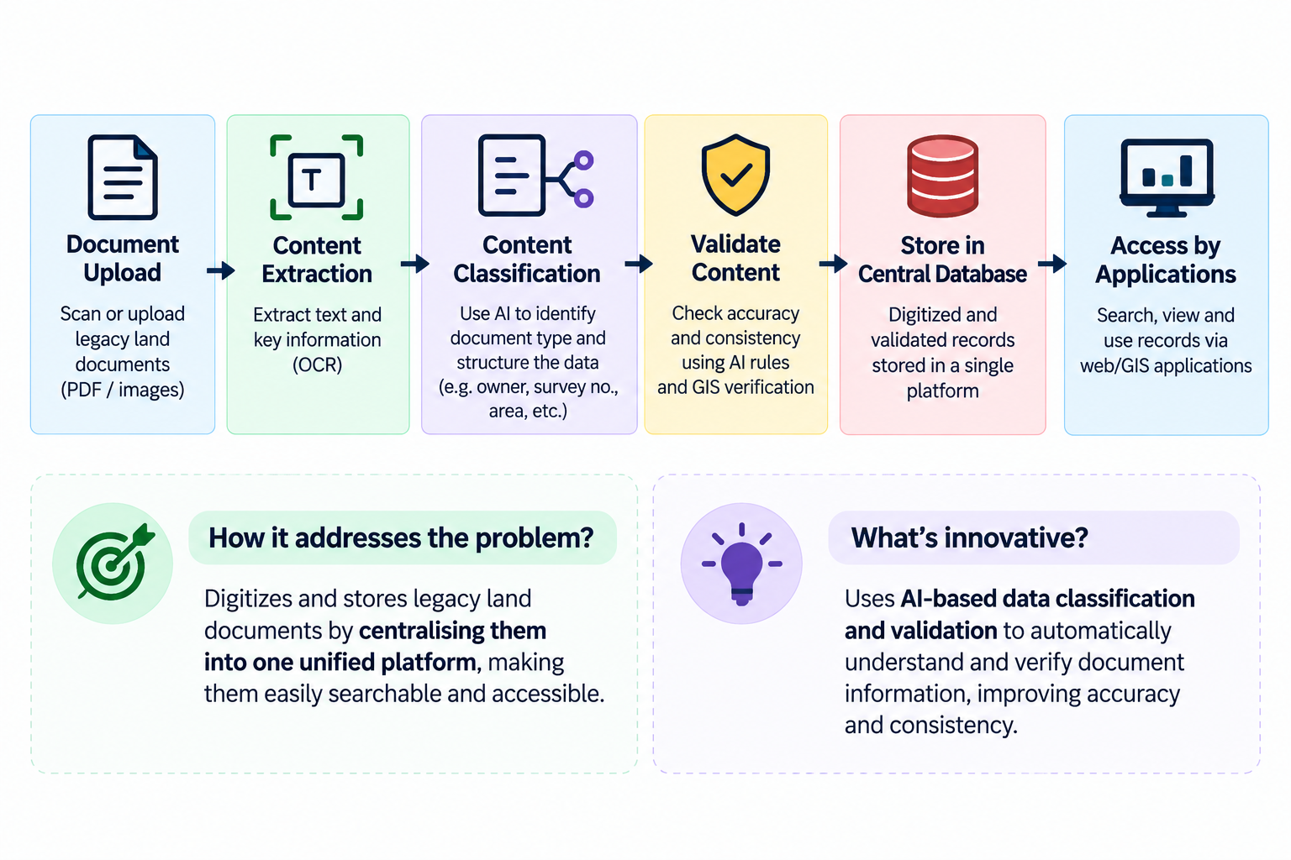
Intelligent Land Record Digitization and Validation System
PrithviX

Slide 3
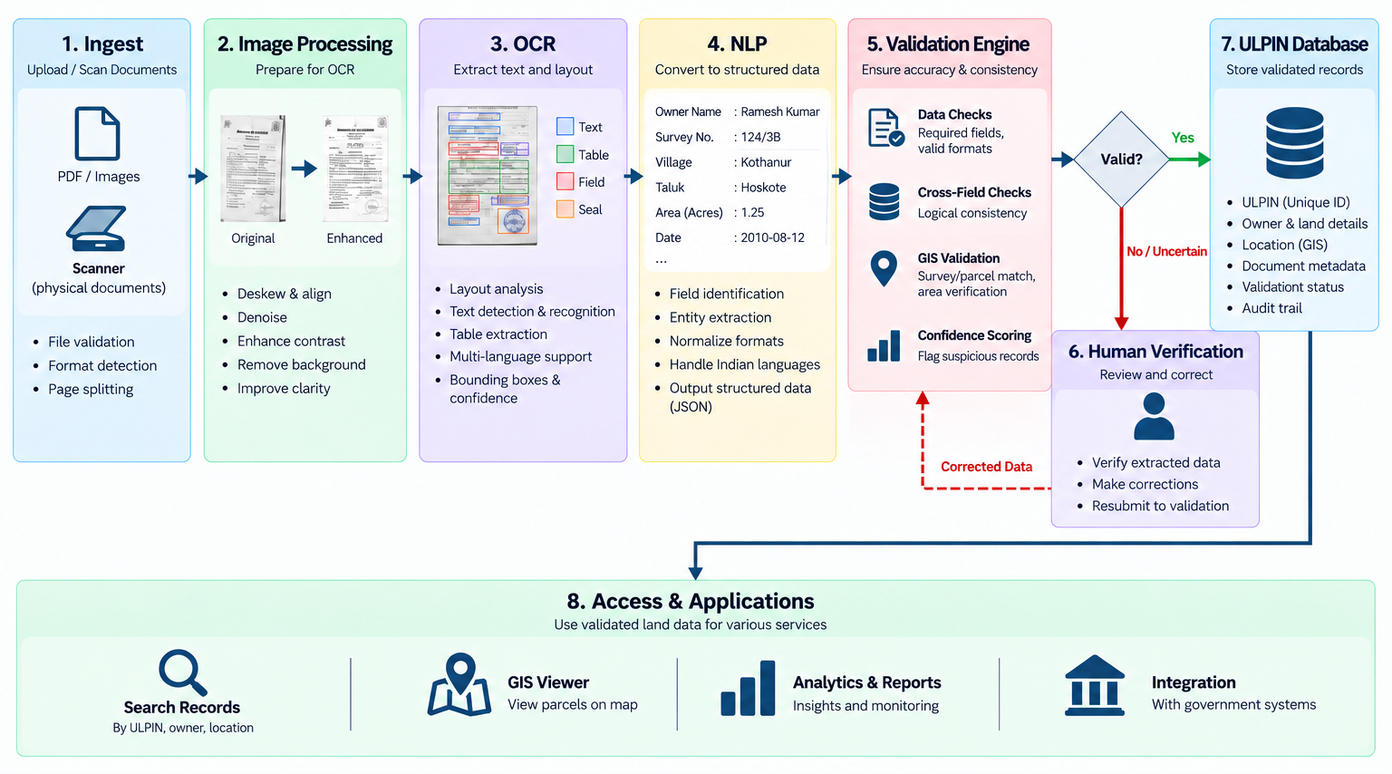
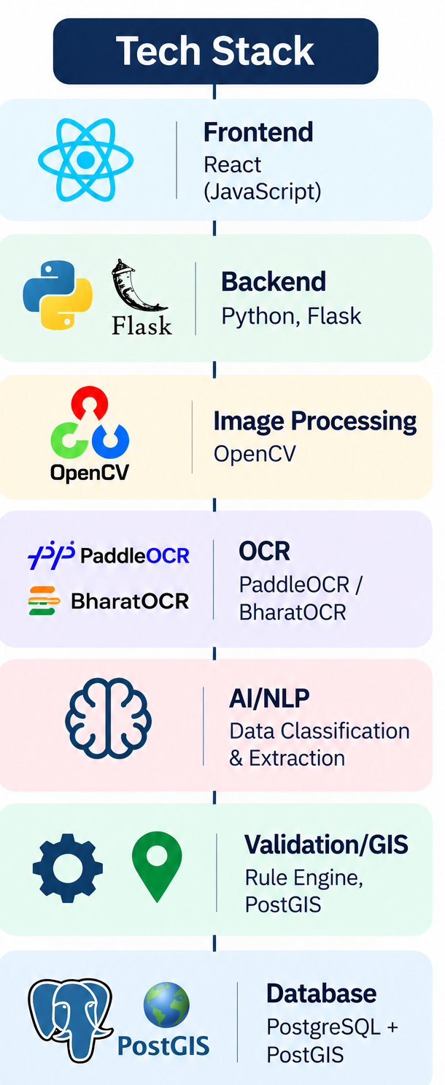
TECHNICAL APPROACH
PrithviX

Slide 4
FEASIBILITY AND VIABILITY
PrithviX
Analysis of Feasibility
The solution is technically feasible using established technologies such as OCR, AI/NLP, image processing, GIS, and centralized databases. Its modular pipeline allows document processing, extraction, classification, validation, and storage to be developed and tested independently.
Potential Challenges & Risks
Legacy documents may be poor-quality, damaged, handwritten, multilingual, or inconsistently formatted, which can reduce extraction accuracy. Conflicting land information may also make automated validation difficult, while large-scale digitization can increase processing and human-review requirements.
Strategies for Overcoming Challenges
Image pre processing can improve OCR quality, while AI-based classification combined with rule-based and GIS validation can detect inconsistencies. Low-confidence records can be routed for human verification, and the modular architecture allows individual components to be improved or scaled without redesigning the entire system.

Slide 5
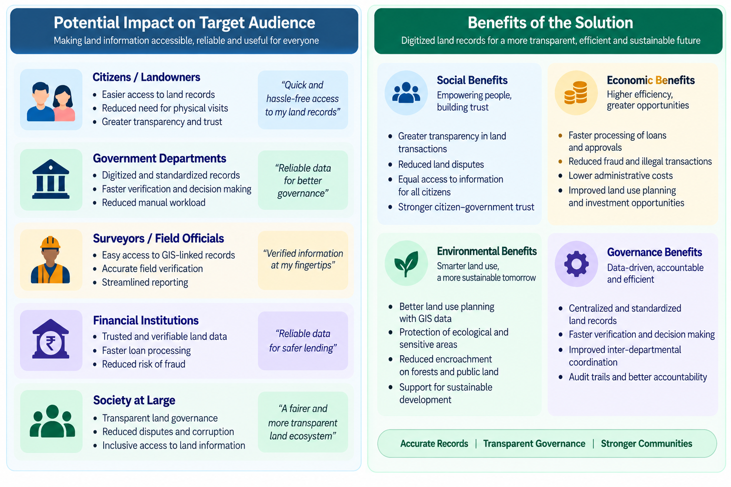
IMPACT AND BENEFITS
PrithviX

Slide 6
RESEARCH AND REFERENCES
PrithviX
Digital India Land Records Modernization Programme (DILRMP) dolr.gov.in/en/document-category/program-dilrmp
DILRMP MIS 4.0 dilrmp.gov.in
DILRMP 3.0 Operational Guidelines (2026–2031) cdnbbsr.s3waas.gov.in/s3d69116f8b0140cdeb1f99a4d5096ffe4/uploads/2026/08/20260827600317271.pdf
ULPIN / Bhu-Aadhaar Press relese www.pib.gov.in/Pressreleaseshare.aspx?PRID=1932867&lang=2&reg=48
Paddle OCR www.paddleocr.ai/main/en/index/index.html
Open CV github.com/opencv/opencv

