Slide 1

Customer Shopping Behavior Analysis
3,900 transactions · 18 features · Python · SQL · Power BI

Slide 2
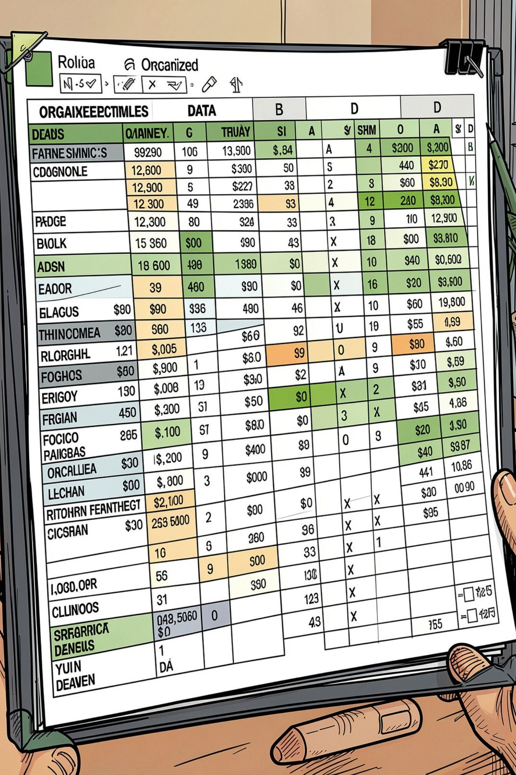
Dataset at a Glance
3,900
18
Transactions
Features
37
Missing Values
Review Rating only
Demographics, purchase details, and shopping behavior across 4 product categories.

Slide 3

Data Preparation in Python
01
Load & Explore
pandas: df.info(), .describe()
02
Clean
Imputed missing Review Ratings by category median
03
Engineer
Created age_group & purchase_frequency_days
04
Load to DB
Exported cleaned DataFrame to PostgreSQL

Slide 4
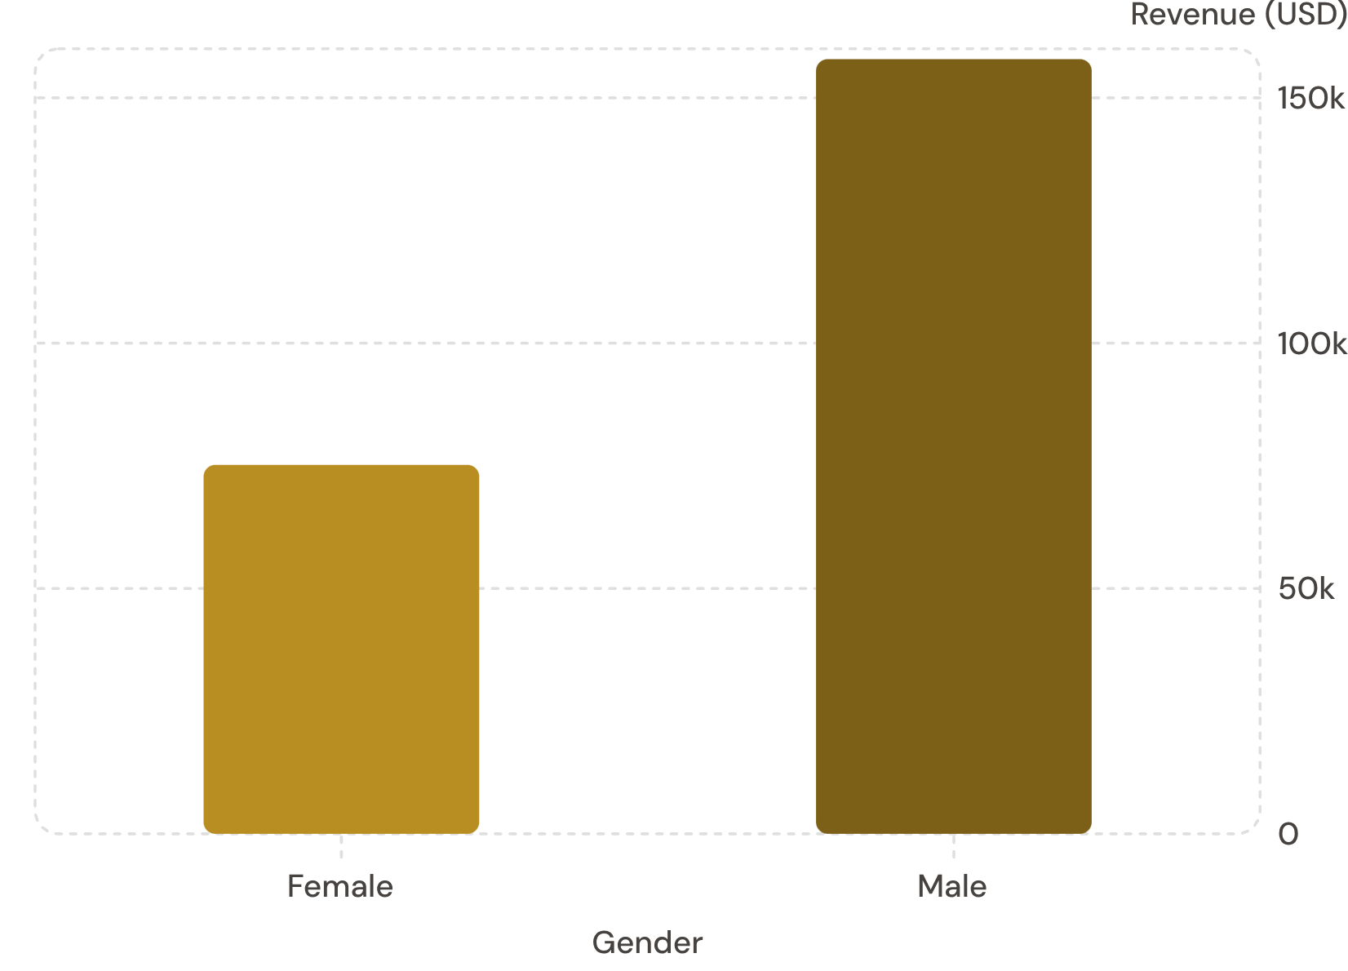
Revenue by Gender
Key Insight
Male customers generated 2.1× more revenue than female customers across 3,900 transactions.
Male
Female
$157,890 · 2,652 customers
$75,191 · 1,248 customers

Slide 5
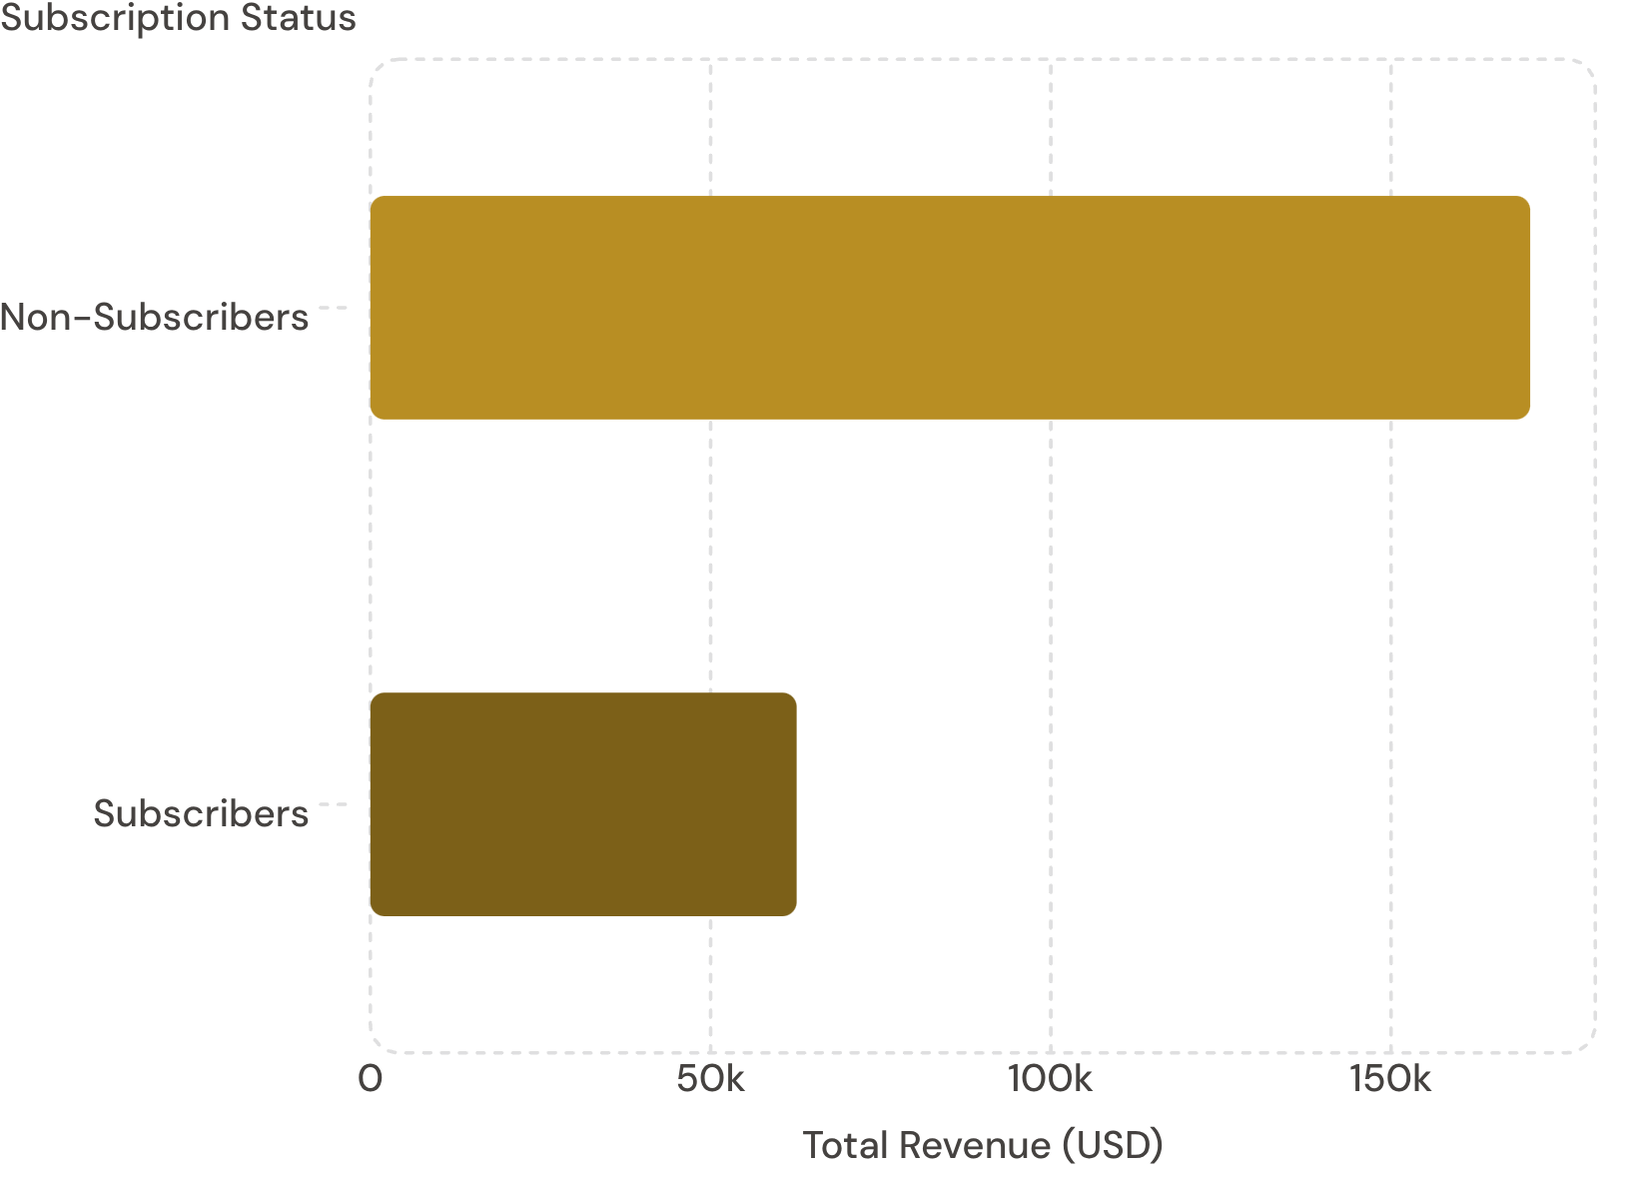
Subscribers vs. Non-Subscribers
Subscription Gap
Only 27% of customers subscribe — yet average spend is nearly identical.
Non-Subscribers
Subscribers
2,847 customers · $59.87 avg
1,053 customers · $59.49 avg

Slide 6
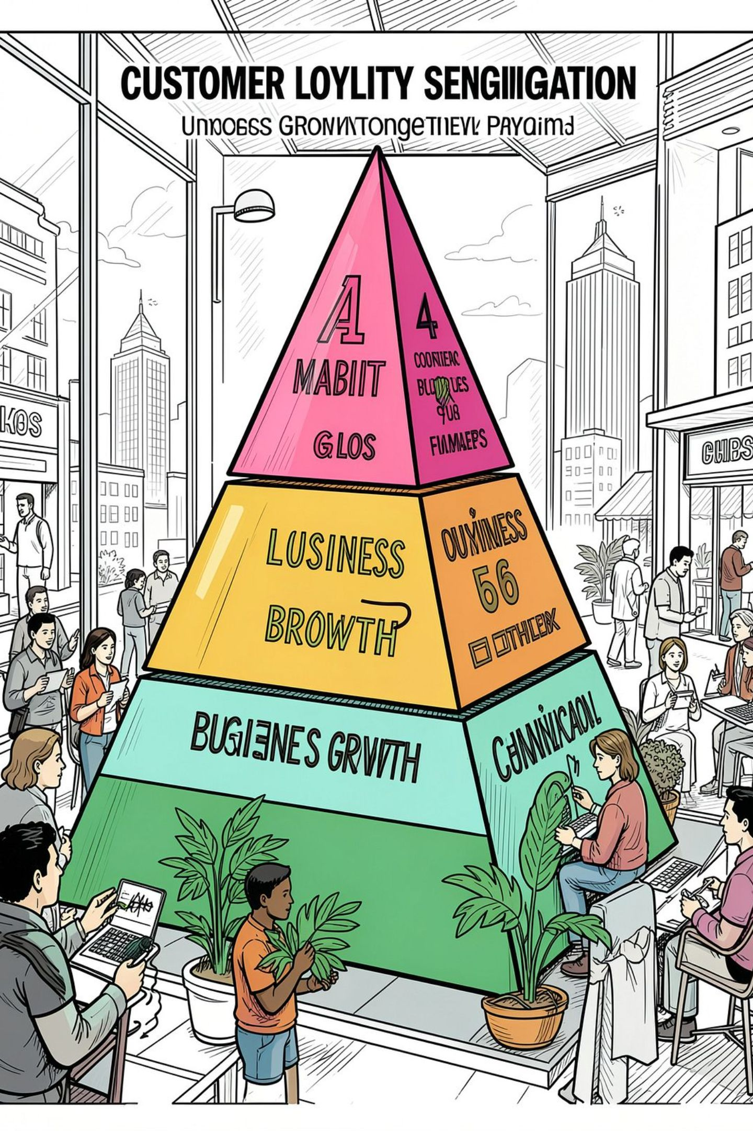
Customer Segmentation
🏆 Loyal
🔄 Returning
3,116 customers
701 customers
🆕 New
83 customers
958 repeat buyers (>5 purchases) subscribe; 2,518 do not — a clear upsell opportunity.

Slide 7
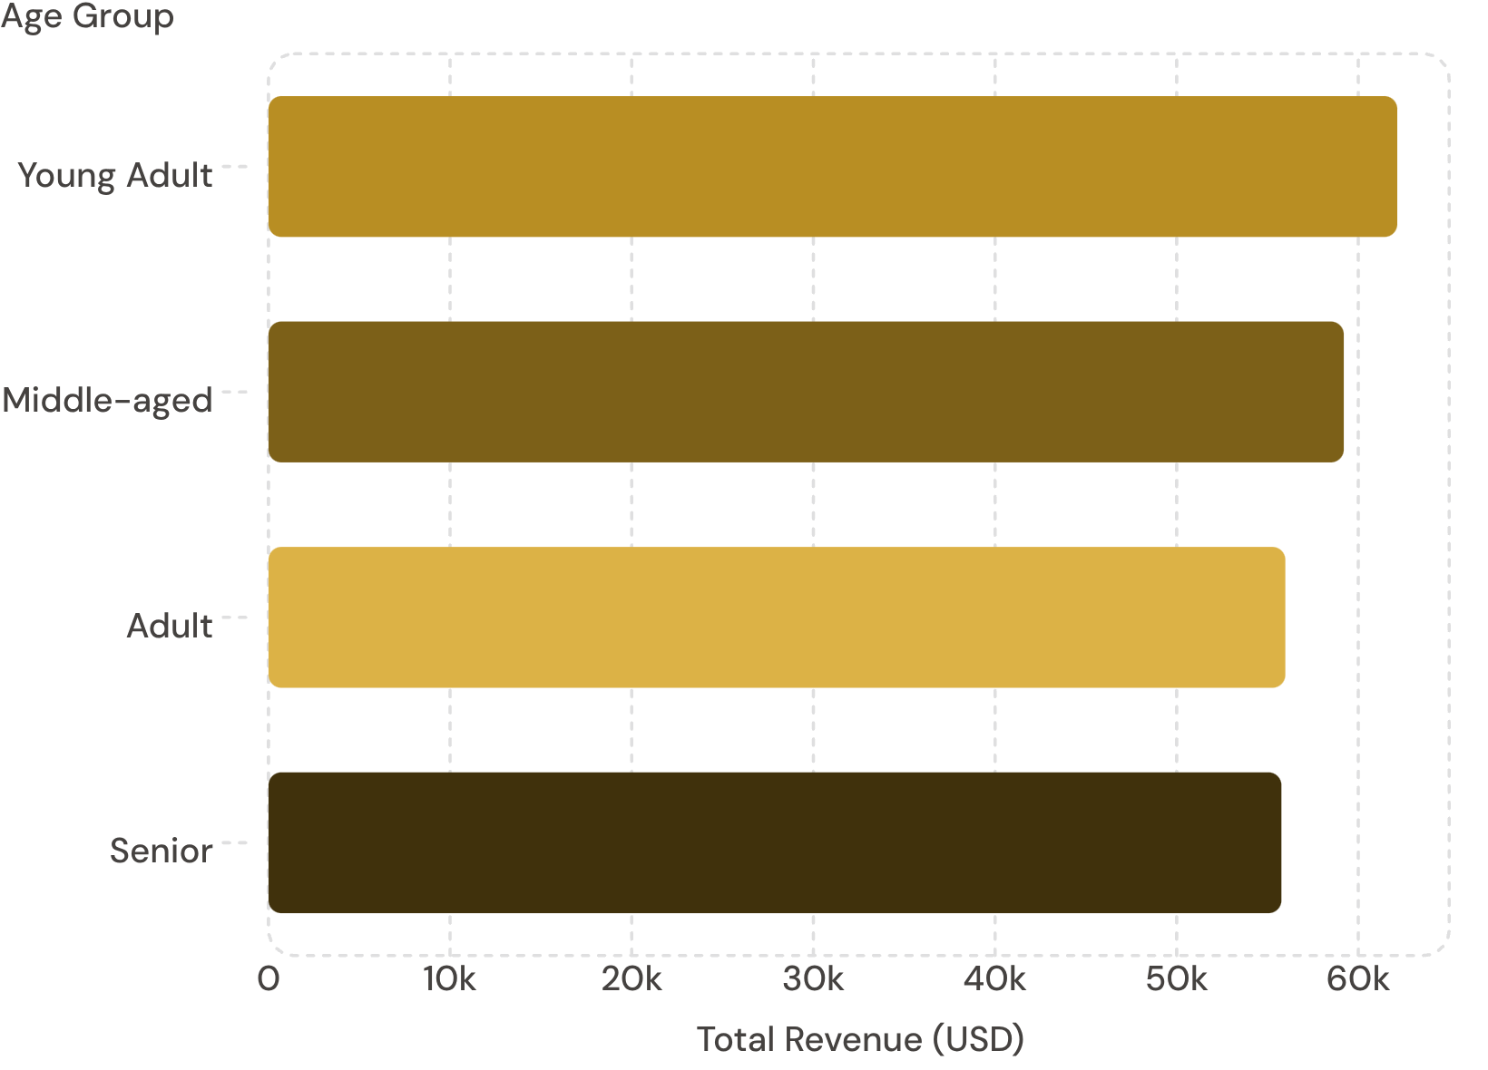

Revenue by Age Group
Even Spread
Revenue is relatively balanced across age groups. Young Adults lead slightly at $62K.
Average customer age: 44 years (range 18–70)

Slide 8
Top Products & Discount Dependency
Top 5 by Rating
Most Discount-Dependent
Product | Avg Rating
Gloves | 3.86
Sandals | 3.84
Boots | 3.82
Hat | 3.80
Skirt | 3.78
Product | Discount Rate
Hat | 50.00%
Sneakers | 49.66%
Coat | 49.07%
Sweater | 48.17%
Pants | 47.37%

Slide 9
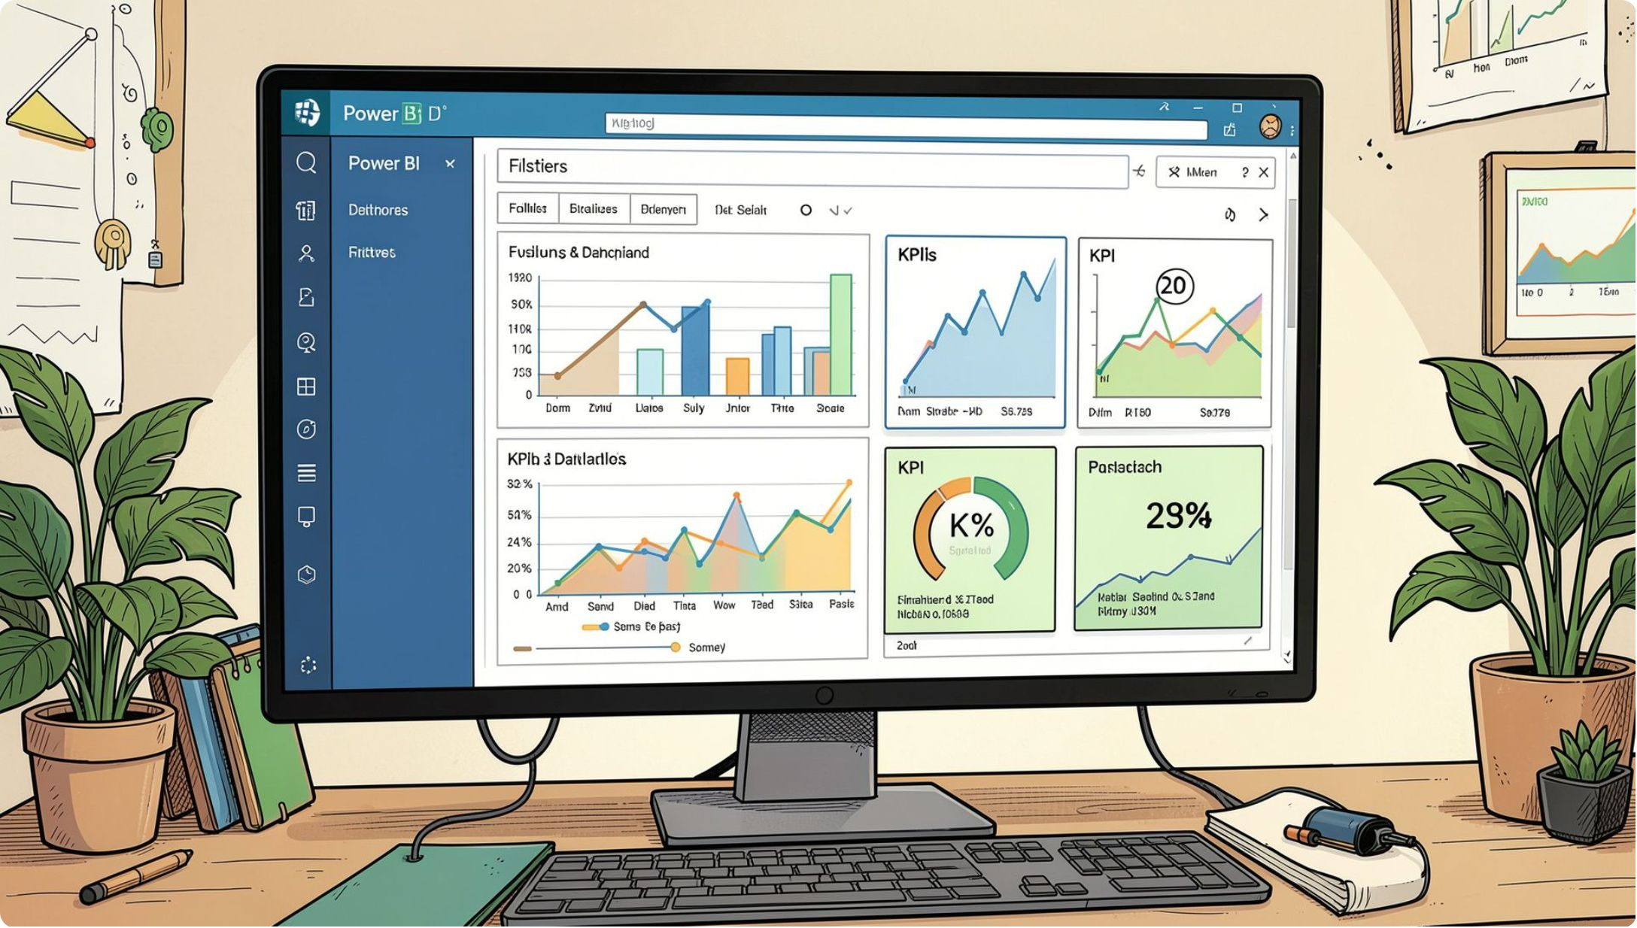

Power BI Dashboard
Dashboard Highlights
3.9K customers · Avg spend $59.76 · Avg rating 3.75
Clothing leads revenue at $100K; Outerwear trails at $20K
Filters: Subscription, Gender, Category, Shipping Type

Slide 10





Business Recommendations
Boost Subscriptions
Promote exclusive subscriber benefits
Loyalty Programs
Reward repeat buyers toward "Loyal" segment
Review Discount Policy
Balance sales lift with margin control
Targeted Marketing
Focus on high-revenue age groups & express-shipping users

