Slide 1

MORSE CODE TRANSLATOR
SUBMITTED By: -
SUBMITTED To: -
Kushal Anjana Sagar Pande Sir
REG. NO: 11809796
Anushil Sharma Section: - K18pv
REG. NO: 11809795

Slide 2
Introduction
Morse code is a method of transmitting string information into a series of dots[.] and dashes[-] encrypting a message between two entities and so making communication possible between two parties.

Slide 3
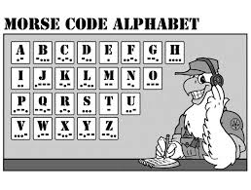

Slide 4
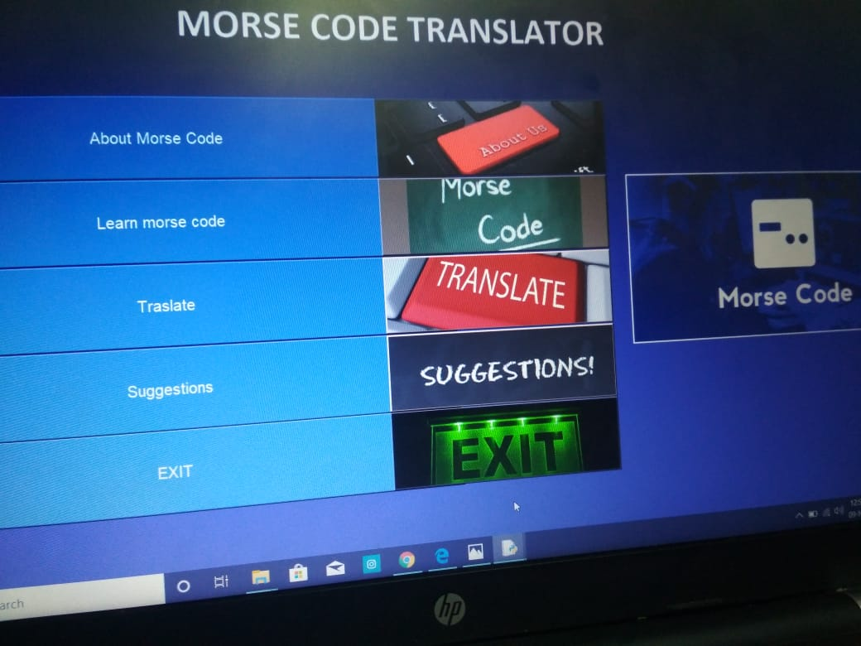

Slide 5
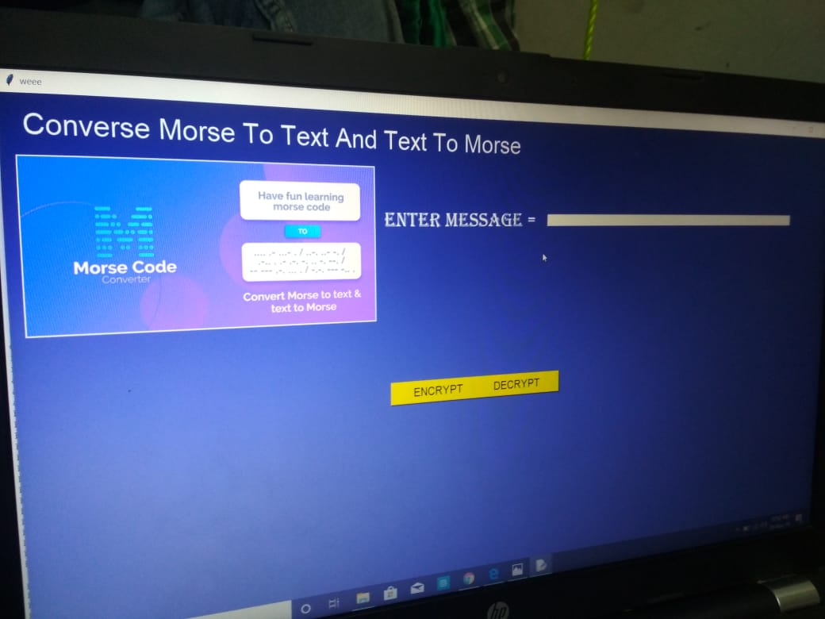

Slide 6
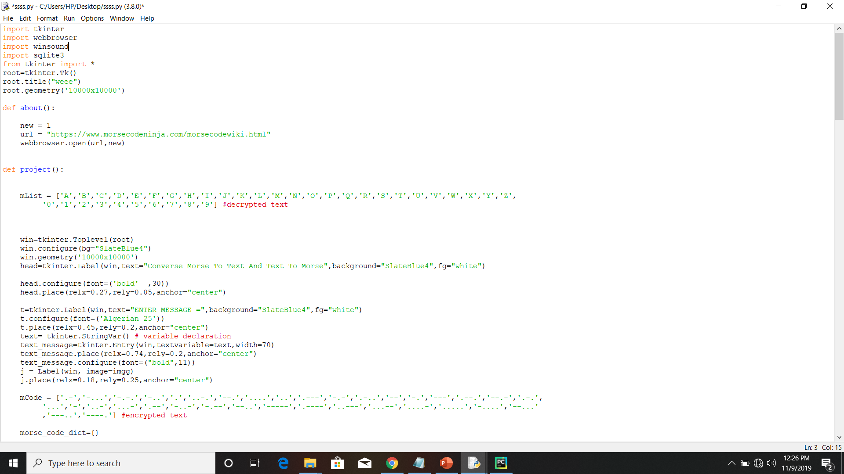

Slide 7
