Slide 1
A
PROJECT REPORT BASED ON
NETWORK TRAFFIC ANALYSIS USING PYTHON
Submitted To
SAVITRIBAI PHULE UNIVERSITY PUNE.
FOR THE PARTIAL FULLFILLMENT OF BACHELOR OF COMPUTER SCIENCE (BCS, SEM-VI 2022-23)
BY
MISS.ANITA BHIKAJI SHINDE
MISS.AKSHADA SHRIKANT CHAURE
UNDER THE GUIDANCE OF PROF.PATADE MAM
THROUGH HOD
PROF.SURAJ GAIKWAD SIR

Slide 2
ACKNOWLEDGEMENT
The project titled “NETWORK TRAFFIC ANALYSIS USING PYTHON” would not have been possible to bring this work to a successful completion without support and guidance of our respectful teachers.
We would like to specially thank Head of Computer Science Dept. our teacher Prof. for timely help
and encouragement of fulfilling of project work.
Finally, we gratefully acknowledge the help provided the Department Of Computer Science at various stages of development of the project. We are also thankful to all our friends for their help and suggestions in completing our project.
“When we start a journey towards something worth while “It’s never a simple trail nor easy mile,
But we often move on without looking back,
Due to all the people who helped & put us on the track.”
With Regards….

Slide 3
INDEX
Average day Traffic Analysis
Source IP Utilizations[SIP]
Top 50 Source Bytes
Top 50 Source Connections
Top 50 Source Durations
Destination IP Utilizations[DIP]
Top 50 Destination Bytes
Top 50 Destination Connections
Top 50 Destination Durations
Top Events Traffic Analysis - Timeline

Slide 4
INTRODUCTION
Network security, also referred to as information technology security, focuses on protecting computers, networks, programs, and data from understand or unauthorized access, change, or destruction.
Government agencies, the military, corporations, financial institutions, hospitals, and other groups collect, process, and store a great deal of confidential information on computers and transmit that data across networks to other computers. With the growing volume and sophistication of
cyber attacks, ongoing attention is required to protect sensitive business and personal information,
as well as safeguard national security.
The term network security is used to refer to the security offered through on-line services to protect your online information.
With an increasing amount of people getting connected to Internet, the security threats that
cause massive harm are increasing also.

Slide 5
FUTURE AND SCOPE
Today we are going to face to 21st Century. Since, all the activities and operations are perform on manually. In the future cybersecurity will be a top priority for every company, and the cybersecurity industry is expected to grow by 44% in the next five years. As the industry grows, it will require more professionals and companies to hire cybersecurity professionals.
Progress in cybersecurity, but access must be widened. Public and private investments in security technologies, as well as broader efforts to tackle cybercrime, defend critical infrastructure, and raise public awareness about cybersecurity, are likely to reap tangible payoffs by 2030.
Scope :-
More than 1 million cyber security jobs will be available by 2023, but less than 400,000 cybersecurity professionals will be trained by then. Cyber security is an ever-growing industry.
It is projected to grow by 11% in 2023 and by 20% in 2025.
By 2025, 60% of organization will use cybersecurity risk as the primary determinant in conducting third party transactions and business relationships.

Slide 6
FACT FINDING TECHNIQUES
While designing the system preliminary investigation is very important and essential one preliminary Investigation part has total base system. Whole building of the investigation of the system is depending upon preliminary investigation.
Following techniques does it:
Observations :
When We observe the proper flow of the system. We got very important information as well
as I understand the current system very well.
Questionaries :
To achieve the information We visited the management staff and they have given me
the answer of my questions, which help me to understand the proper flow of the system.
Record Review :
Also Achieve the information is gathered by reviewing the past and original document, which give clear format, style and recording. So We got clear picture about output document and report format.

Slide 7
OBJECTIVES
The primary goal of network security are Confidentiality, Integrity, and Availability. These three pillars of Network Security are often represented as CIA triangle.
Confidentiality – The function of confidentiality is to protect precious business data from unauthorized.
The main goal of networking is “Resource sharing”, and it is to make all programs, data and equipment available to anyone on the network without the regard to the physical location of the resource and the user. A second goal is to provide high reliability by having alternative sources of supply.
The Identification, Authentication and Access control are the objectives of network security . There is no such thing called lock.
The goal of the network security is to identify and correct any vulnerabilities in the network and ensure that your systems are not secure and will not be compromised.

Slide 8
HARDWARE AND SOFTWARE REQUIREMENT
Hardware Requirements :
Hard Disk 512 GB or above
Processor – Intel 11
RAM - 8GB or above
Software Requirement :
Operating System – Windows 10 or above
Front End – Visual Studio Code 3.MySQL/MySQL Workbench 4.Framework – Flask

Slide 9
SYSTEM DESIGN
1.ENTITY - RELATIONSHIP DIAGRAM
username password
email
username
Firewall logs
Register
Login
username
password
user
configure
Has
password
key _events
manage
Avg _Traffic
Analysis
report
Dashboard
Top _sip
Top _dip

Slide 10
2.Context Level dfd
Data Collection
Data Reporting
Data Cleaning
Data Discretization
Network Traffic Analysis
0.0
Data Transformation
Data Visualization
Data Interpretation
Data Modeling

Slide 11
3. Use case between Admin and Applicant
Login Register
Data Collection
Data Cleaning Data
Transformation
Data Visualization
Data Modeling
-
Data Interpretation
Applicants
Admin
Data Reporting
Logout Update Profile
Delete User Profile

Slide 12
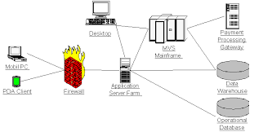
4.Deployment Diagram

Slide 13
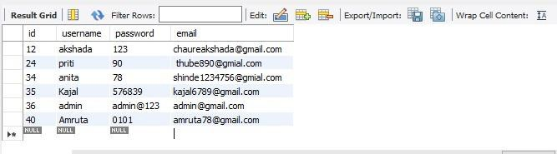

Slide 14
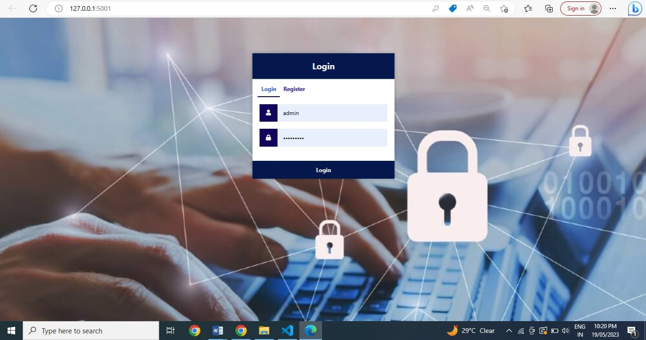

Slide 15
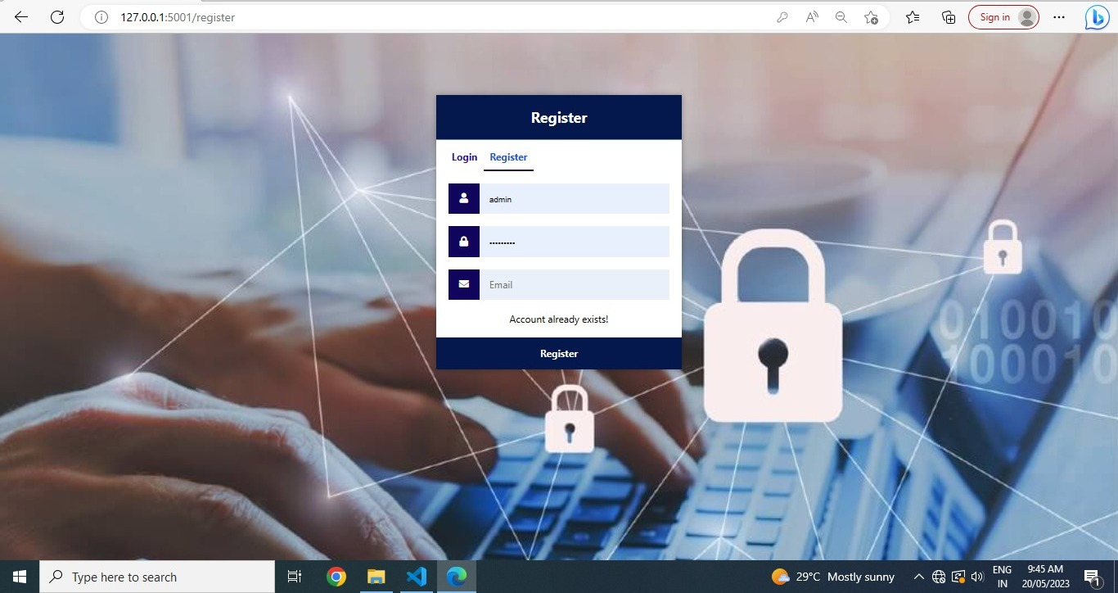

Slide 16
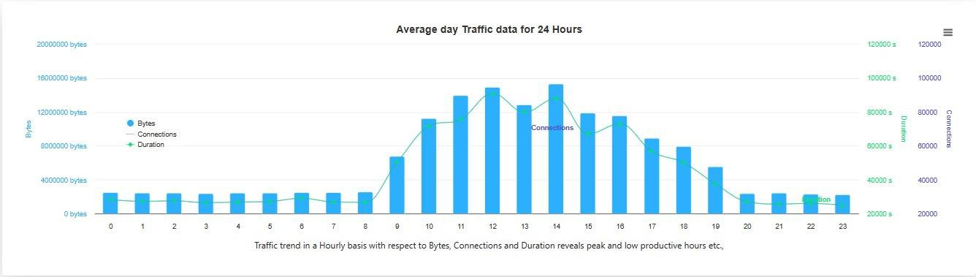

Slide 17
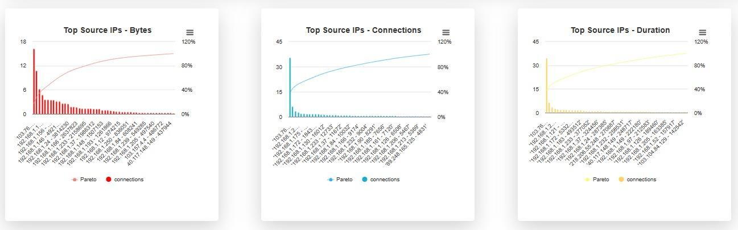

Slide 18
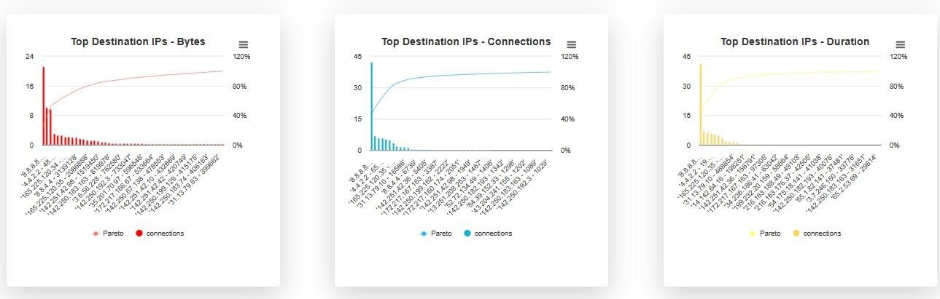

Slide 19
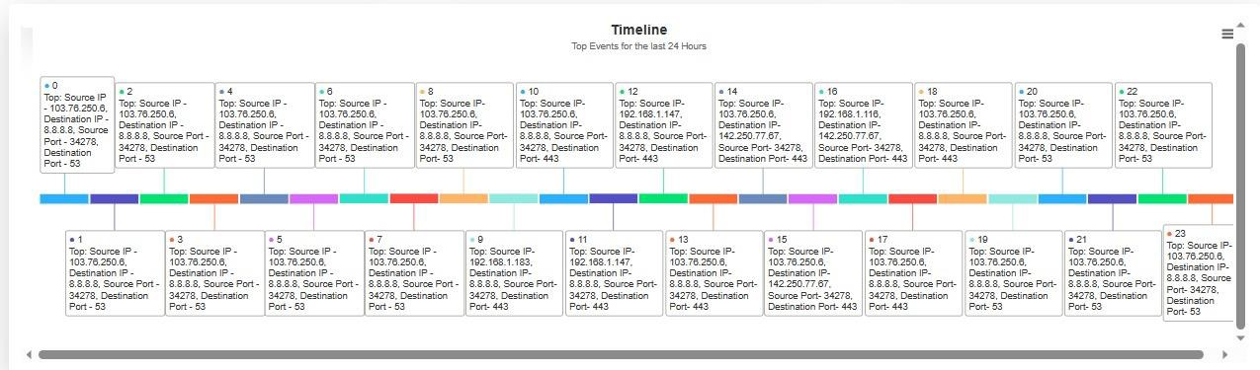

Slide 20
ADVANTAGES
The major benefits of network security is that it prevents unauthorized or malicious user access to the system.
The high-security protocol is implemented to protect against major data theft and makes the experience a lot more relieving.
Build trust. Security for large systems translates to security for everyone.
Protect proprietary information.
Application security.
Provides a business continuity plan.
Improves productivity.

Slide 21
LIMITATIONS
Regular Update : Business need to regularly update their software, hardware, and security strategy to be one step ahead of the attackers.
Needs Continuous learning : The threats are new and never-ending, and so is the learning process to keep up with the threads.
Managing a large network is complicated, requires training and a network manager usually needs to be employed.
Firewalls can be difficult to configure correctly.
Incorrectly configured firewalls may block users from performing certain actions on the internet, until the firewall configured correctly.

Slide 22
CONCLUSIONS
Network security is important because it keeps sensitive data safe from cyber attacks and ensures
the network is usable and trustworthy.
Cybersecurity is crucial because it safeguards all types of data against theft and loss.
Sensitive data, protected health information (PHI), personal information, data, and government and business information systems are all included.
Without having a network, Companies would not be able to share resources and increase productivity more effectively.
Network security is very important for any organization. It play a major role in protecting the network
from any type of instructions, virus attacks, spyware etc.

Slide 23
THANK YOU..!

