Slide 1

DEPARTMENT OF
CSE (ARTIFICIAL INTELLIGENCE AND MACHINE LEARNING)
ACADEMIC YEAR 2025 - 2026
SEMESTER III
ARTIFICIAL INTELLIGENCE LABORATORY
MINI PROJECT REVIEW
Route optimization in a city map
REGISTER NUMBER | 2117240030022
NAME | Anushiya p
YEAR | 2
SECTION | A
FACULTY IN-CHARGE | Mrs. M. Divya
10/28/2025
1

Slide 2
PROBLEM STATEMENT
    Cities often have multiple routes between locations.
    The challenge is to find the most cost-efficient (shortest or least expensive) route.
    Traditional search methods may not guarantee optimality.
    Goal: Use Uniform Cost Search (UCS) to identify the least-cost path between two points in a city map.
    Applications:
    GPS Navigation Systems (Google Maps, Uber)
    Delivery Route Optimization
    Traffic Management Systems
10/28/2025
2

Slide 3
THEORETICAL BACKGROUND
Algorithm Steps
1. Initialize a priority queue and insert the start node with cost = 0.
2. Create an empty set to store visited nodes.
3. While the priority queue is not empty:
a. Remove the node with the smallest cumulative cost.
b. If this node is the goal, return the path and total cost.
c. If the node is not visited, mark it as visited.
d. For each neighbor of the node:
Calculate the new cumulative cost.
Add the neighbor and its cost to the priority queue.
4. Repeat until the goal is found.
10/28/2025
3

Slide 4
IMPLEMENTATION AND CODE
    Link to code in Git-hub Repository
List | Git-hub Repository Links
Implementation of Code Link | https://github.com/anushiya240008-droid/Route-optimization-in-a-city-map/blob/main/Programsystem/blob/main/Program
Word Document Report Link | https://github.com/anushiya240008-droid/Route-optimization-in-a-city-map/blob/main/DOC-20251028-WA0004..docx
PPT Link | https://github.com/anushiya240008-droid/Route-optimization-in-a-city-map/blob/main/23d99696-02d8-4c05-9b79-a08d81bc8610.pptx_20251029_075208_0000.pdf
10/28/2025
4

Slide 5
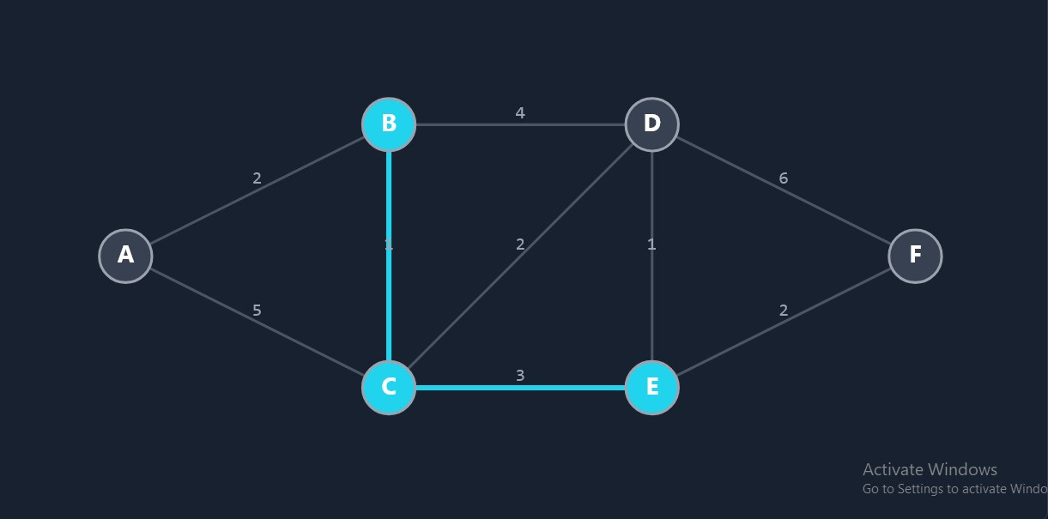
OUTPUT AND RESULTS
10/28/2025
5

Slide 6
OUTPUT AND RESULTS
    Explanation:
    UCS explores all possible routes and chooses the one with the least total cost.
    In this case:
    A → B → C → D = Cost 2 + 1 + 2 = 5
    Other paths had higher costs, so they were not selected.
    Result Visualization (optional):
    Display graph/map using matplotlib or draw a simple route diagram.
10/28/2025
6

Slide 7
REFERENCES
    1. Stuart Russell and Peter Norvig, Artificial Intelligence: A Modern Approach, 4th Edition.
    2. GeeksforGeeks – “Uniform Cost Search (UCS) Algorithm.”
    3. Python NetworkX documentation – Graph representation and pathfinding.
    4. TutorialsPoint – “AI Search Algorithms.”
    5. Research papers on AI-based route optimization in smart cities.
10/28/2025
7

