Slide 1
Automation & Testing Stack
JavaScript • TypeScript • Testing • Mobile Testing• CI/CD

Slide 2

JavaScript (JS)
  Core language for modern web applications
  Supports asynchronous programming using async/await
  Used in frontend, backend, and automation testing

Slide 3

TypeScript (TS)
  Superset of JavaScript with static typing
  Helps catch errors at compile time
  Improves scalability and maintainability of test code

Slide 4
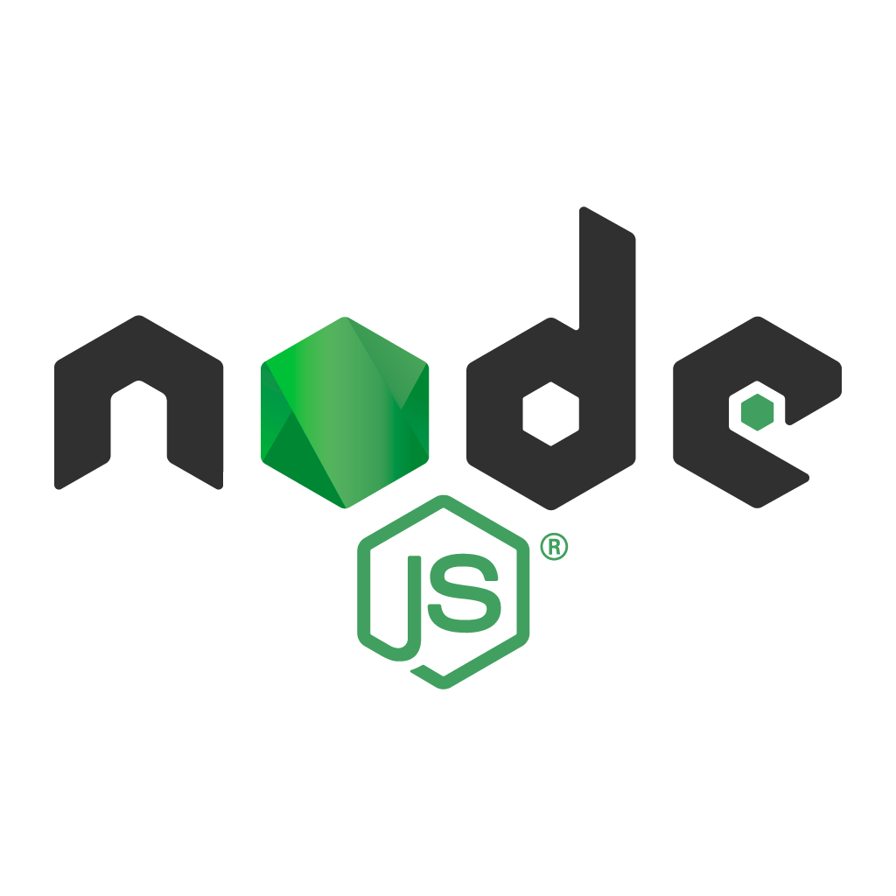
Node.js
  JavaScript runtime built on Chrome V8 engine
  Uses non‑blocking, event‑driven architecture
  Executes automation frameworks and API services

Slide 5
Web Testing – Key Concepts
  Major tools used-> Playwright, Cypress
  In real projects, structured testing approaches like Page Object Model, data-driven testing, and reusable fixtures are implemented

Slide 6
POM, Data driven testing, fixtures
Page Object Model helps separate UI locators and actions from test logic, which makes the framework maintainable.
Data-driven testing allows running the same test with multiple datasets, improving coverage without duplicating code.
Fixtures help manage reusable setups such as login sessions, browser initialization, and test data.
Both Playwright and Cypress support these patterns, although their implementation styles differ slightly.

Slide 7

Web Testing – Playwright
  Modern end‑to‑end testing framework
  Supports multiple browsers and parallel execution
  Auto‑waiting reduces flaky tests
  CSS and xpath can be used to detect element

Slide 8

Web Testing – Cypress
  Developer‑friendly UI testing framework
  Runs directly in the browser
  Provides time‑travel debugging
  CSS selectors and jquery are used as selectors.

Slide 9
API Testing – Overview and Authentication
  Validates backend services independently
  Tests REST APIs using HTTP methods
  Ensures correct authentication and responses
  No auth, Basic auth, API key based, token based are common authentication methods.

Slide 10
API Testing – Playwright & Cypress
  Playwright provides API request context
  Cypress uses cy.request() for API calls
  APIs can be used as test preconditions
  The response returned can be used to validate data.

Slide 11
Mobile Testing (local and cloud)
  Appium enables cross‑platform mobile automation
  WDIO acts as test runner and framework
  Appium Inspector helps locate mobile elements
  Websites like Browserstack provides the devices which can be used to test.
  Emulators can be used on local machine for testing purpose.

Slide 12

CI / CD Integration
  Automates test execution on code changes
  Ensures faster feedback to developers
  Common tools include GitHub Actions and Jenkins.
  Done by creating .yml file in ‘.github’.

Slide 13
AI in Software Testing
Test Generation: AI can create test cases from requirements, user stories, or natural language.
Self‑Healing Automation: Locators and scripts adapt automatically when the UI changes.
Failure Analysis: AI reviews logs, screenshots, and patterns to suggest root causes.
Example- MCP’s in playwright

Slide 14
Conclusion
  Unified JavaScript ecosystem for testing
  Automation improves quality and speed
  CI/CD ensures continuous delivery

