Slide 1


AdWise: Smart Ad Solutions for Small Businesses
Unlocking Growth for Indie Creators

Slide 2


Our Team: HumanKit
Dedicated to transforming digital advertising for the underserved.
Anushka Sharma Arpit Garg
2310991784 2310991623
Diksha Kumari Sajjal
2310991649 2310992357
Connect with us to empower the next generation of small business success.

Slide 3



Our Vision
Empowering Every Creator
We believe powerful marketing should be accessible to all, not just big brands.
Innovation
Accessibility
Growth
Pioneering AI-driven ad insights
Making pro tools affordable for all
Maximising ROI for small businesses

Slide 4
The Challenge for Small Businesses
Navigating digital advertising can feel like a maze, especially for new market entrants.
1
2
3
Budget Blind Spots
Audience Uncertainty
Performance Puzzle
Unsure how much to invest in ads, leading to wasted spend or missed opportunities.
Struggling to define and reach the right customers for their unique products.
Lack of clear data to learn from past campaigns and optimise future ones.

Slide 5

Our Solution: AdWise
AI-Powered Ad Intelligence
AdWise transforms complex ad data into simple, actionable insights.
Learn from past campaign outcomes.
Receive AI-driven recommendations for optimal ad spend.
Identify precise target audiences for your product type.

Slide 6



Target Audience
Empowering the next wave of digital entrepreneurs.
Indie Makers & Artists
Small Business Owners
Digital Newcomers
Especially beginner crochet sellers and other craftspeople new to online marketing.
Entrepreneurs seeking affordable, effective marketing solutions to grow their presence.
Those lacking extensive marketing knowledge or budget for traditional agencies.

Slide 7
Opportunity & Impact
Bridging the gap between creative passion and market success.
Affordable Expertise
Maximized ROI
Market Dominance
Replacing costly human ad strategists with an intelligent, accessible app.
Driving optimal results: more orders, higher views, and tangible growth for users.
Tapping into the rapidly expanding indie creator economy with a unique value proposition.

Slide 8
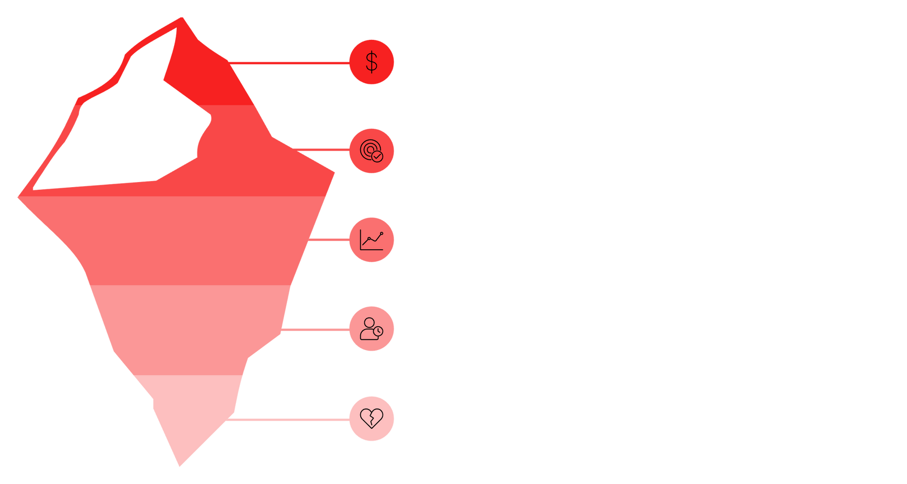





Core Insights
Understanding the nuanced needs of our users.
Ad Spend Guesswork
Vague Targeting
Overwhelming Data
Lack of Time
Fear of Failure
AdWise addresses both surface-level problems and underlying anxieties.

Slide 9

Minimal Viable Product (MVP)
Focused Features
Our initial offering concentrates on core functionalities:
Basic ad campaign setup and tracking.
AI-powered budget allocation recommendations.
Audience targeting suggestions based on product category.
Simple performance analytics and past outcome learning.

Slide 10
Why iOS?
Tapping into a premium and engaged user base.
User Demographics: iOS users often have higher disposable income, aligning with small business owners investing in growth.
Performance & Design: Enables a smooth, intuitive, and visually appealing user experience critical for complex data tools.
App Store Ecosystem: Robust platform for discovery and secure transactions.
Security & Privacy: Apple's strong emphasis on user data protection builds trust.

