Slide 1

Seasonal Agriculture Performance Analysis
Name – Anushka Rajesh Thakur
College Name - Kishinchand Chellaram College
AICTE STU ID - STU6a4be40da9cba1783358477

Slide 2

PROBLEM STATEMENT
Agricultural activities are influenced by seasonal variations in environmental conditions, farming practices, resource availability and market conditions. As a result, agricultural performance may differ from one season to another.
However, raw agricultural data does not clearly explain how agricultural performance changes across seasons or what patterns can be observed in different seasonal conditions.
The problem is to analyze the given agricultural dataset and investigate seasonal differences in agricultural performance by identifying meaningful patterns, trends, relationships and variations within the available data.

Slide 3
Project Description
This project analyzes seasonal agricultural performance using data on crops, farms, environmental conditions, resource usage, production, yield, revenue, costs, profit, and disease/pest risk. The analysis compares Kharif, Rabi, and Zaid seasons to identify differences, patterns, and trends in agricultural outcomes. It examines relationships between rainfall, soil moisture, fertilizer usage, and crop yield, while also comparing crop and state-wise performance. Statistical analysis and visualizations are used to present meaningful insights. The project aims to identify key seasonal factors affecting agricultural performance and provide data-driven recommendations for better crop planning, resource management, profitability, and sustainable agricultural decision-making.

Slide 4

WHO ARE THE END USERS?
The end users of this project include
Farmers
agricultural planners
agricultural researchers
government departments
agricultural organizations
policymakers

Slide 5

Technology Used
Python – For data analysis and processing
Pandas & NumPy – For data cleaning, manipulation, and statistical calculations
Matplotlib & Seaborn – For creating charts and visualizations
Jupyter Notebook – For performing and documenting the complete analysis
CSV Dataset – Used as the primary data source for agricultural analysis

Slide 6
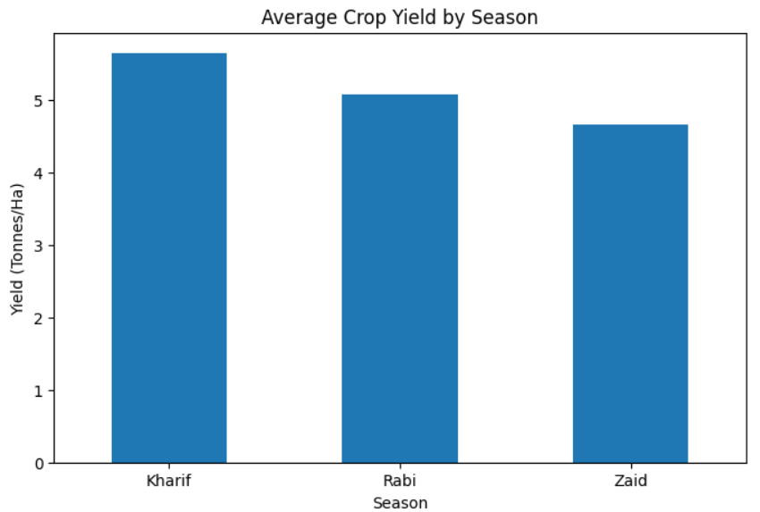
Seasonal Performance Results
Kharif recorded the highest average yield: 5.64 tonnes/ha
Rabi: 5.08 tonnes/ha
Zaid: 4.67 tonnes/ha
Kharif also had the highest average production and profit.
Overall, Kharif showed the strongest agricultural performance.

Slide 7
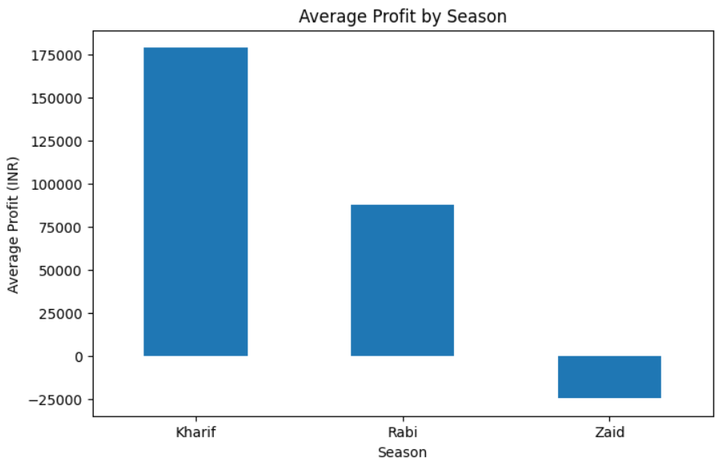
Profit, Revenue & Cost Results
Kharif generated the highest average profit: ₹178,915
Rabi generated an average profit of ₹87,689
Zaid recorded an average loss of ₹24,805
Revenue and total cost showed clear seasonal differences.
Kharif was the most economically favorable season.

Slide 8
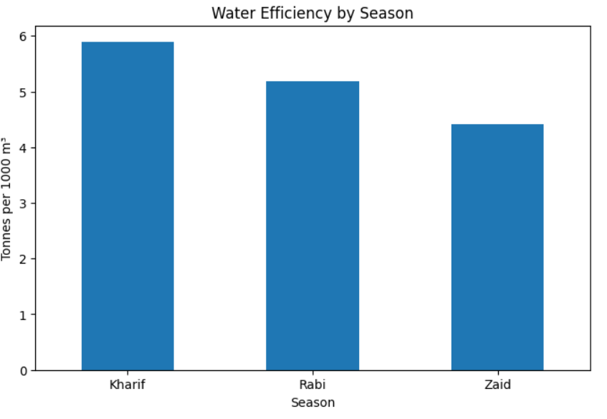
Water & Environmental Results
Kharif had the highest water-use efficiency: 5.89 tonnes/1,000 m³
Rabi: 5.19 tonnes/1,000 m³
Zaid: 4.41 tonnes/1,000 m³
Kharif had the highest disease/pest risk (54.47%).
Rainfall and temperature showed noticeable seasonal variation.

Slide 9
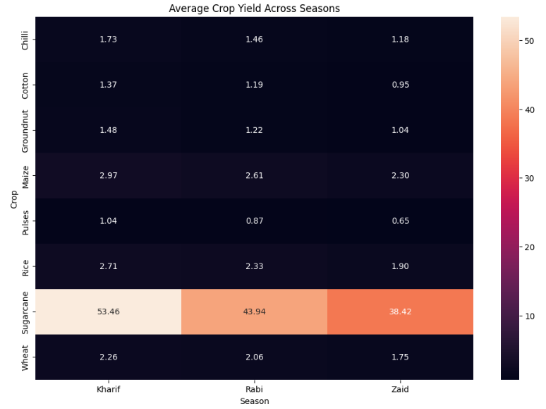
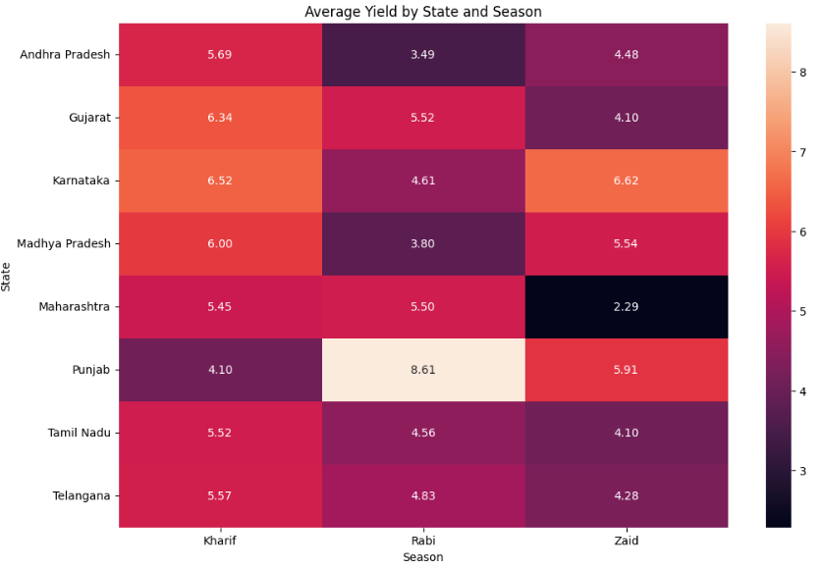
Crop & State-wise Results
Sugarcane achieved the highest yield and profit across all seasons.
Chilli was another consistently profitable crop.
Punjab recorded the highest average Rabi yield: 8.61 tonnes/ha.
Karnataka recorded the highest Zaid yield: 6.62 tonnes/ha.
Seasonal performance varies considerably across states.

Slide 10
Key Findings & Recommendations
Key Findings
Kharif was the strongest overall season.
Zaid showed the weakest performance and negative average profit.
Soil moisture had almost no linear relationship with yield (correlation ≈ 0.01).
Fertilizer usage differed only slightly across seasons.
Recommendations
Prioritize suitable crops and resources during high-performing seasons.
Improve water-use efficiency, especially in Zaid.
Monitor disease/pest risks during Kharif.
Use state- and crop-specific planning for better productivity and profitability.

Slide 11
Future scope
The project can be further enhanced by incorporating real-time weather and market-price data to provide more accurate agricultural insights.
Machine learning models can be developed to predict crop yield, profit, and disease or pest risks for different seasons.
The system can also include soil and weather sensor data for real-time monitoring.
A dashboard could be developed to provide interactive, location-based recommendations for farmers.
Future analysis can also include more years of historical data to identify long-term seasonal trends and improve crop selection, resource management, and agricultural planning.

Slide 12
GitHub Link
https://github.com/anushka-653/Seasonal-Agriculture-Performance-Analysis.git

Slide 13
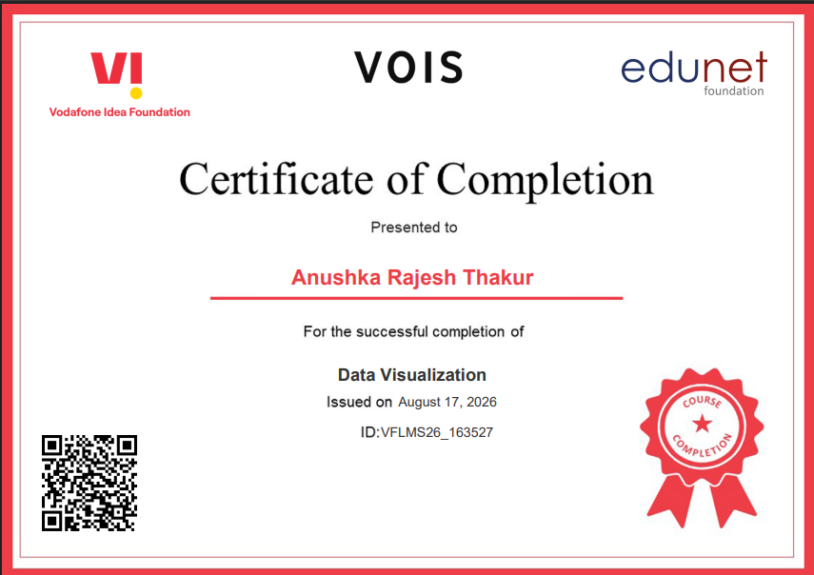
VOIS Course completion certificate - Course name- Data Visualization

Slide 14
Thank you
.
.

