Slide 1


Testing of Hypothesis Statistical Significance Testing
www.easybiologyclass.com
e-mail: easybiologyclass@gmail.com
www.easybiologyclass.com

Slide 2


Slide 3
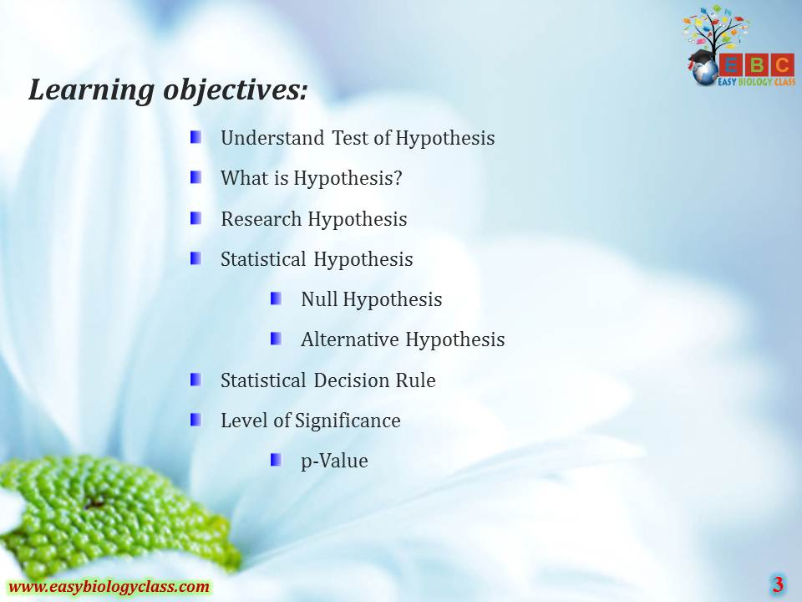

Slide 4
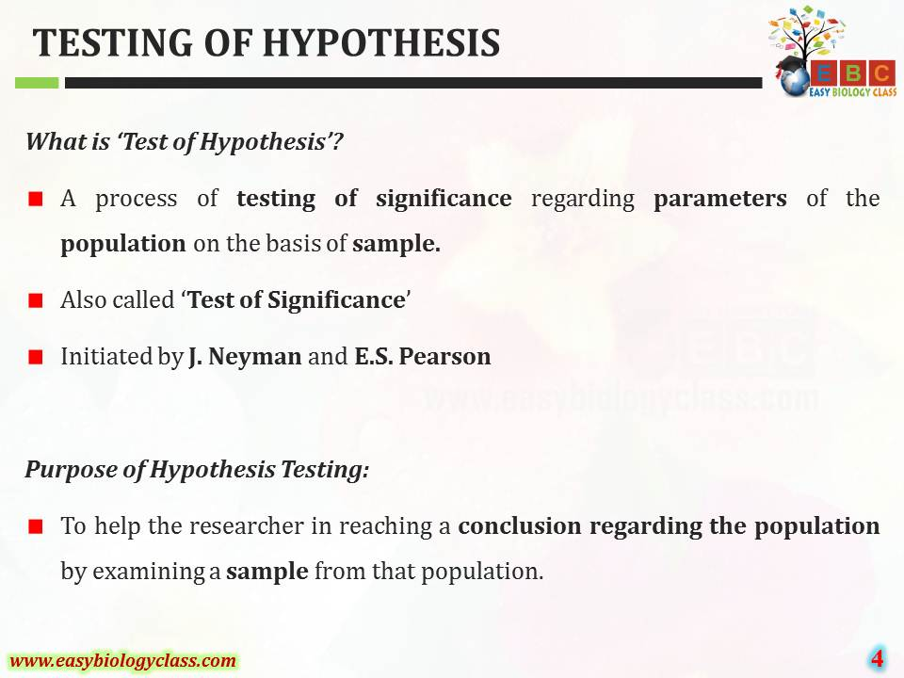

Slide 5
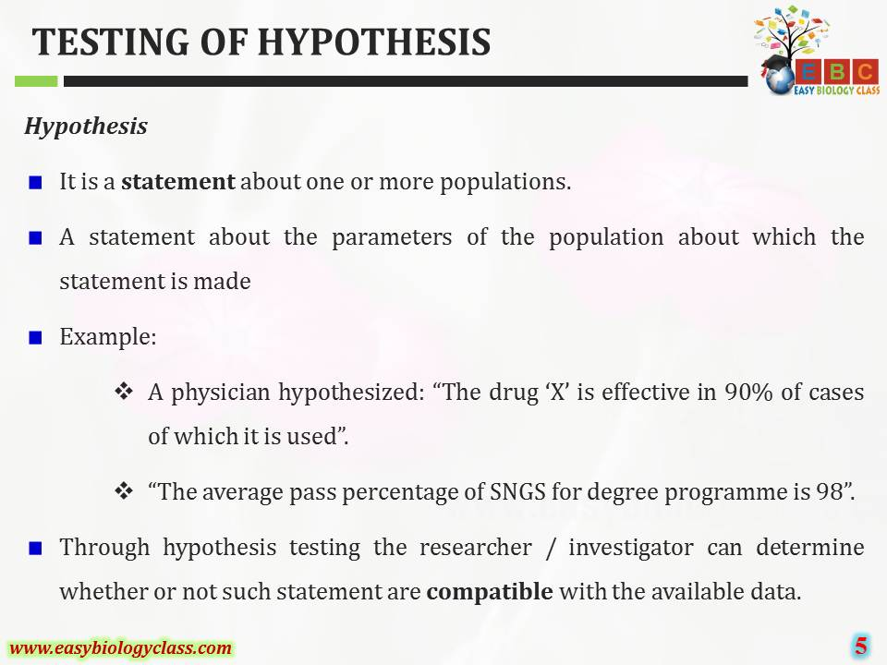

Slide 6
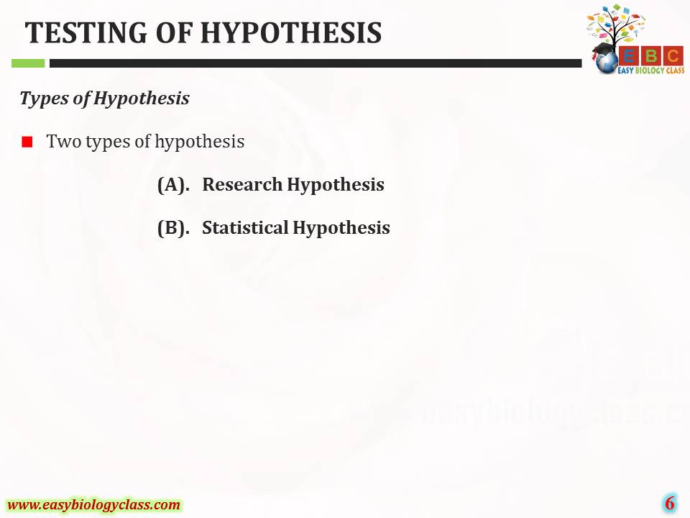

Slide 7
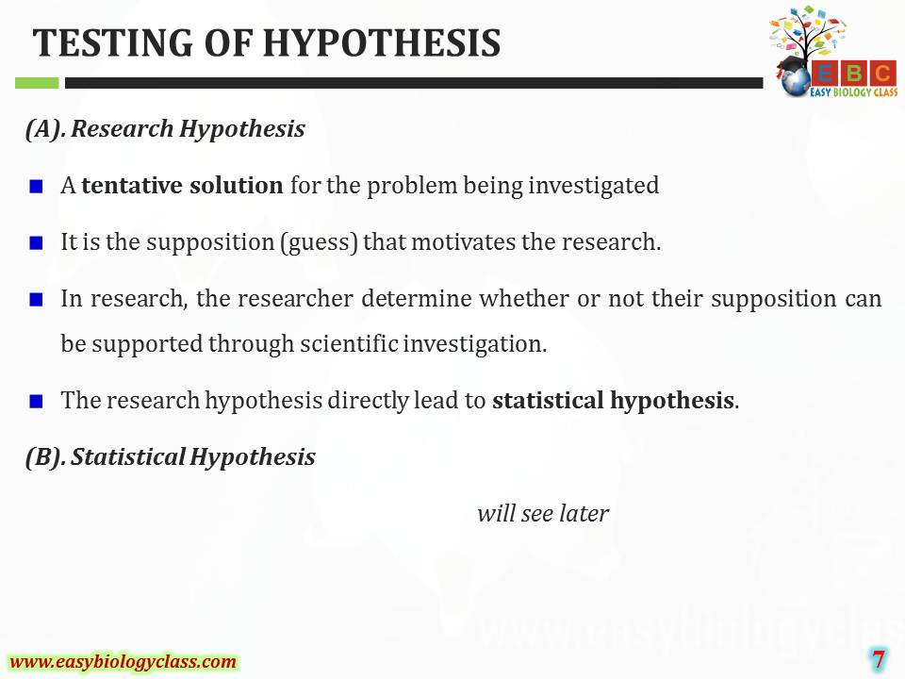

Slide 8
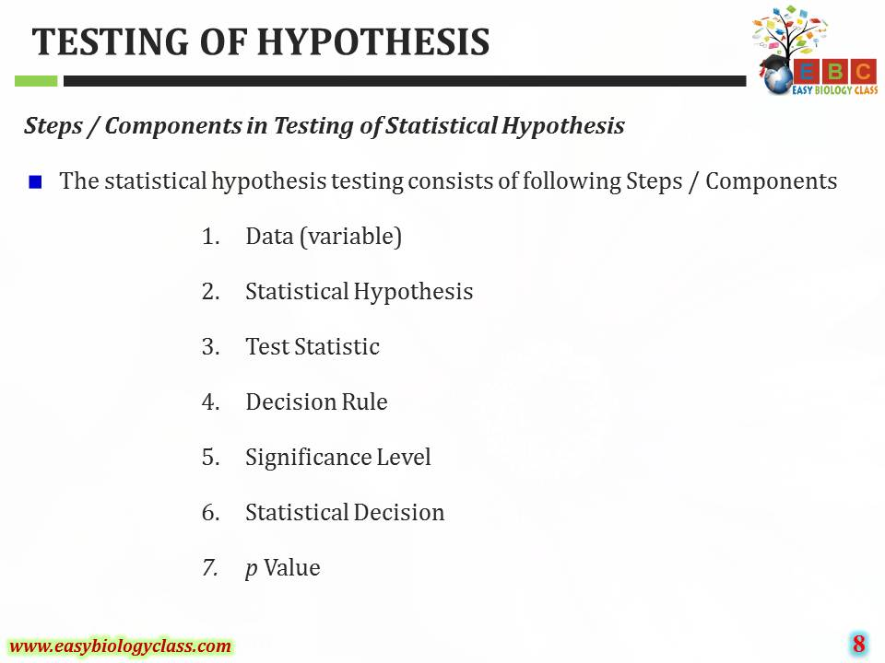

Slide 9
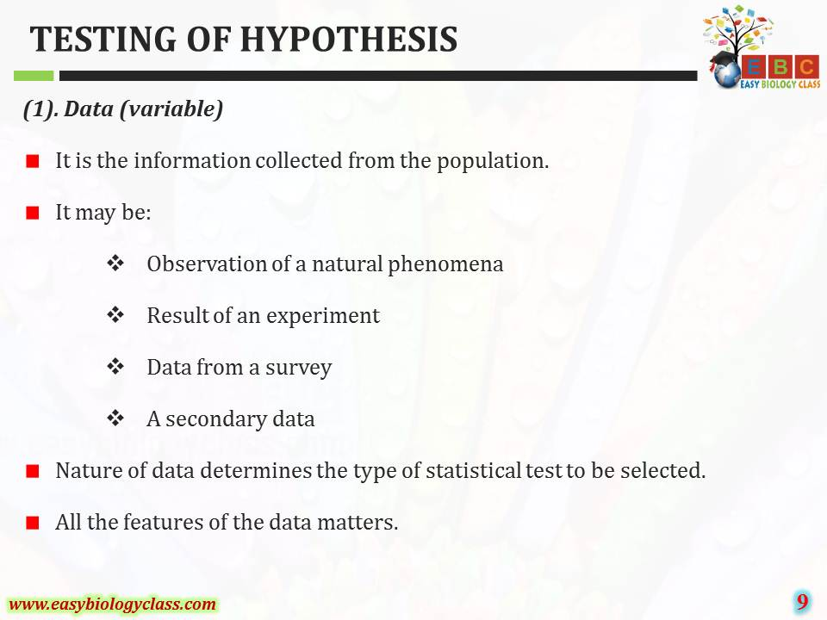

Slide 10
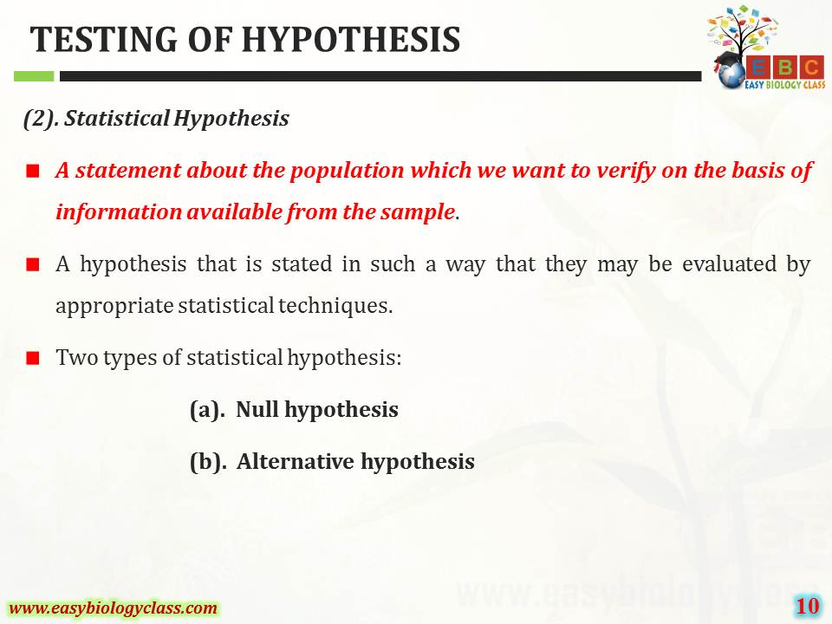

Slide 11
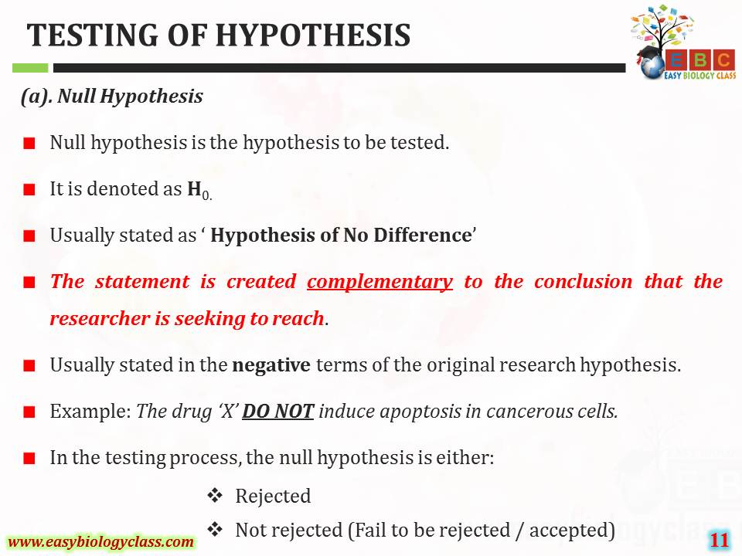

Slide 12
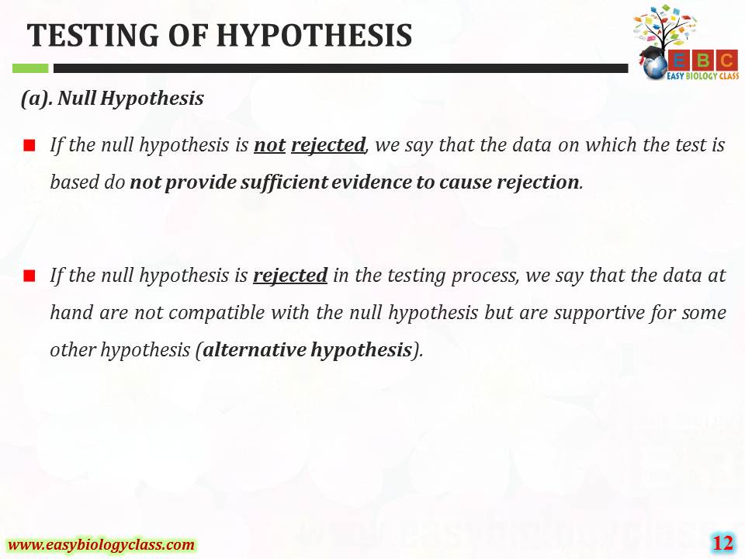

Slide 13
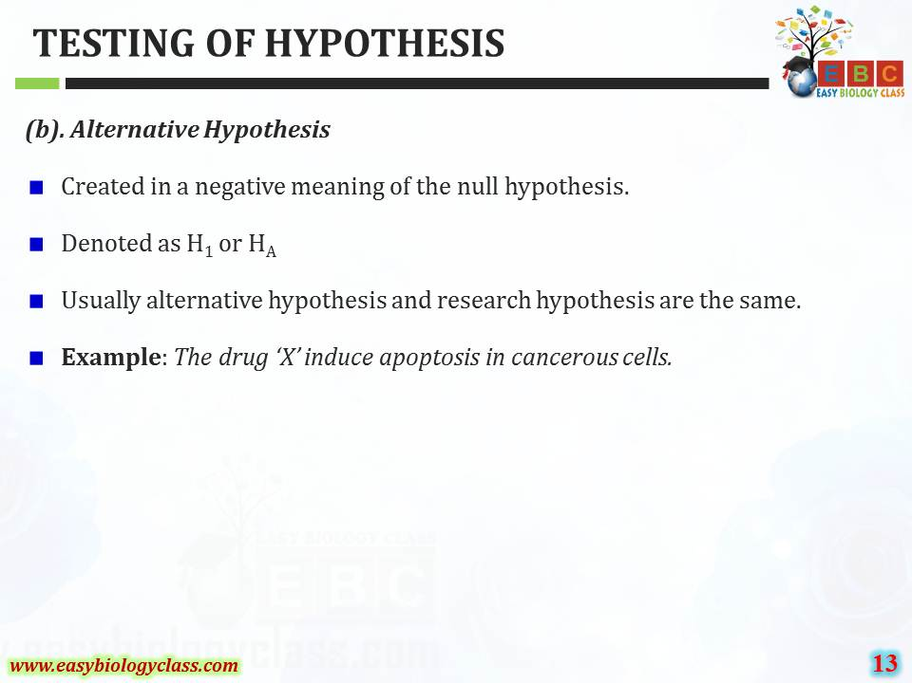

Slide 14
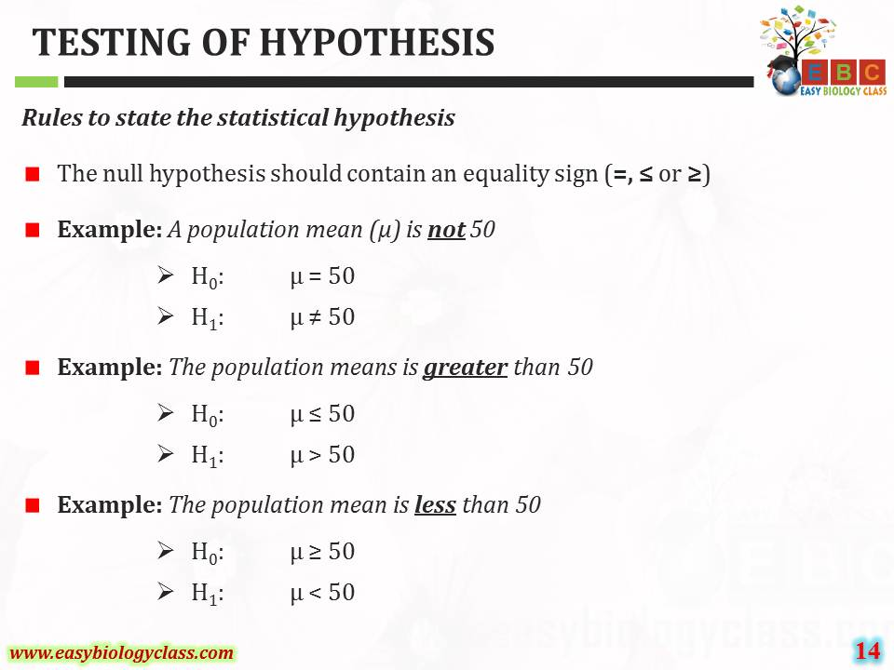

Slide 15
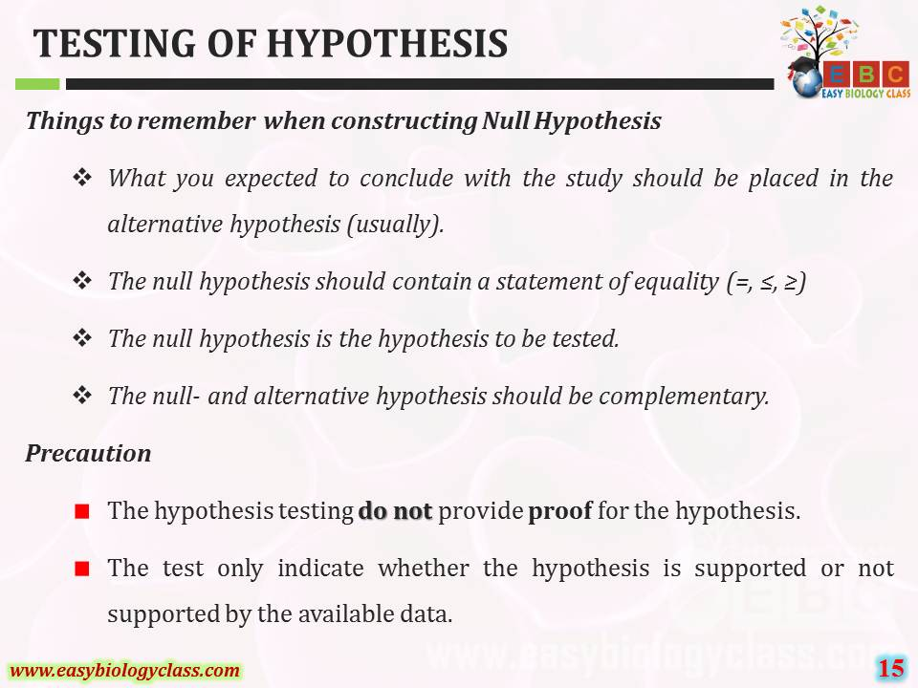

Slide 16
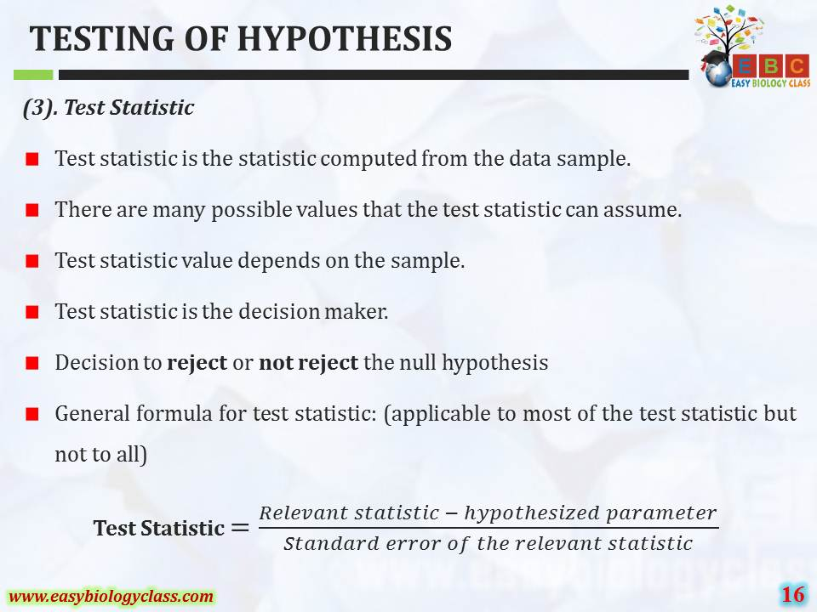

Slide 17
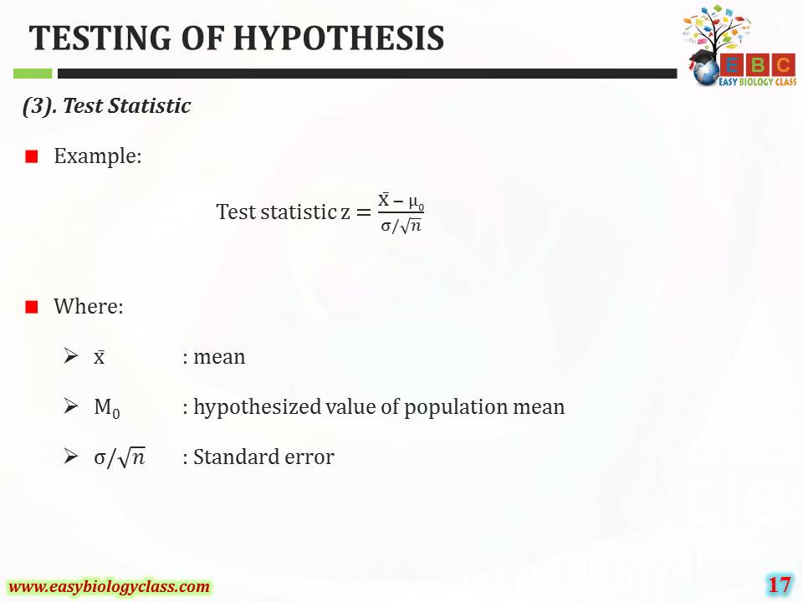

Slide 18
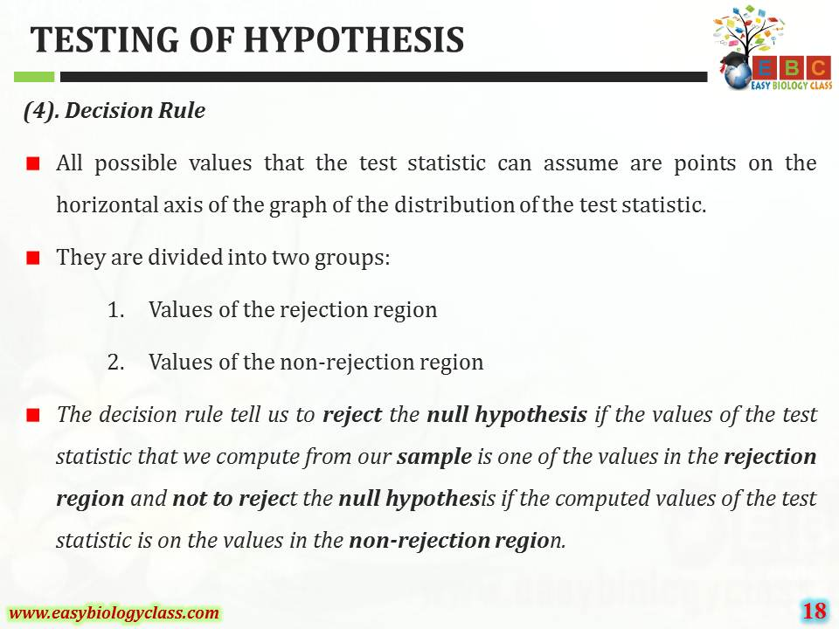

Slide 19
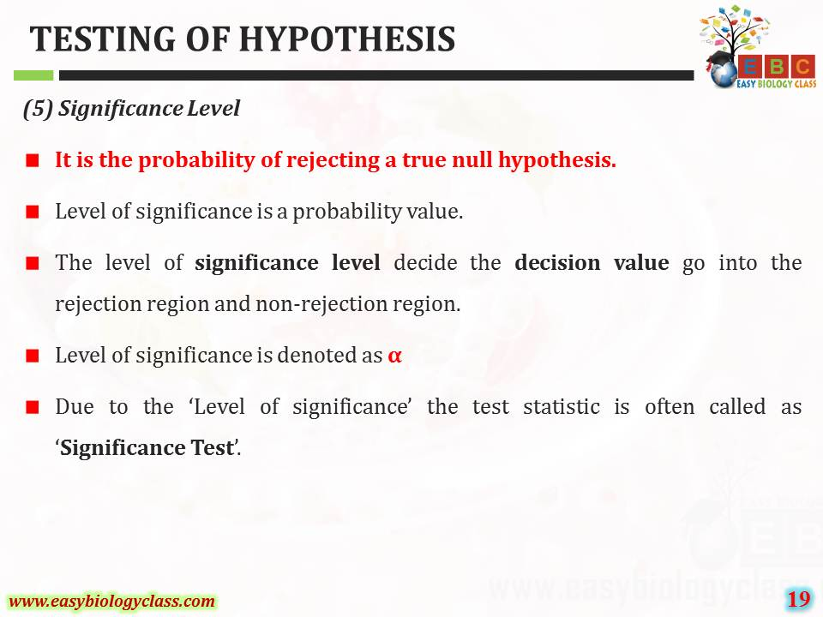

Slide 20
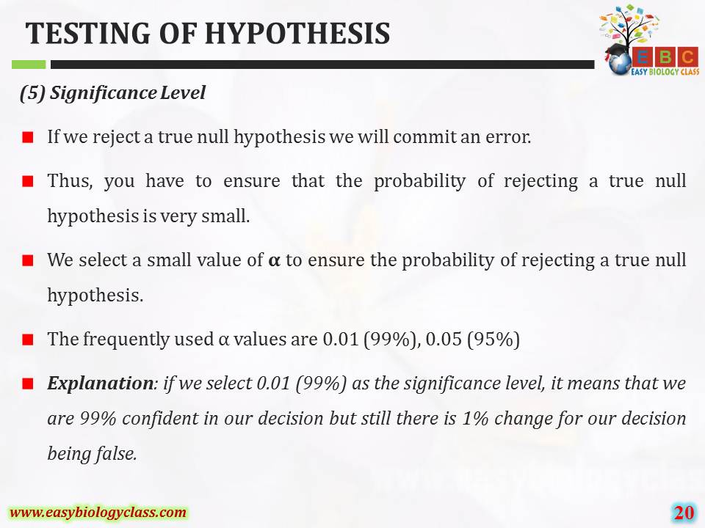

Slide 21
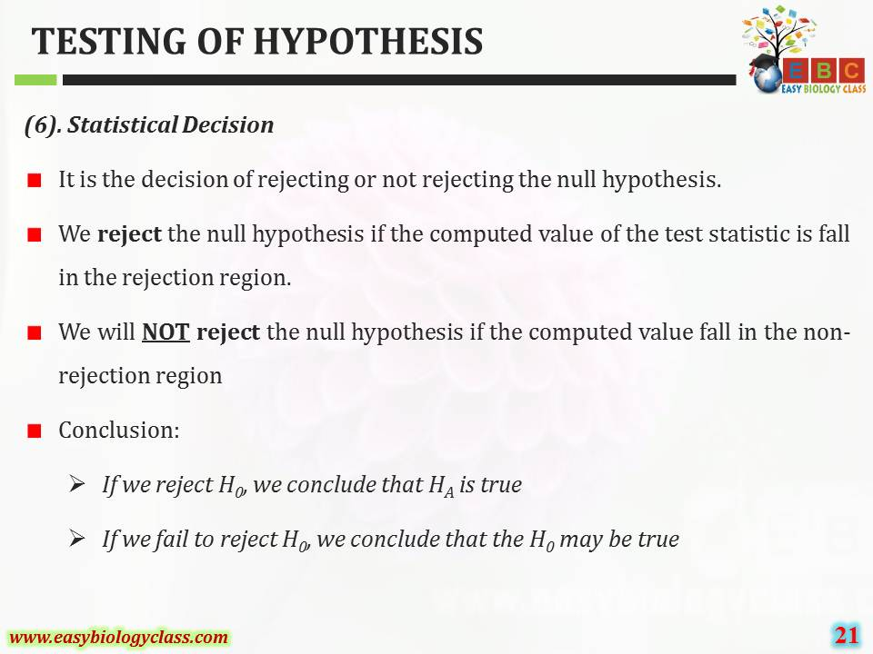

Slide 22
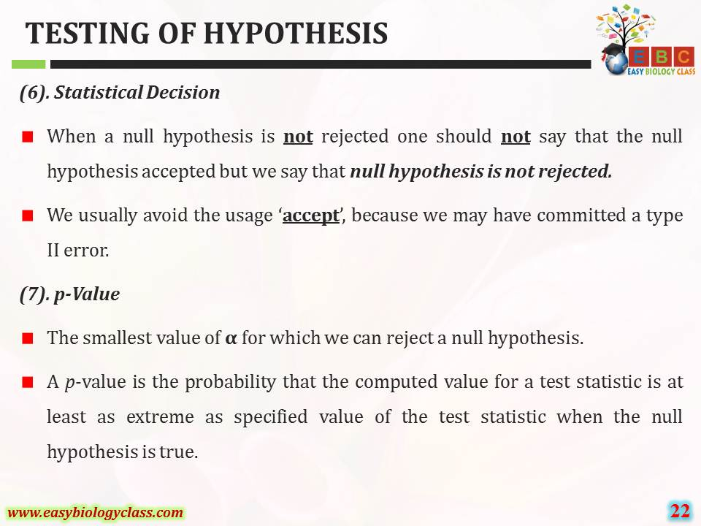

Slide 23
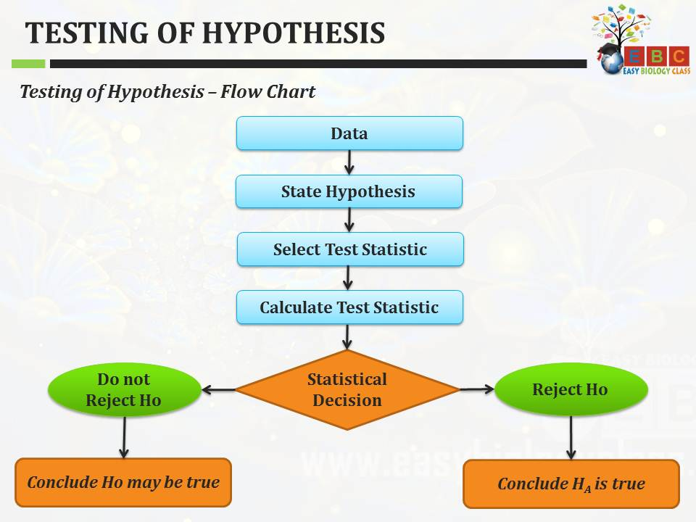

Slide 24
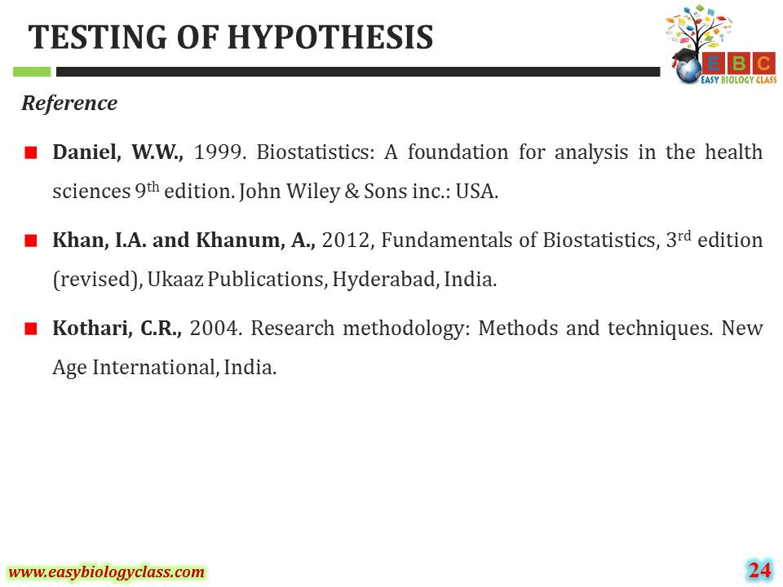

Slide 25

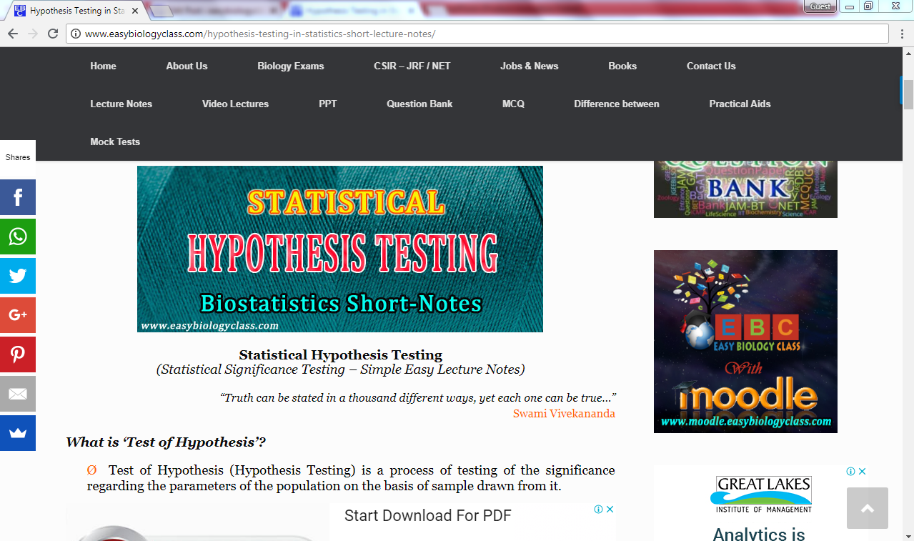
For detailed description of this topic, please click on:
http://www.easybiologyclass.com/hypothesis-testing-in-statistics-short-lecture-notes/

Slide 26



Visit our website: www.easybiologyclass.com for:
Lecture notes
Video tutorials
Biology PPTs
Biology MCQs
CSIR and GATE Study Materials
Job Notifications
Question Bank
Many more…
Our sister concern: www.angiospermtaxonomy.com

Slide 27


For more information, please log on to: www.easybiologyclass.com
For video tutorials : easybiologyclass
Thank You…
E-mail:
easybiologyclass@gmail.com
mail@easybiologyclass.com
visit: www.easybiologyclass.com

