Slide 1
Project Title :Age calculator
Name and Roll No: Anushka Malik
2210991323

Slide 2
Index
Objective
Introduction
Methodology, Approach & Techniques
Algorithm
Source Code (screenshots)
Conclusion
Reference

Slide 3
Objectives
Calculate Age: The primary objective is to accurately calculate a person's age based on their date of birth and the current date.
Input Validation: Ensure that the user inputs are validated to prevent errors or invalid data from being processed. This includes checking if the date of birth is in a valid format and if it makes sense (e.g., not a future date).
Handle Leap Years: Account for leap years when calculating age to ensure accuracy.
Error Handling: Implement robust error handling to gracefully handle any unexpected errors or edge cases that may arise during execution.
Scalability: Design the code in a modular and scalable way so that it can be easily extended or integrated into other projects if needed.

Slide 4
Introduction
The Age Calculator Python project is a simple yet practical application designed to calculate the age of a person based on their date of birth and the current date. This project serves as a useful tool for various purposes, including personal record-keeping, age verification, and age-related data analysis.
The primary objective of this project is to develop a Python program that efficiently computes a person's age by taking their date of birth as input and comparing it with the current date. The program ensures accuracy in age calculation while providing a user-friendly interface for easy interaction.

Slide 5
Methodology ,Approach and Techniques
Below are the key methodologies, approaches, and techniques involved:
Requirements Analysis:
Understand the project requirements, including input format, output expectations, error handling, and user interface specifications.
Algorithm Design:
Design an algorithm to calculate age accurately by considering factors such as leap years, varying month lengths, and time zone differences.
Choose appropriate data structures and algorithms for efficient date manipulation and comparison.
Input Validation:
Implement robust input validation techniques to ensure that the user-provided date of birth is in the correct format and falls within acceptable ranges.
Validate input data against potential errors such as invalid characters, out-of-range dates, or illogical dates.

Slide 6
4. Date Manipulation:
Utilize Python's built-in datetime module or third-party libraries like dateutil
to handle date and time calculations. Perform operations such as date parsing,
date arithmetic, and date comparison to determine the age.
5. Error Handling:
Implement comprehensive error handling mechanisms to gracefully manage
unexpected inputs, exceptions, or edge cases
6.Testing and Validation:
Develop comprehensive test cases to validate the correctness and reliability of the age calculation algorithm. Test the program with various input scenarios, including typical cases, boundary cases, and error cases, to ensure robustness.

Slide 7
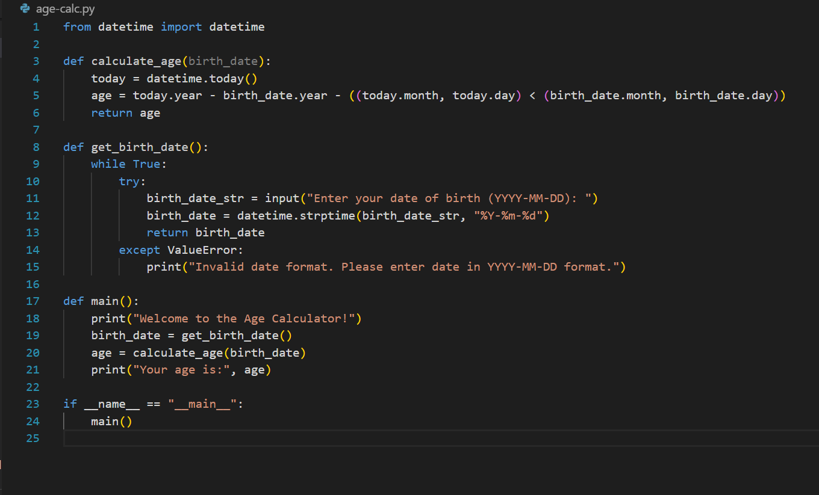
Source Code(Screenshot)

Slide 8
Conclusion
The Age Calculator Python project offers a straightforward yet practical solution for determining a person's age based on their date of birth and the current date.
In conclusion, the Age Calculator Python project exemplifies the principles of simplicity, accuracy, and user-centric design in software development. By providing a practical solution to a common problem, it underscores the versatility and effectiveness of Python in addressing real-world challenges. Whether used for personal or professional purposes, the age calculator serves as a valuable resource for individuals seeking to ascertain their age quickly and conveniently.

Slide 9
Future Scope
The Age Calculator Python project lays a solid foundation for further development and expansion. Its future scope encompasses various avenues for enhancement, innovation, and integration. Integrate a GUI using libraries such as Tkinter , PyQt , or Kivy to enhance user experience and provide a more visually appealing interface. This would allow users to interact with the age calculator through intuitive buttons, input fields, and displays. Support for multiple languages and date formats to cater to a global audience. Localization efforts could include adapting the interface, date formatting, and age calculation logic to suit different cultural norms and regional preferences.

Slide 10
Reference
Geeks for Geeks
w3resource

Slide 11
The End

