Slide 1


Slide 2
Capture user activity and session
Recording
http://www.free-powerpoint-templates-design.com

Slide 3
Introduction
Session record
Session recordings are renderings of real actions taken by visitors as they browse a website. Recordings capture mouse movement, clicks, taps, and scrolling across multiple pages on desktop and mobile devices.
Also known as session replays, user recordings, and user/visitor replay tools, session recordings are used to gain a real understanding of how users interact with a website, which then helps fix issues, optimize UX, and ultimately improve conversion rate.

Slide 4
Understand and empathize with the visitors’ experience
See how users interact with specific website elements
Discover bugs, issues, and obstacles
Find out why people are leaving your website

Slide 5
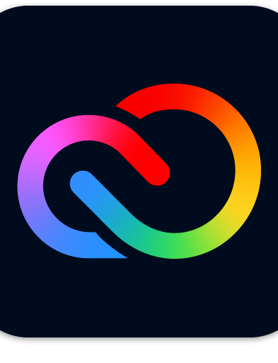

Task
Adobe CC Express
Project X
Adobe Express is available for free with thousands of templates, Adobe Stock photos, Adobe Fonts, design assets, quick actions, and amazing features.
Track the user information and record the activity of the user on Project X .

Slide 6
Target
capture user activity/interactions on project-x
send activities to server for storage
Replay those activities from storage data
Track user and record session

Slide 7
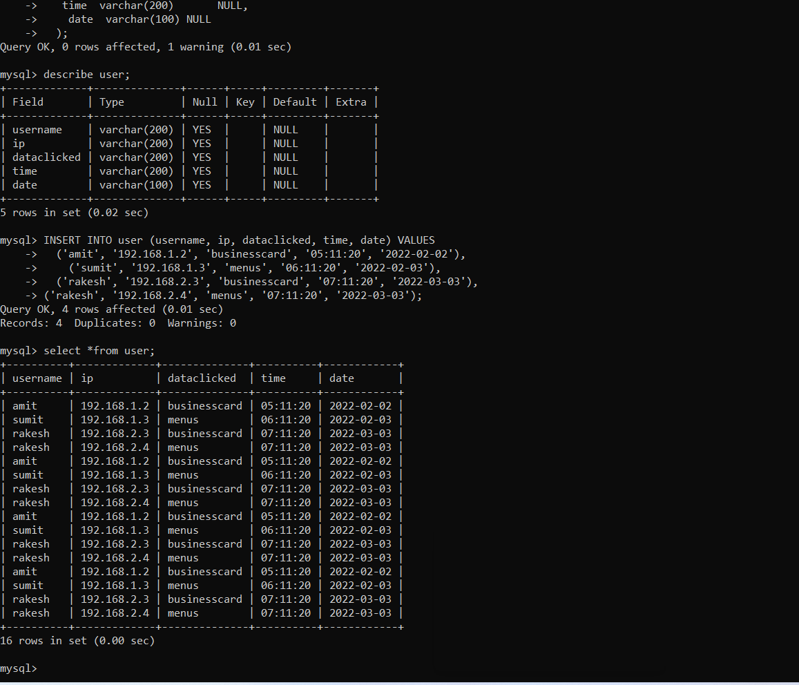
My Sql command prompt
Tracking the user information
Create a table
Storing in the database

Slide 8
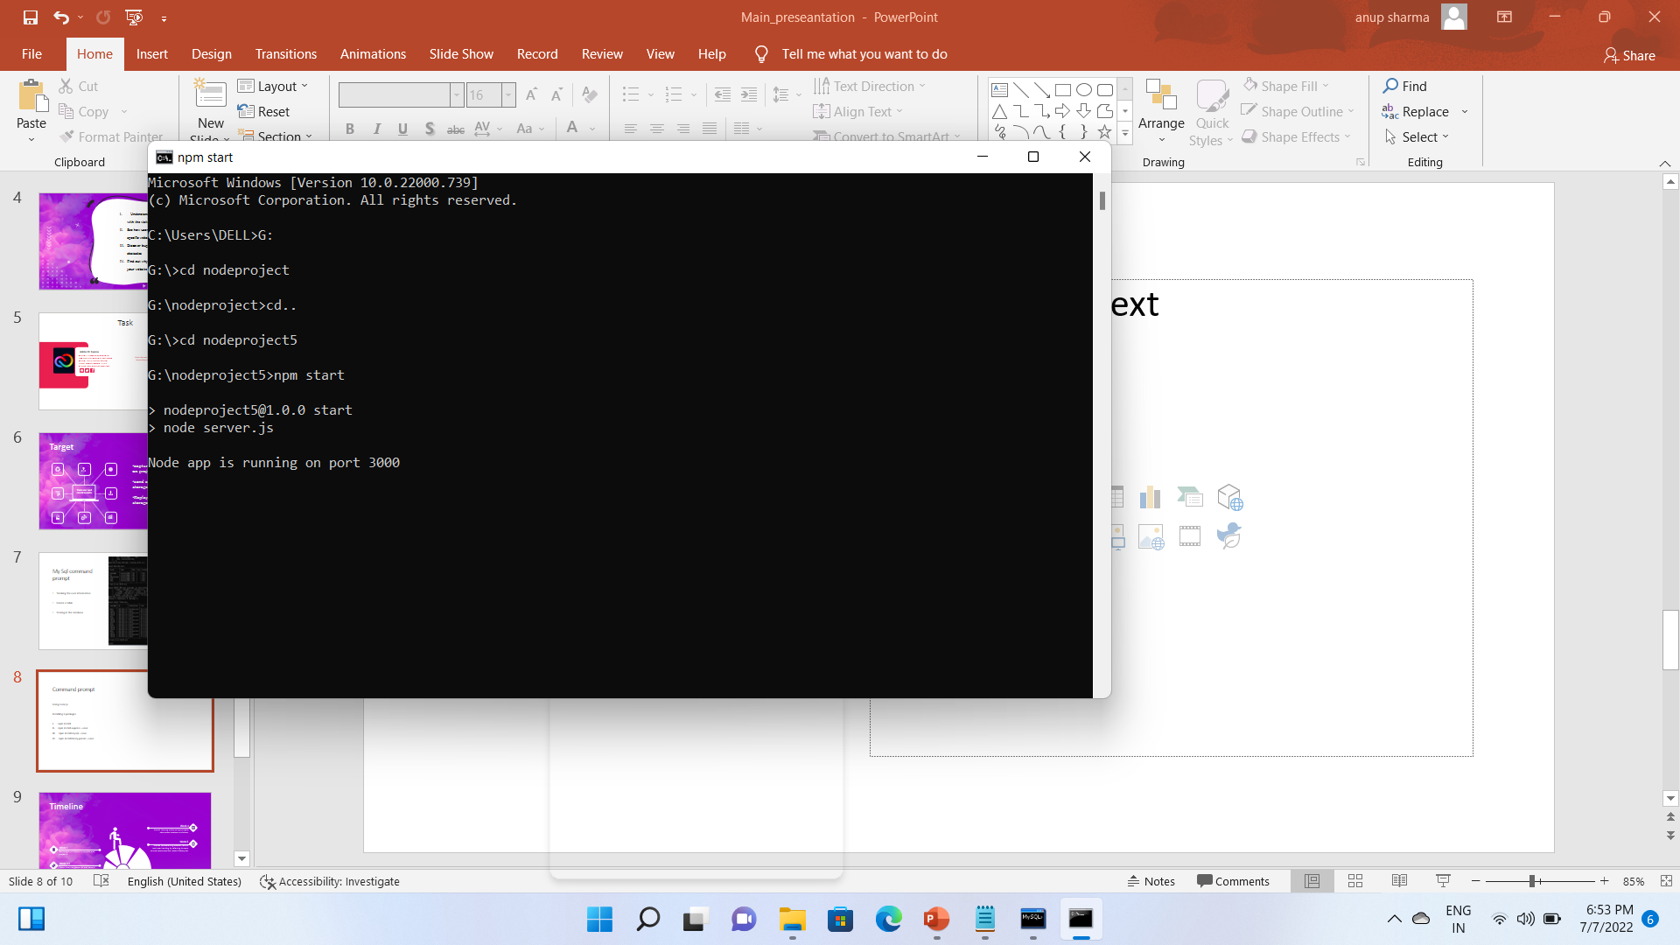
Command prompt
Using node js
Installing 3 packages
npm install
npm install express --save
npm install mysql --save
npm install body-parser --save

Slide 9
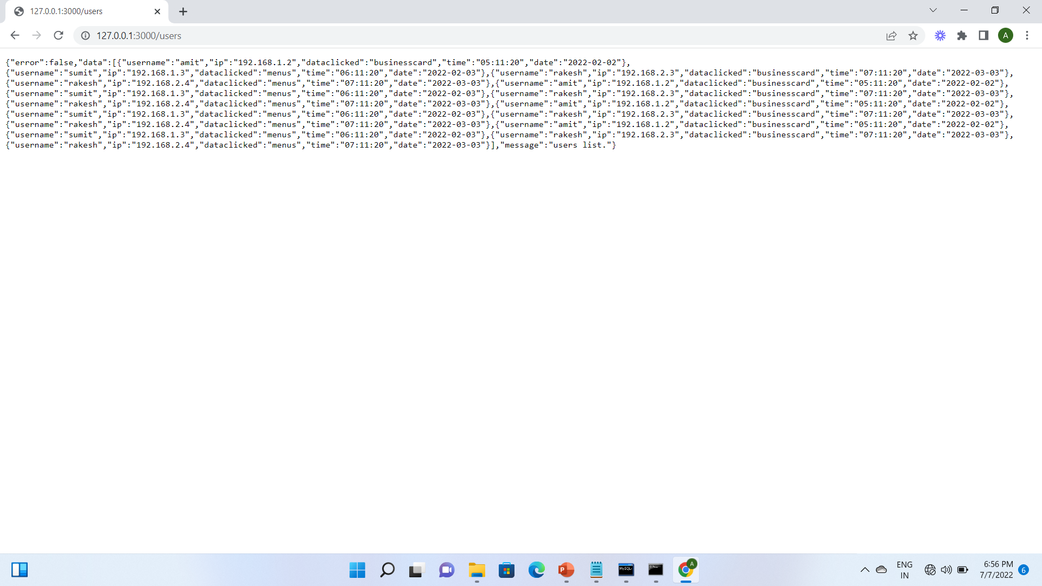

Slide 10
Timeline
Week 4
Started learning nodejs and got insights about what database is all about.
Week 5
Week 1
Started working on session record and user tracking by referring to open source resources
Got insights of adobe cc express and project X
Week 2-3
Learnt html,css,javascript and done a crash course on web development

Slide 11
Session record and replay
Session record
We will be going to check today :
Session record
Session replay
Using reactjs (on command prompt)
npm i reactstrap
npm i recordrtc
npm i bootstrap

Slide 12
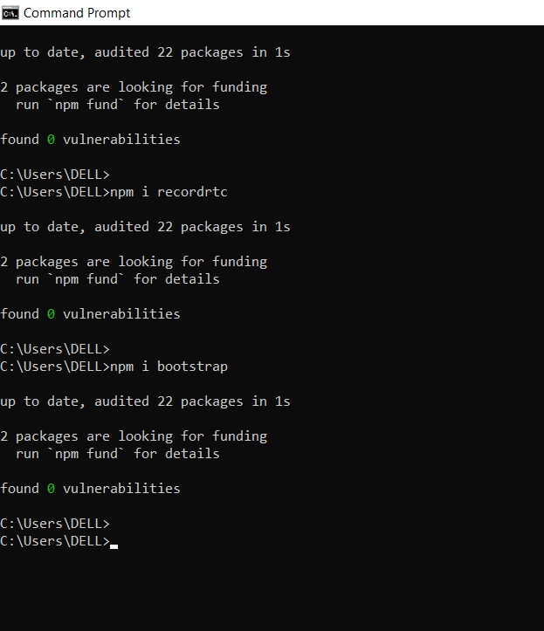
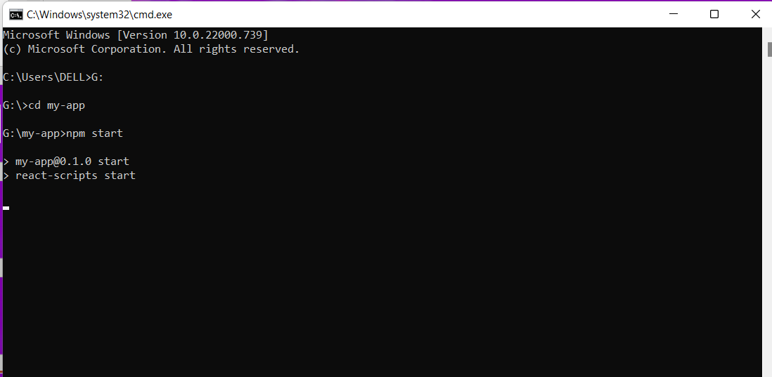

Slide 13
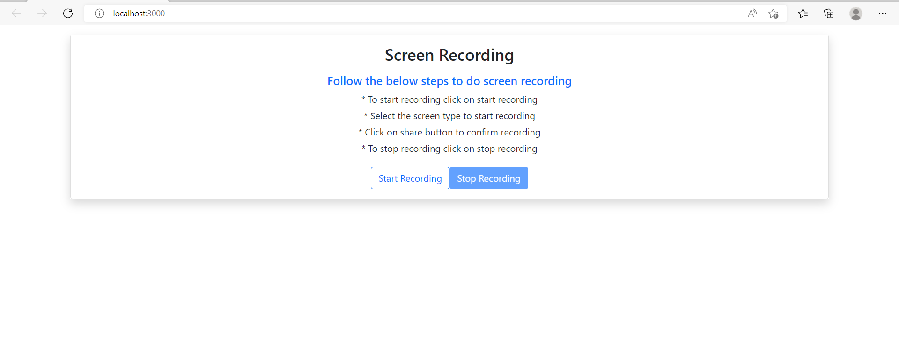

Slide 14
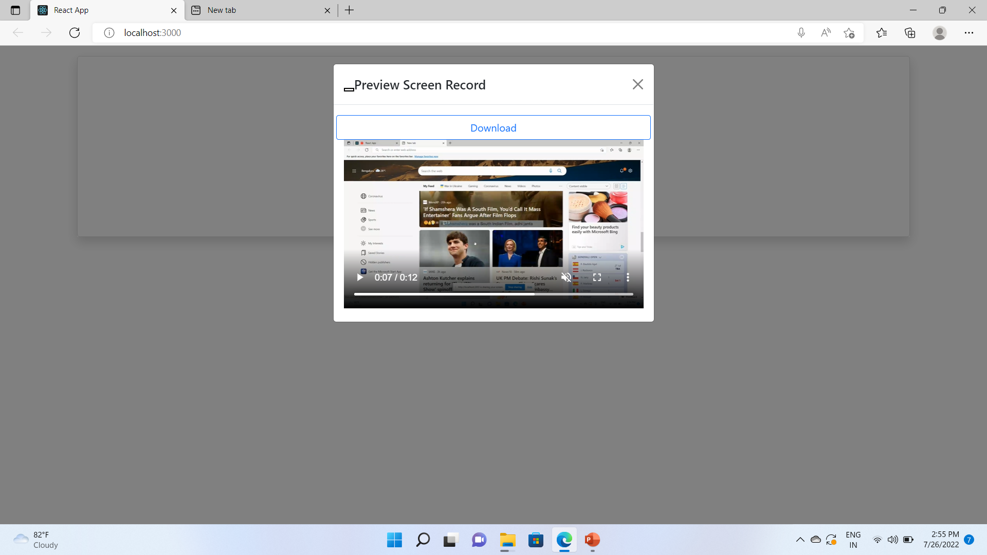

Slide 15
The red circle represents the cursor moving
Which can help us to track user activity
-can download it in mp4 format
Replay the session
Capture the voice and the mouse movements

Slide 16
https://drive.google.com/file/d/1kQEgRcsQQxIrQVlbaQSDrEQ-0a5ke786/view?usp=sharing
(For demonstration of project)

Slide 17
Thank You

