Slide 1


FUNDAMENTALS OF DATA VISUALIZATION IN BOKEH
(Yellow taxi(oct-nov)
http://www.free-powerpoint-templates-design.com

Slide 2
INDEX
About dataset
Types of visualization done using bokeh
Timeline and my learning

Slide 3
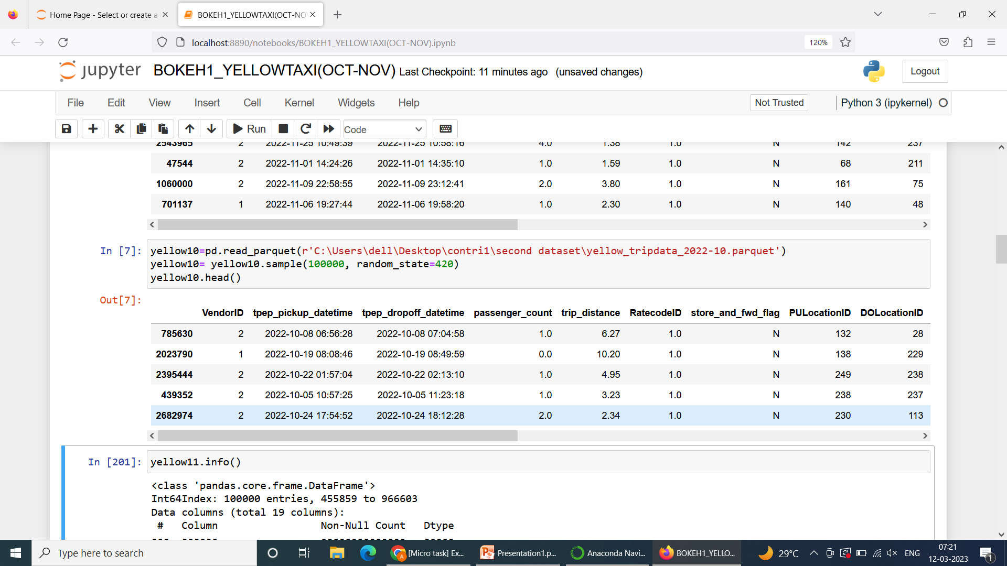
ABOUT DATASET
This is the dataset containing the information of yellow taxi betwwen the months oct and nov .It contains the number of passengers,total and fare mount,tips ,extra ,vendorID etc

Slide 4
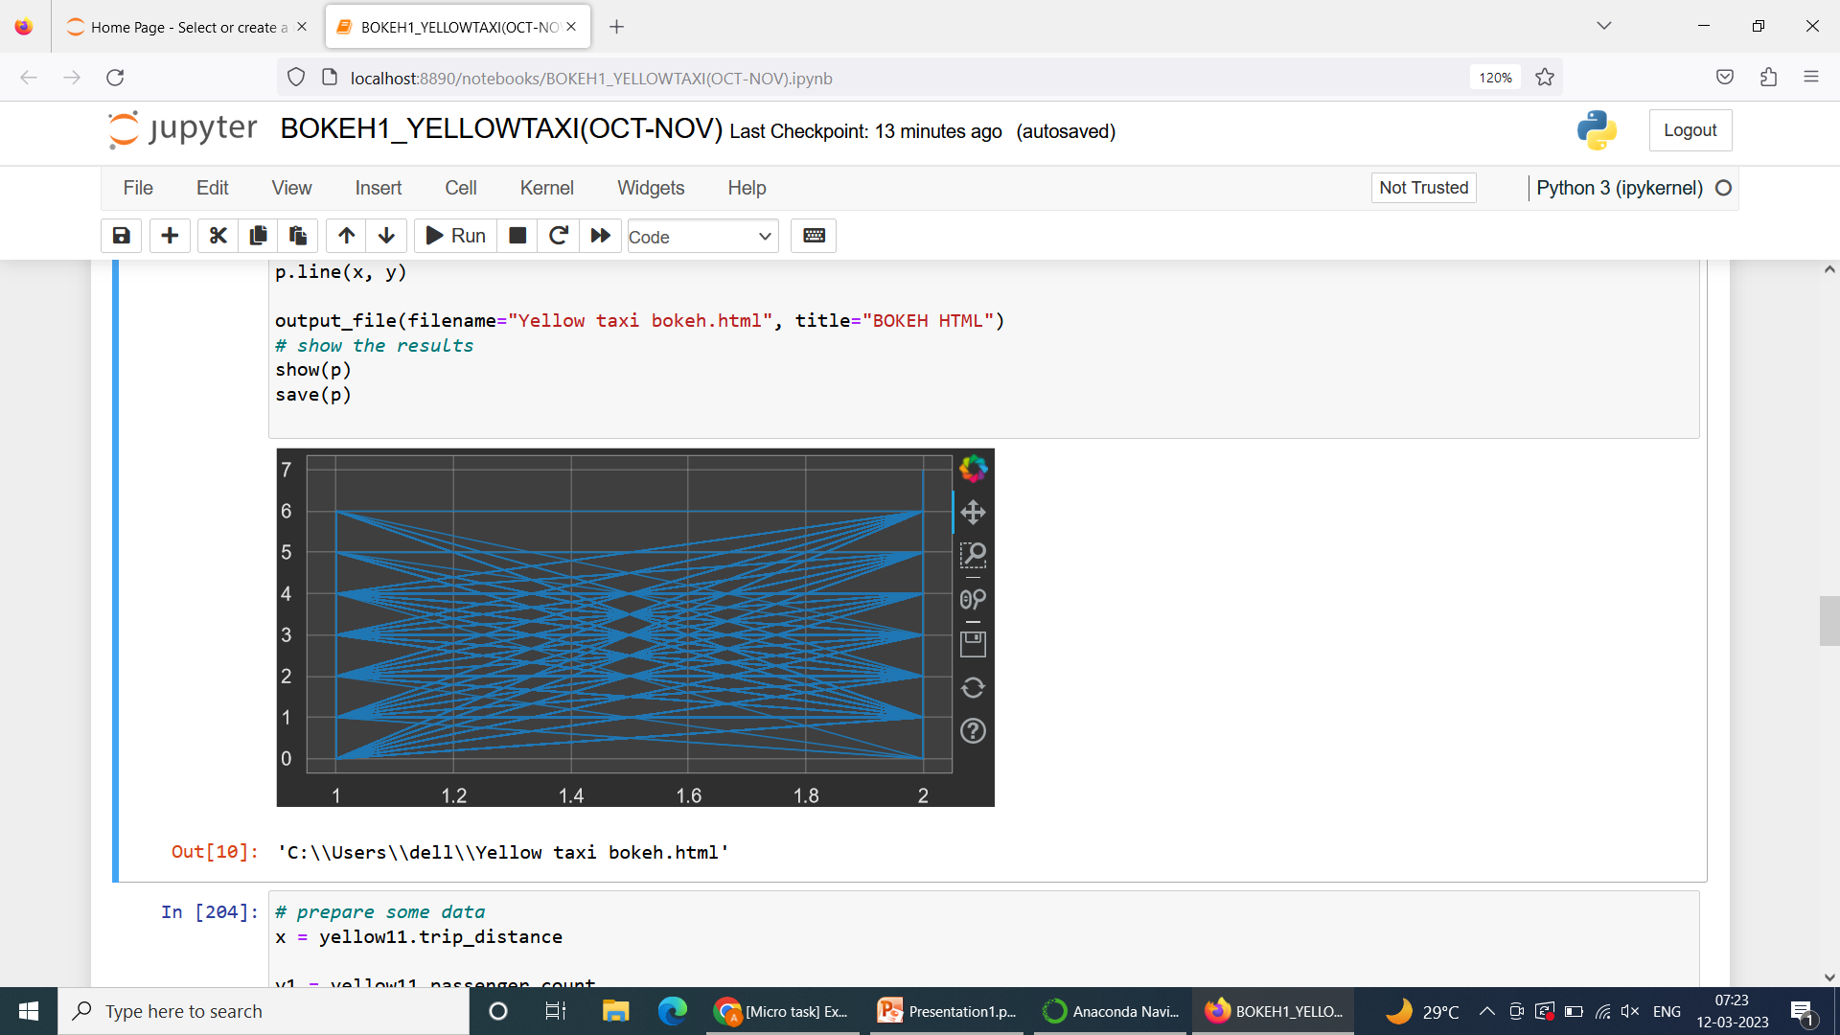
# Marking the vendor ID and passengers going for yellow taxi
Link to access:'C:\\Users\\dell\\Yellow taxi bokeh.html'

Slide 5
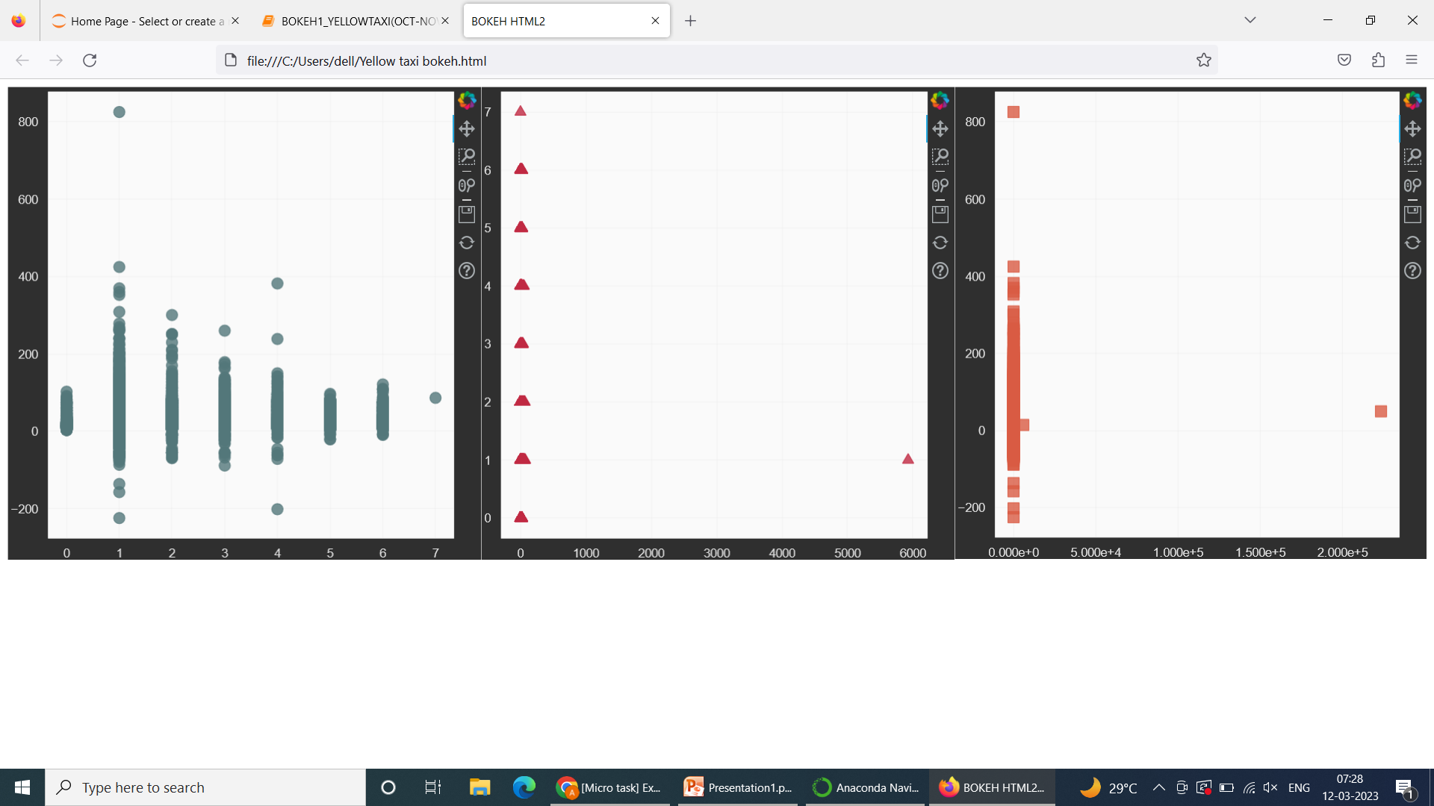
#gridplot for analysing the relation between trip distance,total amount and number of passenger travelling
Plot 1- passenger count and total amount
Plot 2- trip distance and passenger count
Plot 3-trip distance and total amount

Slide 6
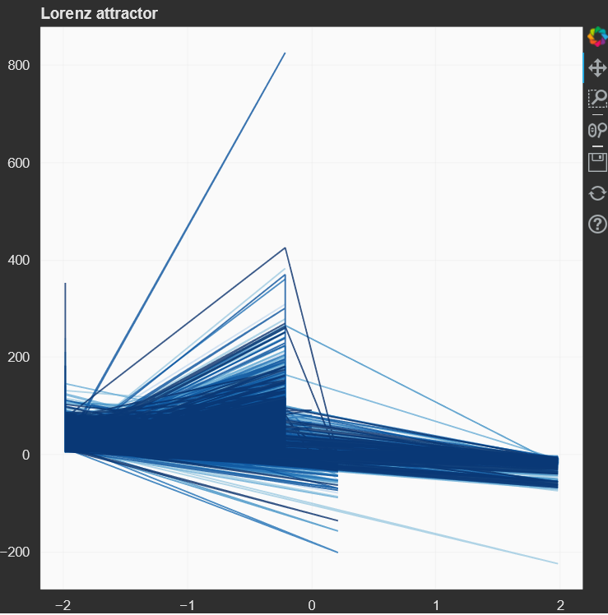
#plotting the lorenz for trying to analyse the relation between improvement and congestion surcharge along with total_amount
Link:
'C:\\Users\\dell\\Yellow taxi bokeh.html'

Slide 7
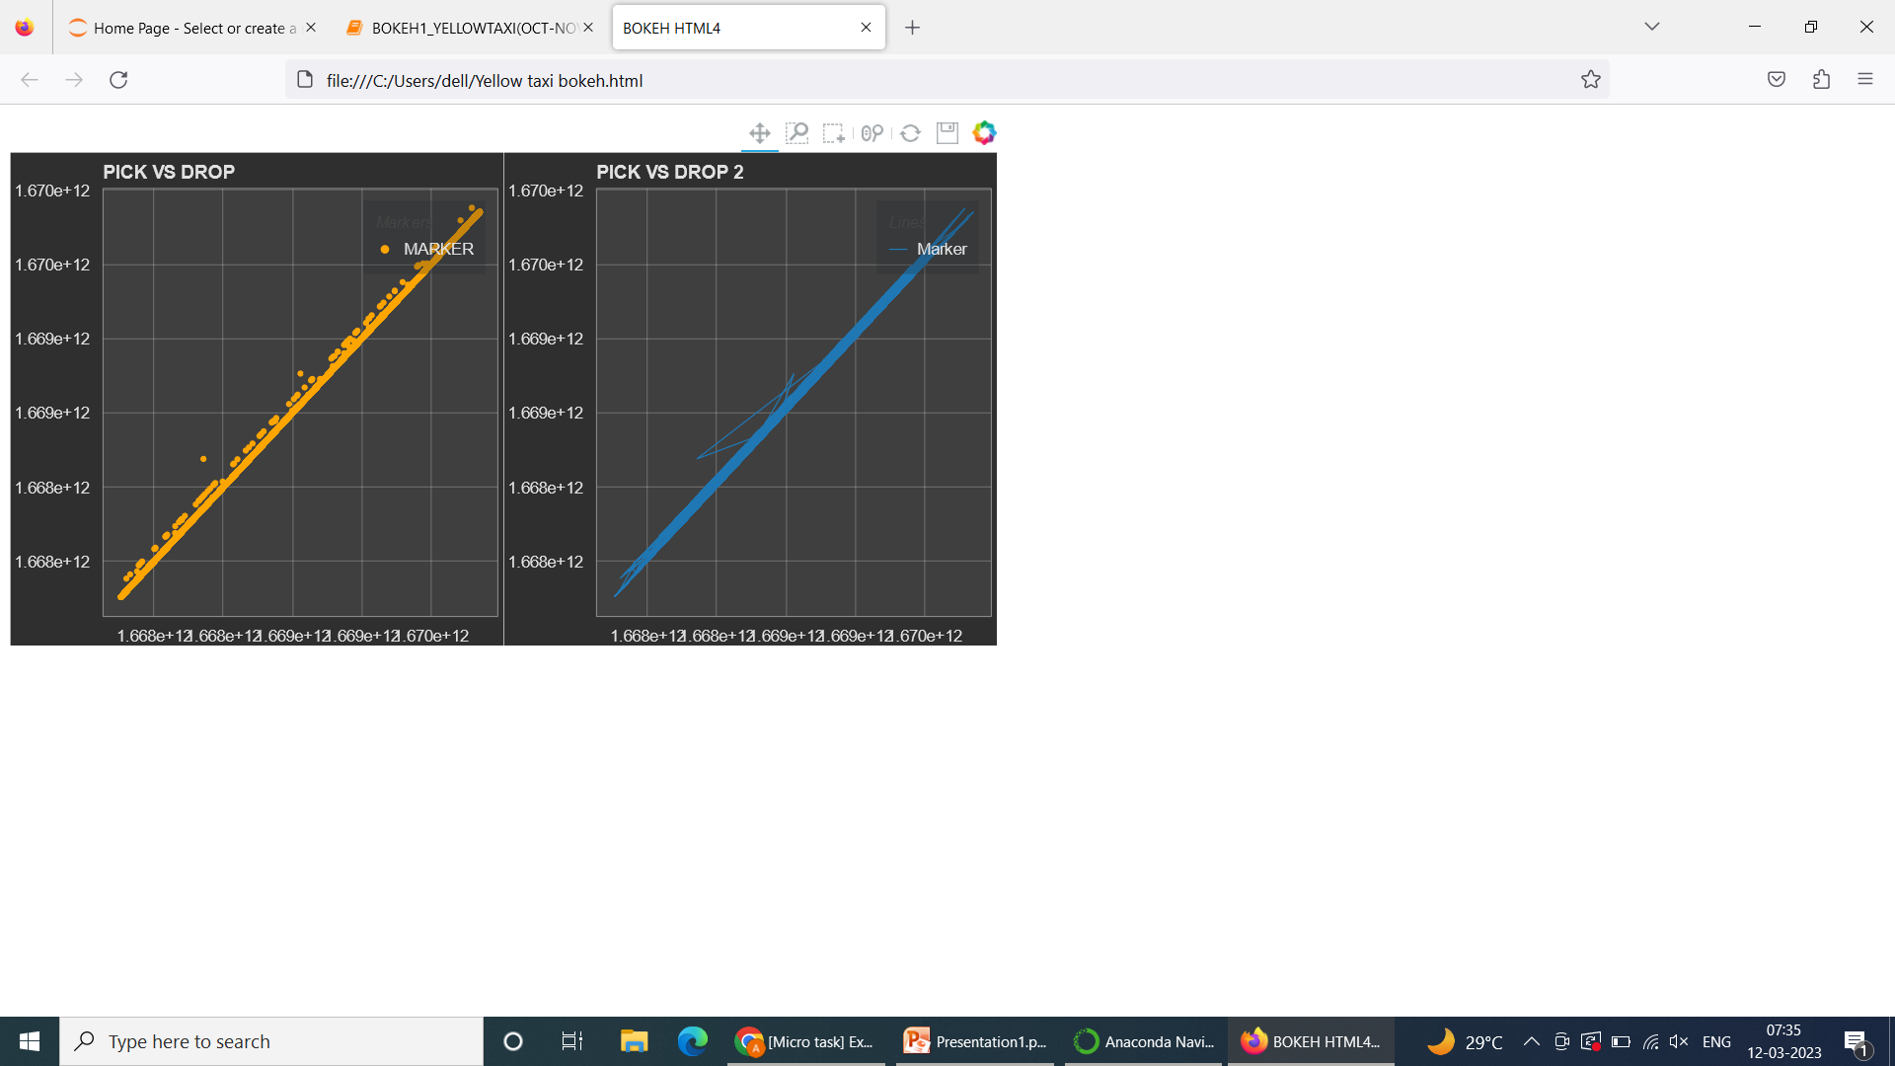
#trying to get the pick up and drop date&time using two different plots circle and line

Slide 8
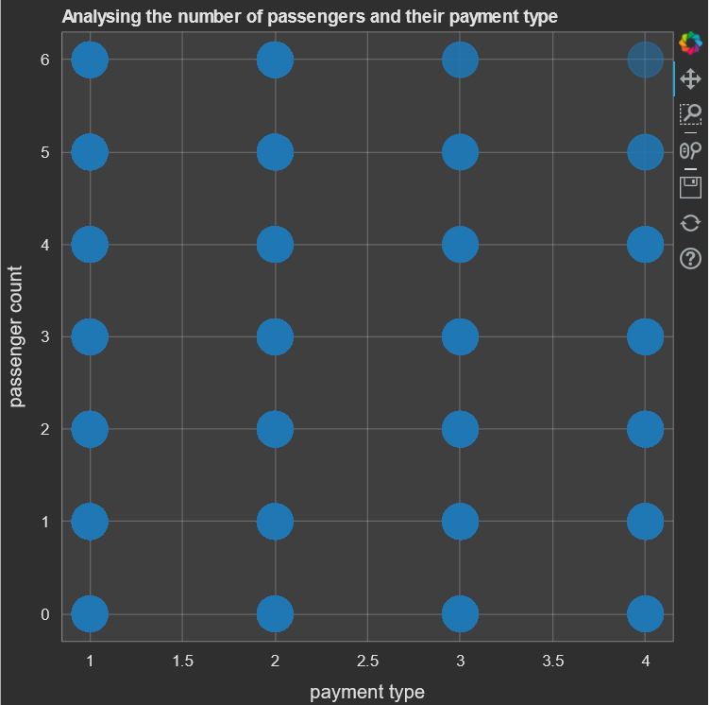
# Create plot to analyse the payment type chosen by the number of passengers in the taxi
Link:
'C:\\Users\\dell\\Yellow taxi bokeh.html'

Slide 9
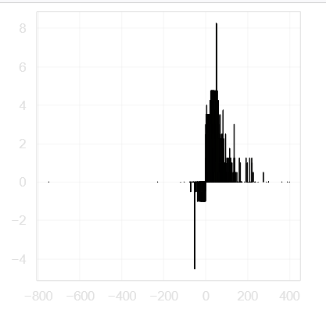
‘#plot showing the relation between the fare amount and extra paid by the passengers
Link :
C:\\Users\\dell\\Yellow taxi bokeh.html'

Slide 10
Timeline
Day 5-7
Started coding and debugging issues encountered while plotting the graph .
Day 7-8
Day 1-3
Reviewing the code again and preparing the proper documentation
Got insights of Bokeh through documentation and introduction in the slack
Day 4-5
Understanding the dataset and finding the relationship between them

Slide 11
Thank You

