Slide 1
WHATSAPP CLONE APP
MINI PROJECT-2
Session : 2021-22
Submitted by:
Anushka Singh Rathore
(191500143)
Submitted to:
Md. Amir Khan

Slide 2
Why WhatsApp Clone Web App?
Whatsapp is a freeware application which can be installed on mobile phones, tablets and other computing devices.
It works on VOIP (Voice Over Internet Protocol).
It can be used to send text messages, images, documents, user location, audio/video and other media files etc.
Whatsapp can be used to make voice calls and video calls to other phones. Both the phones (e.g. caller and called) require whatsapp installation before making calls.
Whatsapp support variety of operating systems (OSs) such as iOS, android, windows, symbian, blackberry etc.

Slide 3
Features of this App
This app comes with Google Authentication login options.
Just by login , user can chat with any one he/she wants.
After successfully signin, user can see his/her Gmail account image in
chat user window .
Add new user or room option is there for more user to chat with one
another.

Slide 4
Technology Used
For Frontend
Visual Studio Code Editor.
React JSX
HTML and CSS
For Backend
Firebase (Authenticaton & Realtime database).
Node Server

Slide 5
Impact of App on User
The effect of WhatsApp on our lives, culture, and society keeps on increasing. It is also becoming popular tool for marketing in businesses and publicity in politics.
This growth has also drawn the attention of researchers to understand the implications and effect of WhatsApp on its user’s social and personal life.
This survey results show that there is a significant impact of WhatsApp on its users. Around 66% of WhatsApp users believe that WhatsApp has improved their relationship with friends. More than 63% of its users think it is not harmful for them.

Slide 6
Scalability / Usability of our App
WhatsApp has quickly emerged as the go-to messaging app for over 1.6 billion consumers around the globe. It's a fast, simple, and convenient way for family and friends to chat, create group texts, share photos and videos, send and receive documents, and engage in private, secure conversations anytime, day or night.
WhatsApp Messenger is a cross-platform instant messaging application that allows iPhone, Blackberry, Android, Windows Phone and Nokia smartphone users to exchange text, image, video and audio messages for free. WhatsApp is especially popular with end users who do not have unlimited text messaging.

Slide 7
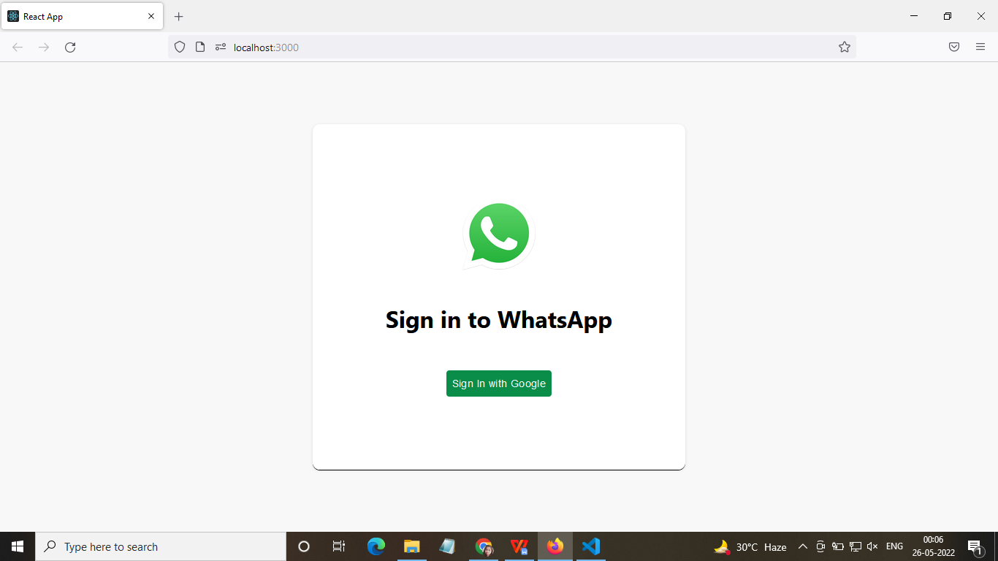
Working of our App
Login Screen

Slide 8
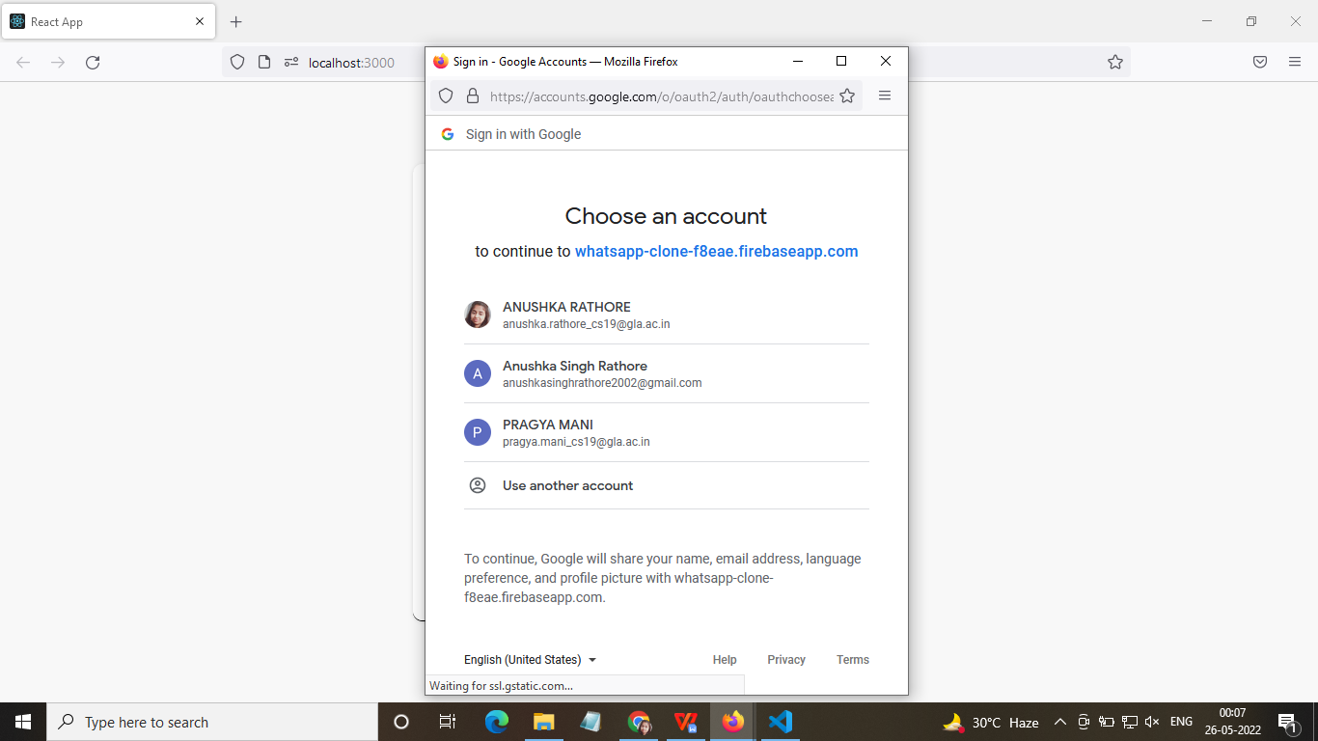

Slide 9
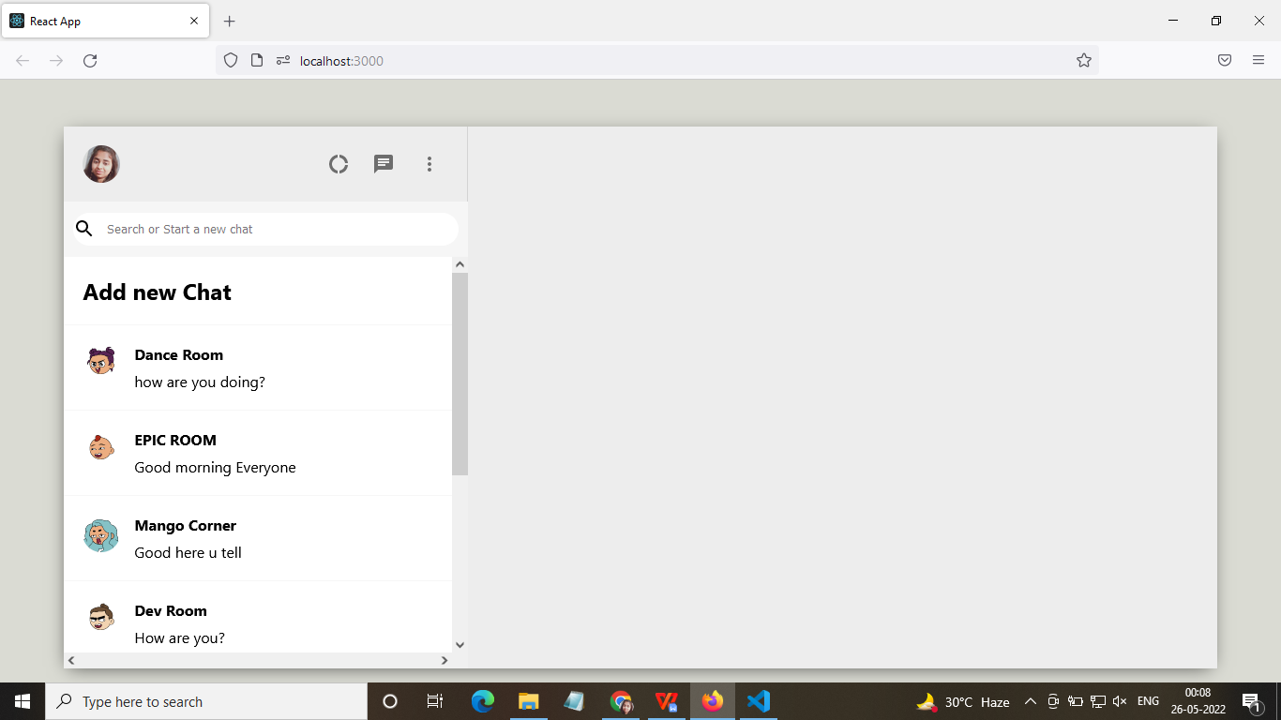
Chat Screen

Slide 10
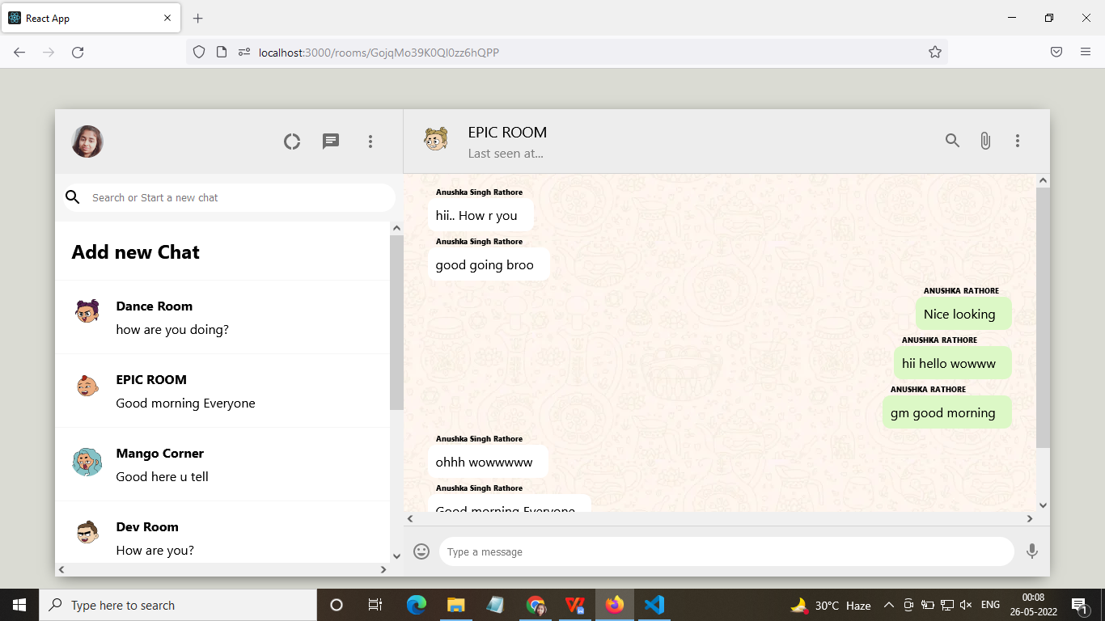

Slide 11
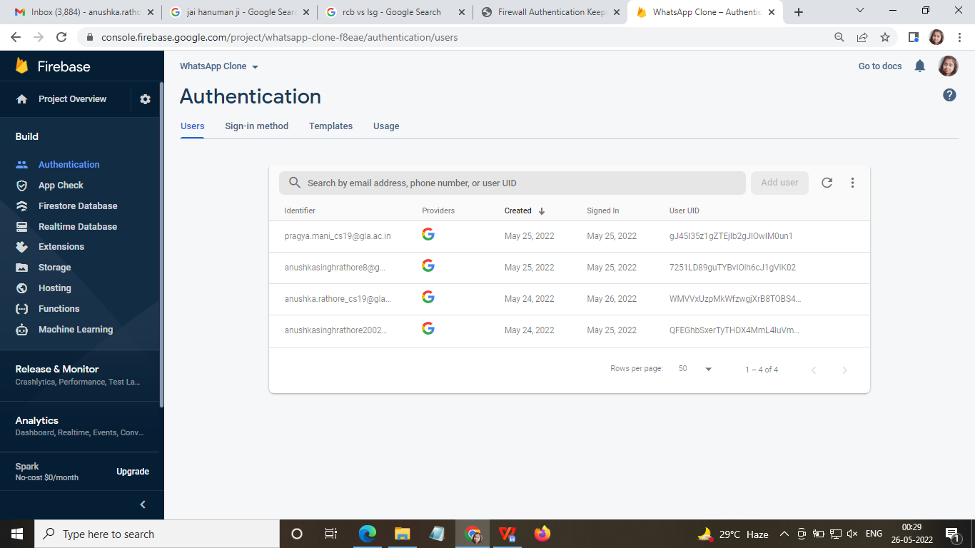
Database - Authentication

Slide 12
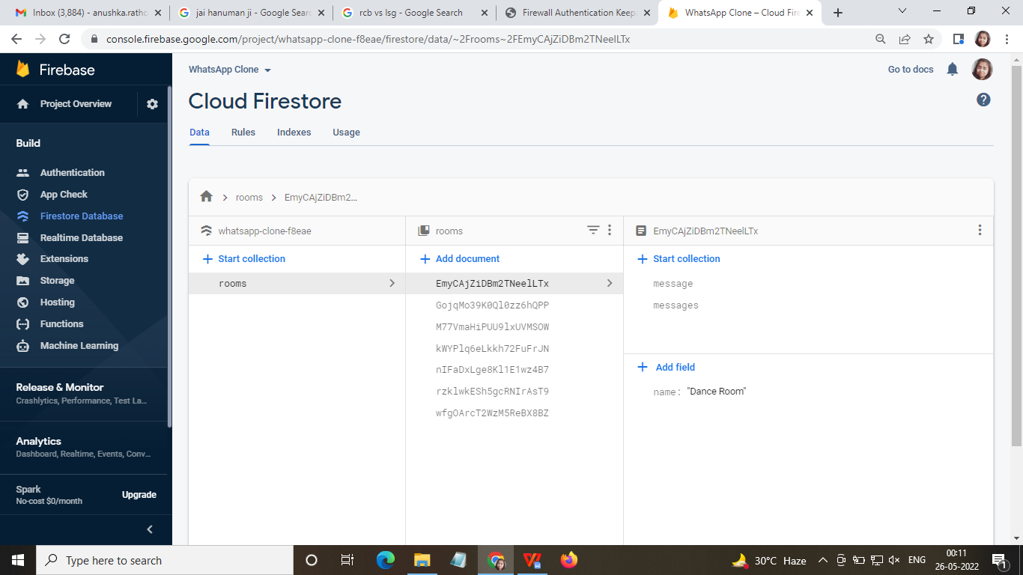
Firestore Database

Slide 13
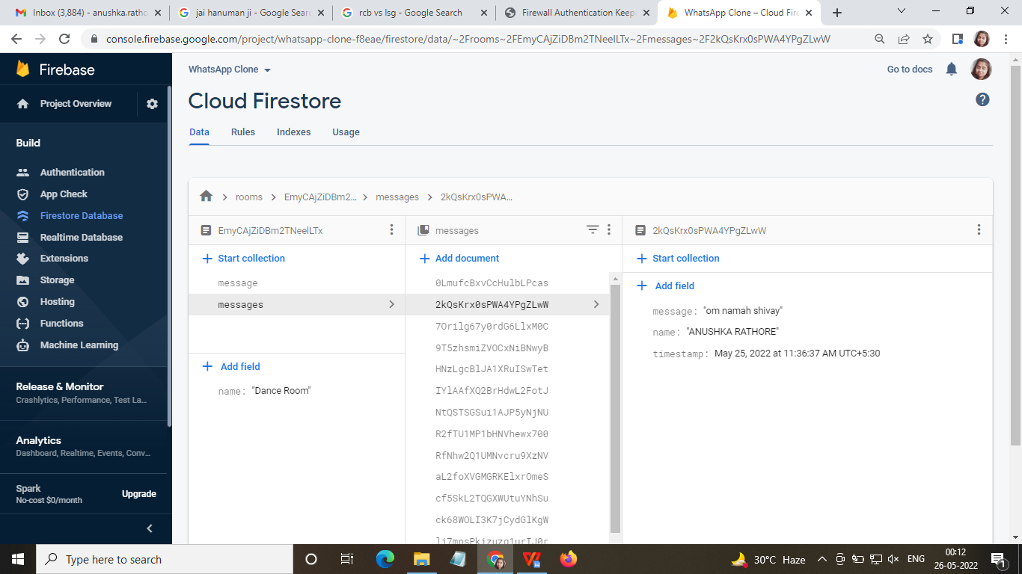
Firestore Database

Slide 14
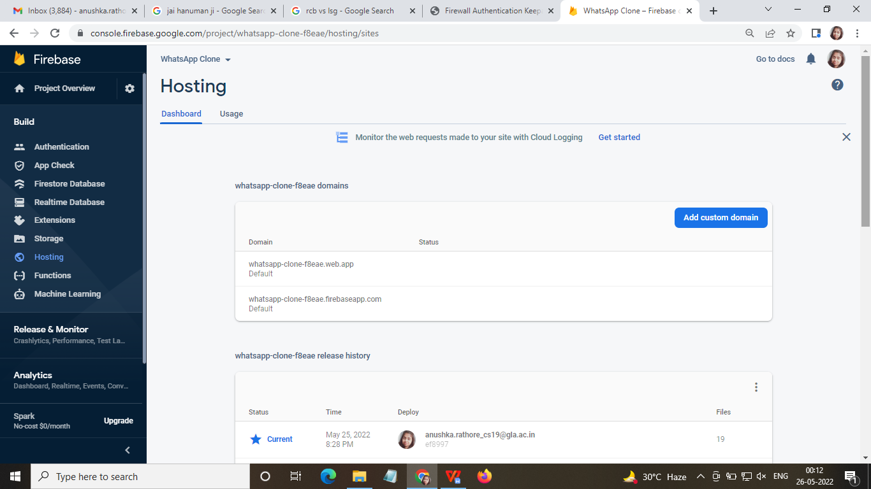
Firebase Deploy

Slide 15
Future Scope
Addition of online payment option.
Documents and other file sending option.
Voice typing should be there.
Different databases can be used for better handling of user data.

Slide 16
THANK YOU

Slide 17
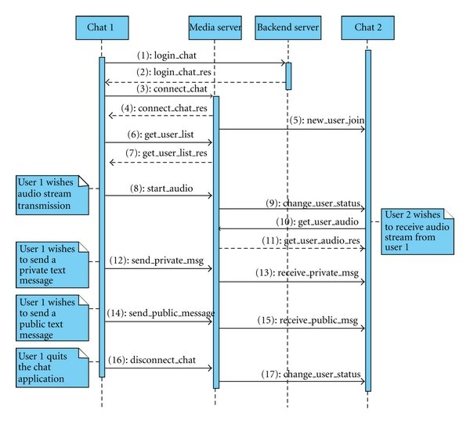
Working of our App

