Slide 1
PHASE-1
ME-609
Optimisation Methods in Engineering
Bounding Phase Method & Golden Section Method
Submitted by
Anushka Anand-190103016
Richa Kumari- 190103074

Slide 2
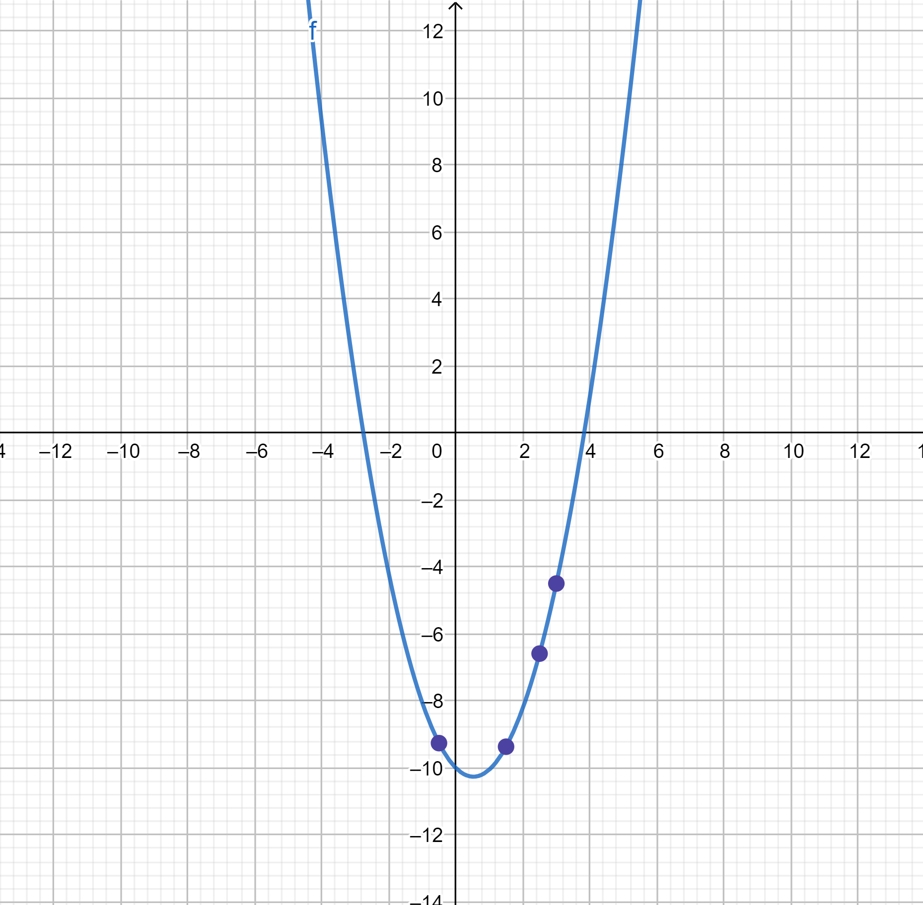
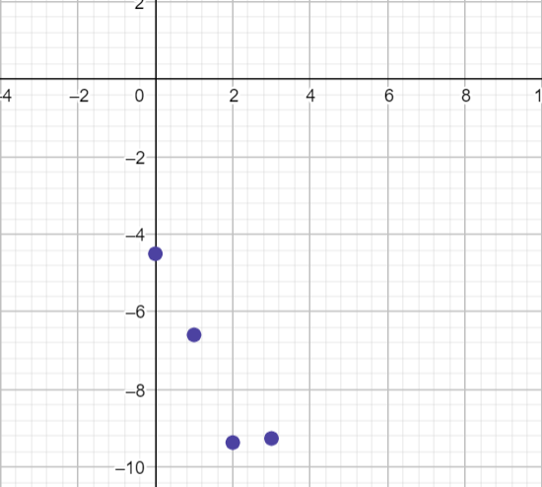

f(x)
f(x)
x
No. of iterations
Initial guess, x=3
Bounding Phase
Delta=0.5
Total Iterations: 3
First Iteration, x=2.5
Last Iteration, x=-0.5

Slide 3
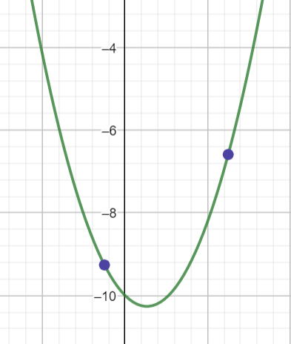
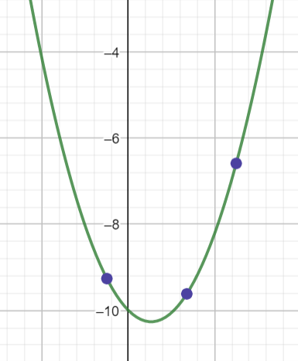
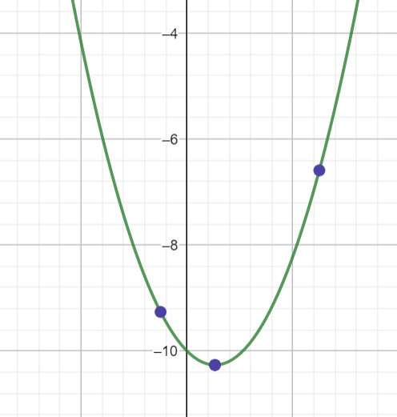
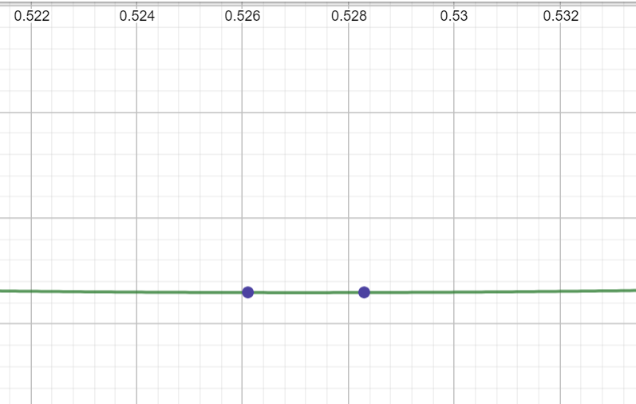
f(x) vs x
First Iteration
Last Iteration
(-0.5, 2.5)
(-0.5, 1.354)
Golden Section Method
Input Range(From Bounding Phase)= (-0.5, 2.5)
Initial guess=3
Total Iterations: 15 Epsilon=0.001
Golden Section Method
Input Range(From Golden Section)= (-0.5, 2.5)
Initial guess=3
Total Iterations: 15 Epsilon=0.001
Final Range= (0.526102, 0.5283)

Slide 4
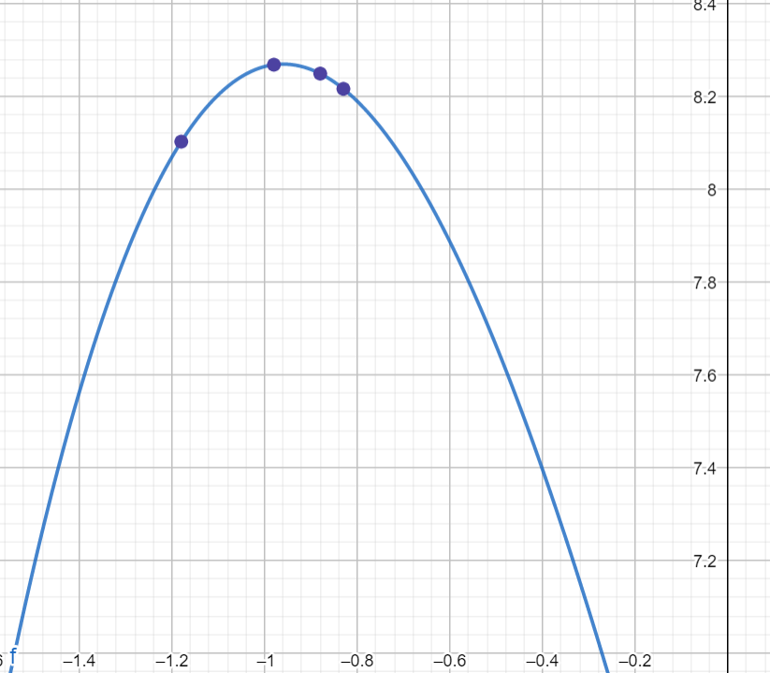
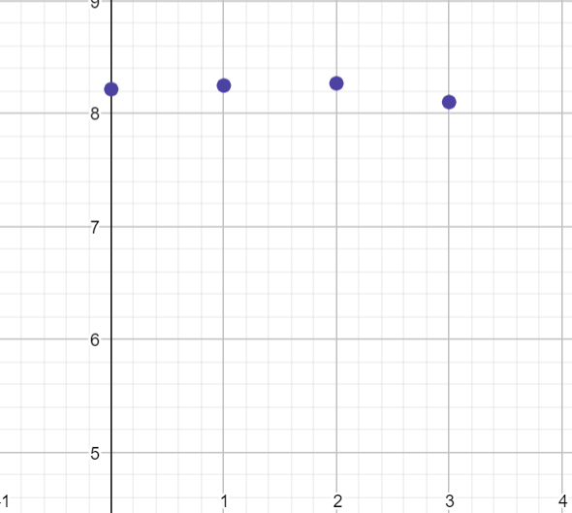

f(x)
First Iteration, x=-0.880018
Initial guess, x=-0.830018
Last Iteration, x=-1.18002
f(x)
No. of iterations
x
Bounding Phase
Delta=0.05
Total Iterations: 3

Slide 5
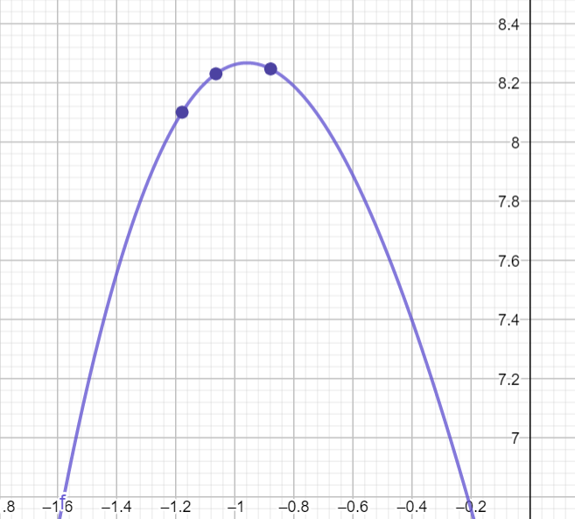
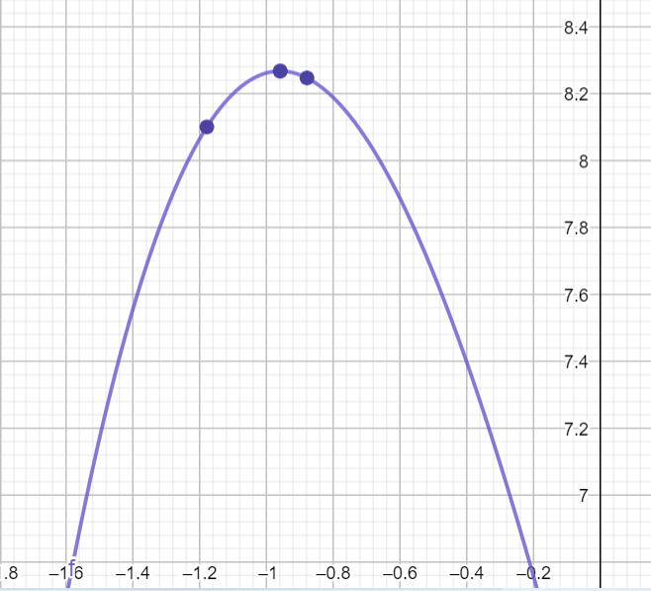
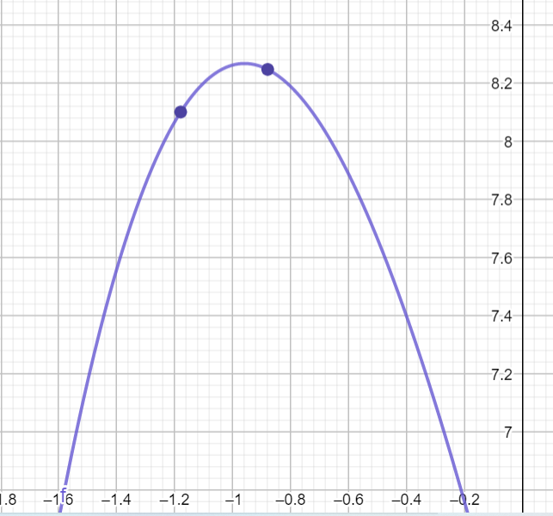
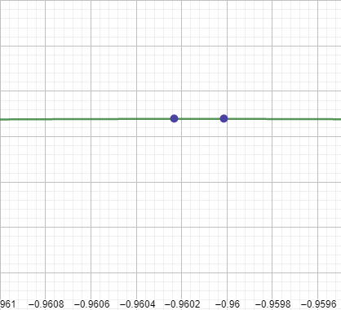
f(x) vs x
(-1.06542 ,-0.880018)
(-1.18002, -0.880018)
Golden Section Method
Input Range(From Golden Section)= (-1.18002, -0.880018)
Initial guess=- 0.830018
Total Iterations: 15 Epsilon=0.001
Final Range= (-0.960233, -0.960014)

Slide 6
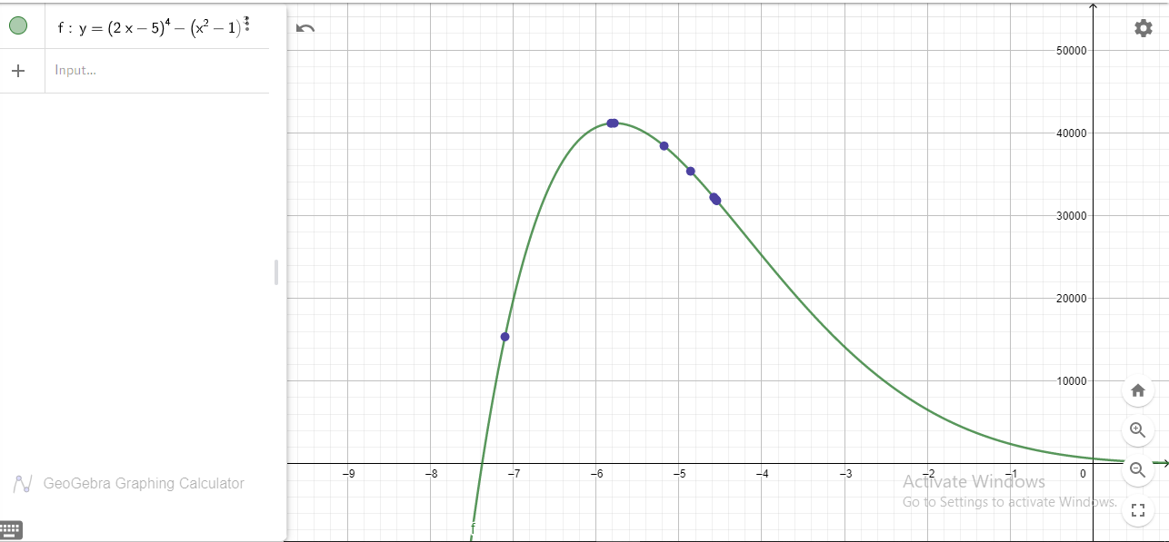

Other example
f(x)
x
f(x) =${(2x−5)}^{4} −(x^{2}−1)$

Slide 7
Thankyou
Submitted by
Anushka Anand-190103016
Richa Kumari- 190103074

