Slide 1



WRITE
JANE AUSTEN TEXT GENERATOR

Slide 2

INTRODUCTION
Developed a text generation model mimicking Jane Austen’s writing style.
Focused on the first five chapters of Pride and Prejudice.
Utilized Natural Language Processing (NLP) techniques for text analysis and generation.
Aimed to produce coherent, stylistic prose that reflects Austen’s tone and vocabulary.
Deployed using Streamlit for interactive text generation.

Slide 3


PROCESS
Data Preparation & NLP Analysis
Collected first five chapters of Pride and Prejudice
Applied NLP techniques:
Named Entity Recognition (NER)
Sentiment Analysis
Topic Modeling
Dimensionality Reduction for Topic Visualization
Deployment & Generation
Built an interactive interface using Streamlit
User inputs a prompt; model returns Austen-style prose
Deployed locally for demo use
Model Training & Fine-tuning
Used GPT-2 architecture
Fine-tuned on Jane Austen’s style

Slide 4
Why this topic ?
Reviving Classic Literature
Bringing Jane Austen’s timeless writing style to life through AI.
Exploring AI Creativity
Combining technology and creativity to generate human-like text.
Innovative Learning Gaining hands-on experience in Natural Language Processing (NLP) and AI development.

Slide 5
IDENTIFIES ENTITIES LIKE NAMES, LOCATIONS, DATES, ETC., FROM THE TEXT.
LEVERAGED SPACY FOR ACCURATE EXTRACTION AND LABELING.
NAMED ENTITY RECOGNITION (NER)
EXTRACTS LATENT TOPICS FROM A LARGE COLLECTION OF TEXTS.
APPLIED LATENT DIRICHLET ALLOCATION (LDA) WITH TF-IDF TO DETECT HIDDEN THEMES IN THE TEXT.
TOPIC MODELING (LDA)
NLP
TECHNIQUES
ANALYZES THE SENTIMENT (POSITIVE, NEGATIVE, NEUTRAL) OF THE TEXT.
HELPS UNDERSTAND EMOTIONAL TONE AND CONTEXT WITHIN AUSTEN’S WORKS.
SENTIMENT ANALYSIS
DIMENSIONALITY REDUCTION
FOR TOPIC VISUALIZATION
CREATIVE IDEA
PRINCIPAL COMPONENT ANALYSIS (PCA): REDUCED THE DIMENSIONALITY OF TOPIC DISTRIBUTIONS FOR CLEAR VISUALIZATION.
T-DISTRIBUTED STOCHASTIC NEIGHBOR EMBEDDING (T-SNE): VISUALIZED HIGH-DIMENSIONAL TOPIC DATA IN 2D FOR EASIER INTERPRETATION.

Slide 6

Novelty
Combines AI with Classic Literature: Merges NLP techniques with Jane Austen's writing style, enabling AI-generated content that mimics her tone and themes.
Fine-Tuned GPT-2 Model: Trains GPT-2 specifically on Austen’s novels, ensuring output reflects her unique language and style.
Interactive Text Generation: Users can generate personalized content in Austen's style, making AI engaging and accessible.
Topic Modeling for Literary Insights: Uses LDA to uncover thematic patterns in Austen’s works, providing a tool for literary analysis.
Streamlit Cloud Interface: The project is deployed on Streamlit Cloud, offering an easy, real-time platform for exploring AI-generated content.

Slide 7
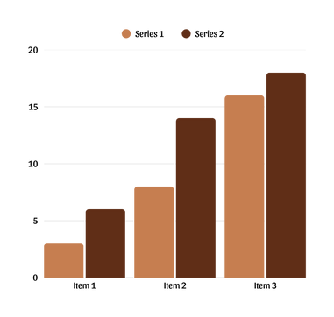
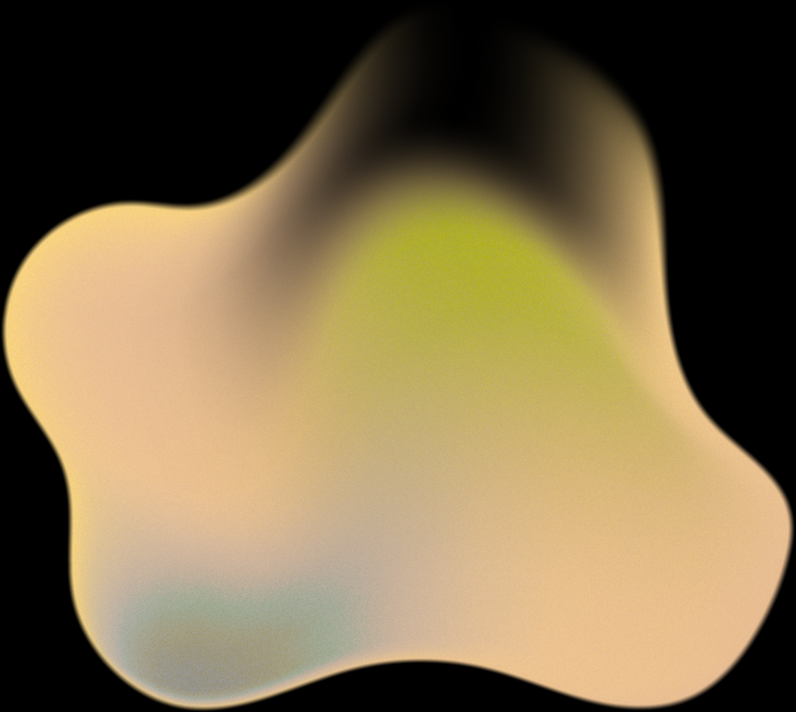


Challenges & Solutions
Fine-tuned GPT-2 on selected chapters using TextDataset and custom tokenization to capture her vocabulary, tone, and syntax.
Performed Topic Modeling (LDA with TF-IDF) and NER to identify dominant themes and characters, making the model’s output more explainable.
EMULATING
JANE
AUSTEN’S
LITERARY
STYLE
SMALL
AND
DOMAIN
SPECIFIC
TRAINING
DATA
LACK OF
INTERPRETABILITY
IN LANGUAGE
GENERATION
DIFFICULTY
IN USER
ACCESS AND
DEMONSTRATION
Augmented limited chapter data with custom preprocessing (lemmatization, stopword removal), then combined chapters into one dataset to strengthen stylistic consistency.
Built an interactive Streamlit app and hosted it via Ngrok, enabling real-time prompt-based generation of Austen-style text.

Slide 8
FUTURE SCOPE
Multi-Author Style Generation
Extend the model to generate text in the style of various authors (e.g., Shakespeare, Dickens, J.K. Rowling).
Allow users to choose an author and switch styles dynamically.
Interactive Writing Assistant
Develop a co-writing tool that helps users compose stories or essays in Jane Austen's style.
Provide real-time suggestions, grammar checks, and stylistic enhancements.
Use of Larger Language Models
Fine-tune more advanced models like GPT-3, GPT-J, or LLaMA for improved accuracy and coherence.
Enable longer, more thematic content generation.
Web and Mobile App Deployment
Build a responsive and aesthetic UI for mobile and web using frameworks like React or Flutter.
Host the model via Streamlit Cloud, Hugging Face Spaces, or a custom API.
Integration into Educational Tools
Embed the generator in educational platforms for literary style analysis and creative writing practice.
Help students learn writing styles through interactive examples.
Voice-to-Text Style Conversion
Add a voice input feature where users speak, and the model rephrases their speech in Austen’s style.
Useful for accessibility and a more immersive experience.

Slide 9

THANK YOU
ANUSHKA RAI
E23BCAU0011

