Slide 1

AWS Elemental MediaConvert for Video Editing
B. Anushka (2210030416)
Under the esteemed guidance of
Ms. P. Sree Lakshmi
Assistant Professor,
Department of Computer Science and Engineering

Slide 2
Project Overview
With the increasing demand for video content across platforms such as YouTube, social media efficient video processing has become crucial.
Cloud-based video editing provides a scalable and cost-effective way to process, edit, and deliver high-quality video content.
The goal is to automate video editing and transcoding by leveraging AWS cloud services, eliminating the need for on-premises infrastructure.

Slide 3

Services Used
Amazon S3
Amazon Simple Storage Service is an object storage service offering industry-leading scalability, data availability, security, and performance.
By integrating S3 with AWS Elemental MediaConvert, videos can be processed directly from the storage, ensuring a seamless workflow.

Slide 4

Services Used
2. AWS IAM
IAM is used to define roles and permissions, ensuring that only authorized users and services can access specific AWS resources.
IAM policies are implemented to grant MediaConvert permissions to read videos from S3 and store the processed files back securely.

Slide 5

Services Used
3. AWS Elemental MediaConvert
AWS Elemental MediaConvert enables professional-grade video transcoding by converting video files into multiple formats, adjusting resolution, and optimizing compression.
It also provides advanced features such as noise reduction, subtitle embedding, multi-bitrate streaming, and watermarking for content protection.

Slide 6
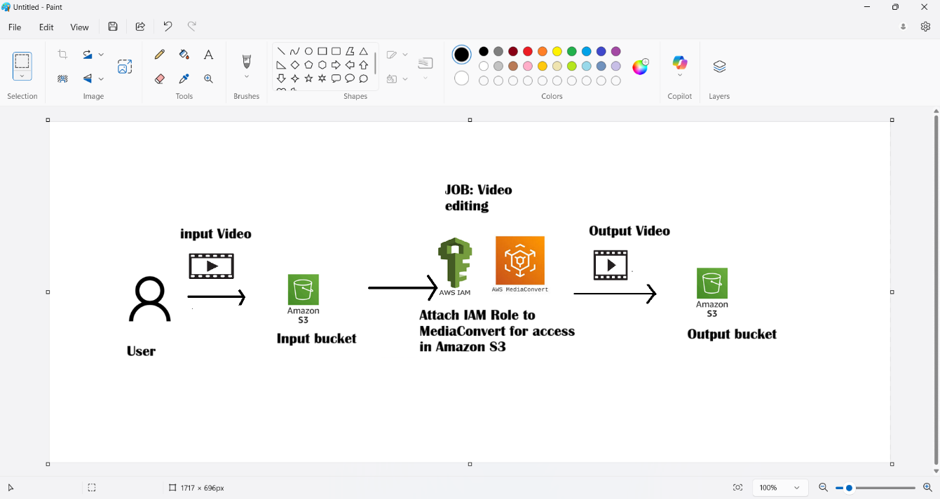
Flow Diagram

Slide 7
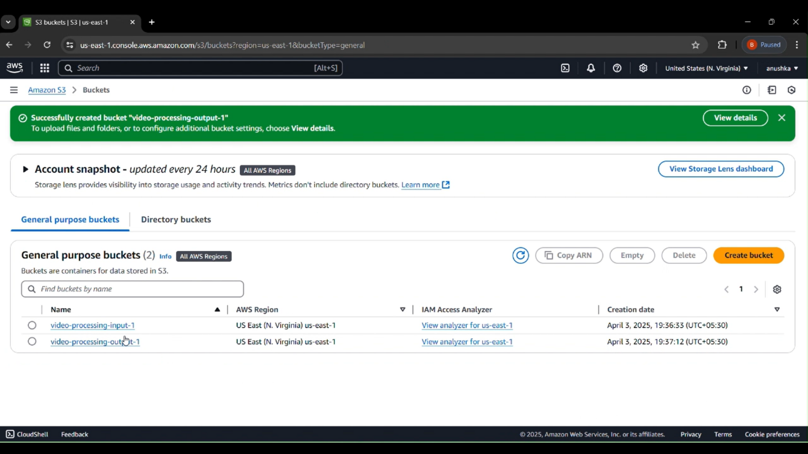
Implementation Process
Step-by-step execution flow:
Step 1: Login to AWS Console.
Step 2: Open S3 Service and create two buckets one for input and other for output.

Slide 8
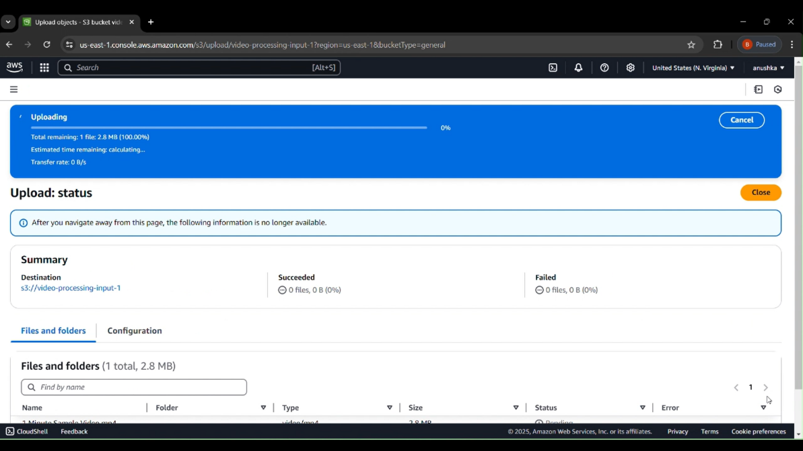
Implementation process
Step 3: Upload Video to input S3 bucket.
Step 4: Create an IAM Role for MediaConvert to access in S3 bucket.
Step 5: Create job in MediaConvert and integrate with the IAM Role.

Slide 9
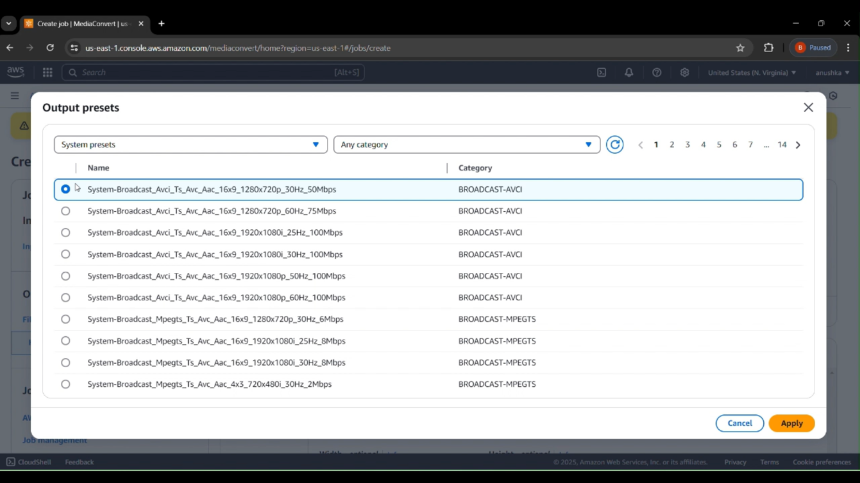
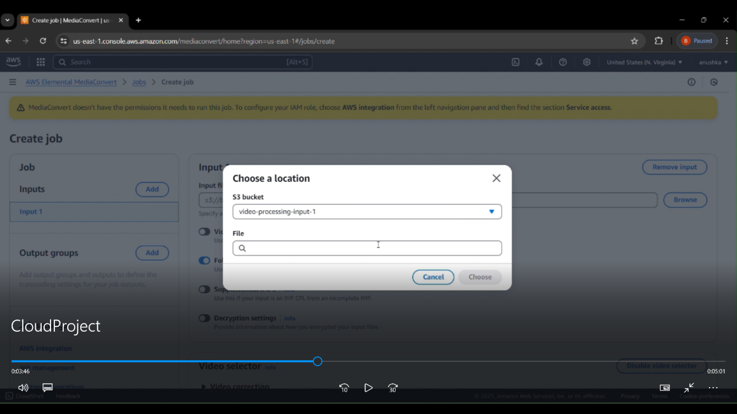
Implementation process
Step 6: Video Processing with AWS Elemental MediaConvert.
Step 7: Select output bucket which stores the processed video in S3.

Slide 10
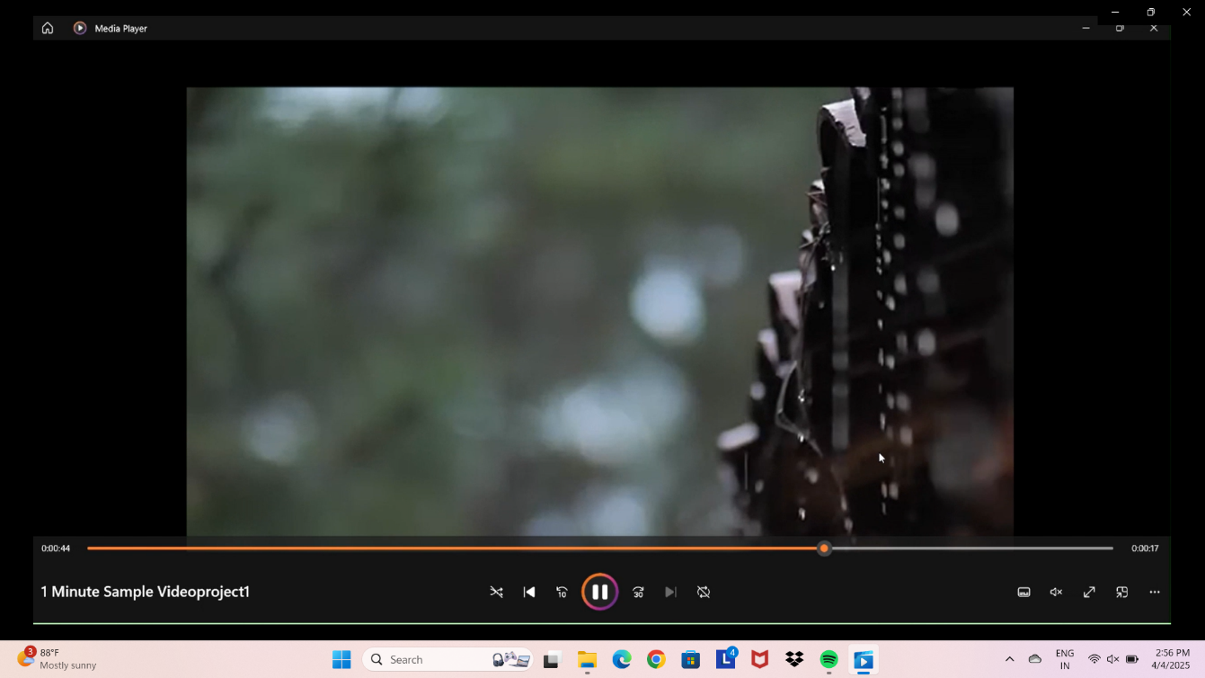
Implementation process
Step 8: If we have disabled block public access we can watch it in browser or download in local computer.

Slide 11
Key Features and Functionality
MediaConvert supports a wide range of video formats, including MP4, HLS, and MPEG-DASH, ensuring compatibility across different devices.
It also provides advanced features such as noise reduction, subtitle embedding, multi-bitrate streaming, and watermarking for content protection.
Can be opened in browser, or use the link to open in local computer device or can be downloaded in various formats and resolutions which affects the size and bitrate rate.

Slide 12
Key Features and Functionality
By integrating these AWS services, the cloud-based video editing platform becomes highly automated, scalable, and efficient.
Amazon S3 stores the video content, IAM ensures secure access management, and MediaConvert performs the required video processing operations.
This architecture eliminates the need for on-premises hardware, reduces processing time, and ensures high availability, making it an ideal solution for applications such as content creation, business video production, and live streaming.

Slide 13
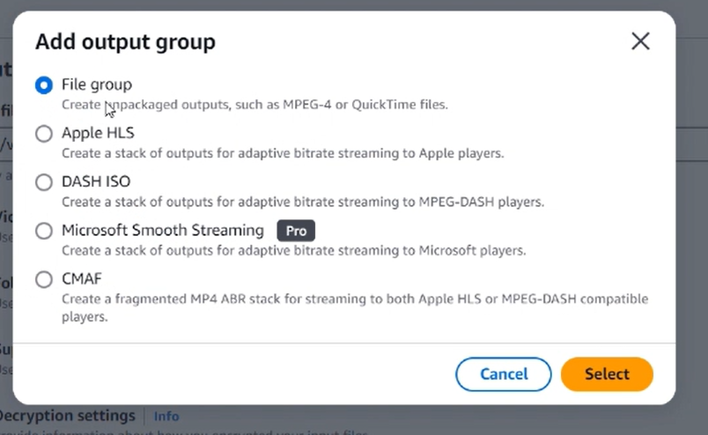
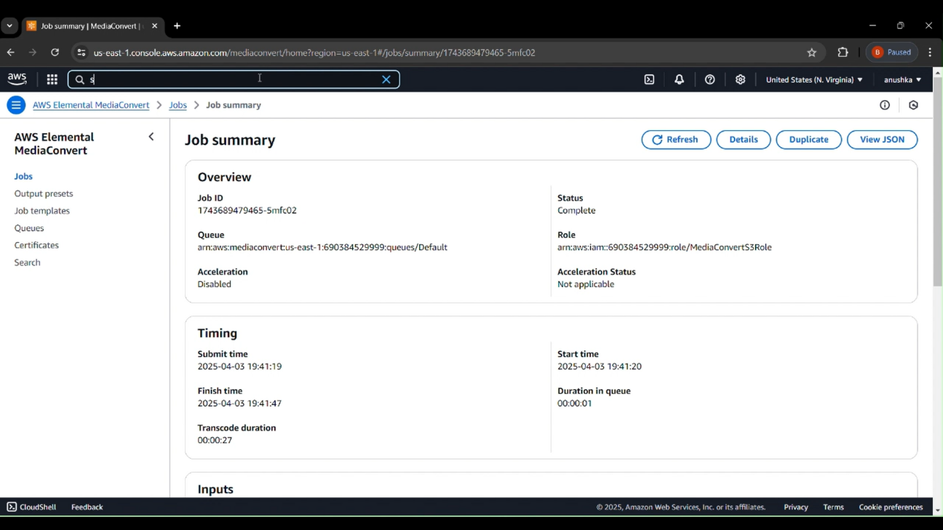
Results and Outputs
1. Selecting output file type.
2. Job completion Status.

Slide 14
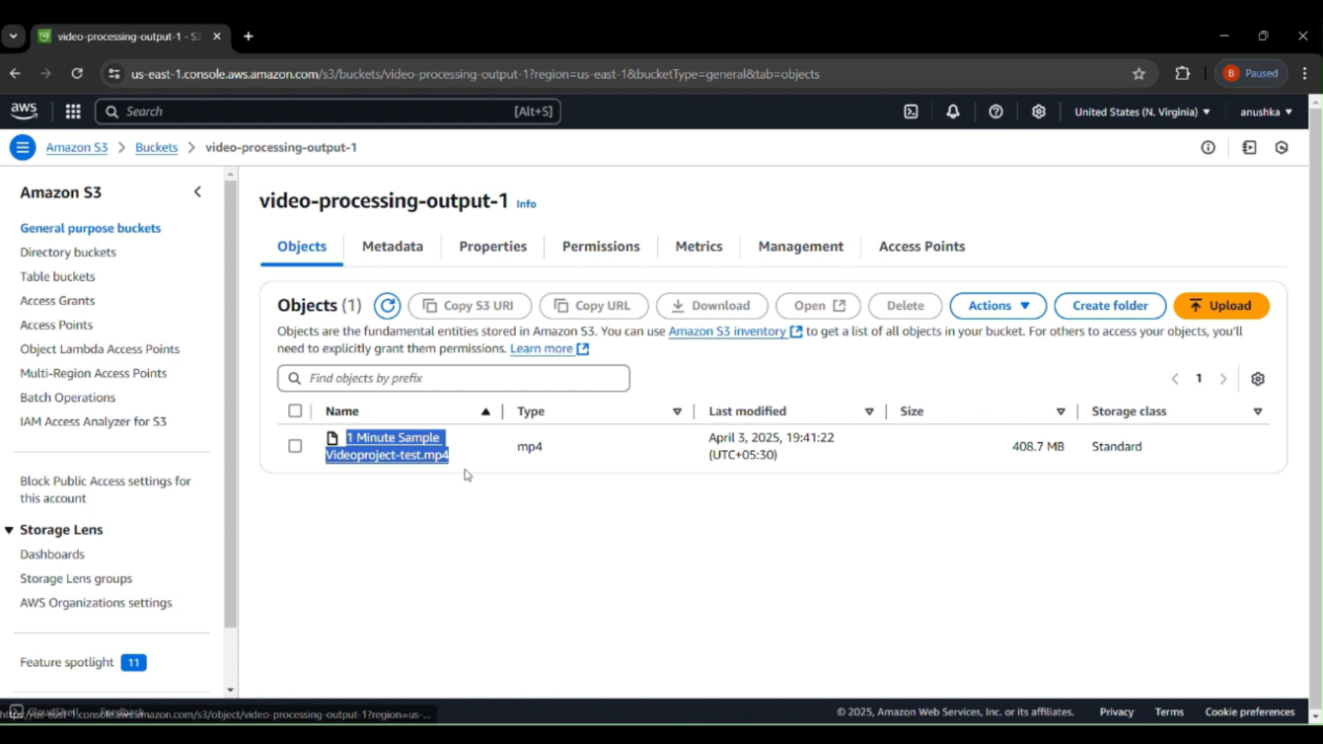
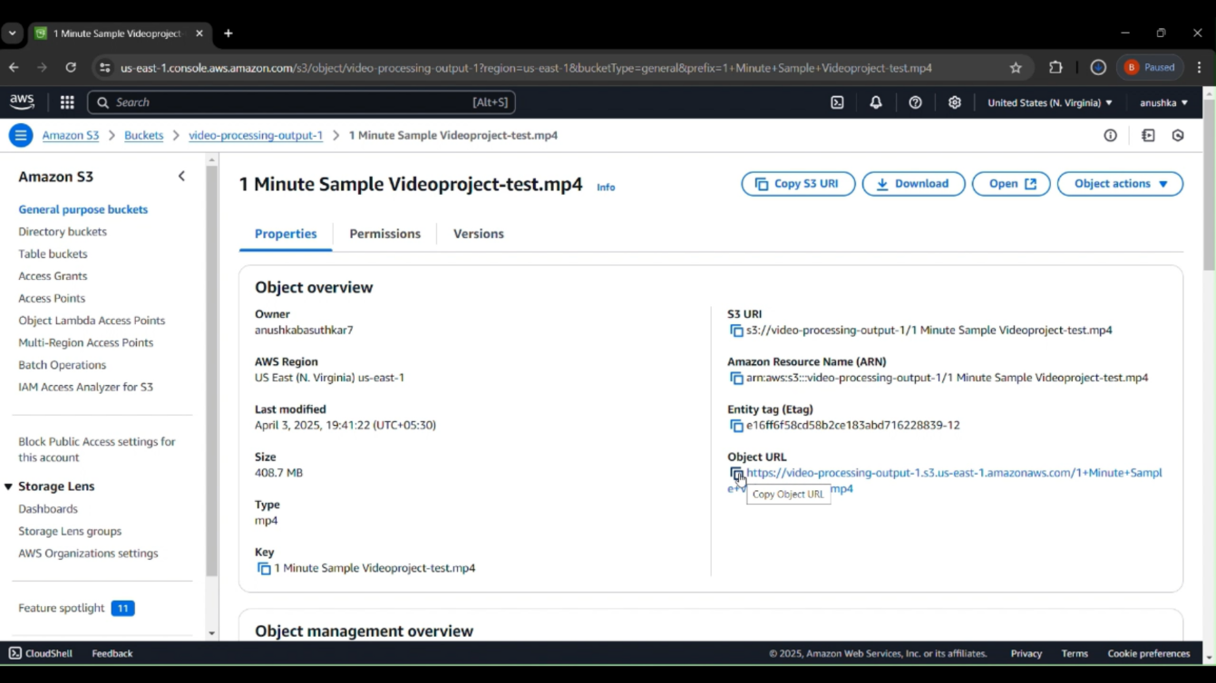
Results and Outputs
3. The processed viseo is in output bucket.
4. The video can be downloaded or opened in browser.

Slide 15
Results and Outputs
5. The output can be played on local computer.

Slide 16
Challenges and Solutions
Challenges:
IAM Role Configuration: Difficulty in assigning the correct permissions to allow MediaConvert to access S3 buckets.
Understanding Output Presets: Challenges in selecting appropriate codecs, formats, and resolutions for compatibility across devices.
Solutions:
Used AWS documentation and IAM Policy Simulator to verify and fix permission issues.
Experimented with various presets and learned through AWS forums and trial-and-error testing.

Slide 17
Learnings & Takeaways
1. Using Core AWS Services
Become familiar with key AWS services like :
Amazon S3 for storage,
AWS IAM for secure access control, and
AWS Elemental MediaConvert for media processing.
2. Implementing Video Editing Features
Video transcoding,
Compression, abd
Resolution scaling

Slide 18
Future Scope
Automation with AWS Lambda & Step Functions: Enhancing the current manual workflow by integrating Lambda and Step Functions for fully automated video processing pipelines.
Advanced Editing Features Incorporating features like trimming, watermarking, thumbnail generation, and frame extraction using custom job templates.
Integration with Front-End UI: Building a web interface using AWS Amplify or a React frontend to allow non-technical users to upload and manage videos easily.

Slide 19
References
Amazon Web Services (AWS). “AWS Documentation” - https://docs.aws.amazon.com/
Amazon Web Services (AWS). “Amazon S3 Storage” - https://aws.amazon.com/s3/
Amazon Web Services (AWS). “AWS IAM Security” - https://aws.amazon.com/iam/
“AWS Elemental MediaConvert” - https://aws.amazon.com/mediaconvert/
“Statista Research Department. (2023). Growth of Cloud Video Services.” - https://www.statista.com/statistics/1107702/global-cloud-video-streaming-market-size/

Slide 20
THANK YOU

