Slide 1
PSIT
MINI PROJECT
ARTICULATE
(A WEB COMMUNITY FOR WRITERS
AND READERS)
Presented by-
Anushka Gupta
2001640100061
CS - 2 – A

Slide 2
INTRODUCTION
With the coming of free online writing platforms, writers have been able to showcase their work more openly and easily.
A faster way of connecting with audience.
Sharing work in rich text format.
Minimal Constraints.
Cost effective.

Slide 3
OBJECTIVE
Provide an online platform to writers and readers.
Connect writers with their audience.
Allow sharing of stories easily.
Post stories in rich text format.
Allow readers to choose stories according to genres and writers.

Slide 4

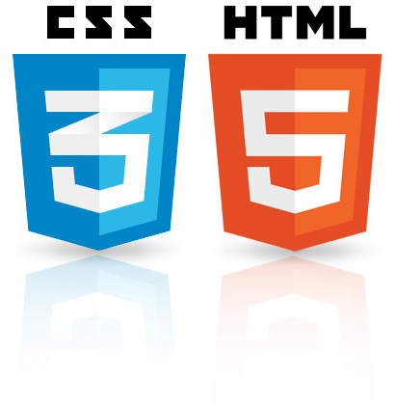



TOOLS, HARDWARE AND SOFTWARE
Django Framework
Python
HTML, CSS
JavaScript
SQLite Database

Slide 5
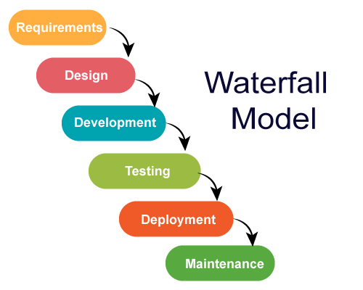
PROPOSED METHODOLOGY

Slide 6
1. REQUIREMENTS
Django Framework:
A High-level Python web framework (collection of Python libraries).
For rapid development of secure and maintainable websites.
SQLite Database:
For storing data into relational database.
Knowledge of HTML/CSS, JavaScript, Python:
HTML for the structure of the page.
CSS for the (visual) layout.
JavaScript to make web pages interactive.
Python for writing server-side scripts.

Slide 7

2. DESIGN
Home Page
Explore Page
Login Page
Register Page
See Story Page
Profile Page
My Stories Page
Write Page
Logout Page

Slide 8

3. DEVELOPMENT: FRONTEND
HTML/CSS: HTML (the Hypertext Markup Language) and CSS (Cascading Style Sheets) are two of the core technologies for building Web pages. HTML provides the structure of the page, CSS the (visual) layout, for a variety of devices.
JavaScript: JavaScript is a text-based programming language used both on the client-side and server-side that allows you to make web pages interactive.
Bootstrap Library: Bootstrap is a free front-end framework for faster and easier web development.

Slide 9
HTML
This website contains following pages:
home.html
login.html
register.html
explore.html
story_detail.html
see_story.html
profile.html
edit_profile.html
write.html

Slide 10
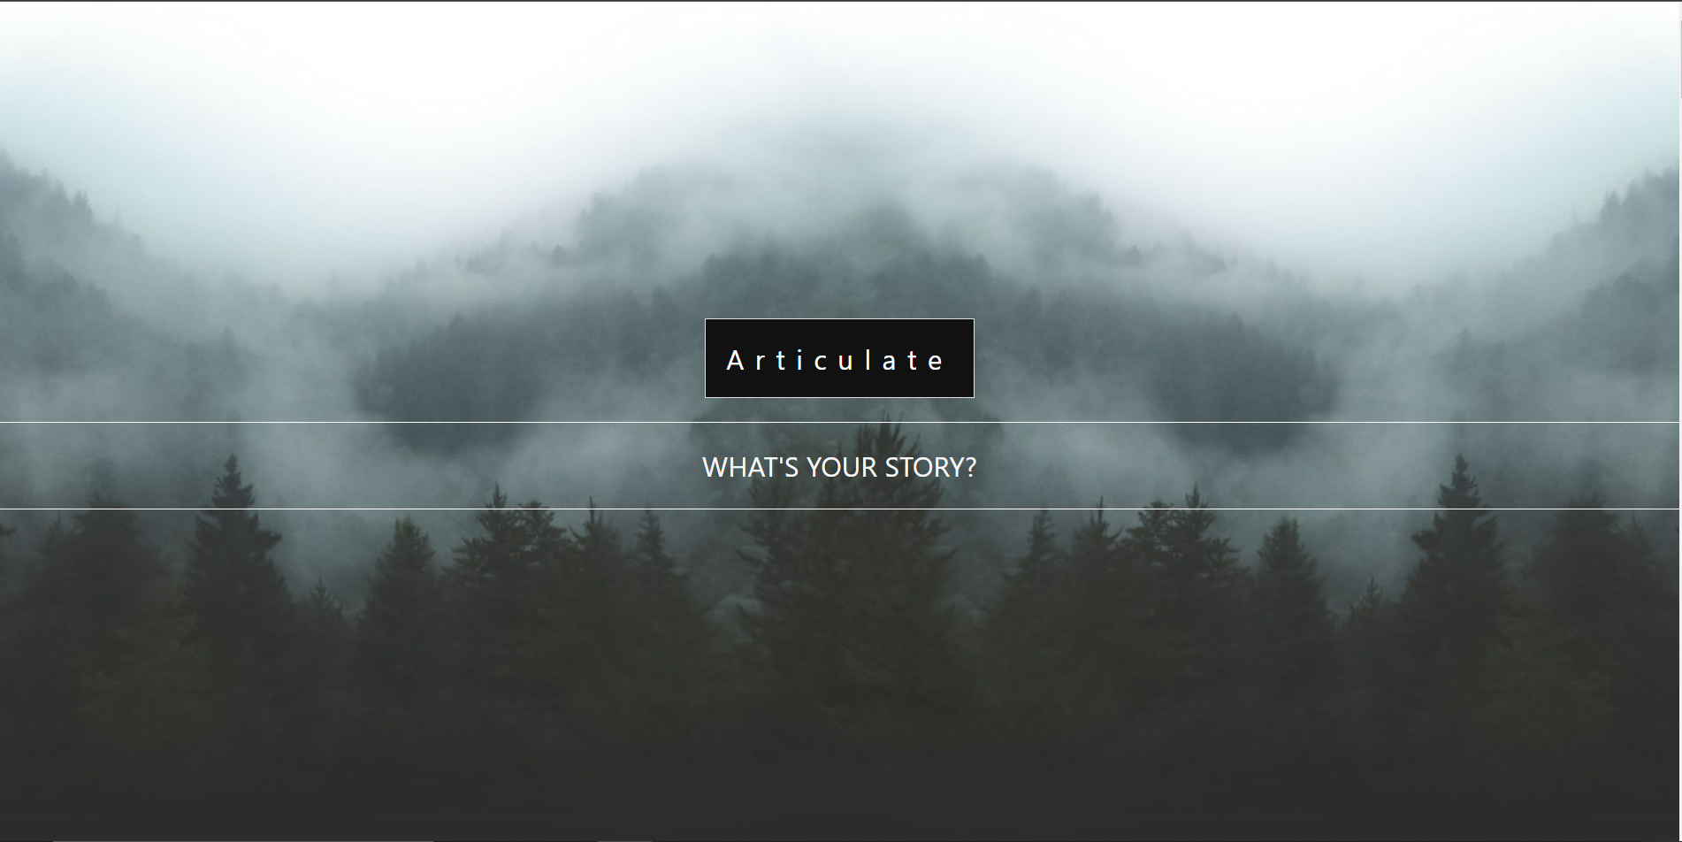
Home Page

Slide 11
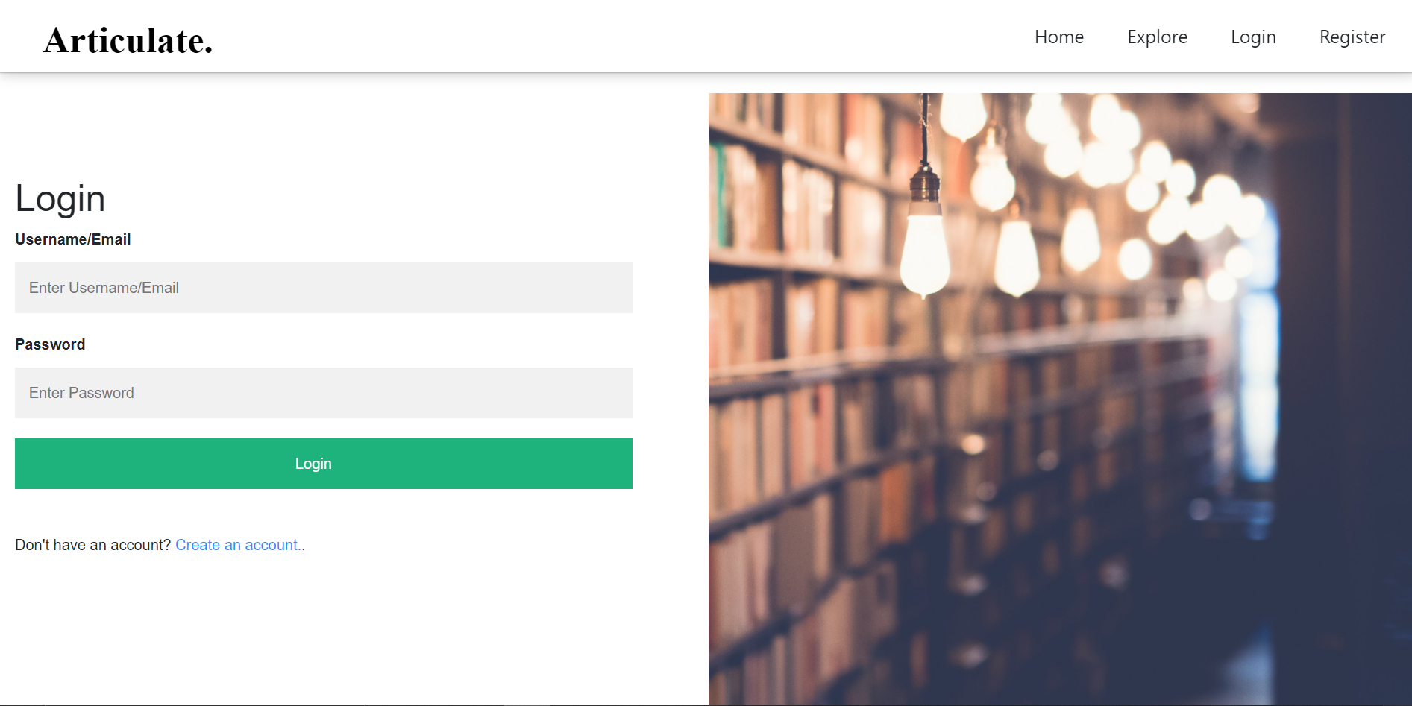
Login Page

Slide 12
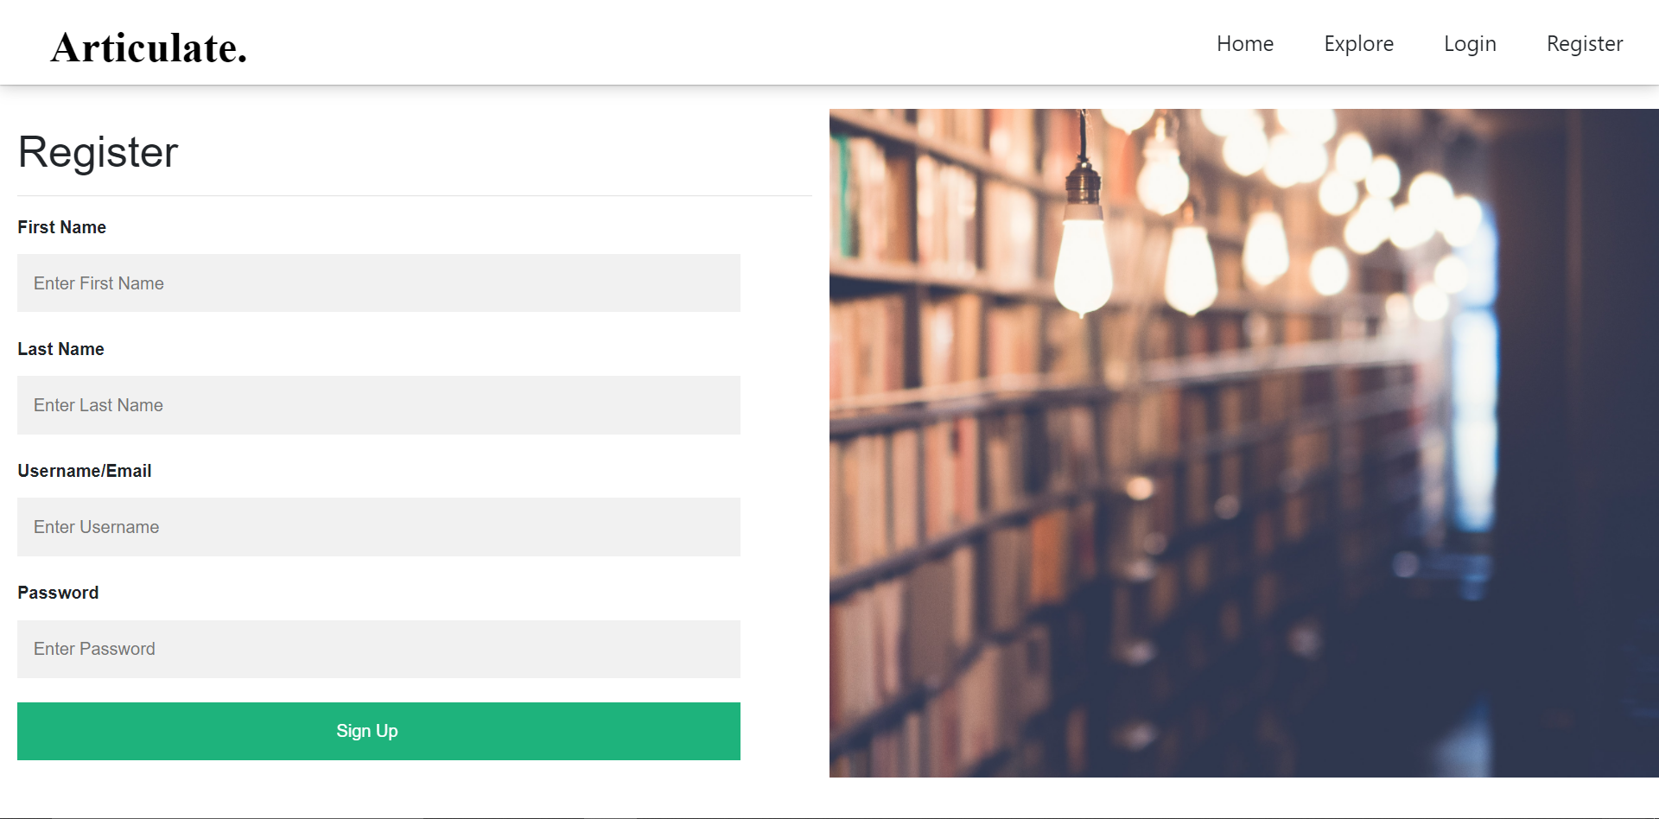
Register Page

Slide 13
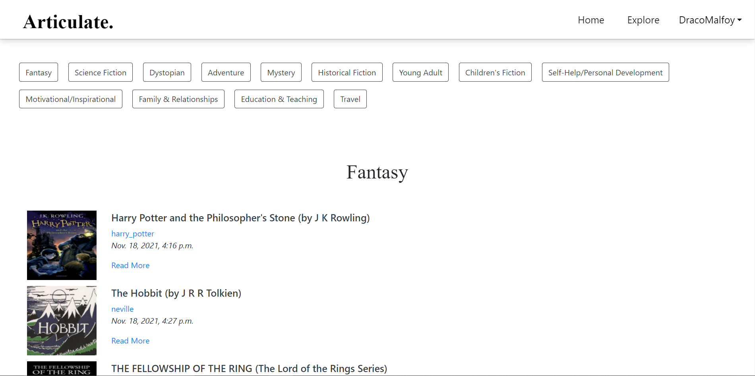
Explore Page

Slide 14
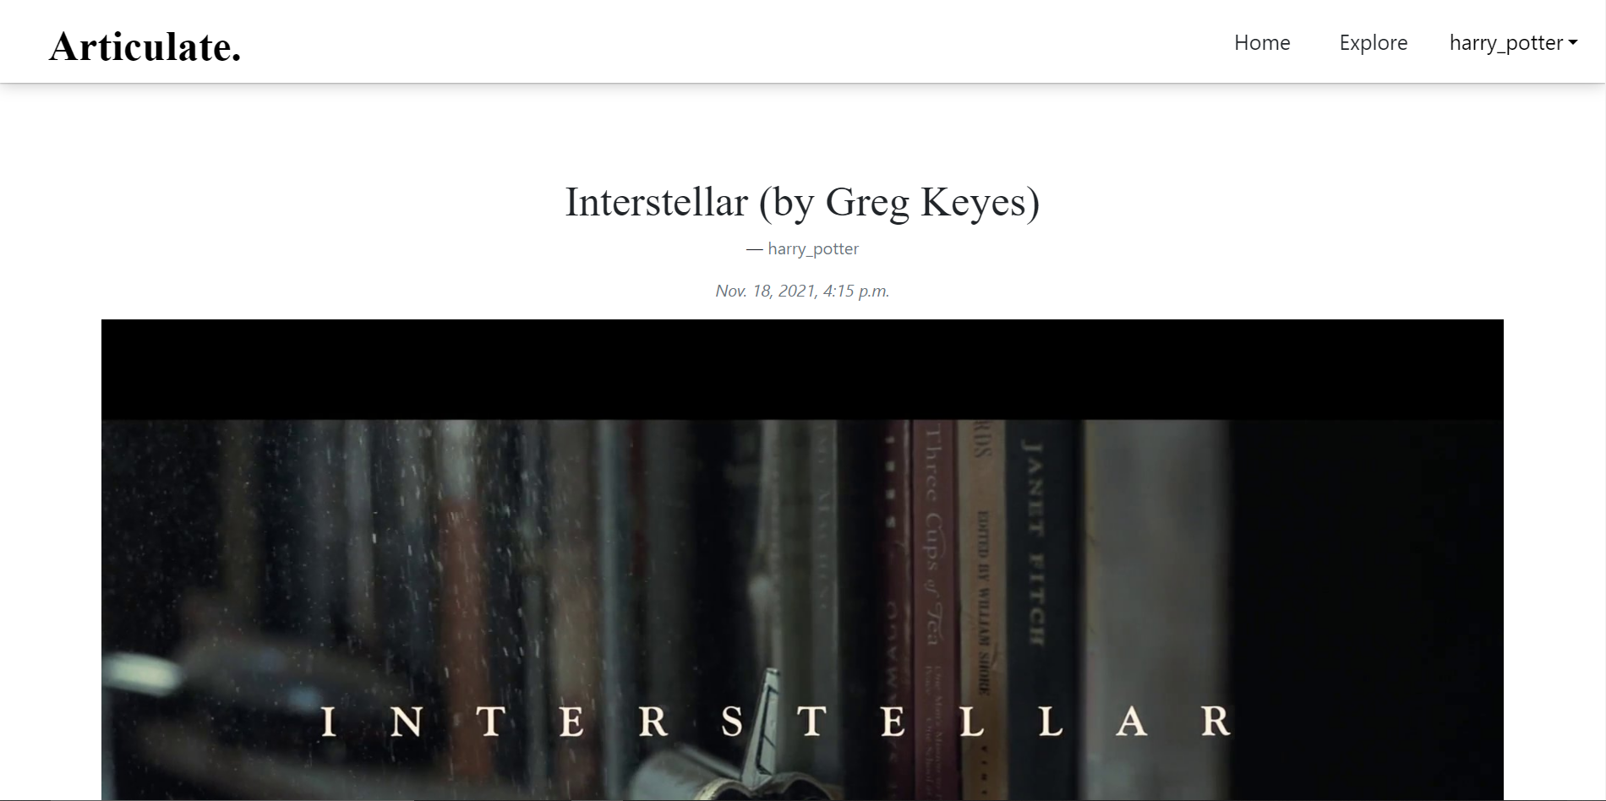
Story Detail Page

Slide 15
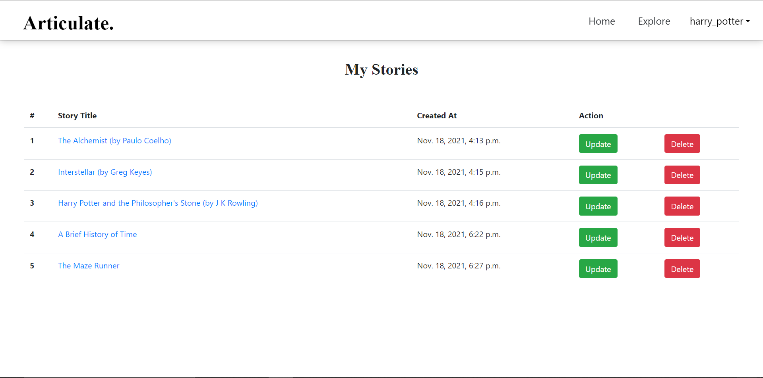
See Story Page

Slide 16
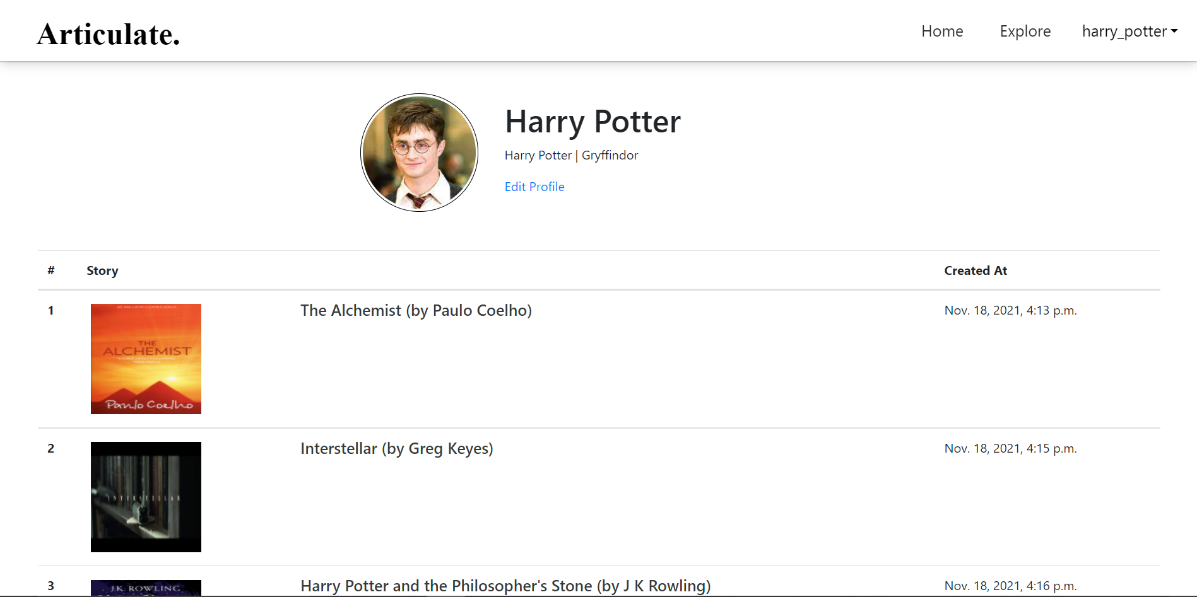
Profile Page

Slide 17
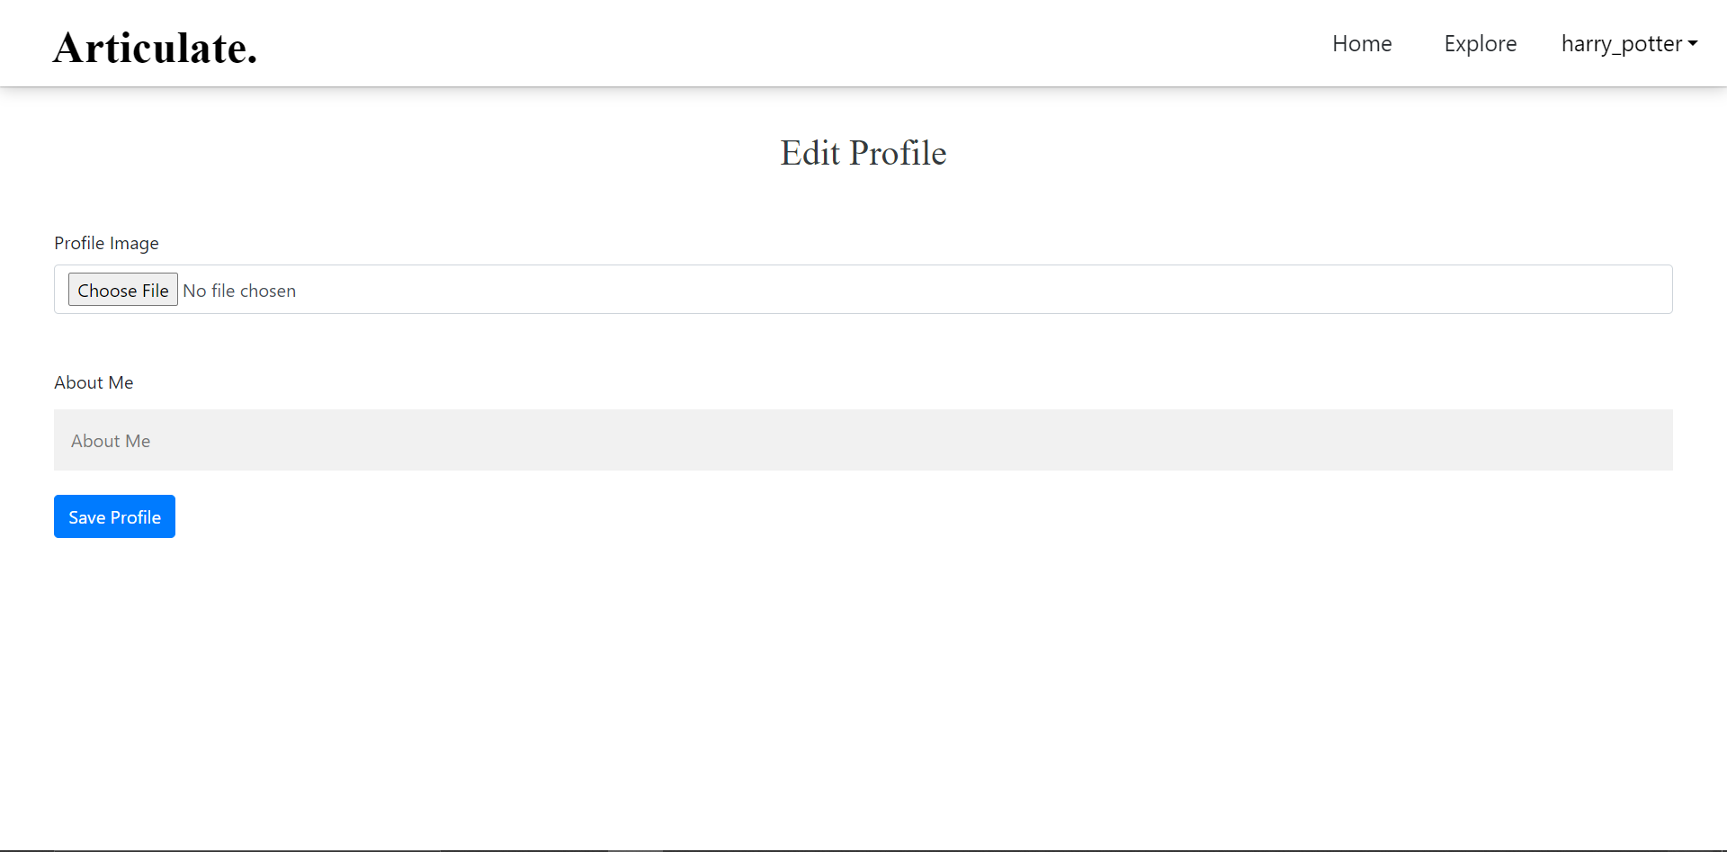
Edit Profile Page

Slide 18
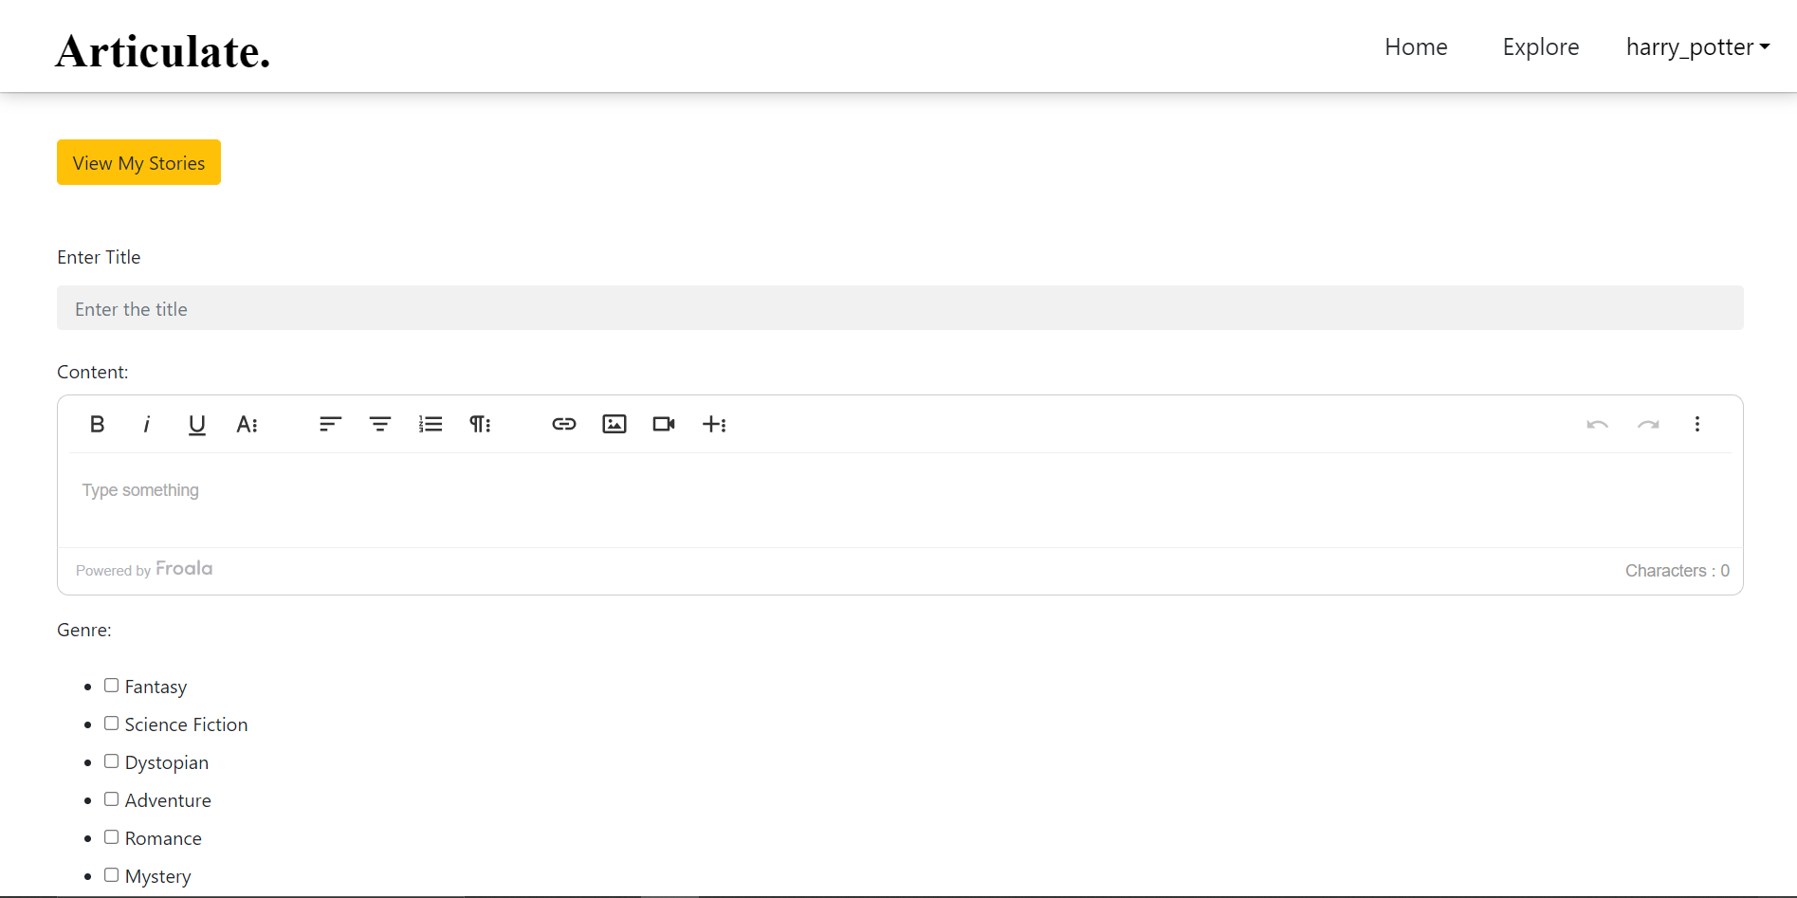
Write Page

Slide 19
3. DEVELOPMENT: BACKEND
SQLite database: SQLite is an open-source database that helps to interact with relational databases. SQLite is stored as a single file. This makes sharing databases easier. By default, Django uses the SQLite database.
Python: Python is a computer programming language often used to build websites and software, automate tasks, and conduct data analysis. Python is a general purpose language, meaning it can be used to create a variety of different programs and isn't specialized for any specific problems.

Slide 20
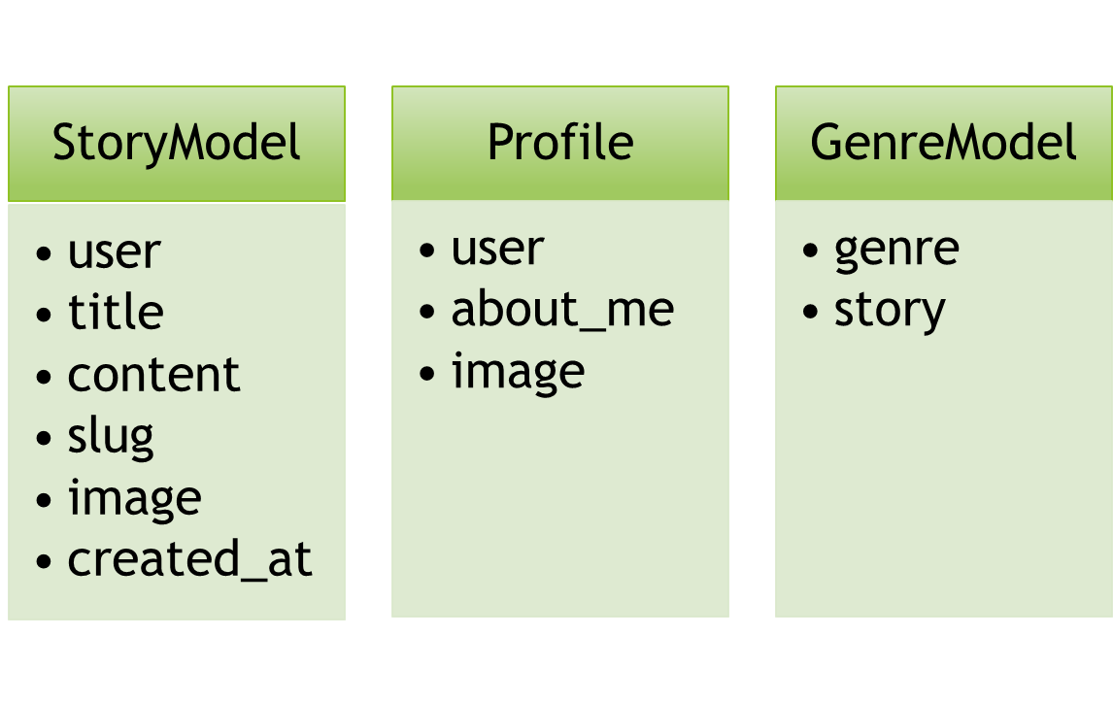
User
username
first_name
last_name
password
SQLite Database

Slide 21
Python
Following are the major python files used in this project:
models.py: contains all database models.
views.py: contains functions that receive a web request and return web response.
urls.py: defines mapping between urls and views.
manage.py: command-line utility that allows interaction with Django project in various ways.

Slide 22
REFERENCES
Harvard CS50’s Web Programming with Python and JavaScript
https://docs.djangoproject.com
https://developer.mozilla.org/en-US/docs/Learn/Server-side/Django
https://www.w3schools.com

Slide 23
Thank You!

