Slide 1

TITLE- Electroencephalogram Brain Signal Processing for Chromatic Visual Impression Identification.
(differentiate the brain signals from red and white colour)
Supervisor Name:
Prof. Debasis Samanta, CSE, IIT Kharagpur
: Tutan Nama, PHD scholar, CSE,IIT Kharagpur
:Subrata Pain, PHD scholar, CSE,IIT Kharagpur

Slide 2
Contents
1. Project Description
2. Plan of when and for how much duration to show red or green or blue colour:
3. Step by step process we used OpenBCI to collect the brain signals data.
3.1 Setting the hardware part
3.2 Setting the software part
4. Data description
5. Data Pre-processing
6. Data epoching
7. Feature extraction
8. Feature Selection
9. Models used
10. Results of Each Model on different features Combination
11. conclusion

Slide 3
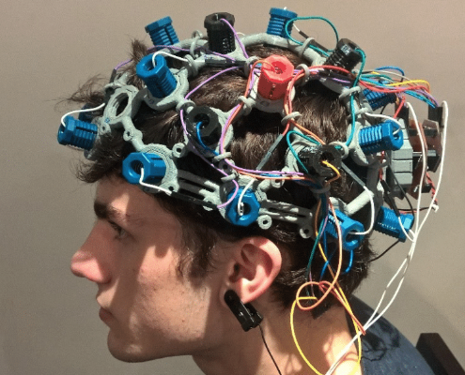
1. Project Description
TITLE- Electroencephalogram Brain Signal Processing for Chromatic Visual Impression Identification.
(differentiate the brain signals from red and white colour)
Description- we are using openBCI device to record the signals from the brain, when the subject is shown only red and white colors. And then using Preprocessing steps, extracting features and training models to differentiate between 3 colors(red, green or blue).
Applications- if we are able to discriminate three different colors then we can use this as two control commands for controlling any dedicated computer applications.
(especially helpful for handicapped people)

Slide 4
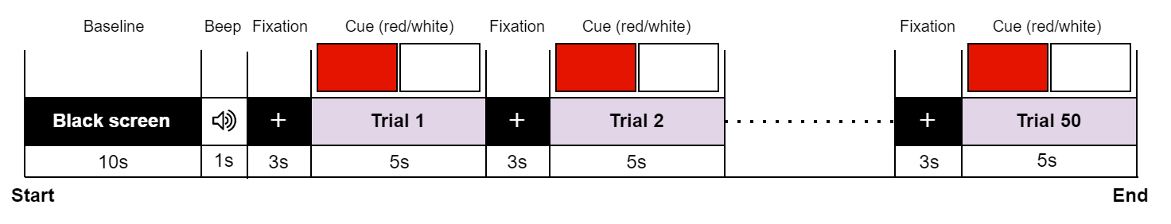
2. Plan of when and for how much duration to show red or white color:
In each session recording:
total time: 10 mins
75 colors shown

Slide 5
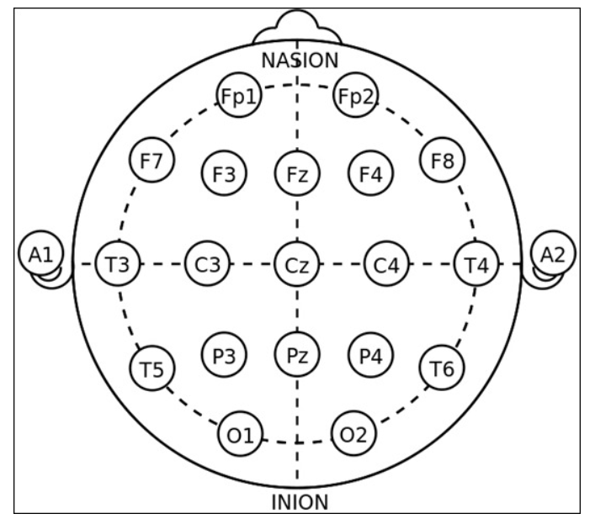
3. Step by step process we used OpenBCI to collect the brain signals data.
3.1 Setting the hardware part
1.) decide which which portion of the subject’s head you want to measure the data from by setting the points on the headset. We are using fp1,fp2,c3,c4,p3,p4,o1,o2 as visual stimuli is measured by the back of the head and using ………………….. as support electrodes.
2.)make the subject wear this headset kit and make it comfortable on the subject’s head by adjust the supporting and non-supporting electrodes(which actually gives us data) to get the brain signals as a data properly.
3.) put the SRB pin clip to the right ear to get all be measured against this reference pin.
4.) connect dongle to the PC

Slide 6
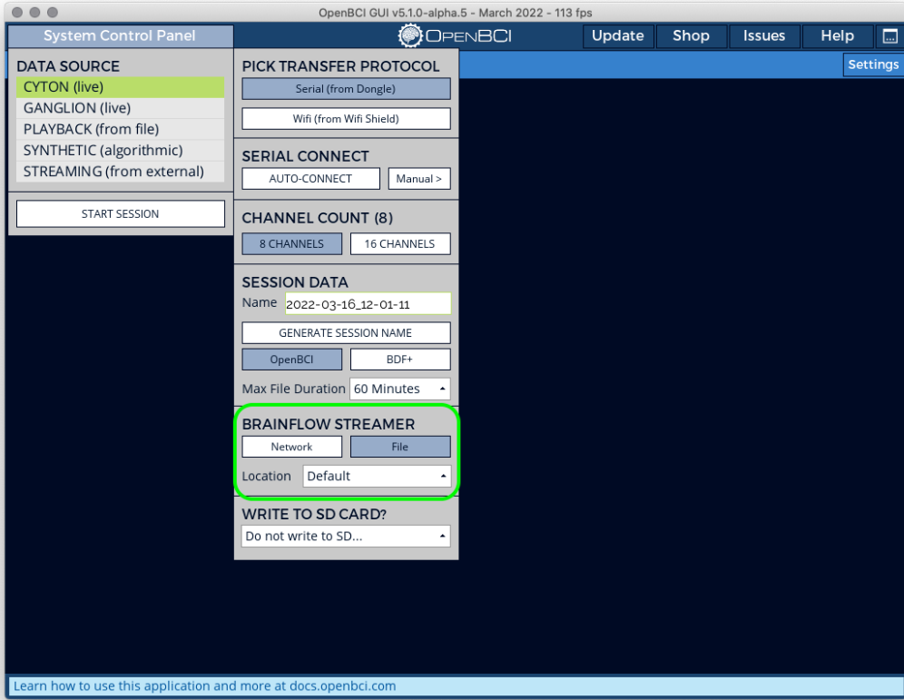
3.2 Setting the software part
1.) installing Softwares - a) OpenBCI GUI b) driver for support < windows 11
2.) Open the openBCI GUI. Click on system control panel -> CYTON(live) ->Serial from Dongle . and then click on SERIAL CONNECT->AUTO-CONNECT. to get the data from the electrodes in headset into the PC through the Dongle.

Slide 7
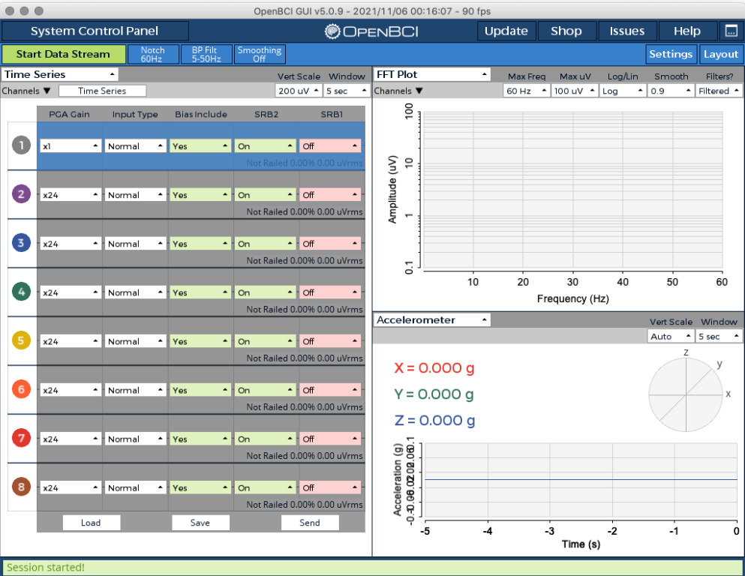
3.) Now session is started, completing the hardware settings:-
set the PGA gain= 4 (…why…) and bias include = No (….why…) for all the 8 channels.

Slide 8
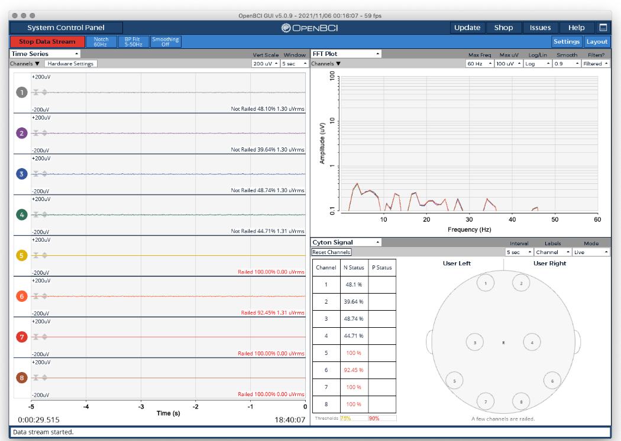
4.) Now for checking the signal quality :-
Go to the FFT plot and try to put not railed for all the channels for good quality of signal. Now we are ready to collect the signals.
5.) for stop collecting the data click on stop data stream . Data for this session will get saved as .txt and .csv format and events.txt file also got saved using the python script we wrote.

Slide 9
4. Data Description
Subject_2
Subject_1
Session_1
Session_1
Each session has:
events.txt – stores the time stamp information of red and white data in trial.txt.
trials.txt – contains brain signals data of all the 8 channels and their time stamps using OpenBCI.
We filter out the data of only (all the 8 channels and the time stamp) from trials.txt.

Slide 10
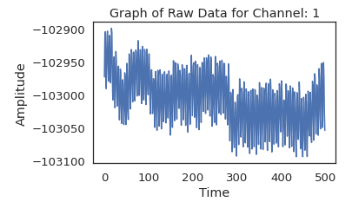
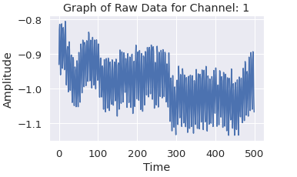
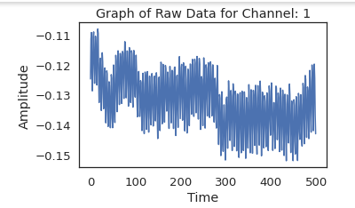
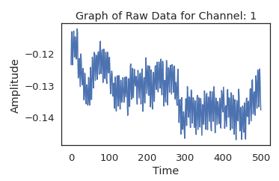
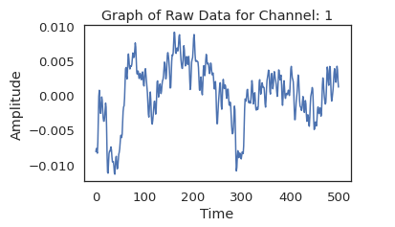
5. Data preprocessing:
Raw data 🡪 common average referencing 🡪scaling factor🡪 50 hz notch filter 🡪 0-40 hz band pass filter
Raw data
After common average ref
After Notch filter
Scaling factor
After Band pass filter

Slide 11
6. Data Epoching:
By filtering out only the time stamps when the red or white color was shown.
(50colors)
Also each second 256 readings were recorded, by splitting the data secondwise and removing the last 5 readings from each of the seconds
Further splitting the each of the 75 colours(which are of 5 sec each) into 5 readings.
So we are getting (375,250,8) matrix for each session
Each session
No. of trials in each second
No. of channels

Slide 12
7. Feature Extraction
Then the features we extracted from this kind of organized data-
Statistical Features (mean, standard deviation, skewness, kurtosis)
2. DCT Features (dct power)
3. Wavelet Features (cA energy, cD energy)
4. Band Power (delta, theta, alpha, beta, gamma)
5.) secDiffMean
6.) secDiffMax
7.) first_diff_mean
8.) first_diff_max
9.)hjorth
10.) maxPwelch

Slide 13
8. Feature selection:
Experimented on different feature combinations we extracted
1. Statistical + DCT + Wavelet + Band Power + secDiffMean + secDiffMax + first_diff_mean
+ first_diff_max + first_diff_max + hjorth + maxPwelch
(All features Combined)
2. Statistical + DCT + Band Power + secDiffMean + secDiffMax + first_diff_mean
+ first_diff_max + first_diff_max + hjorth + maxPwelch
(All features Except Wavelet features)
3. Only Wavelet
(Only wavelet features)
Only KNN was giving us 72% and all other models were giving us less than 40% so we observed only KNN vs features.
KNN accuracy didn’t changed after removing each of the features from all the features except Wavelet features.
KNN accuracy change from 72 % to 30% when we removed Wavelet features from all the features.
So by feature selection procedure we observed only wavelet features are required.

Slide 14
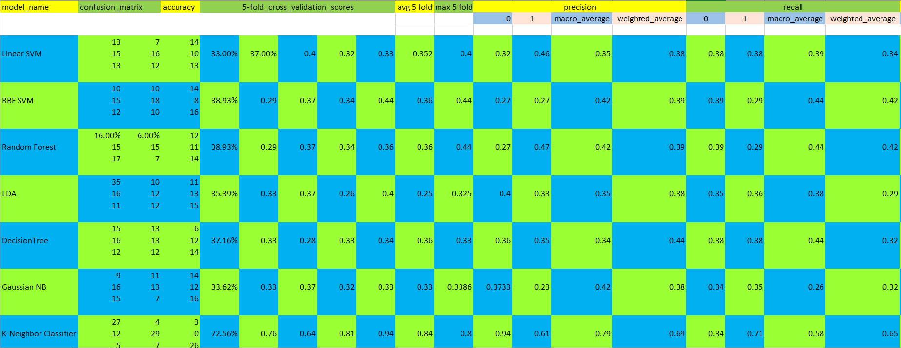
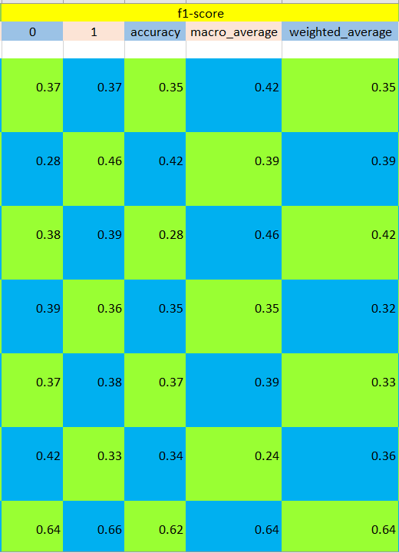
1. Statistical + DCT + Wavelet + Band Power + secDiffMean + secDiffMax + first_diff_mean
+ first_diff_max + first_diff_max + hjorth + maxPwelch
(All features Combined)

Slide 15
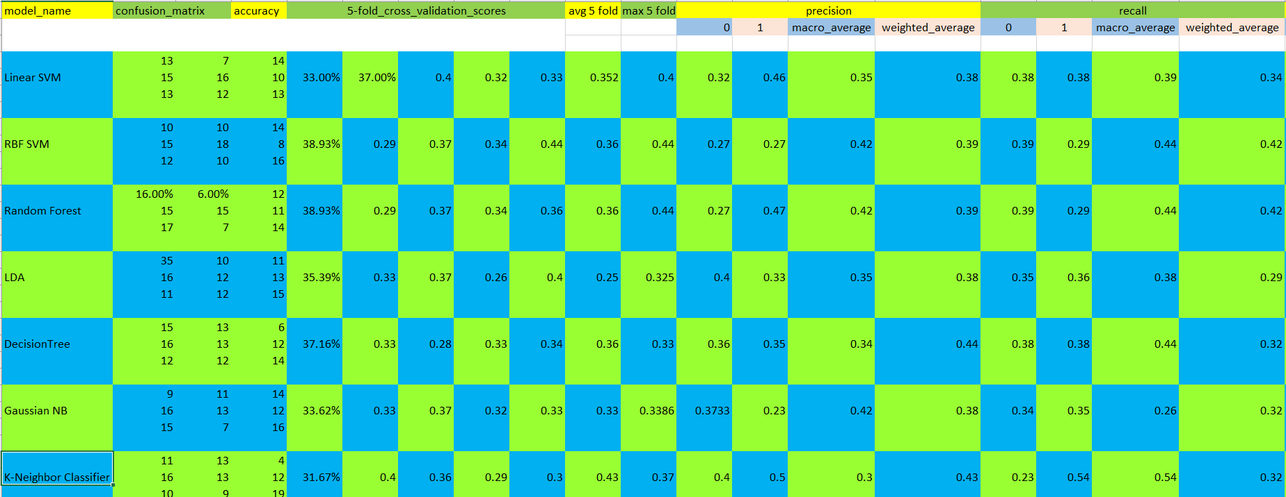
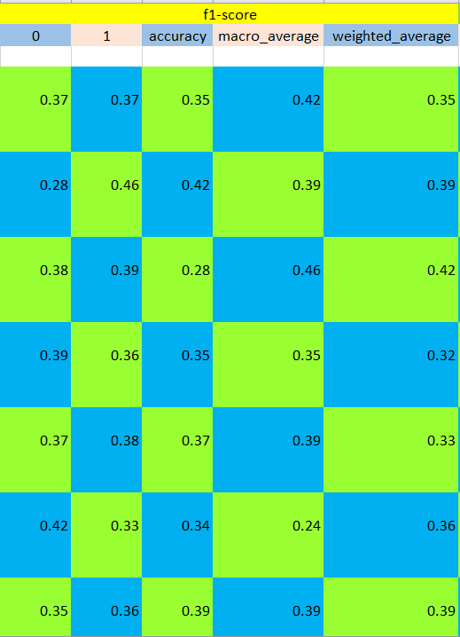
2. Statistical + DCT + Band Power + secDiffMean + secDiffMax + first_diff_mean + first_diff_max + first_diff_max + hjorth + maxPwelch (All features Except Wavelet features)

Slide 16
3. Only Wavelet (Only wavelet features)

Slide 17
11. conclusion
Model:
mostly KNN is giving us very good accuracy.
Features:
only with Wavelet features are giving very good accuracy.

Slide 18
THANK YOU

