Slide 1
Order Forecast in Oasis Store
Team - Error by Night

Slide 2
01
PROJECT TITLE AND INFORMATION
PROBLEM STATEMENT
02
IDEA OVERVIEW
03
04
SOLUTION FLOW
TABLE OF CONTENTS
05
TECHNOLOGY STACK
06
ACCURACY DETAILS
07
SOURCES RELIED
08
DEMO

Slide 3


ORDER FORECASTING IN OASIS STORE
TEAM MEMBERS:
1. Anushka Tiwari
2. Antara Chakrabarti
3. Priya Mittal
4. Taneesha Mathur

Slide 4
PROBLEM
STATEMENT
The problem is to analyze the ordering pattern of IT Assets placed by VMware colleagues at the internal e-commerce site in VMware by training and testing the AI/ML models with the help of given KPIs and then forecasting the orders with the greater accuracy.

Slide 5
IDEA OVERVIEW
Analysing KPIs provided : Location, IT Asset type , IT Asset OEM , Order Date , Cost and then filter data using different built-in libraries. Further data preprocessing and training is carried upon using ML models and then the evaluation and testing of the split data. We are then going to present the analyzed data on a browser with the help of flask.

Slide 6
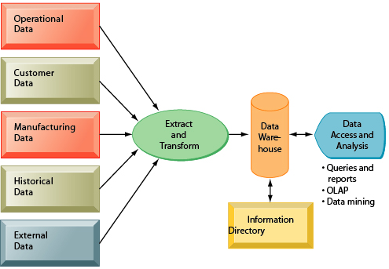
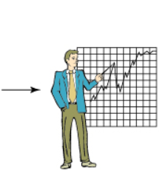
SOLUTION FLOW
KPI’s
Location
Business Intelligence
IT Asset type
IT Asset OEM
Data Visualisation
Order Date
Information Directory
Cost
Decision to respond to the data and patterns

Slide 7
Technology Stack
Python
Python is a popular programming language. It can be used on a server to create web applications.
Machine Learning
Machine learning is the study of computer algorithms that can improve automatically through experience and by the use of data.
Artificial Intelligence
Artificial is the ability of a computer or a robot controlled by a computer to do tasks that are usually done by humans because they require human intelligence and discernment.
Google Colab/Pycharm
Colab notebooks allow you to combine executable code and rich text in a single document, along with images, HTML, LaTeX and more.
Flask
Flask is a small and lightweight Python web framework that provides useful tools and features that make creating web applications in Python easier.

Slide 8
ACCURACY DETAILS
As it is a regression problem we have to do prediction on the basis of given data.
After analysing data it is found that values are not discrete so we applied two algorithms:-
XGBoost Regressor
Linear Regression
R-squared value with 1st model on testing data:-99.99964345664892%
R-squared value with 2nd model on testing data:-99.9951250891881%

Slide 9
SOURCES
RELIED
Published Journals
Popular Websites
Research Papers

Slide 10
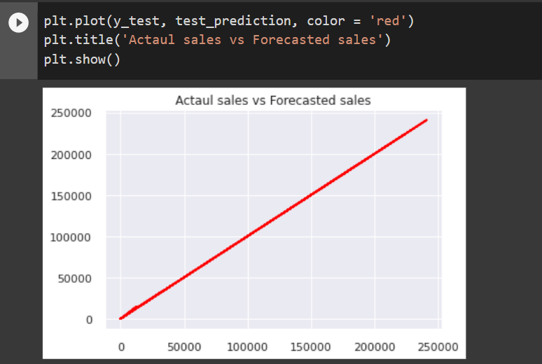
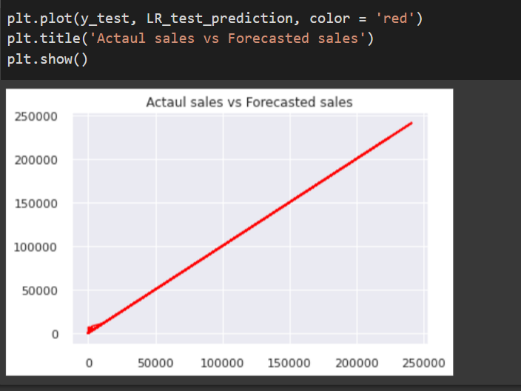
DEMO
BOTH THE MODELS SHOW HIGH CORRELATION…
Output for XGBooster Regressor
Output for Linear Regression

Slide 11
Thank you…

