Slide 1
FITNESS GYM MANAGEMENT SYSTEM
push yourself because no one else
is going to do it for you….
#Fitnessjourney
ANUSHKA AVHAD : VU4F2122044
Jayesh singh : VU4F2122048
Prachi sanap: VU4F2122057
Saurabh desai: vu4f2122072
Under the guidance of:
Prof. Saniya haji

Slide 2
INTRODUCTION:
Gyms are become the essential part of our lives, providing best exercise and body
building facilities to our society. Therefore, at the management end there are some necessary steps to maintain the records of every individual including trainer, trainees, and staff But maintaining the records on paper is very difficult So, it is necessary to have a computerized system that manages all these issues.
Thus working on the management system for Gym Industry are the basis of our project. We have developed an automated version of the manual system, named as Gymnasium Management System. This system also provides excellent security of data at to its user.

Slide 3
EXISTING SYSTEM AND COMPARISON
Existing System
Proposed System
Existing system is a static website so you have to use file system to save record.
Time consuming system.
No proper system to make announcements.
Important information can be missed while writing on page
Inefficient and slow search.
New proposed system allow to user to save record is database.
Fast and easy to use
An easy way to make a announcements.
Full fledge information system.
Efficient and proper availability of data.

Slide 4
Project scope:
The administrator has the full fledged rights over this system.
The admin can register and view the customers profile data.
The admin can make announcement about any thing.
The admin can upgrade gym packages at any time.
Customer can contact with the admin through message box any time.
Customer can avail the diet plan of their own desire.
Customer can get more updates from the system by joining different social accounts.
Customers can view updated diet plan , updated exercises schedule,and can question to admin and view the answer.
Customers can contact with other gym mates online.

Slide 5
Project Goal:
To remove the manual or paper work in the Fitness club.
Provide a platform with interactive user interface for both customer and admin.
Save the time of both admin and customer.
Get online plans in effective manners.
To save cost of each user.
The one who cannot afford gym packages ,also get benefits by viewing different exercise , diet plan tutorials.
User friendly.

Slide 6
Software and Hardware Requirements & Techniques
Requirements:
CPU SECONDARY STORAGE MEMORY WEB BROWSER
TECHNIQUES:
HTML
PHP
CSS
JavaScript
python/java

Slide 7
Functional requirement:
LOGIN
MANAGE USERS
MANAGE TRANSACTIONS
MANAGE EXPANSES
MANAGE MACHINERY
CREATE REPORTS

Slide 8
Non Functional requirement:
PERFORMANCES
RELIABILITY
SECURITY
SCALABILITY
EASE OF USE
ACCESSIBILTY
EFFICIENCY
MAINTAINABILITY

Slide 9
Modules:
Admin
User
Approve user
Package
Trainer module
Contact us
Login and logout

Slide 10
Functionality performed by admin
Login
Manage user
Approve user
Equipment data
Message box
Trainer data
Update fee
Update packages
Diet plan
Contact us
Gallery update
logout

Slide 11
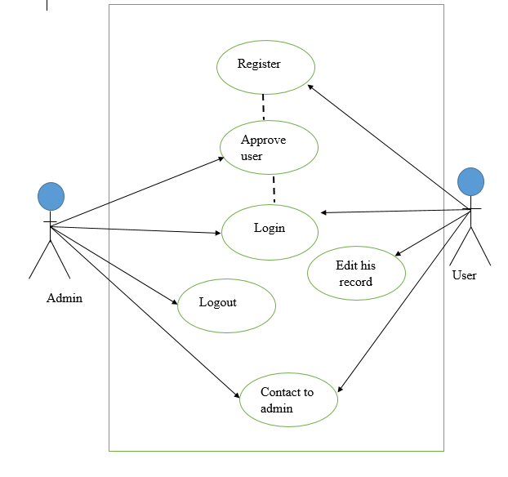
User & admin Use case Diagram

Slide 12
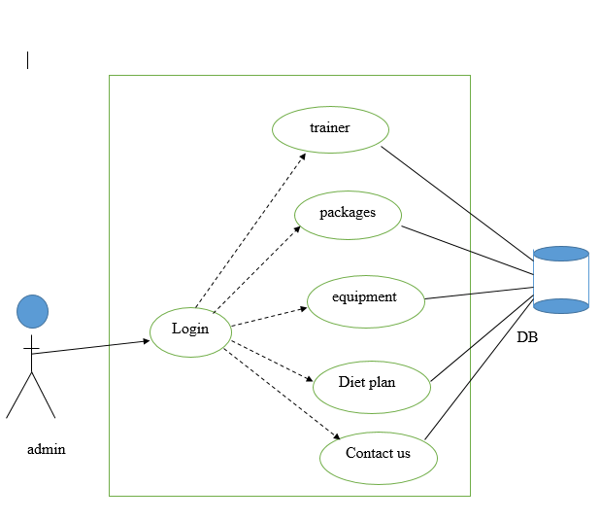
Admin Use case Diagram

Slide 13
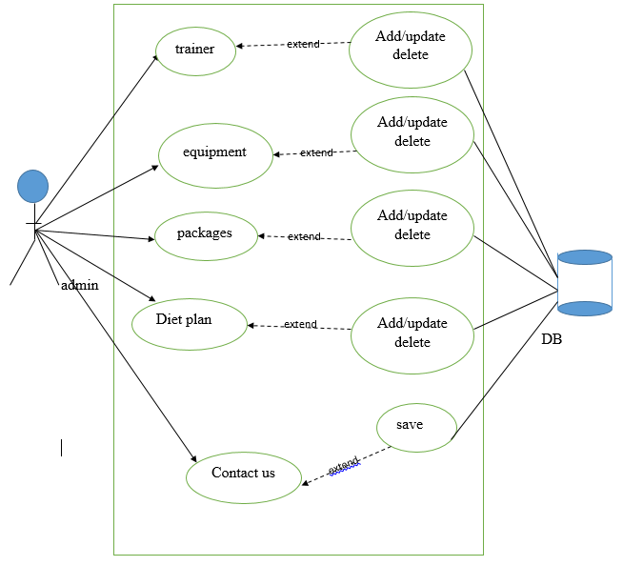
Admin Use case Diagram

Slide 14
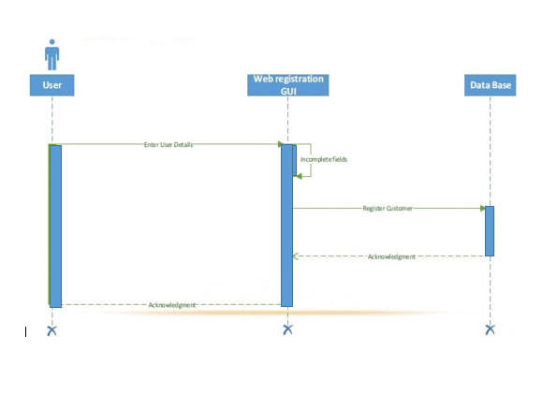
User register Sequence diagram

Slide 15
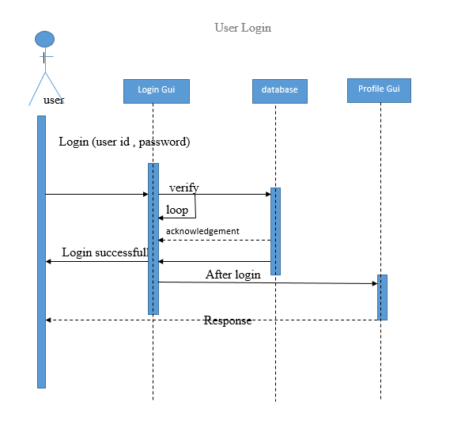
User login Sequence diagram

Slide 16
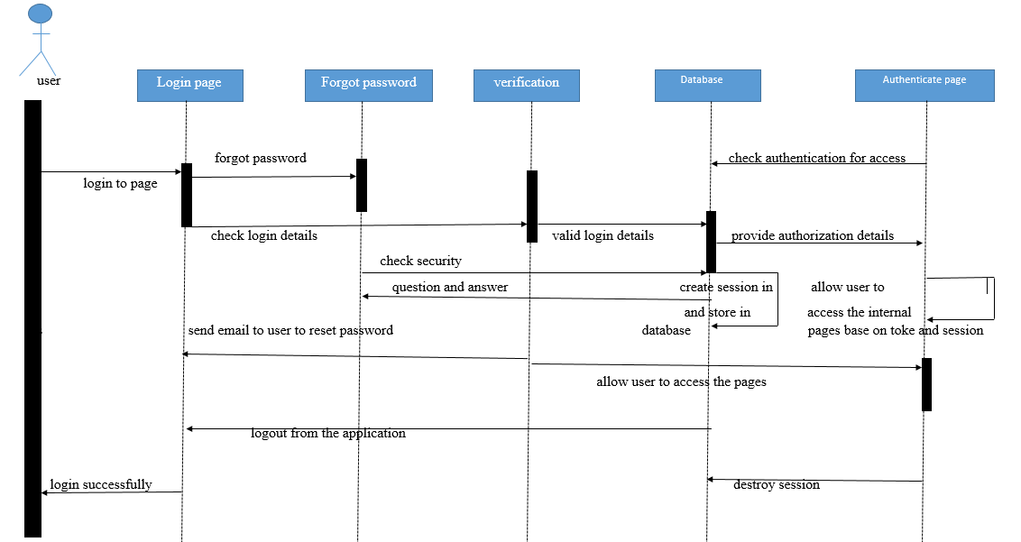
User Sequence diagram

Slide 17
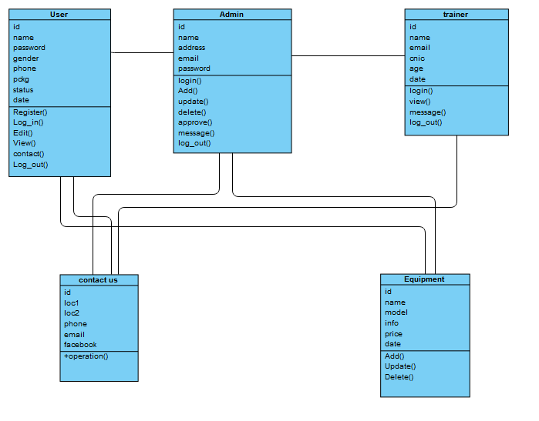
Class diagram

Slide 18
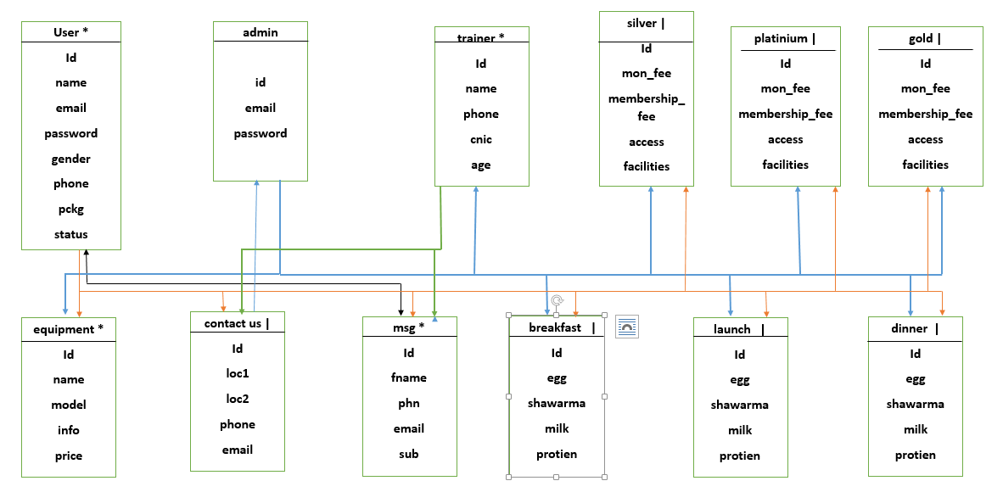
ERD diagram

Slide 19
SNAP SHOTS

Slide 20
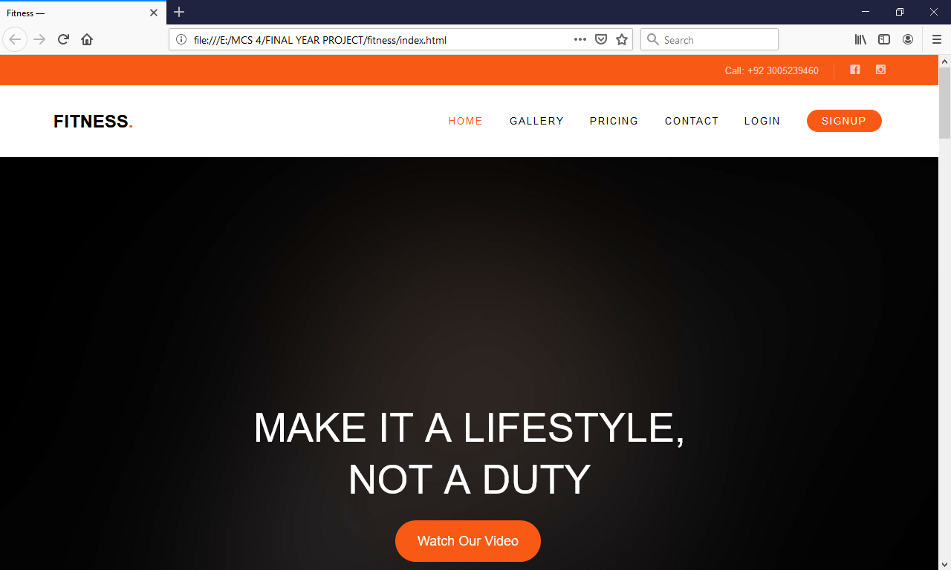
Home Page:

Slide 21
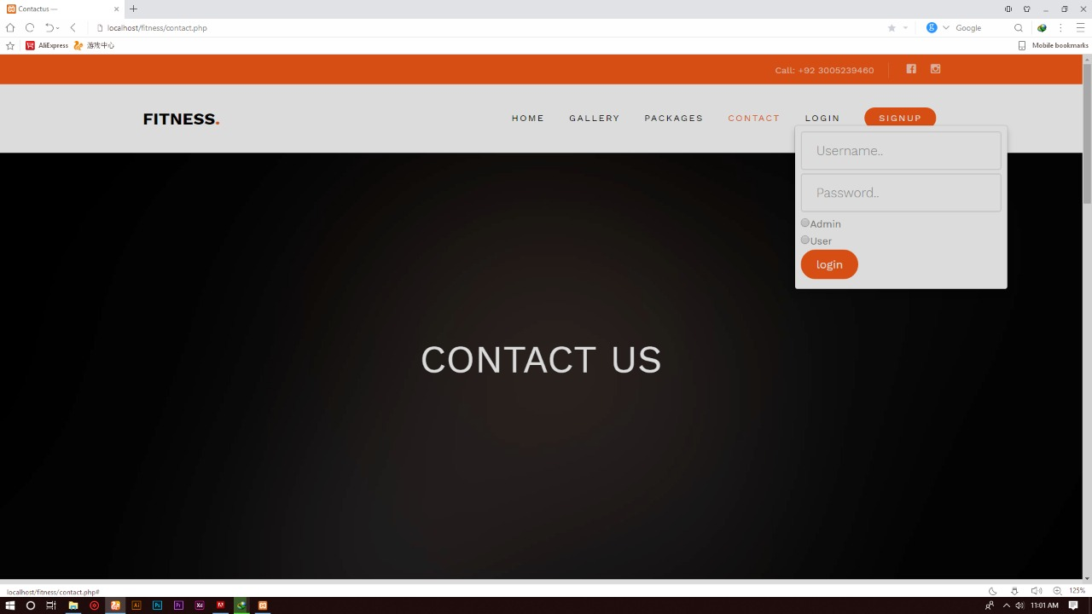
Admin Login:

Slide 22
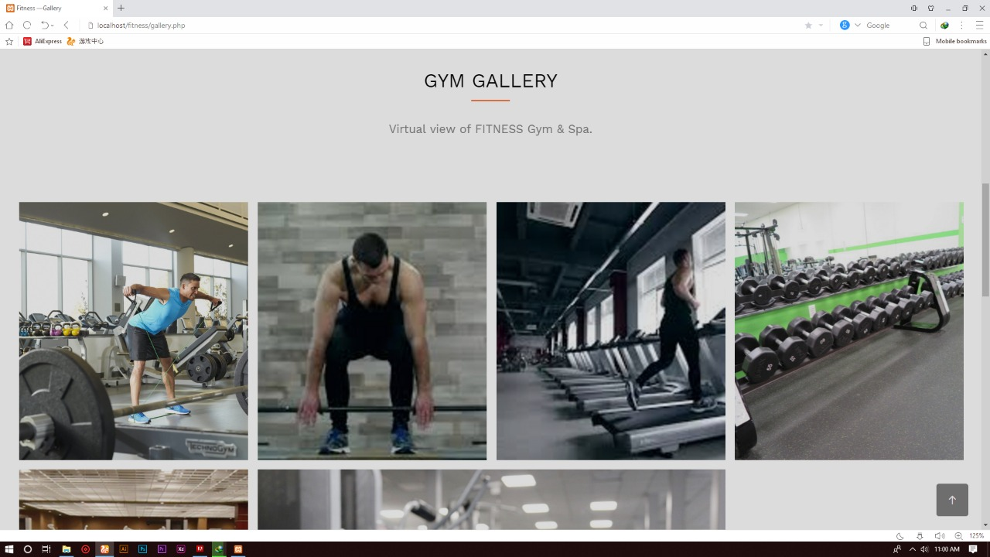
Gym Gallery :

Slide 23
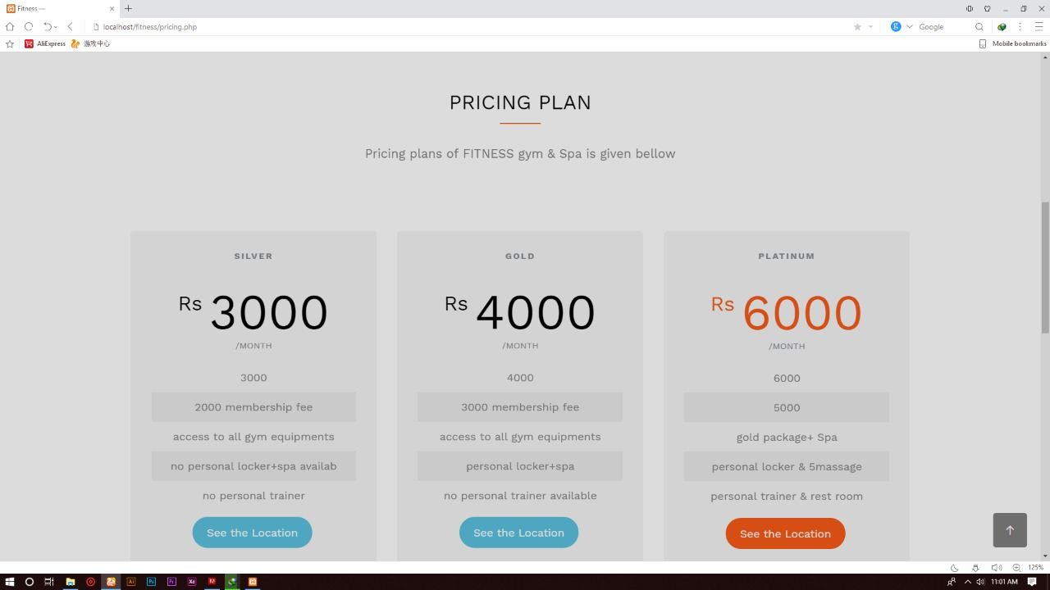
Pricing plan:

Slide 24
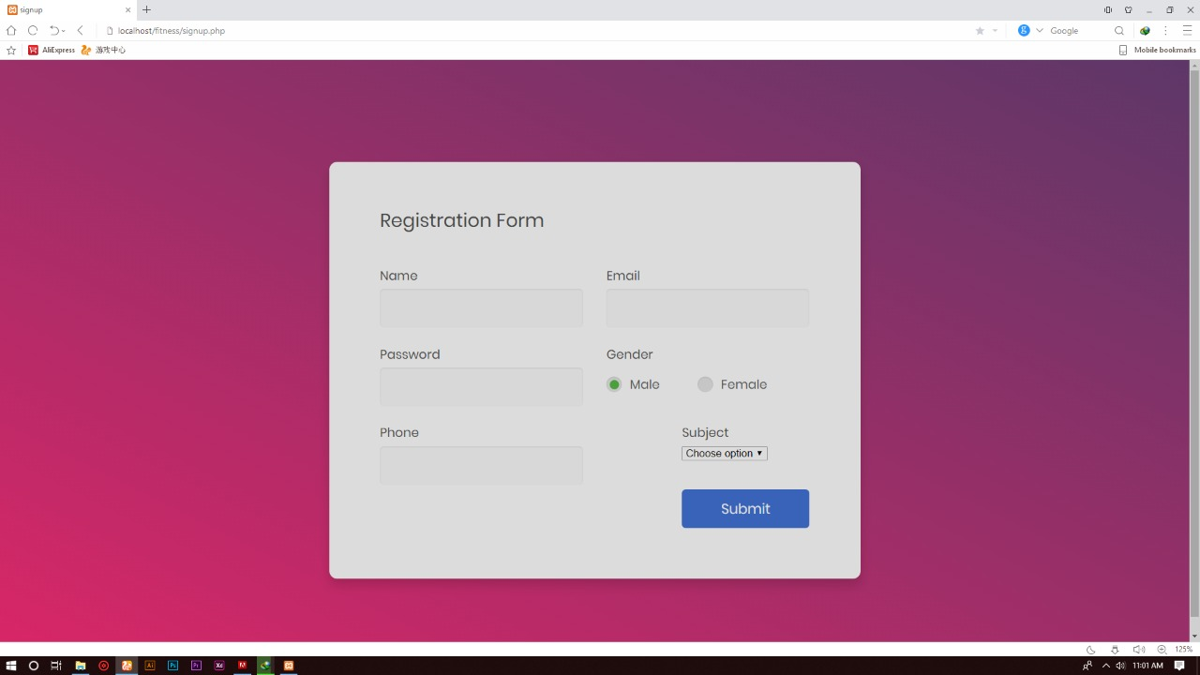
User registration :

Slide 25
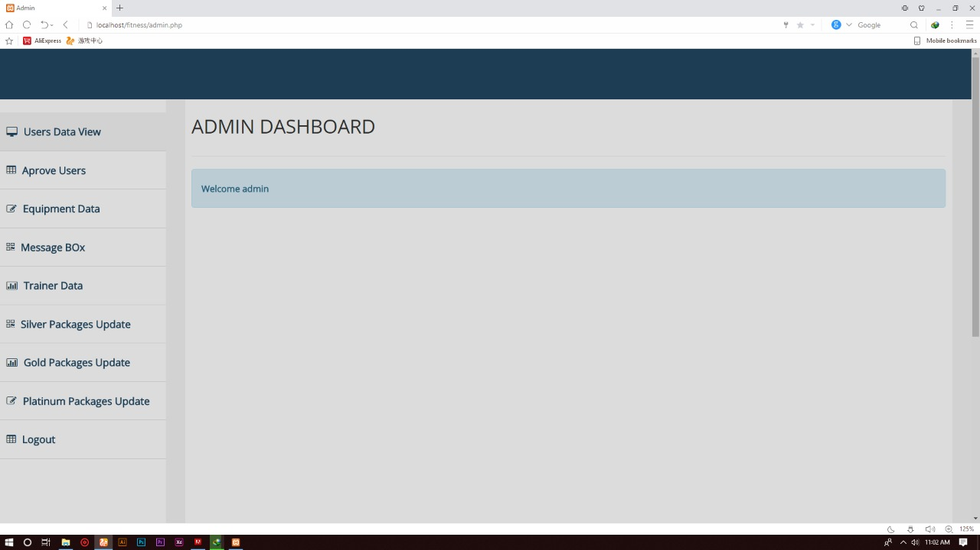
Admin dashboard :

Slide 26
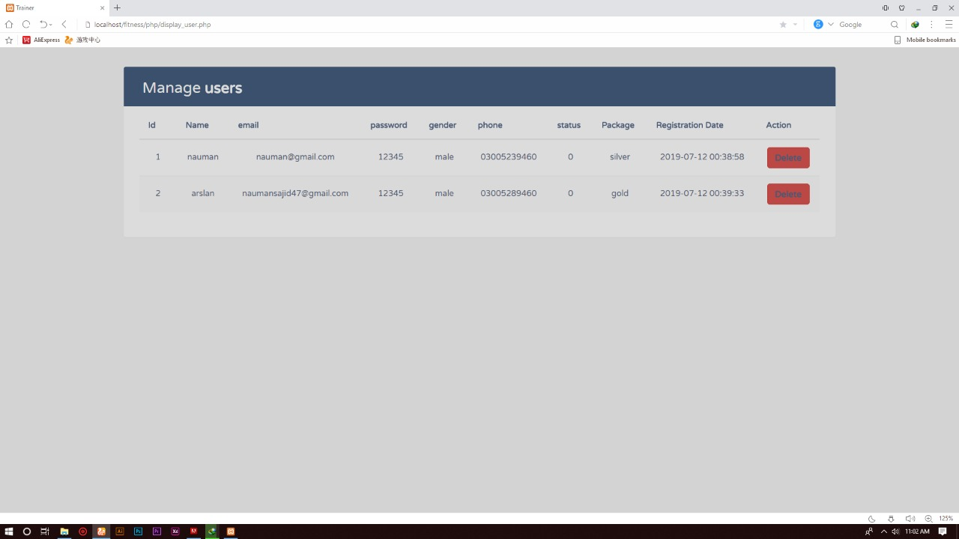
Manage user:

Slide 27
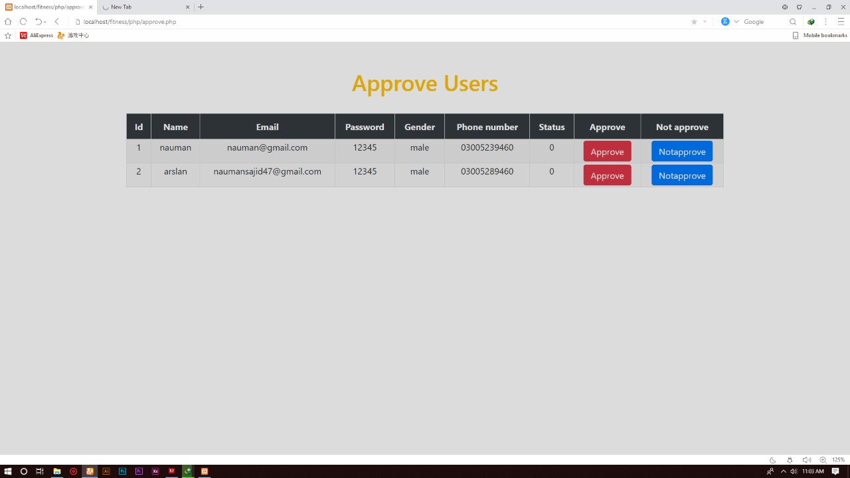
Approve user:

Slide 28
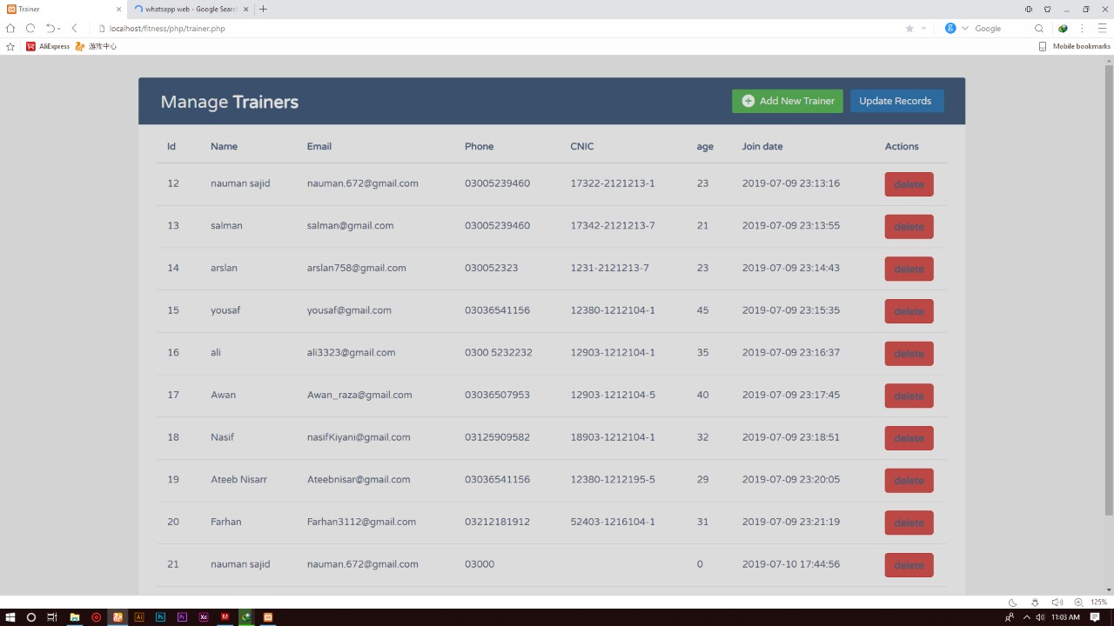
Manage trainer:

Slide 29
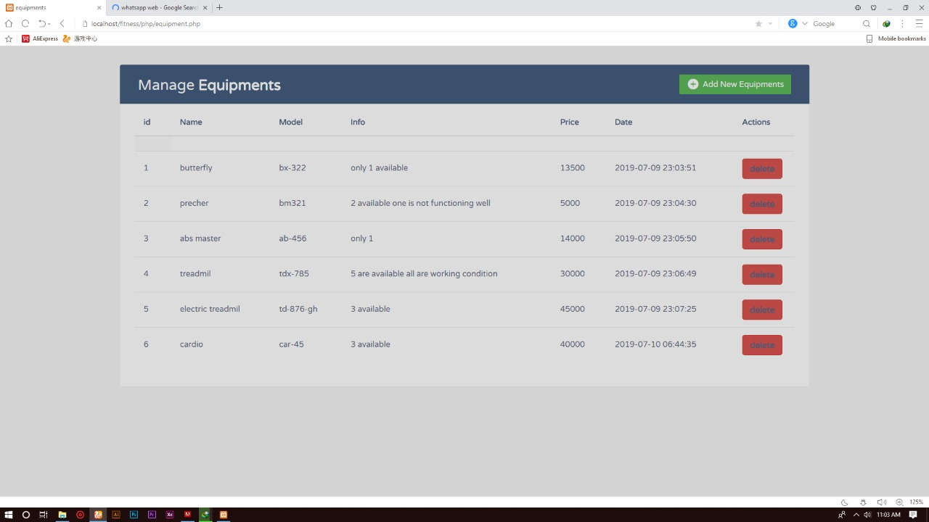
Manage equipment:

Slide 30
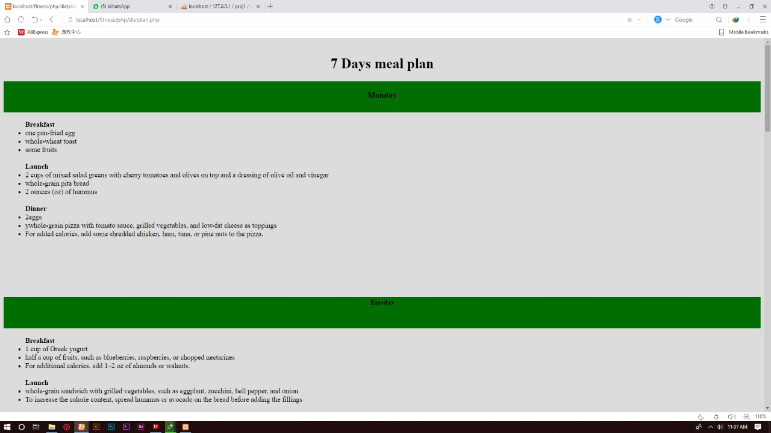
7 days diet plan:

Slide 31
THE END THANK YOU ALL!!

