Slide 1
Trust network based prediction for user ratings in Trip advisor
Presented by,
Anushka H Patil , Snehal S Vyawahare
Guided by,
Prof. Arjan Durresi
CSCI 59000 Advanced Mobility and Cloud Computing
Spring 2018 - IUPUI

Slide 2


Overview
Abstract
Literature Survey
Design Model
Methodology
Implementation
Result Analysis
Conclusion
Future work
References
This Photo by Unknown Author is licensed under CC BY-SA

Slide 3
Abstract
Now-a-days, recommender systems aim to provide a trusted review about different businesses.
In this project, we aim to implement the trust system on one such recommender system “Trip Advisor”
Objective:
To develop a trust-based recommender system
To provide a mechanism to verify the quality of reviews in terms of the reviewer’s trustworthiness.
To implement an improved, précised and reliable system

Slide 4
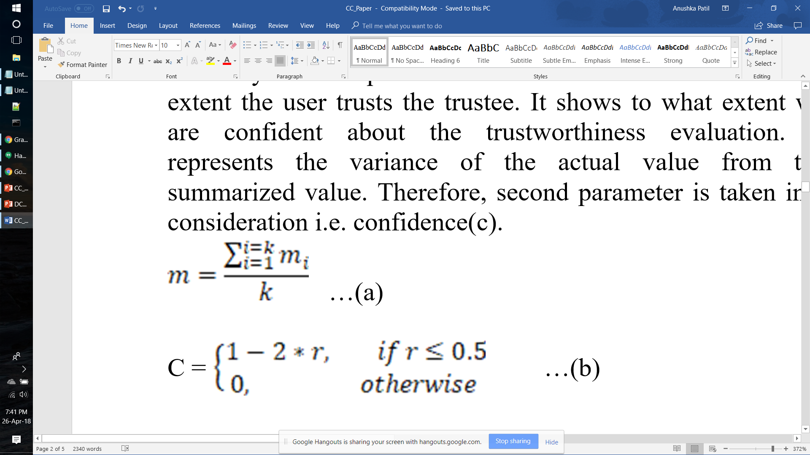
Literature Survey
“A General Trust Management Framework for Internet of Things”
In this paper, we analyzed it is difficult to manage trust and relationship amongst different agents and their partners
It talks about the general trust framework irrespective of the environments and factors in a specific application
It provides us a different perspective of trustworthiness and confidence.
“Trust Assessment for Internet of Things in Multi-access Edge Computing”
MEC aims to improve the delivery of content and applications to users
It provides end users with a network which is congestion free and improve application performance.
Trustworthiness and confidence

Slide 5
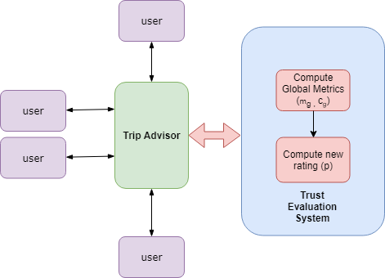
Design Model
Fig. 1. Trust-based Trip Advisor System

Slide 6
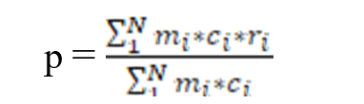
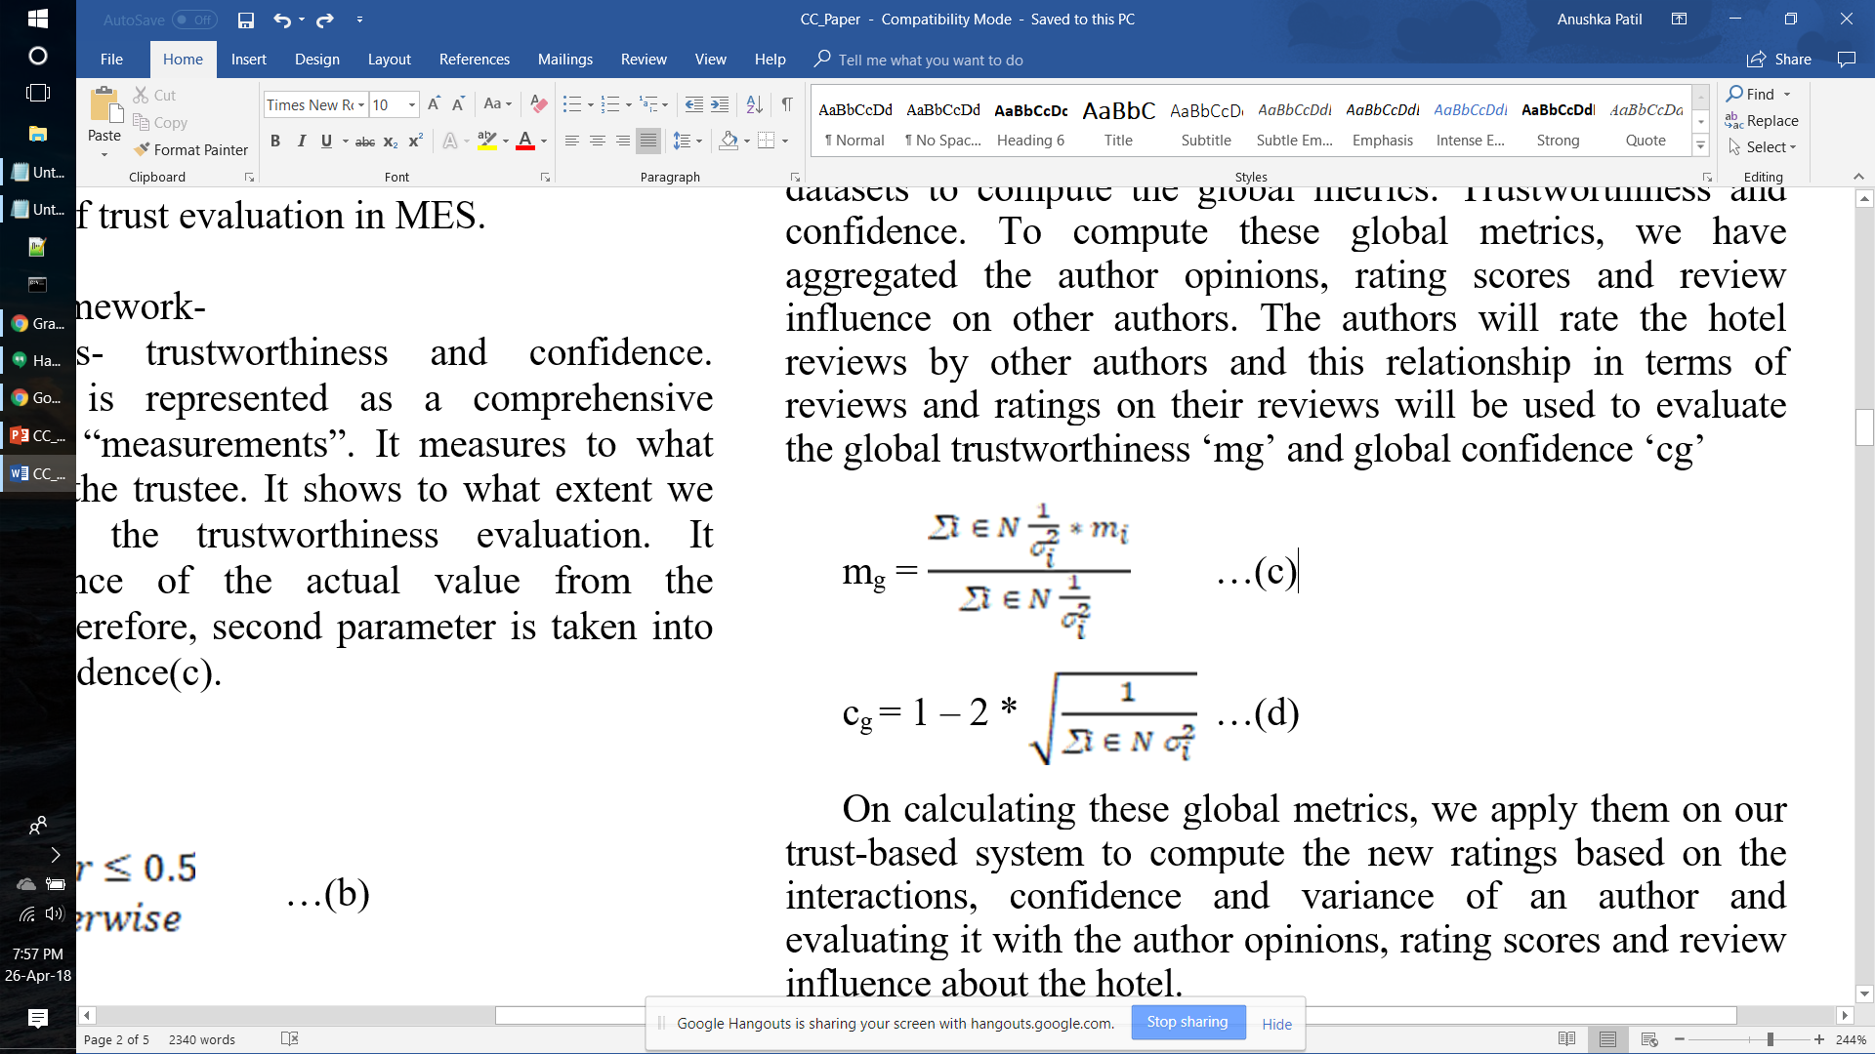
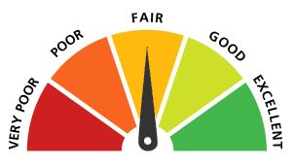
Methodology
Datasets:
Random
Classified
Data (JSON Files):
Authors_Info
Hotel_Info
Reviews
Global Metrics
Trustworthiness:
Confidence:
New Ratings
This Photo by Unknown Author is licensed under CC BY-SA

Slide 7
Implementation
Created dummy datasets
Computed global metrics : ‘mg’ and ‘cg’
Establish Trust, by building Author’s reputation based on the global metrics
Computed new ratings
Compared new ratings with the old ratings for analysis

Slide 8
Our process is easy
Hotel_01
2. Reads the Author_05 review
Author_02
3.Visits hotel_01
Author_05
1. Review
4. Rates

Slide 9
2
H_03
2
H_07
A_02
3
A_02
3
4
1
4
1
A_05
A_05
2
H_10
A_02
3
Author_02 → Author_05
- “4” Interactions
4
1
A_05
9

Slide 10
Result Analysis
Random dataset
Classified dataset

Slide 11
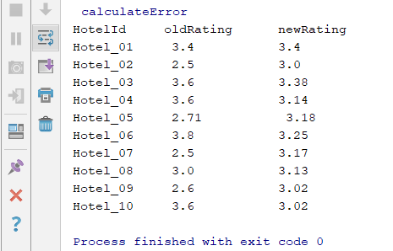
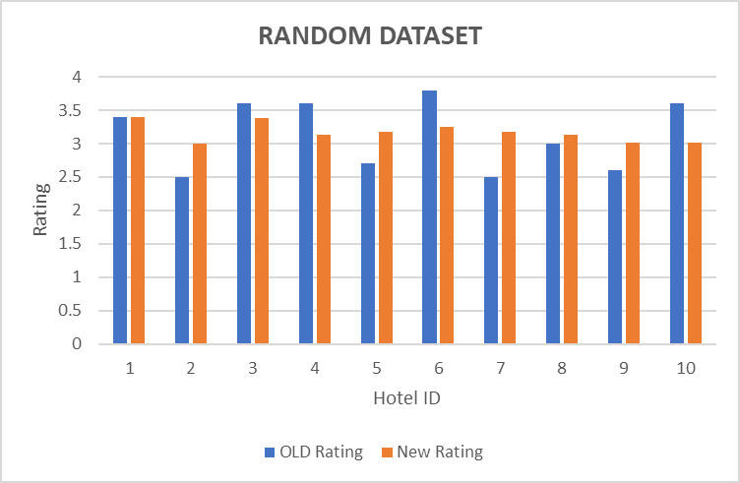
Random dataset
Fig. 2a. Comparison between old and new ratings
Fig. 2b. Comparison graph plotted for random datasets

Slide 12
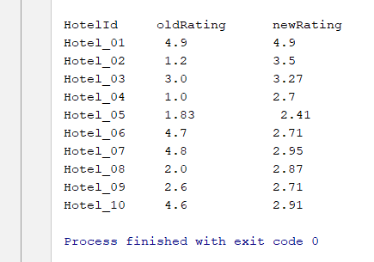
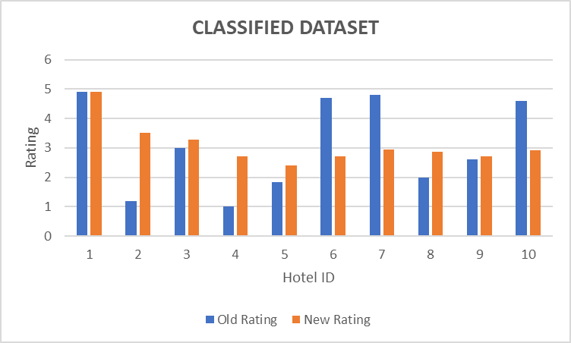
Classified dataset
Fig. 3a. Comparison between old and new ratings
Fig. 3b. Comparison graph plotted for classified datasets

Slide 13
Conclusion
Based on the author-author interaction and confidence we were able to compute the new ratings using our trust-based system.
From result analysis:
The new ratings are more prominent and trustworthy
It verifies that we have an improved, précised and reliable system
Thus, we have successfully provided a mechanism to verify the quality of reviews in terms of the reviewer’s trustworthiness

Slide 14
Future Work
To work on larger datasets which might advance the reliability of the system
To add more parameters to enhance the trust prediction in our system
To integrate this methodology over other ecommerce sites which rely on the user opinions and reviews

Slide 15
References
Yefeng Ruan, Arjan Durresi, Suleyman Uslu, “Trust Assessment for Internet of Things in Multi-access Edge Computing”
Yefeng Ruan, Ping Zhang, Lina Alfantoukh, and Arjan Durresi, “Measurement Theory-Based Trust Management Framework for Online Social Communities”
Yefeng Ruan, Arjan Durresi, Lina Alfantoukh, “Using Twitter trust network for stock market analysis”
Yefeng Ruan, Arjan Durresi, Lina Alfantoukh “A General Trust Management Framework for Internet of Things”
Kushagra Bhargava, Tanvi Gujral, Mihir Chawla , Tanya Gujral, "Comment Based Seller Trust Model for E-Commerce”
Wikipedia

Slide 16
Thank you!
Any questions?

