Slide 1
Packet Loss Detection and Recovery
SDN-Socket Programming | Jackfruit Mini Project | Computer Networks
Anushka Acharya
PES2UG25CS631
Adarsh Shankar Chanapannavar
PES2UG25CS626
Gowtam M
PES2UG25CS646
Notes:
Introduce the team and the project: a UDP application that detects packet loss and works with an SDN controller to move traffic to a healthy path.

Slide 2
Two roads, one controller
When the main path degrades, resending packets over it is slow and wasteful. Better: detect the problem and move traffic to a healthy path.
1
2
3
Detect
Alert
Reroute
UDP packets carry sequence numbers. The receiver spots missing numbers and measures loss.
The receiver tells the SDN controller through a socket when loss is too high or traffic stops.
The controller rewrites the switch flow rules so traffic uses the alternate path.
Notes:
Analogy: two roads to school. If Road 1 gets damaged, resending parcels down the same road is slow. A traffic controller can send everyone down Road 2. In our project the roads are network paths, the parcels are UDP packets, and the controller is Ryu.

Slide 3
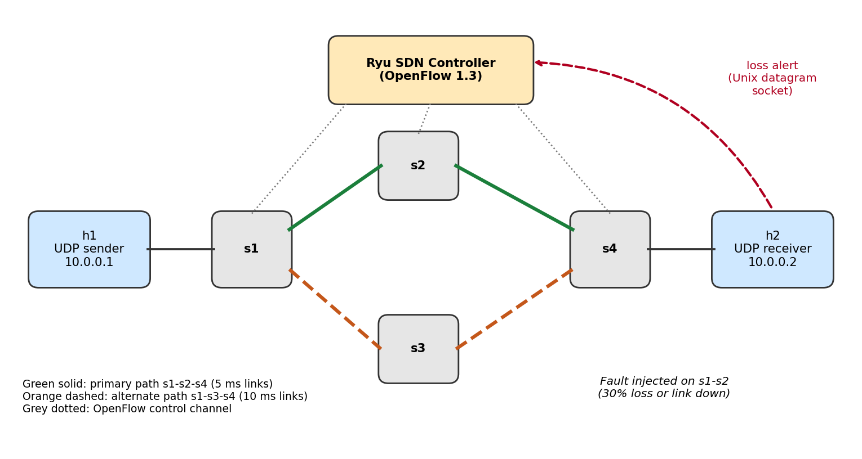
System architecture
h1 sends, h2 receives (UDP)
Primary path: s1, s2, s4
Alternate path: s1, s3, s4
Ryu controller (OpenFlow 1.3) programs the switches
Receiver alerts the controller
Notes:
Two hosts, four OpenFlow switches in a diamond. Primary path s1-s2-s4 (5 ms links), alternate s1-s3-s4 (10 ms links). The Ryu controller programs all switches. The red dashed arrow is the loss alert from the receiver to the controller.

Slide 4
How it works
Send
Detect
Alert
Reroute
Sender numbers each UDP packet. Receiver ACKs. No ACK? Resend.
Receiver finds gaps in sequence numbers, per 20-packet window.
Loss of 15% or more, or 1 s of silence, goes to the controller.
Controller changes flow rules on s1 and s4 to the alternate path.
Window: 20 packets | Alert at 15% loss | Silence limit: 1 s | Resend after 250 ms
Notes:
Walk through the four steps. Key numbers: loss window of 20 packets, alert at 15 percent loss or 1 second of silence, retransmit after 250 ms. The reroute is a single FlowMod with the same match and priority, which replaces the old rule.

Slide 5
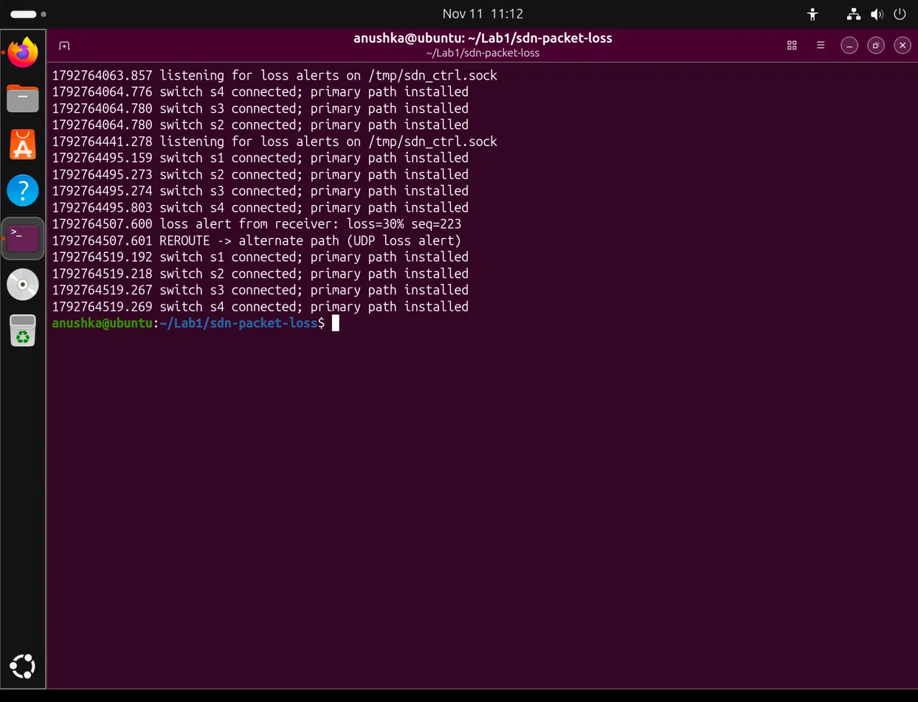
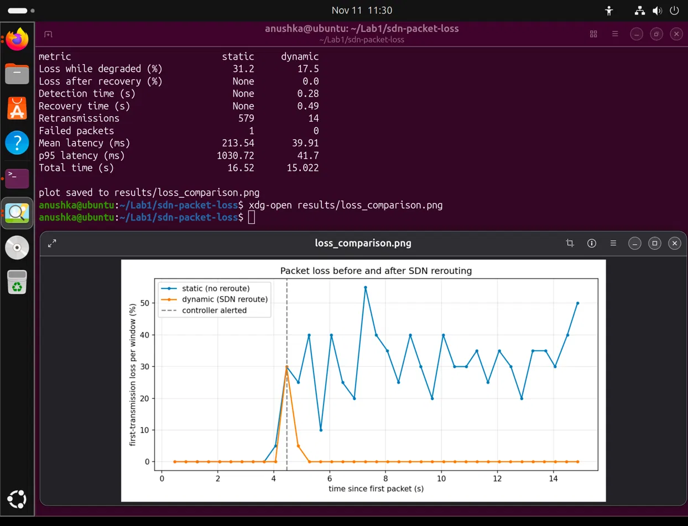
Running the experiment
SCREENSHOT 1
Controller terminal: switches connected, loss alert, REROUTE
SCREENSHOT 2
plot.py table (static vs dynamic) or loss_comparison.png
Notes:
Start the controller in Terminal 1 first, then run topo.py in Terminal 2. Do NOT run sudo mn -c after the controller is up, because it kills the controller. Show the loss alert and REROUTE lines in the controller terminal, then the comparison table.

Slide 6
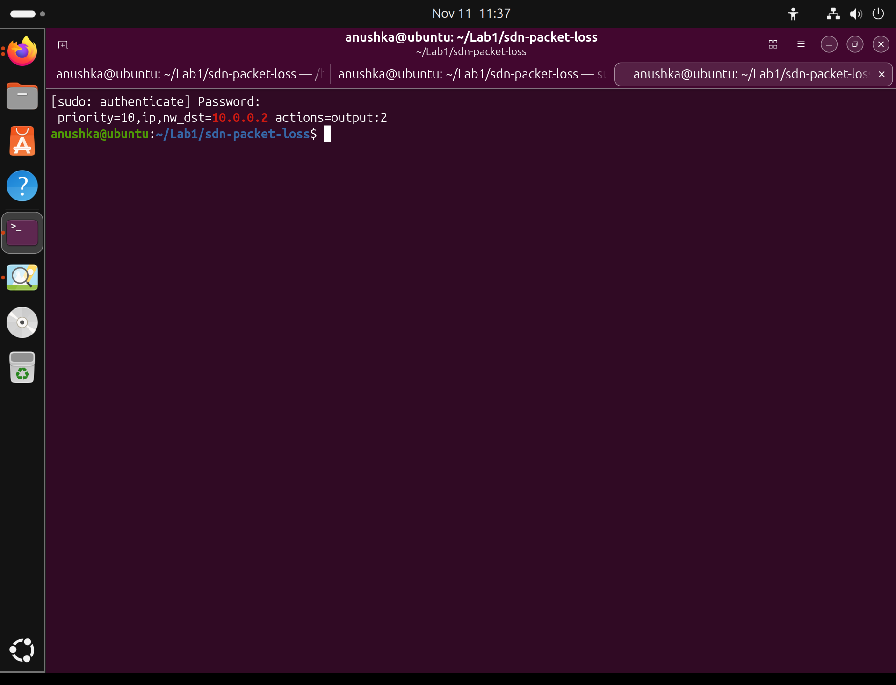
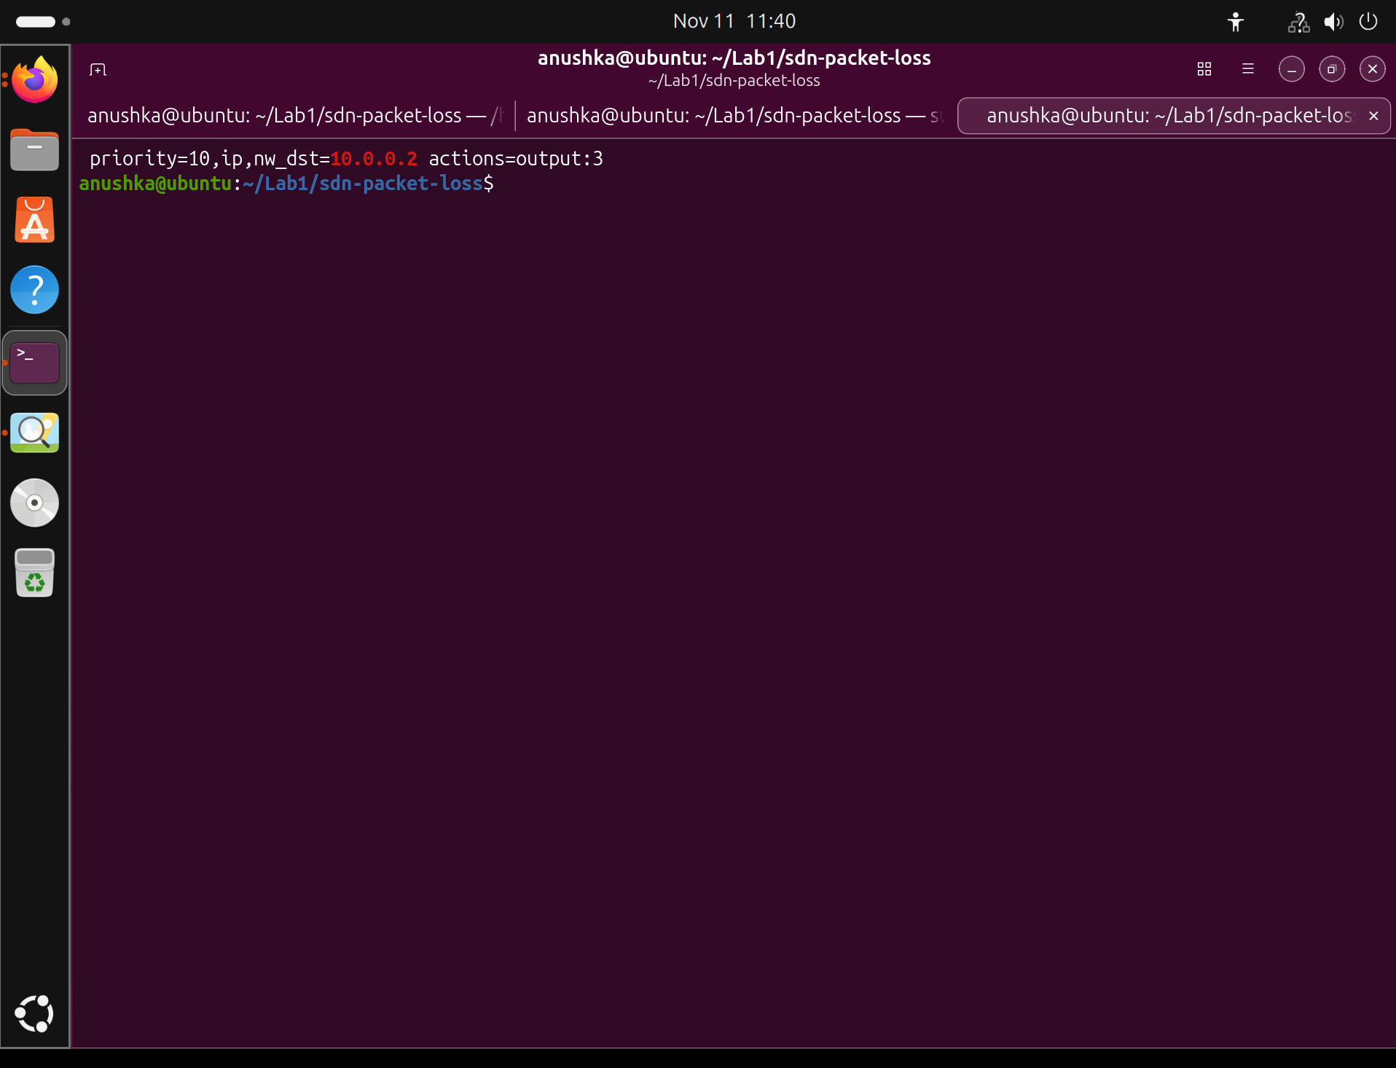
Proof: the flow rule changes
BEFORE failure
port 2 = toward s2 (primary path)
AFTER reroute
port 3 = toward s3 (alternate path)
Primary path: s1 to s2 to s4
Alternate path: s1 to s3 to s4 (command: sudo ovs-ofctl -O OpenFlow13 dump-flows s1)
Notes:
Live demo. Run dump-flows on s1 before, then source demo.cmds at the mininet prompt (it breaks link s1-s2 mid-transfer), wait about 10 seconds, and run dump-flows again. The rule for 10.0.0.2 moves from s1-eth2 to s1-eth3.

Slide 7
Results: static vs dynamic
0.28 s
to detect 30% loss (recovered in 0.49 s)
1.2 s
to recover after a link failure
0 vs 552
packets lost of 750: dynamic vs static (link down)
Notes:
Static = no reroute, dynamic = SDN reroute. 30% loss: retransmissions 579 vs 14, mean latency 213 ms vs 40 ms, detected in 0.28 s and recovered in 0.49 s. Link failure: 552 of 750 packets never delivered without rerouting, 0 with rerouting, recovery about 1.2 s.

Slide 8
What we showed
UDP app with sequence numbers, ACKs and retransmission
Loss detected in under half a second; link failure in about 1 s
Ryu controller reroutes traffic with a single flow update
Compared against a static baseline: far fewer retransmissions, no lost packets
github.com/anushkaacharya35/sdn-packet-loss
Notes:
Summarise the four points, then take questions. Likely questions: why UDP, how loss is detected, how the app talks to the controller, why the monitor shows 0 percent loss (netem drops after the counters), and the limitation that traffic does not switch back after repair.

