Slide 1


Slide 2
ABOUT THIS PROJECT
Project Overview
Airbnb Open Data Analysis (100K+ records)
End-to-end Data Analytics Project
Workflow: Excel → SQL → Power BI
Focus on pricing, availability & customer trends
Objectives
Clean and preprocess raw dataset
Analyze price variation by location & room type
Identify demand & availability patterns
Understand customer behavior (reviews & ratings)
Build interactive dashboard for insights
Dataset
Source: Airbnb Open Data (Kaggle)
~102K+ records | 25 columns
Key Features:
Location (Neighbourhood, Country)
Pricing (Price, Service Fee)
Room Type & Availability
Reviews & Ratings
Host & Listing Details
Tools Used
Excel → Data Cleaning
SQL → Data Analysis & Queries
Power BI → Dashboard & Visualization

Slide 3
EDA (Exploratory Data Analysis)
-Analyzed price distribution of listings
-Compared room type availability (Entire home, Private, Shared)
-Identified top locations with highest listings
-Explored availability patterns (365 days)
-Studied customer engagement using reviews data

Slide 4
SQL Analysis
SQL Analysis
Performed pricing analysis (min, max, avg)
Identified expensive locations
Compared room types and pricing
Analyzed demand using reviews
Categorized listings based on availability

Slide 5
Power BI Visuals
Developed interactive Airbnb dashboard using Power BI
Visualized price trends across neighbourhoods
Analyzed room type distribution and listings
Identified top hosts based on reviews
Explored monthly review trends
Categorized listings by availability status
Added filters (Neighbourhood Group, Room Type) for interaction

Slide 6
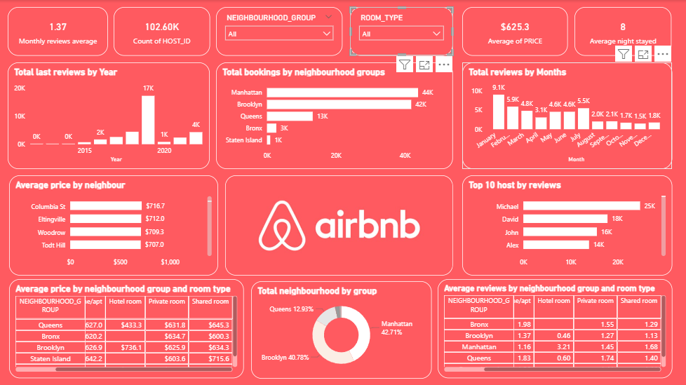
Dashboard

Slide 7
Insights
Manhattan & Brooklyn have highest listings and demand
Prices vary significantly based on location and neighbourhood
Entire homes/apartments are more expensive than other room types
Few hosts generate high number of reviews (high engagement)
Listings show seasonal trends in reviews and bookings
Availability varies → indicates supply-demand imbalance

Slide 8
Conclusion
Successfully analyzed Airbnb dataset using Excel, SQL & Power BI
Identified key factors affecting price, demand, and availability
Built interactive dashboard for data visualization
Derived insights useful for hosts and customers
Project demonstrates end-to-end data analytics workflow

