Slide 1
H1B VISA APPLICATION
ANALYSIS (2025)
-Anushka Kumari Astha
Aspiring Data Analyst

Slide 2
OBJECTIVE
-Analyze H1B visa application trends
-Identify valid vs total applications
-Evaluate approval rate and case status distribution
-Discover top employers, job roles, and salary trends
-Analyze state-wise hiring patterns

Slide 3
DATASET OVERVIEW
Source: Public H1B Visa Applications Dataset
Total Records: ~2.4 Million (Raw Data)
Valid Applications: ~596K (After Data Cleaning & Removing Duplicates)
Key Features:
-Case Status (Certified, Denied, Withdrawn)
-Employer Name
-Job Title
-Salary
-Work Location (State)
-Application Date

Slide 4
TOOL USED
• SQL → Data analysis
• Power BI → Dashboard

Slide 5
KEY PERFORMANCE INDICATORS
Total Valid Applications analyzed:596K+
Number of Employers involved:72K+
Average Salary offered: $389K
Unique Job Roles identified: 120K+
Overall Approval Rate: 92.5%

Slide 6
KEY INSIGHTS
High Approval Rate (~92.5%) indicates strong demand for skilled foreign workers.
Significant data reduction (2.4M → 596K) highlights the importance of data cleaning and removing duplicates.
Technology roles (e.g., Software Engineers) dominate H1B applications.
Top employers such as Amazon, Google, and Microsoft lead in visa sponsorship.
California, Texas, and New York emerge as major hiring hubs.
Salary distribution shows higher pay in specialized and managerial roles.

Slide 7
DASHBOARD OVERVIEW
KPI Cards display key metrics like applications, salary, and approval rate
Pie Chart shows distribution of application status -Certified, Denied, Withdrawn
Line Chart highlights application trends across quarters
Bar Charts represent top employers and job roles
Map Visualization shows state-wise distribution of applications
Filters (Case Status, Quarter) enable dynamic analysis

Slide 8
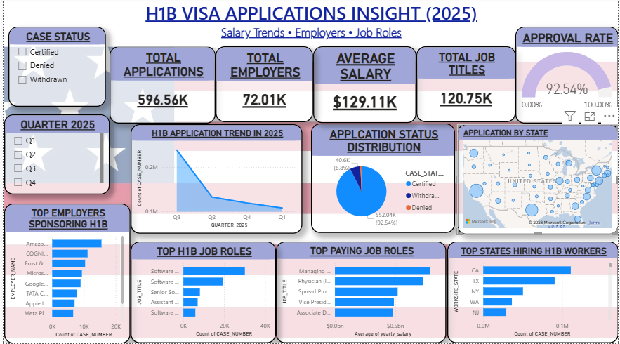
DASHBOARD

Slide 9
Conclusion
H1B visa applications show a consistently high approval rate
Technology roles dominate the job market
Major hiring is concentrated in key states like California and Texas
Data-driven insights can help organizations improve hiring strategies

Slide 10
THANK YOU

