Slide 1
AI-Powered Financial Fraud Detection System
Submitted By:
Anushkaa Mishra
Internship: IBM-PBEL Internship(Batch 3)(GENERATIVE AI)
Technology Used: Python | Machine Learning | Streamlit

Slide 2





Introduction
Financial fraud is increasing rapidly due to online banking and digital transactions.
Traditional fraud detection methods are slow and less efficient.
Artificial Intelligence (AI) and Machine Learning (ML) help detect fraudulent transactions automatically.
This project uses a Random Forest Machine Learning algorithm to identify fraud.
This Photo by Unknown Author is licensed under CC BY-NC

Slide 3
Problem Statement
Millions of financial transactions occur daily.
Manual fraud detection is difficult.
Fraud causes huge financial losses.
An intelligent automated system is needed to detect fraudulent transactions accurately.

Slide 4
Objectives
Develop an AI-based fraud detection system.
Detect fraudulent credit card transactions.
Improve accuracy using Machine Learning.
Build a user-friendly web application.
Reduce financial losses.

Slide 5
Technologies Used
Technology
Purpose
Python
Pandas
Scikit-learn
Streamlit
Joblib
VS Code
Programming language
Data processing
Machine learning
Web application
Model saving
Development environment

Slide 6
System Workflow
Project Workflow
Credit Card Dataset
↓
Data Preprocessing
↓
Feature Selection
↓
Random Forest Training
↓
Model Saved (.pkl)
↓
Streamlit Web App
↓
Fraud Prediction
Explanation:
The system first loads the credit card transaction dataset and preprocesses the data. The Random Forest machine learning model is then trained and saved as a .pkl file. Finally, the Streamlit web application loads the trained model and predicts whether a transaction is genuine or fraudulent based on the user's input.

Slide 7
AI Model
Machine Learning Algorithm – Random Forest Classifier
Why Random Forest?
High prediction accuracy.
Handles large datasets efficiently.
Reduces overfitting by combining multiple decision trees.
Provides fast and reliable fraud detection.
Suitable for binary classification problems (Fraud or Genuine).
Working of the Model
The credit card transaction dataset is divided into training and testing data.
The Random Forest algorithm learns patterns from historical transactions.
Multiple decision trees are created during training.
Each tree predicts whether a transaction is genuine or fraudulent.
The final prediction is based on the majority vote of all decision trees.

Slide 8
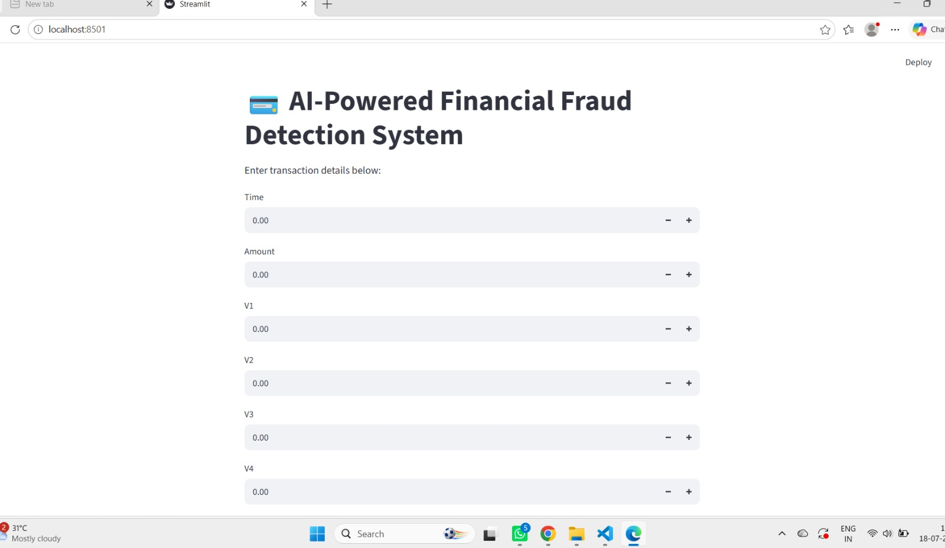
Project Implementation
Implementation Steps
Loaded the Credit Card Fraud Detection dataset using Pandas.
Split the dataset into training (80%) and testing (20%) sets.
Trained the Random Forest Classifier using Scikit-learn.
Saved the trained model as fraud_model.pkl using Joblib.
Developed a Streamlit web application for user interaction.
Used the trained model to predict whether a transaction is
genuine or fraudulent.

Slide 9
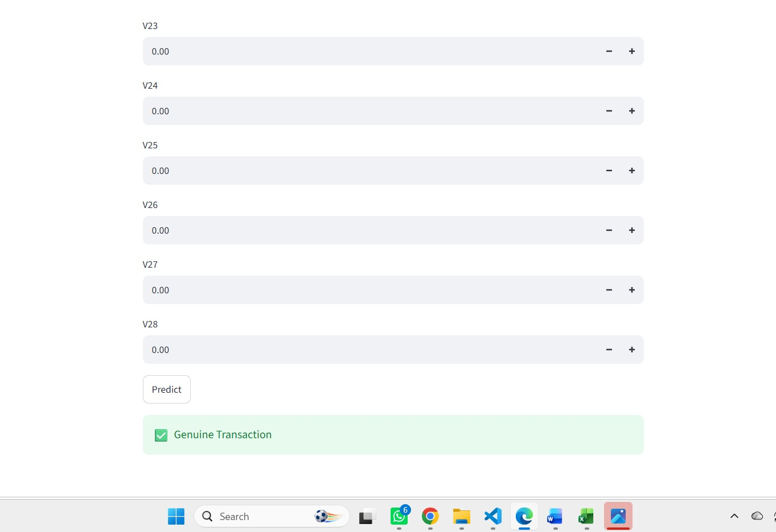
Results
Output of the AI-Powered Financial Fraud Detection System
The Random Forest model was trained successfully using the credit card transaction dataset.
The trained AI model predicts whether a transaction is Genuine or Fraudulent.
The prediction is displayed instantly through the Streamlit web application.
The system demonstrates how AI can assist in detecting financial fraud efficiently.

Slide 10
Conclusion & Future Scope
Conclusion
Successfully developed an AI-powered financial fraud detection system.
Random Forest model predicts fraudulent transactions effectively.
Streamlit provides an easy-to-use interface.
AI improves the speed and accuracy of fraud detection.
Future Scope
Real-time transaction monitoring
Deep Learning models
Cloud deployment
Mobile application
Integration with banking systems

Slide 11
THANK
YOU

