Slide 1
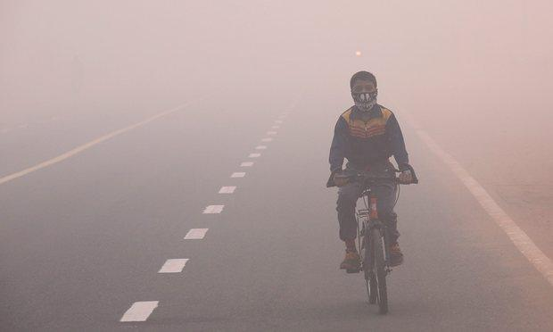
Fight Against Pollution
PollEnemy
A Presentation by HARDCODERS

Slide 2
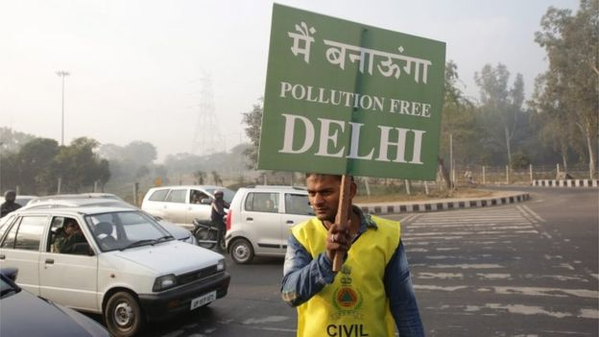
Holding Strikes is important for creating awareness, but, why not work out a solution instead...?

Slide 3
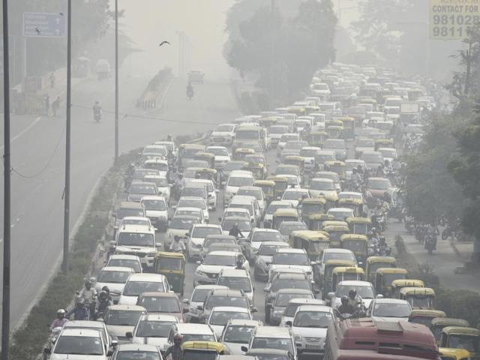
What is AIR POLLUTION ?
Presence of unwanted or harmful substances in the air.
SMOG = Smoke + Fog
Reduction of visibility
Inability to breathe properly - Choking

Slide 4
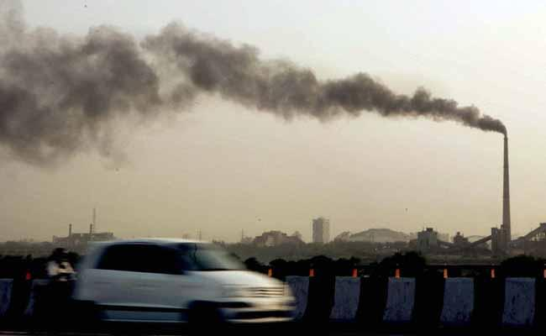
WHAT ARE THE MAJOR POLLUTANTS?
OZONE
NITROGEN DIOXIDE
SULFUR DIOXIDE
CARBON MONOXIDE

Slide 5
What does PollEnemy do?
Equipped with MQ 135 and Sharp Dust Sensor, PollEnemy measures the concentration of CO (Carbon Monoxide) and dust density in the air.
It indicates a suitable colour alerting the local user about the pollution level outside so that he can take suitable precautions.
It is also integrated with Cloud Service storing the data over a range of time and thus forming a graph indicating the variation in the amount of pollutants in our surroundings.
It is used to send the Authorities the feedback about the pollution level listing out the causes and giving suggestive measures to be taken.

Slide 6
What we Envisioned
Blinking led lights to locally show both the values of dust sensor and the gas sensor
Dumping the values to a google sheet using the Sheets API
Making a chart which will update in real-time due to the constant stream of data into the Sheet
Providing an e-mail advisory service

Slide 7
What we ended up building
Blinking led lights to locally show both the values of dust sensor and the gas sensor

Slide 8
Causes of AIR POLLUTION
Burning of fossil fuels emits sulphur dioxide.
Use of insecticide, pesticide and fertilizers drains out ammonia in atmosphere.
Manufacturing industries releases large amount of carbon monoxide, hydrocarbons, organic compound into air.
During mining process, dust and chemicals are released out in air.
Household cleaning products, painting supplies toxic chemicals in air.

Slide 9
Effects
Respiratory and heart problems.
World is witnessing due to global warming.
Water droplets combined with pollutants causes acid rain.
It causes eutrophication.
Depletion of ozone layer.

Slide 10
LET DELHI… BREATHE
GO GREEN…

