Slide 1
https://bit.ly/2TgfTmy
Intro to Image Analysis and Computer Vision
TinkerEve[17]
C11 05:30 Friday Jan 25
Anushka Bhandari

Slide 2
Image are Arrays
Image = (266 *484* 3)
Finding shapes
Detecting edges
Removing noise
Counting objects
measuring region and image properties of an object.
Image enhancement to remove noise
Image segmentation to isolate regions and objects of interest
Morphological filtering to remove more noise
Region analysis to extract statistical data

Slide 3
Loading...
Install Jupyter Notebook
Go to https://github.com/anushkab/ElectroholicsTinkerEve17
Clone the above repository .
Run “jupyter notebook” on the terminal.
Open “00_images_are_arrays.ipynb”
Afterwards “1_image_filters.ipynb”
A short cv2 demonstration of inbuilt functions and applications {Under the “opencv-tutorial” folder}

Slide 4
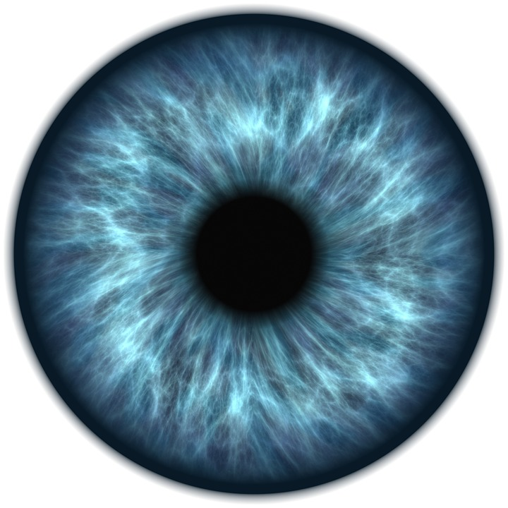
”ARE YOU WATCHING CLOSELY ?..”

Slide 5
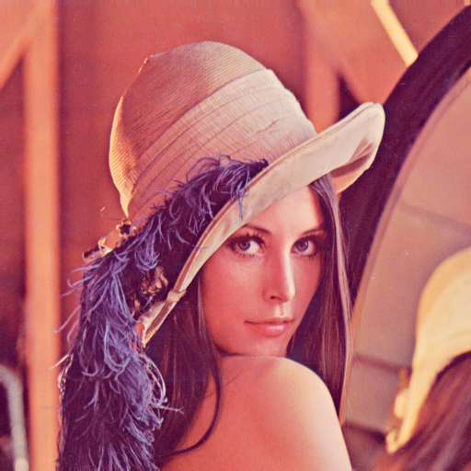
Detecting and Storing Data Hidden In A Image
Storing account info, passwords etc
{Demonstration}

Slide 6
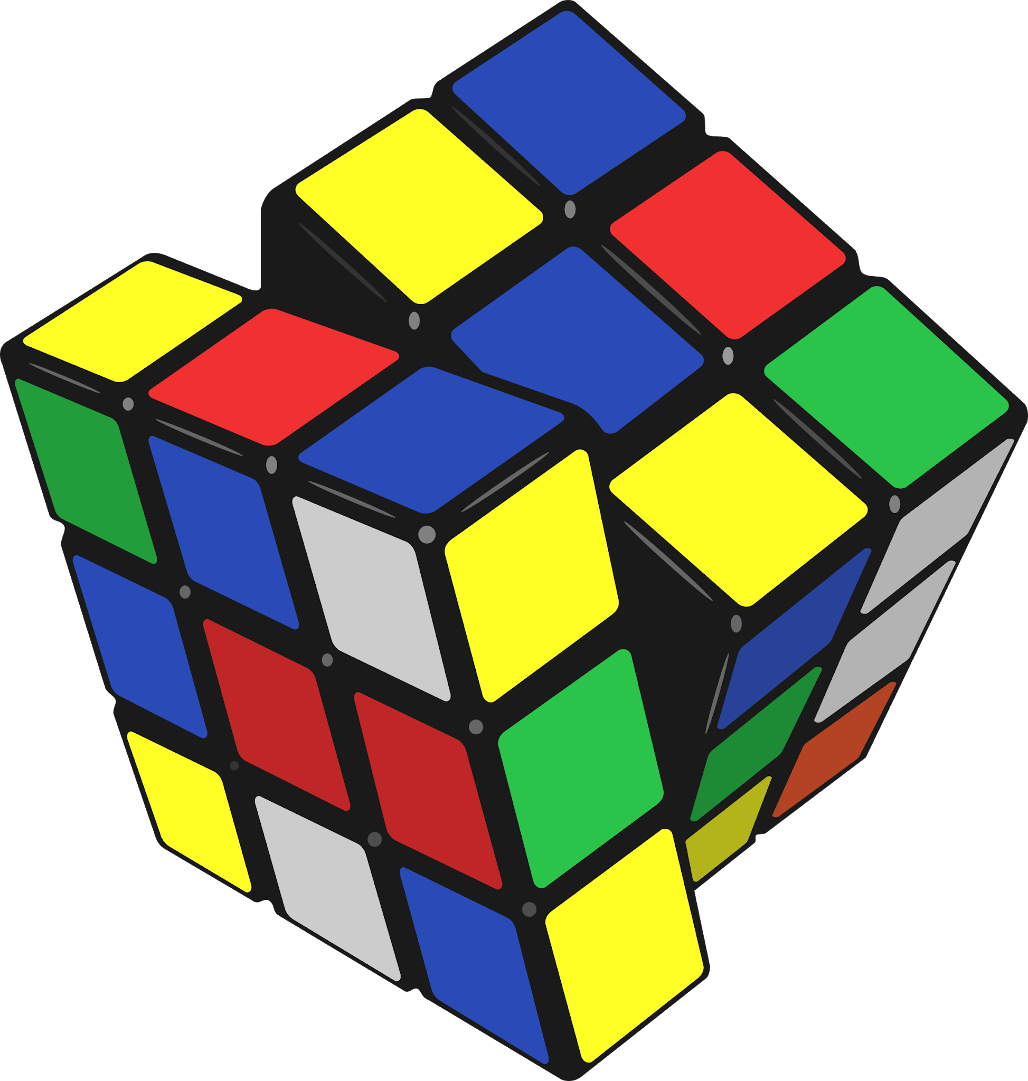
Solving RUBIK'S Cube
{Demonstration}
Edge Detection Color Detection Computer Vision
Algorithms

Slide 7
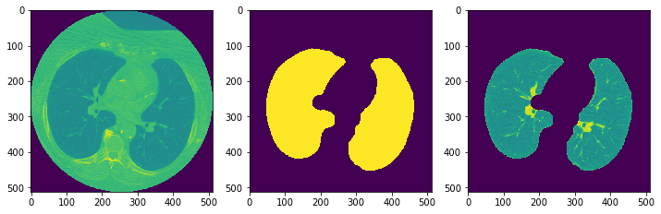
Detecting Lung Cancer
{Demonstration}

Slide 8
._.
Hope you Enjoyed
THANK YOU..

