Slide 1

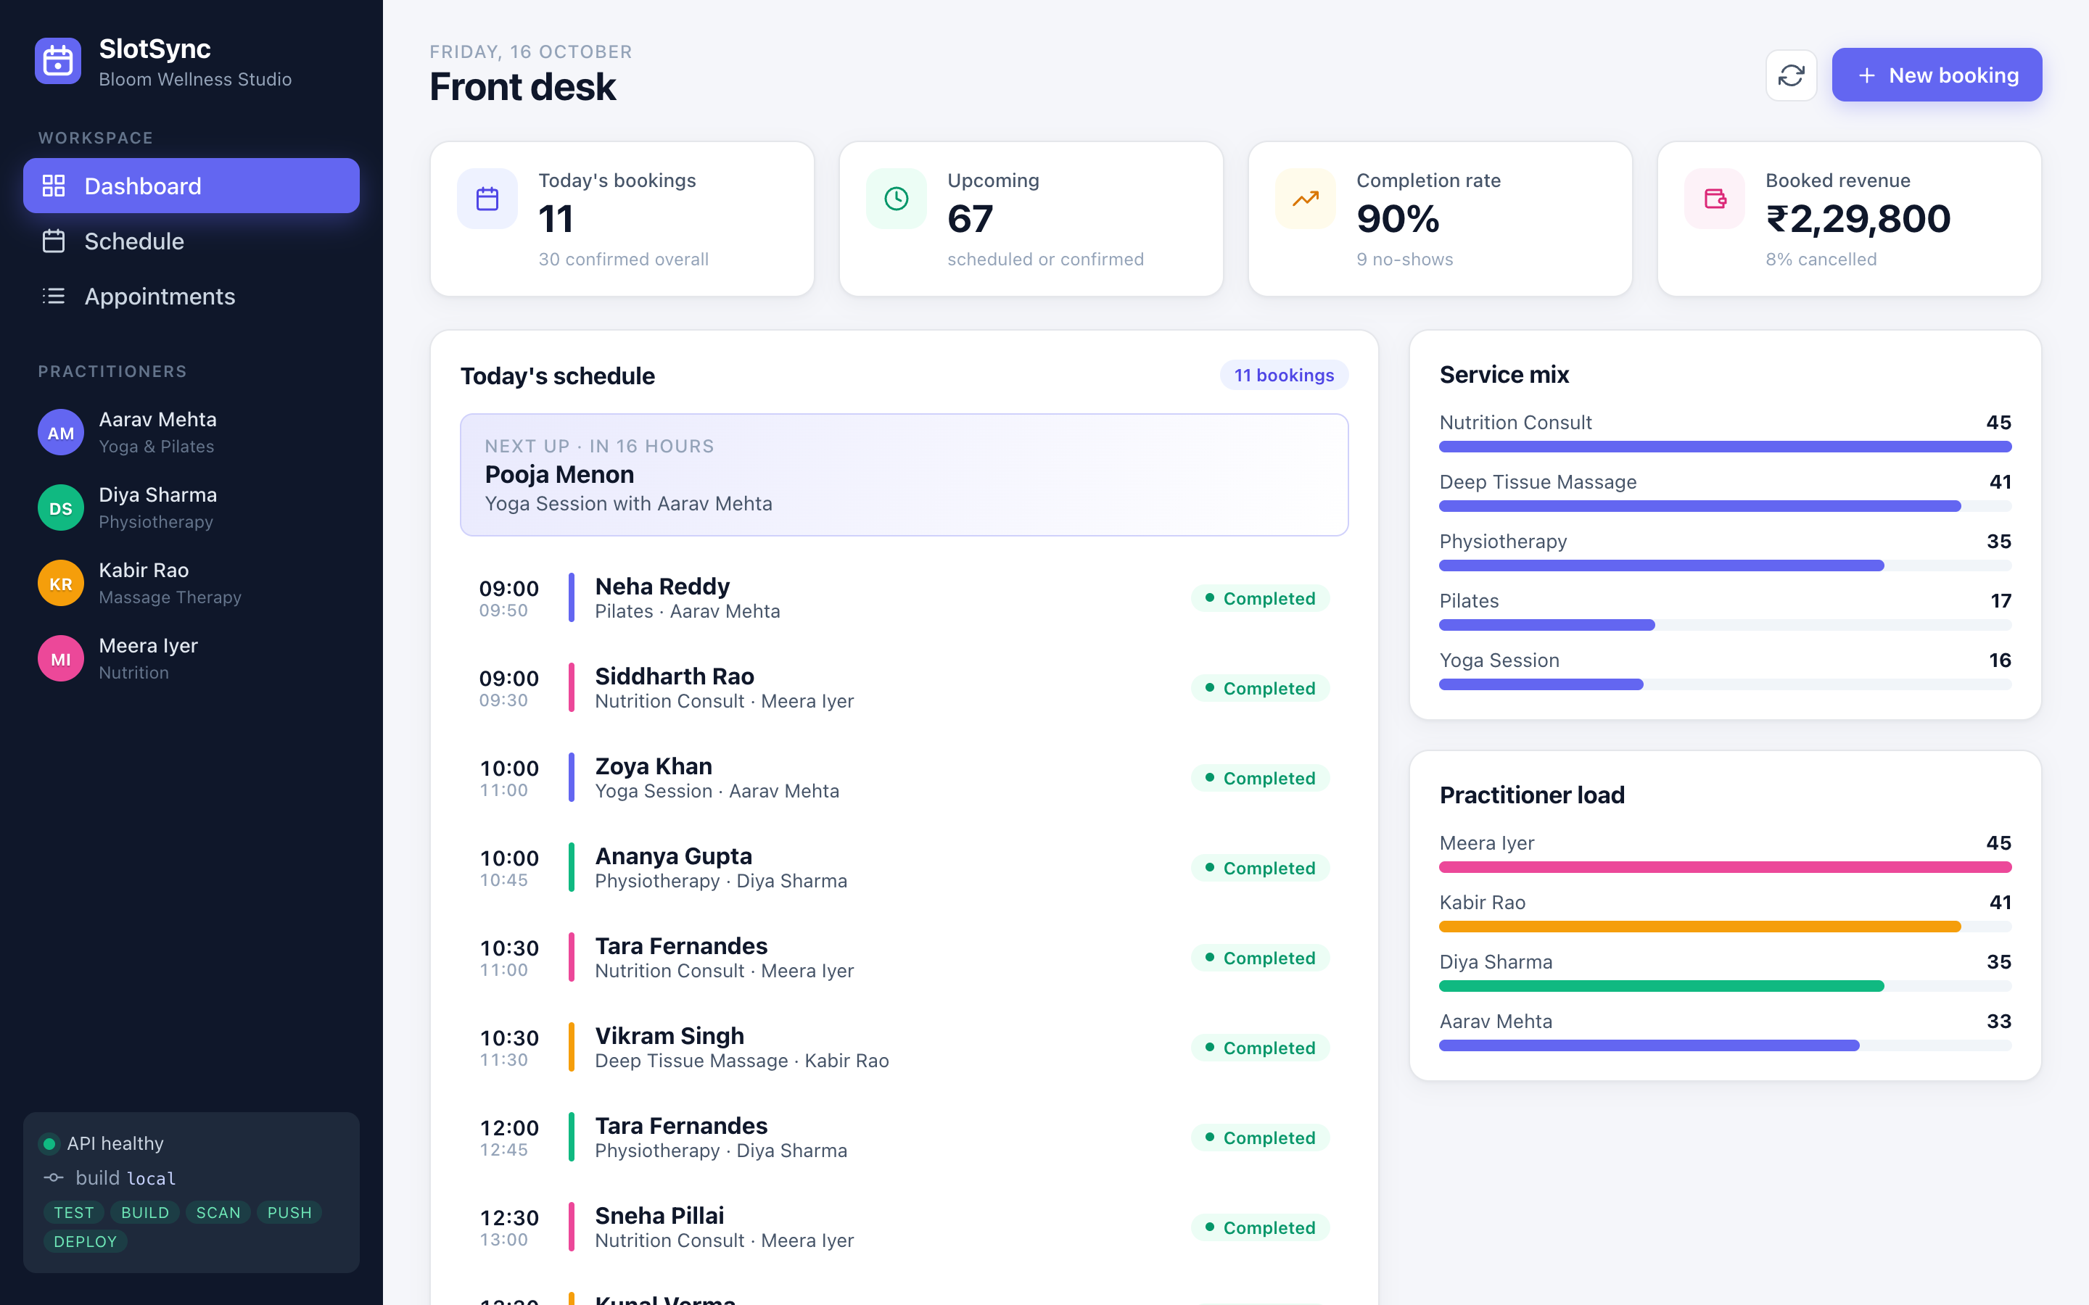
SlotSync
Appointment booking, from laptop to a monitored Kubernetes cluster
DevOps Final Capstone
Anushka Jain · Scaler School of Technology · October 2026
github.com/anushkabhansalii/apoointment-booking-devops-project
Notes:
Hi, I'm Anushka. My capstone is SlotSync, an appointment booking system for a wellness studio, and the full DevOps platform that takes it from a git push to a monitored Kubernetes cluster on AWS.

Slide 2
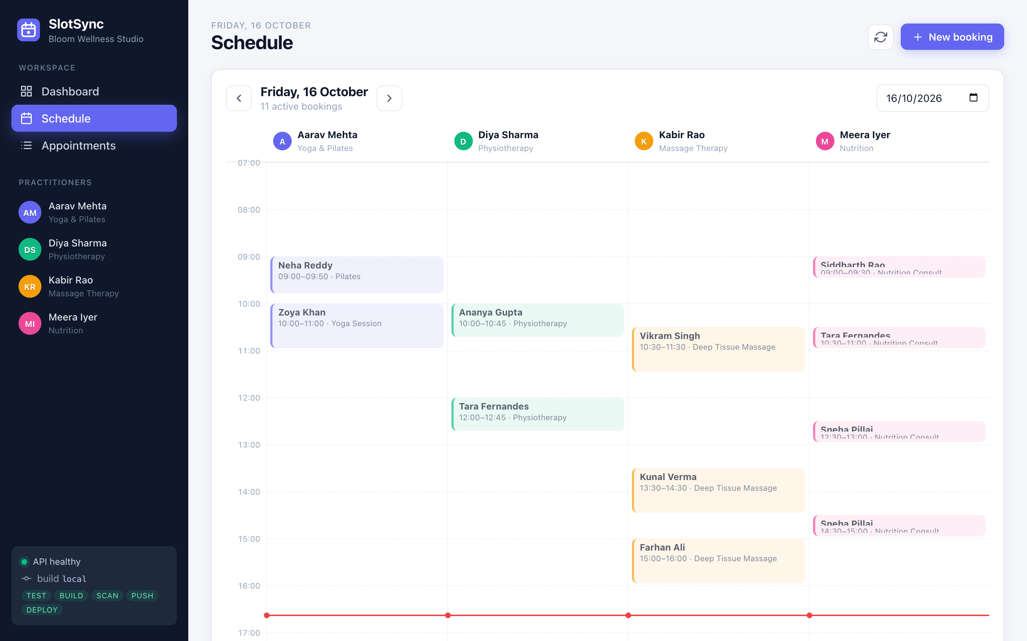
What I built and why
The problem: a 4-practitioner wellness studio double-books rooms and has no view of the day
The app: book, reschedule, confirm and cancel sessions; the API refuses double-bookings and out-of-hours slots
The platform: every push is tested, scanned, packaged, published and rolled out to EKS by GitOps, then monitored
Ground rules: nothing clicked in a console, no secrets in Git, every artefact traceable to a commit SHA
13
32
61
REST endpoints
automated tests
AWS resources in code
Notes:
Front-desk staff see today's KPIs, a timeline per practitioner and a filterable list. The interesting part is the delivery platform: tests, security scans, images, Terraform, Kubernetes, GitOps and monitoring.

Slide 3










Tech stack
Application
Data
React 18 + Vite · FastAPI · SQLAlchemy 2 · Pydantic v2
PostgreSQL 16 · Alembic migrations · gp3 EBS volume
Quality
Containers
pytest + coverage gate · Ruff · ESLint · alembic check
Multi-stage Dockerfiles · non-root · Docker Compose
CI/CD
DevSecOps
GitHub Actions · GHCR · multi-arch images · SHA tags
Trivy · Gitleaks · SBOM + provenance · Pod Security
Infrastructure
Kubernetes
Terraform · AWS VPC · NAT · EKS 1.35 · Pod Identity
Helm chart · Ingress · HPA · PDB · NetworkPolicy
GitOps
Observability
Argo CD · automated sync, prune, self-heal
Prometheus · Grafana · ServiceMonitor · alert rules
Notes:
Python and React for the app; Docker, GitHub Actions and GHCR for delivery; Trivy and Gitleaks for security; Terraform on AWS for infrastructure; Helm and Argo CD for deployment; Prometheus and Grafana for observability.

Slide 4
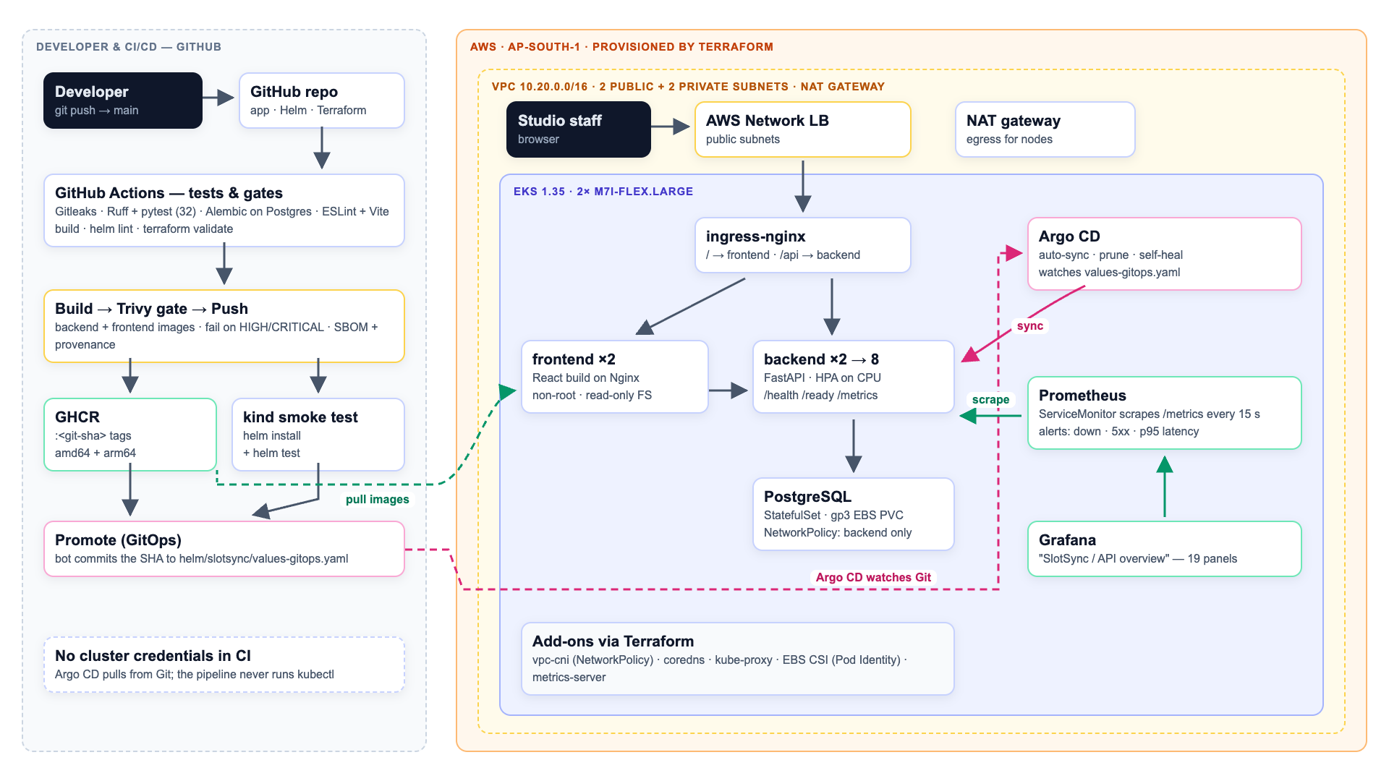
Architecture
Notes:
Left: the GitHub side. A push runs the gates, builds and scans images, pushes them to GHCR and commits the new SHA into the GitOps values file. Right: AWS. Terraform builds the VPC and EKS; Argo CD watches Git and syncs the cluster; the NLB and ingress-nginx route slash to the frontend and slash-api to the backend; Prometheus scrapes the backend and Grafana shows it.

Slide 5
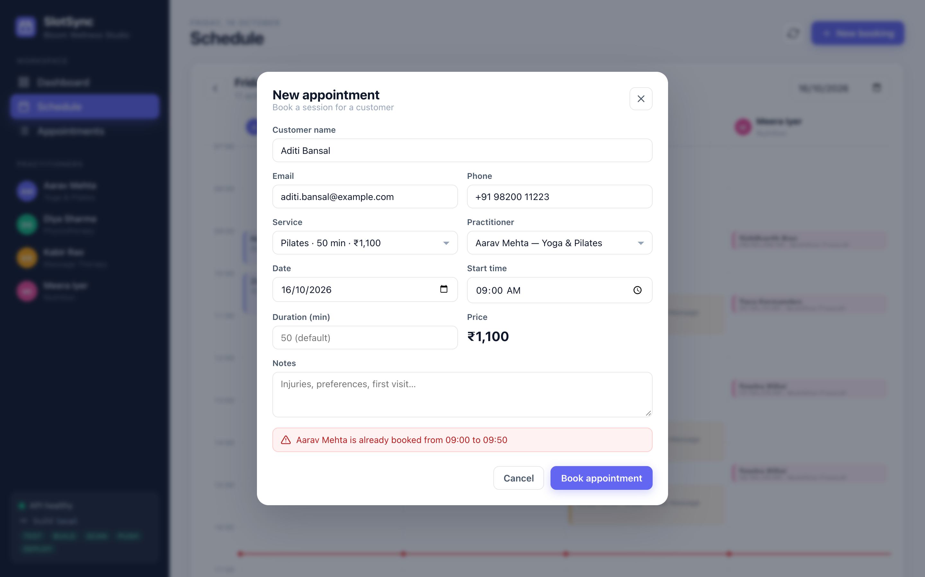
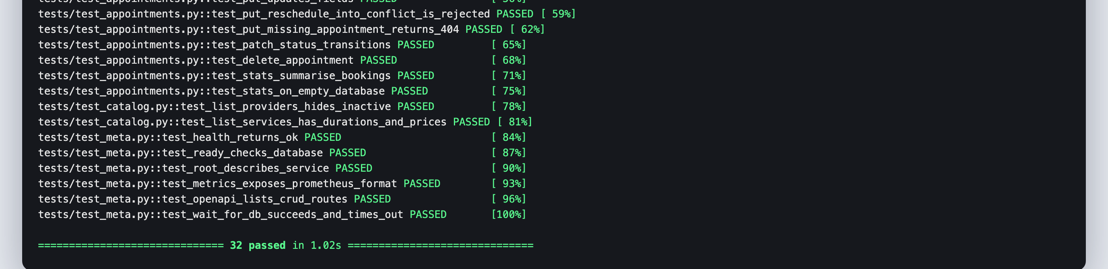
Application and API
FastAPI: CRUD on /api/appointments, status PATCH, stats, providers, services
Probes: /health for liveness, /ready runs SELECT 1, /metrics for Prometheus
Rules: 409 on double-booking, 422 outside 07:00–21:00, UTC storage, IST display
Database: Alembic revision 0001 creates both tables and seeds practitioners; advisory lock stops replicas racing
Tests: 32 pytest cases on an isolated in-memory DB, 97% coverage, warnings are errors
Notes:
The API enforces the business rules, which the UI shows inline - here a double-booking attempt gets a 409 with a readable message. Tests use a throwaway SQLite database through FastAPI dependency overrides, so they never touch Postgres.

Slide 6
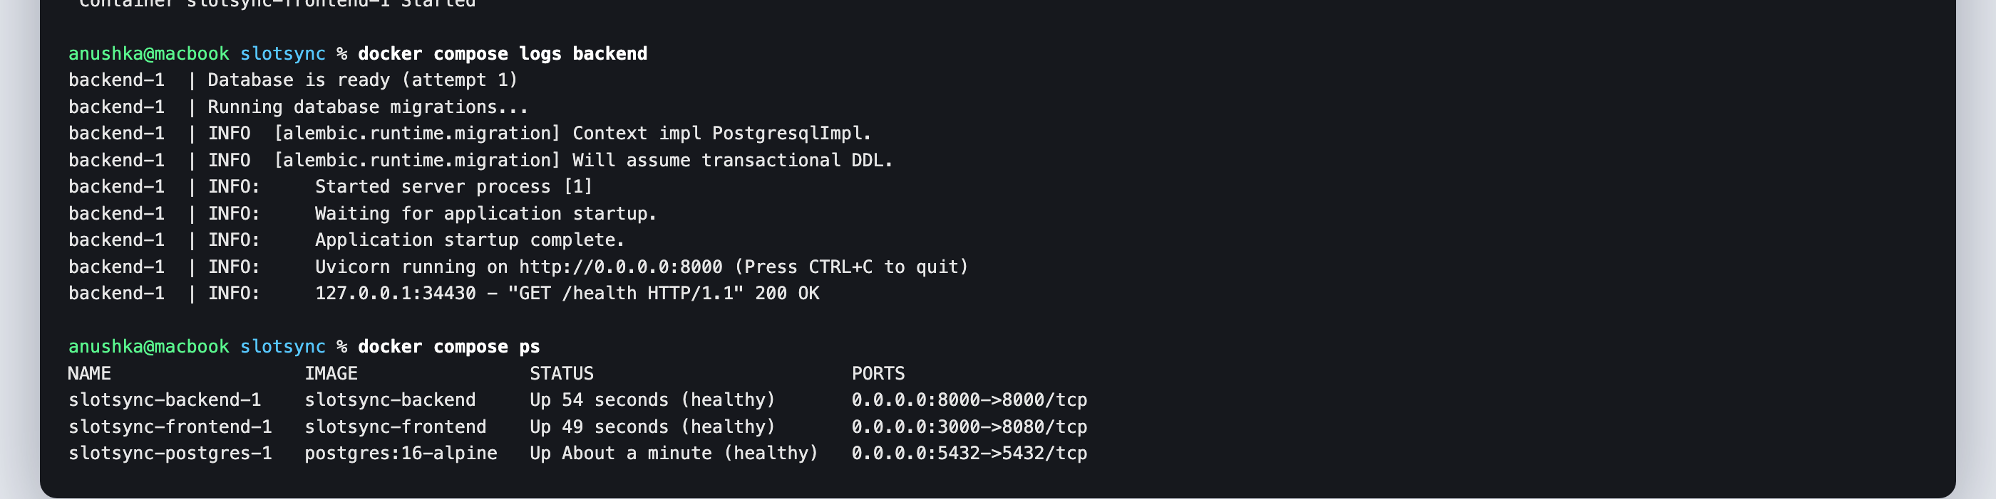
Containers
Backend image
Frontend image
Compose stack
python:3.12-slim, multi-stage venv
pip and setuptools removed at runtime
UID 10001, waits for DB, migrates, runs Uvicorn
Stage 1: node:20 builds the Vite bundle
Stage 2: nginx-unprivileged on :8080, UID 101
Proxies /api, SPA fallback, security headers
postgres → backend → frontend
each waits for the previous healthcheck
one command: docker compose up --build
Notes:
Both images are multi-stage and run as non-root users. Compose brings up Postgres, then the API, then the frontend, each gated on a healthcheck.

Slide 7
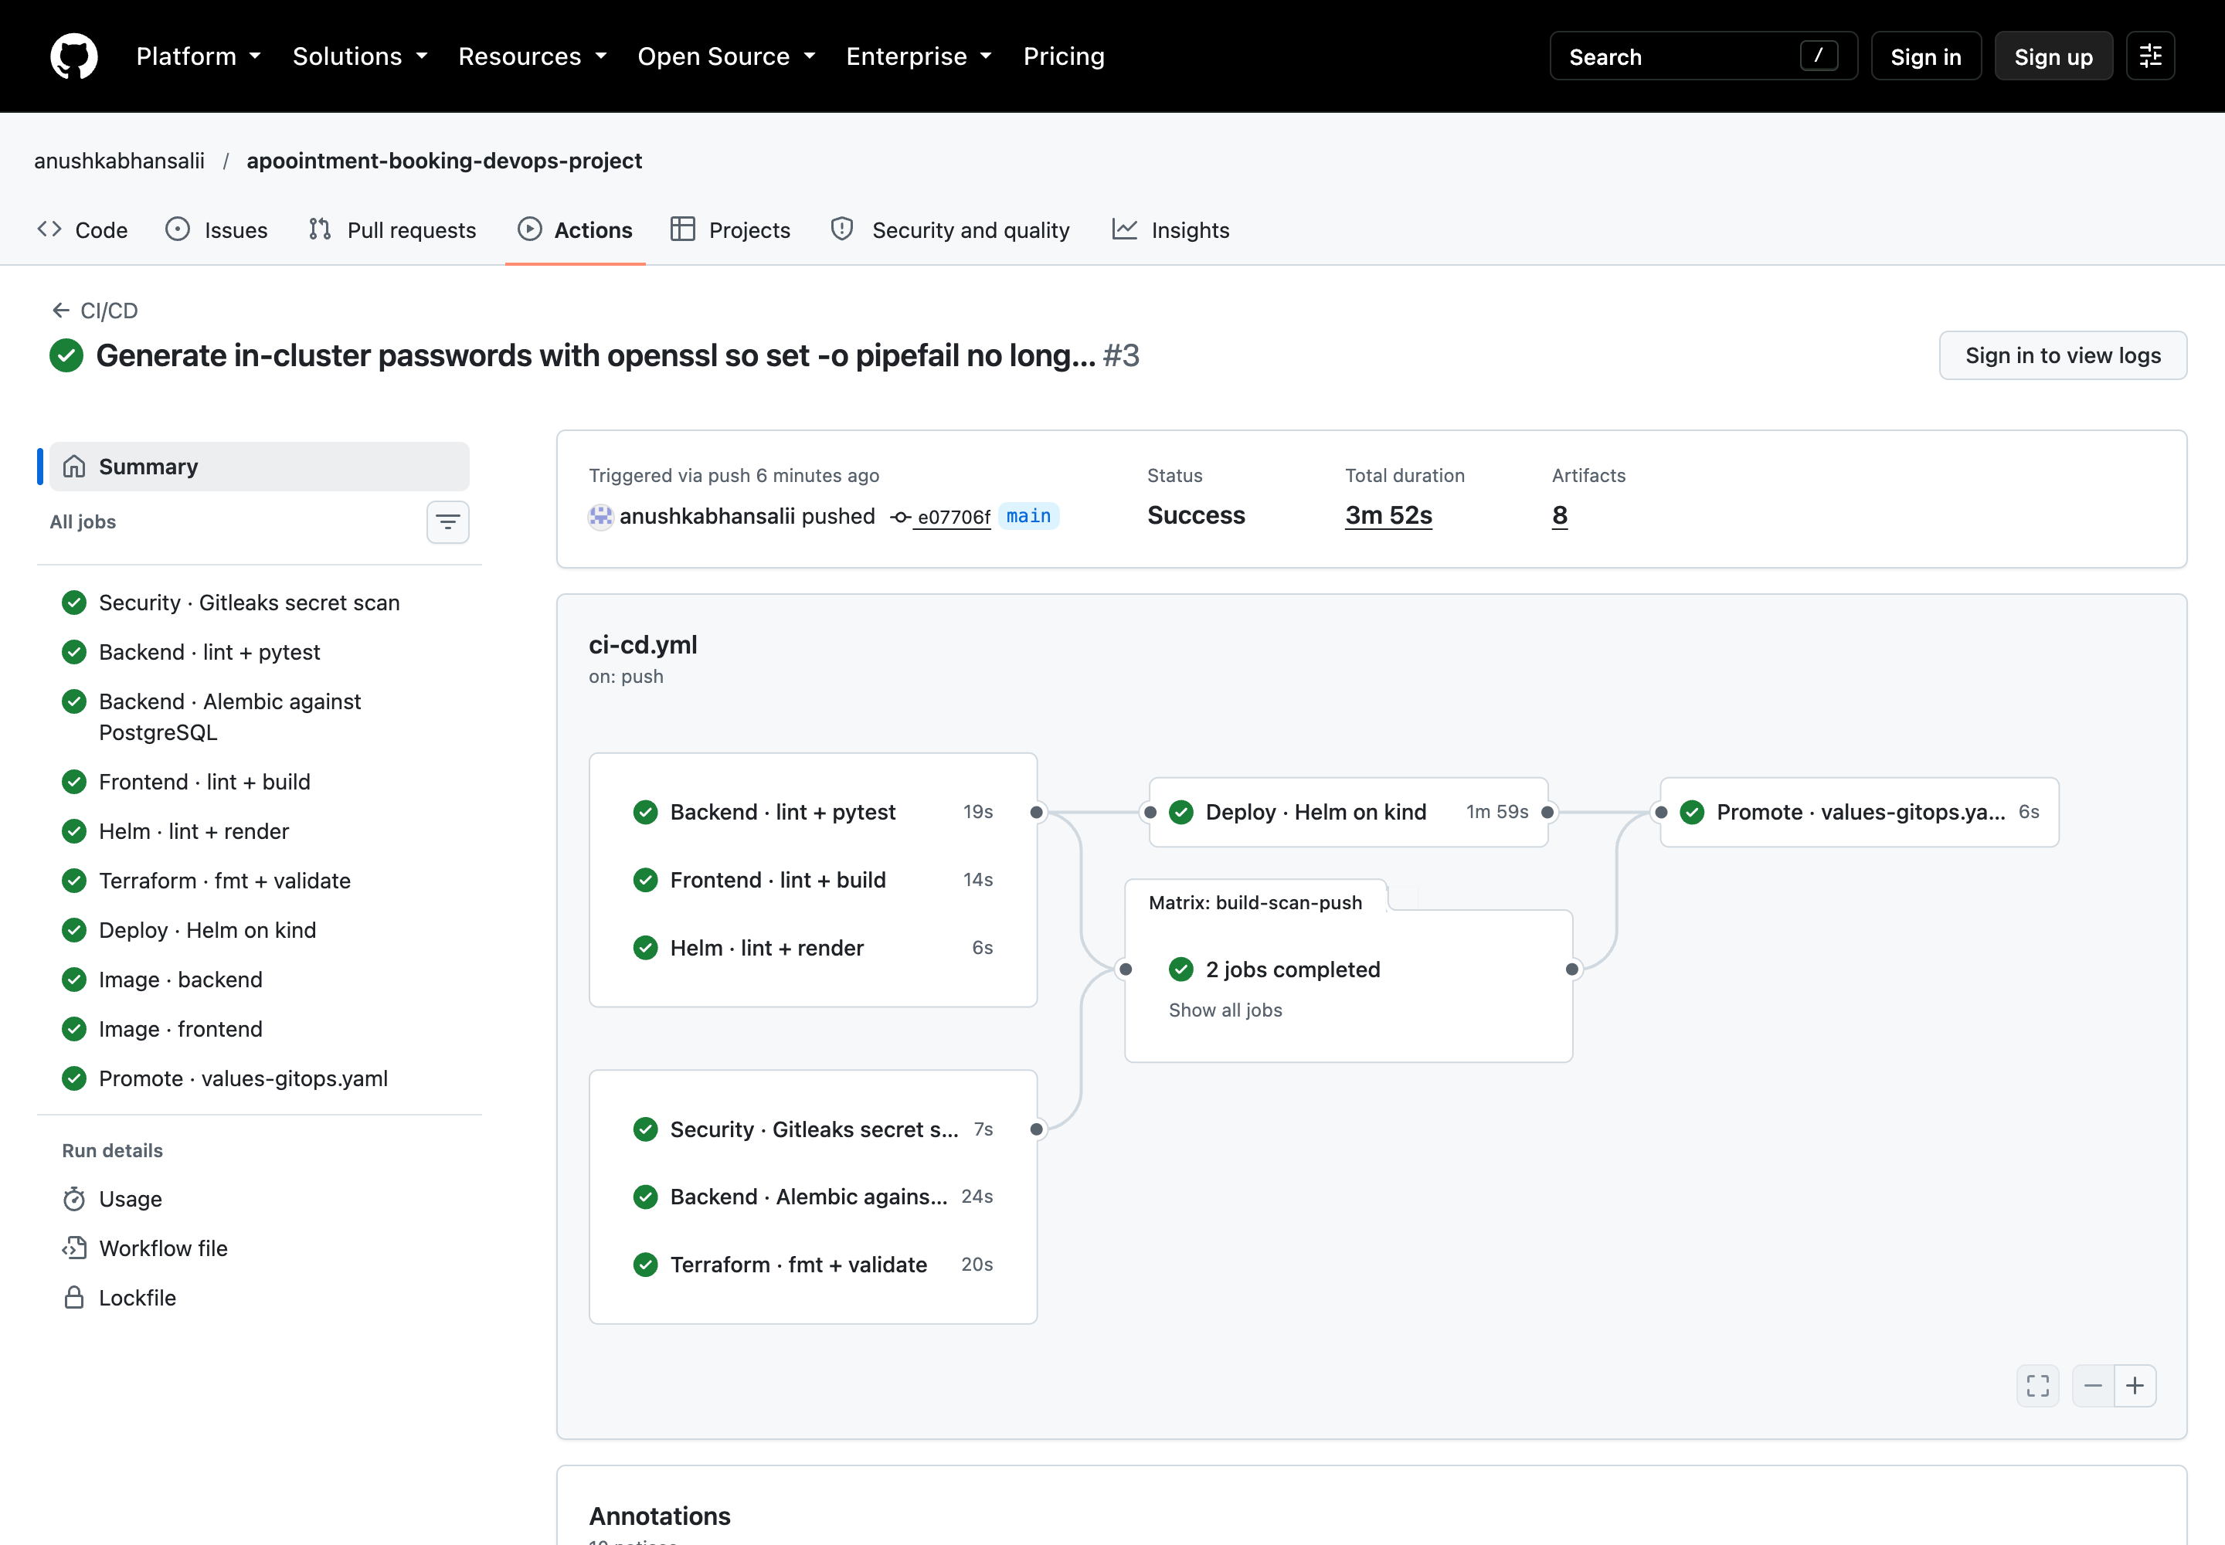
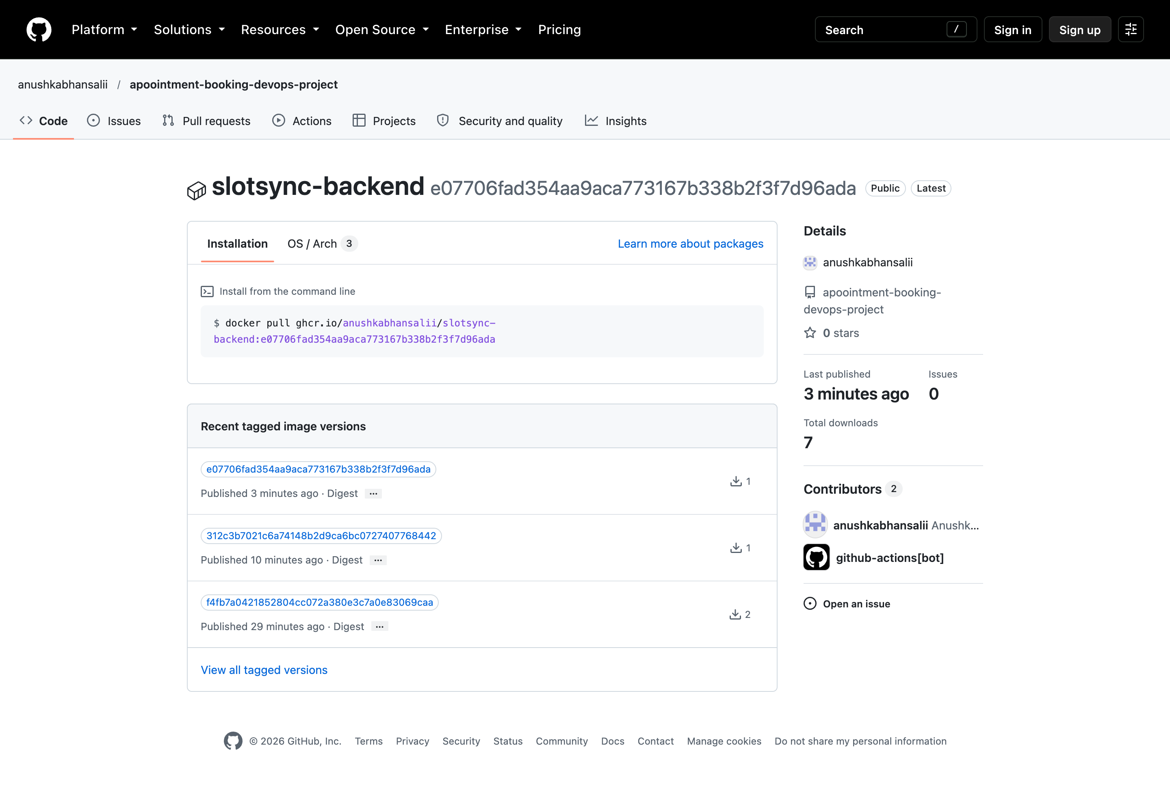
CI/CD pipeline
1 Test
2 Build
3 Scan
4 Push
5 Deploy
Gitleaks · pytest · Alembic · ESLint · helm lint · tf validate
Docker build, cached, both images
Trivy gate on HIGH/CRITICAL
GHCR :<git-sha>, amd64 + arm64
kind smoke test, then GitOps promote
Notes:
One workflow on every push to main. Nothing is pushed until every gate passes. Images are tagged with the full commit SHA, never latest, so any running pod traces back to its exact commit. Third-party actions are pinned to commit SHAs.

Slide 8
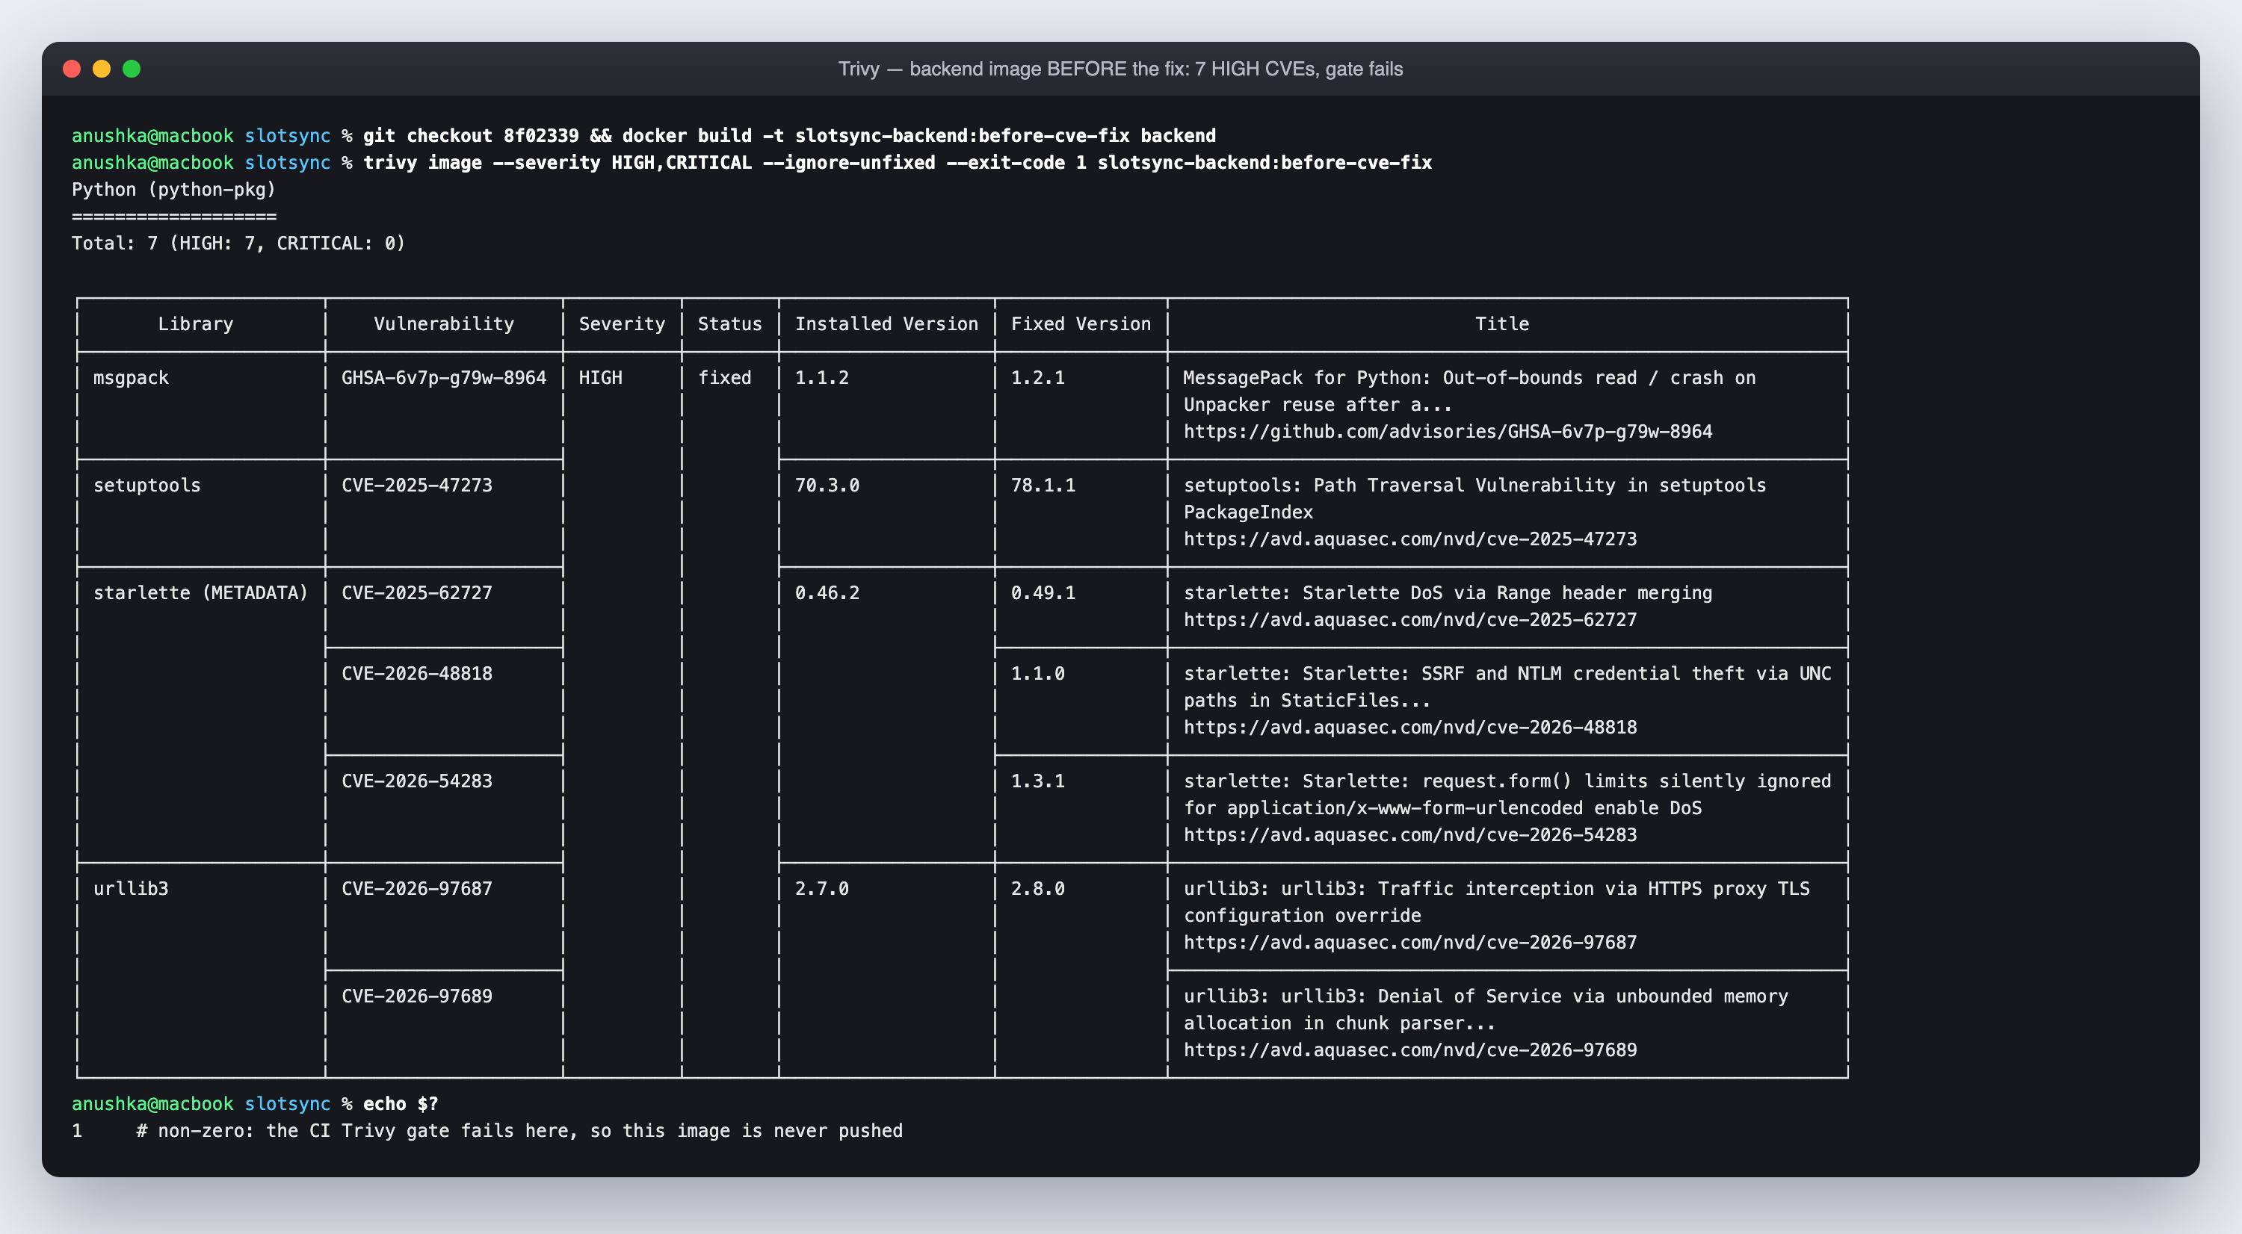
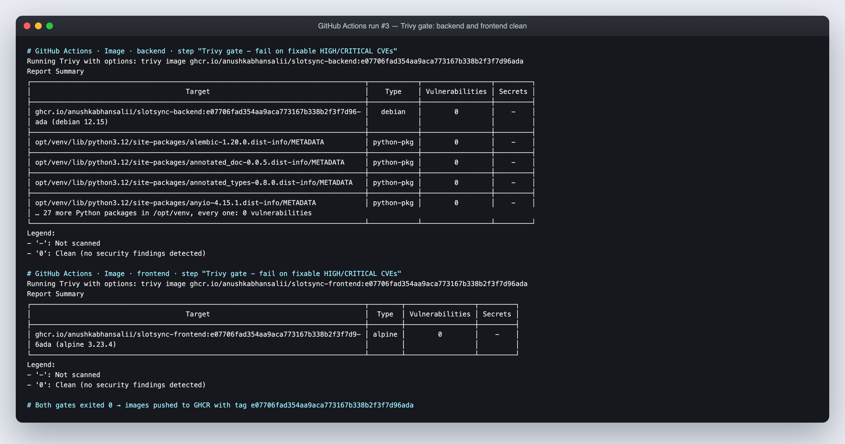
DevSecOps: the gate caught real CVEs
7 HIGH
0
first backend scan: Starlette, urllib3, msgpack, setuptools
after upgrading FastAPI/Starlette and removing pip from the image
CVE-2025-62727: a crafted Range header made Starlette merge ranges in quadratic time - one request could pin a CPU (DoS)
Gate: Trivy fails the build on fixable HIGH/CRITICAL; SARIF goes to the GitHub Security tab
Gitleaks: scans all Git history for credentials on every run
Runtime: non-root, read-only root FS, capabilities dropped, Pod Security restricted, NetworkPolicy on Postgres
Notes:
Trivy reads the OS and Python package metadata inside the image and matches versions against vulnerability feeds. Our first scan found seven HIGH issues; the Starlette one let a single crafted Range header burn CPU. We upgraded and removed pip from the runtime image, and the gate now passes clean.

Slide 9
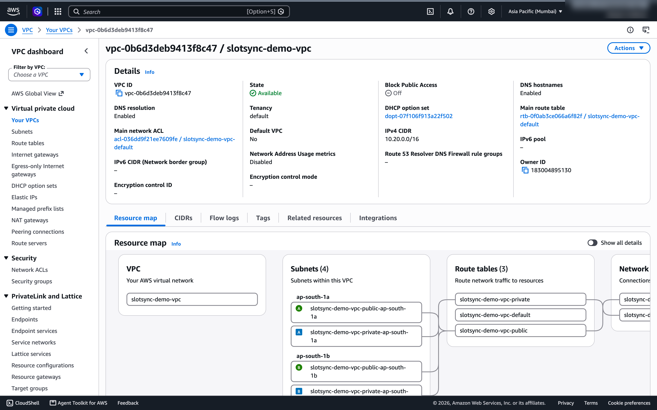
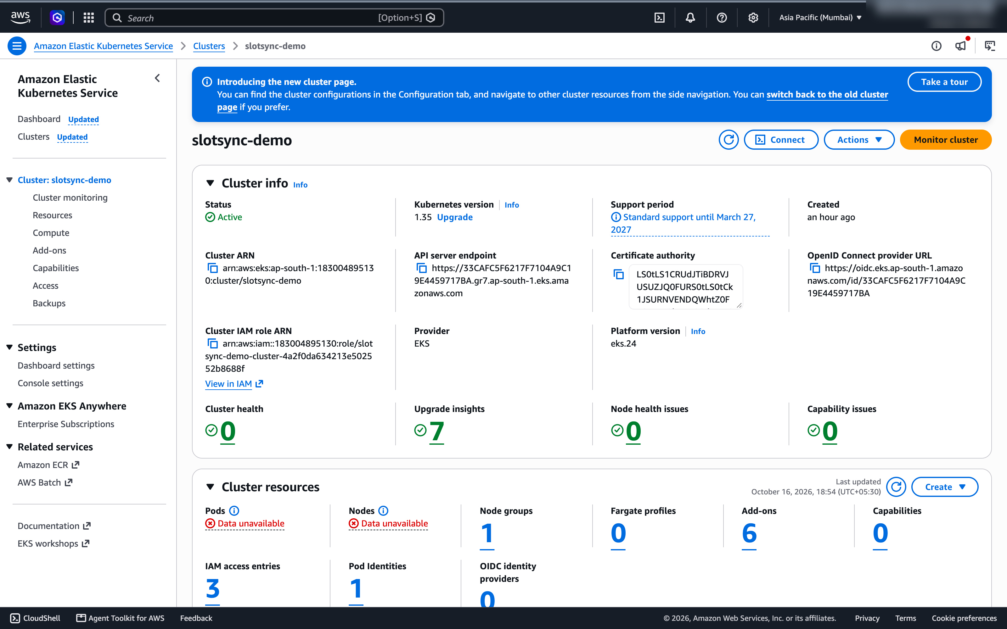
Infrastructure as code: AWS VPC + EKS
VPC 10.20.0.0/16: 2 public subnets (NLB, NAT) and 2 private subnets (nodes) across 2 AZs
EKS 1.35: managed node group of 2× m7i-flex.large, API restricted to my IP, secrets encrypted with KMS
Add-ons: VPC CNI with NetworkPolicy, CoreDNS, kube-proxy, EBS CSI via Pod Identity, metrics-server
Workflow: terraform plan → apply (61 resources) → destroy; state and tfvars git-ignored
61
~$0.35/h
resources, 0 clicks
while running
Notes:
Terraform describes the network and cluster; the community VPC and EKS modules keep it short. The plan creates 61 resources. The EBS CSI driver gets its AWS permissions through Pod Identity, so there are no static keys in the cluster.

Slide 10
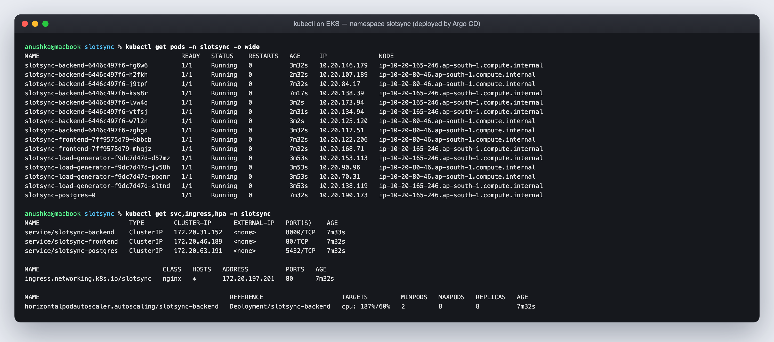
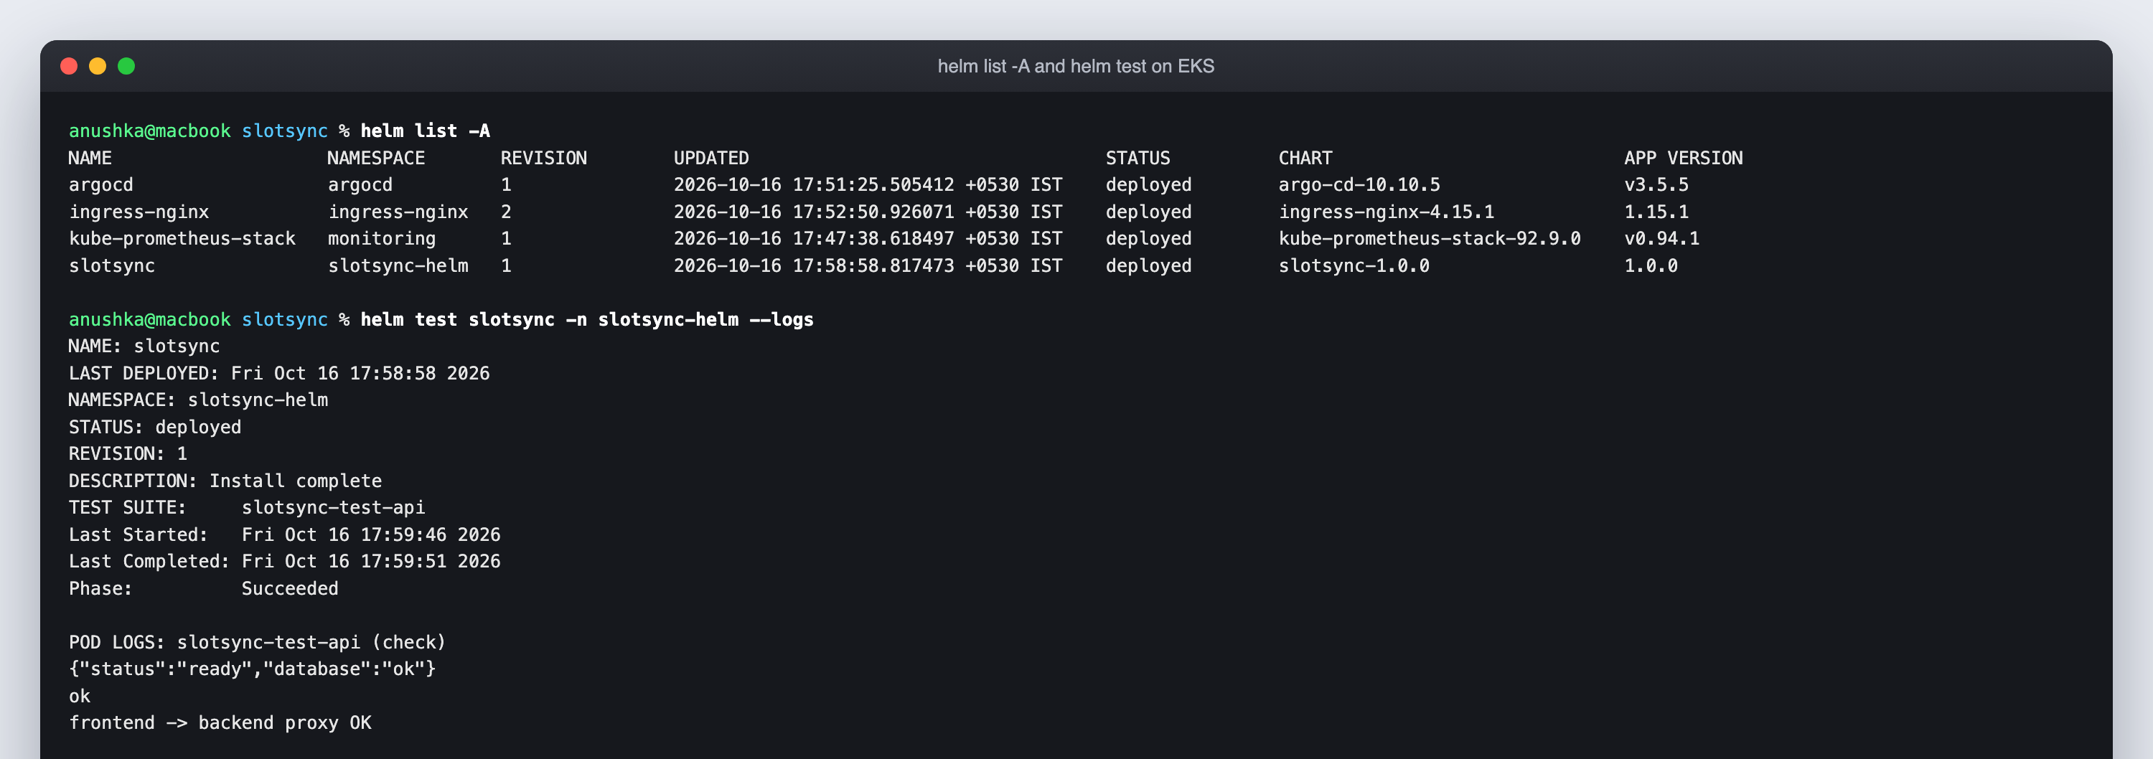
Kubernetes and Helm
Chart helm/slotsync: Deployments, Services, Postgres StatefulSet, Ingress, HPA, PDBs, NetworkPolicy, ServiceMonitor, alerts, dashboard
Ingress: / → frontend, /api and /docs → backend via ingress-nginx (NLB-ready; this new AWS account can't create load balancers yet, so the demo reaches the controller by port-forward)
Resilience: 2+ replicas, startup/liveness/readiness probes, zero-downtime rolling updates
HPA: backend scales 2 → 8 on CPU; the EKS load test drove it to 8/8 pods
helm test: checks /ready and the frontend → backend proxy path
Notes:
One Helm chart packages the whole application. The values files switch between local minikube, EKS and GitOps. kubectl shows every pod Running with at least two replicas of each tier.

Slide 11
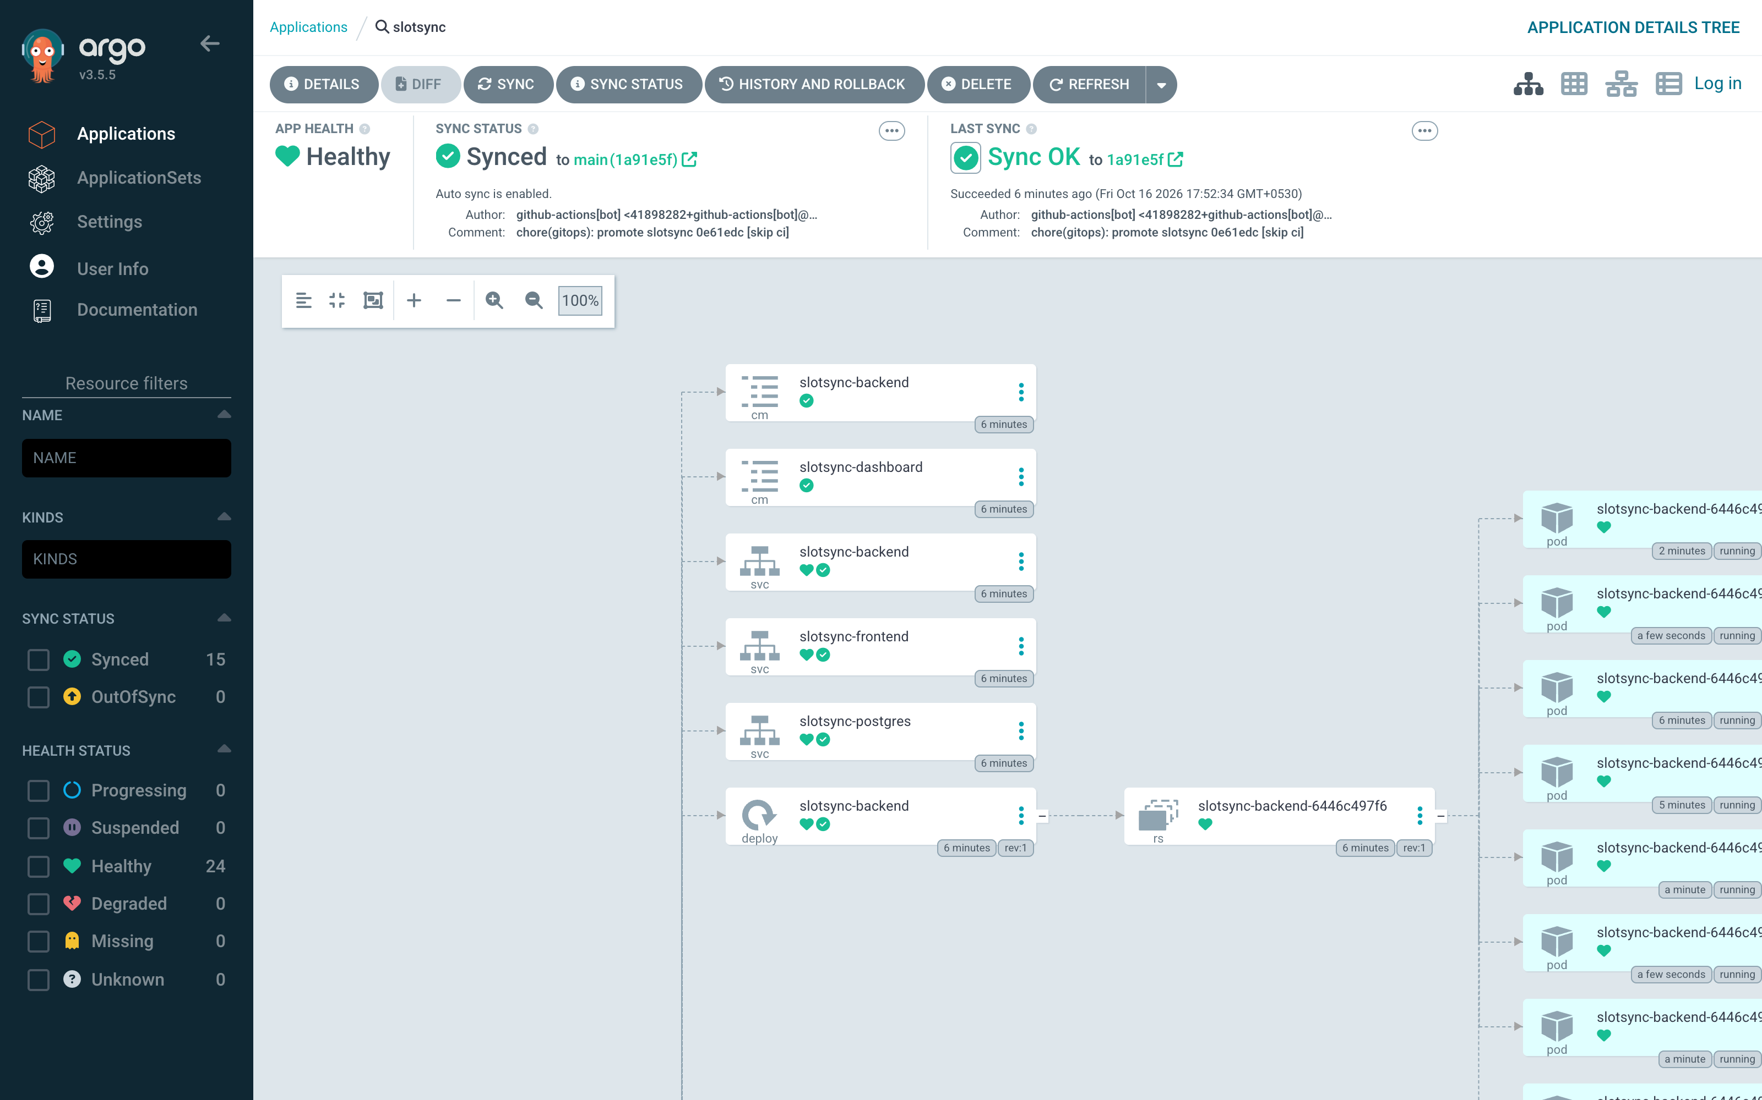
GitOps with Argo CD
1. git push
2. pipeline green
3. bot commits SHA
4. Argo CD syncs
5. rolling update
Live on EKS: push eb90e7c → green pipeline → bot commit be5839a → Argo CD rolled all 8 backend pods with zero downtime. Rollback = git revert.
Notes:
Argo CD watches the values-gitops file on main. When the pipeline promotes a new SHA, Argo CD rolls the cluster forward on its own. Prune removes what was deleted from Git and self-heal undoes drift.

Slide 12
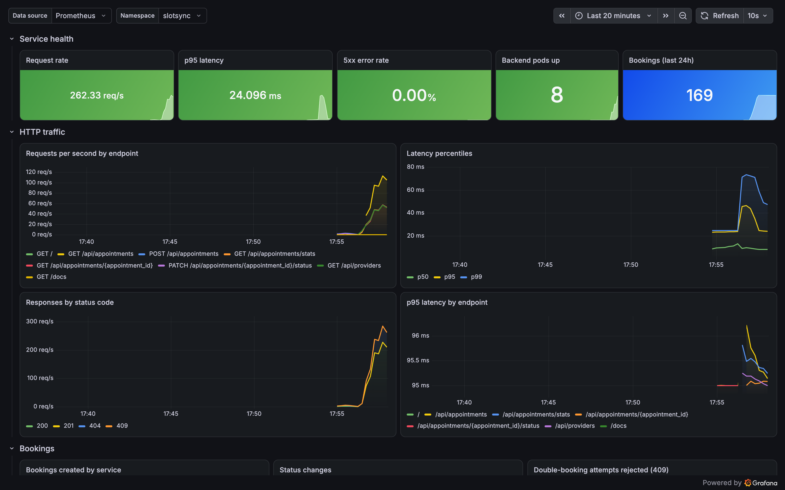
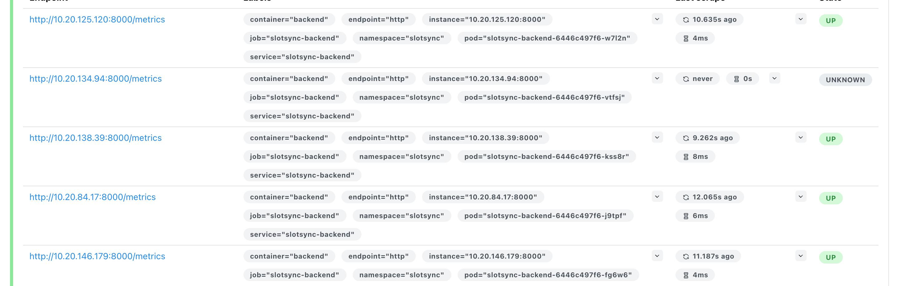
Observability
/metrics: request count, latency histograms and business counters (bookings, status changes, rejected double-bookings)
Prometheus: kube-prometheus-stack; a ServiceMonitor scrapes each backend pod every 15 s
Alerts: backend down, 5xx above 5%, p95 latency above 500 ms
Grafana: 19-panel dashboard generated from code and shipped by the Helm chart
Notes:
Prometheus shows the SlotSync backend targets as UP. The Grafana dashboard answers the operational questions: how much traffic, how fast, how many errors, how many bookings, and whether the HPA is scaling.

Slide 13



Key learnings
Scanners earn their place
Start-up order matters
GitOps simplifies CD
Trivy found 7 real HIGH CVEs on day one - two came from pip, which the app never needed at runtime.
Pods crash-looped while Postgres initialised; a wait-for-DB step and an advisory lock fixed restarts and migration races.
CI only writes a SHA to Git. No kubeconfig in GitHub, and rollback is a git revert.
Cloud is more than code
Secure by default is cheap
Measure what users feel
An org SCP blocked EKS, a resolver dropped IAM calls, a new account could not create load balancers - read the error, then adapt.
Non-root, read-only FS and drop-all capabilities cost a few lines once; the namespace now rejects any pod that breaks them.
Latency and booking counters say more about the studio than CPU graphs alone.
Notes:
The biggest lessons: security scanning finds real issues, start-up ordering matters in Kubernetes, GitOps keeps credentials out of CI, and debugging cloud failures means reading the error, not retrying.

Slide 14

Thank you
Next steps: Amazon RDS instead of in-cluster Postgres · TLS with ACM and Route 53 · OIDC login for staff · request-based autoscaling with KEDA
Repository github.com/anushkabhansalii/apoointment-booking-devops-project
Demo video demo/presentation.mp4
Evidence docs/EVIDENCE.md
Notes:
Next steps would be managed Postgres, TLS, staff login and request-based autoscaling. Thank you.

