Slide 1
Oil-Price-Prediction
Time-Series Forecasting For Future Prediction

Slide 2

Meet Our Team
P269-Group2
SYED SHAHID NAZEER
GOURAB SOM
SUNNY HIRALAL DONGARE
Project Guide:
Aishwarya Ajay Mate from @Excelr team
MANOJ KUMAR KUNA
ANUSHKA HEMANT BOROLE

Slide 3
Contents
Data Collection
Collecting the data using y-finance.
Data Cleaning
A Brief Info Of Topics Covered In PPT
Performing EDA
Feature Engineering
Understanding the data and extracting necessary information
Model Building
Trying different models on dataset
Model Selection
Selecting the best model
App Deployment
Making the app to utilize by users

Slide 4
INTRODUCTION
🛢️ Introducing the Future of Oil Price Forecasting: Our Dynamic Dash App!
🔍 Interactive Insights: Dive into real-time data with intuitive charts and controls for a seamless analysis experience.
🔮 Crystal-Clear Forecasting: Peer into the future and make strategic choices with confidence.
📊 Data-Driven Confidence: Our Prophet model is trained on a comprehensive dataset spanning from 1987 to 2023, boasting a remarkable RMSE of approximately 1.6.
✨ Precise Predictions: Powered by advanced machine learning models, our app delivers spot-on oil price forecasts with just a slight variance of 1.5 to 3 percent.
📲 Anywhere Access: Empower yourself on any device, wherever you are.
💡 Experience the Future: Witness the power of our app in action. Schedule your personalized demo today!
Elevate your oil price predictions with our innovative Dash app. Ready to reshape your strategies? Let's get started!

Slide 5
Project - Timeline
Collected the data using python from
y-finance API
Preparing data for model application
Week 2
Week 4
Performed
Data Cleaning,
EDA, and
Feature Engineering
Model Application and Deployment
Week 1
Week 3

Slide 6
The yfinance API is a Python library that lets us easily get financial data from Yahoo! Finance. For our project, we used it to fetch historical oil price data. Here's how we did it:
Import: We imported the yfinance library into our Python environment.
Choose Ticker: We selected the oil-related symbol, like 'CL=F' for crude oil.
Select Date Range: We picked the time period we wanted data for.
Get Data: Using the .history() method, we got historical data with Open, High, Low, and Close prices.
Integration: We used this data in our analysis and prediction models.
In short, yfinance helped us quickly access financial data for better insights.
Data Extraction using yfinance API

Slide 7
Data Collection
Web Scraping - Yfinance oil price
May
2018
Install the module using pip install yfinance
The code for extracting oil prices is CL=F
.csv
Extract the data
By using the above code we extracted data from API using python from May 2018 – July 2023
July
2023
Save it in a csv file
After extracting the data we integrated and saved it in the form of a .csv file using python

Slide 8
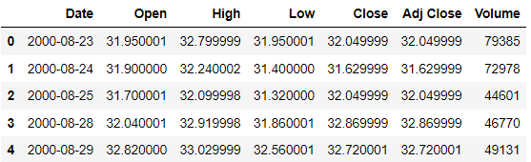
Data Description
oil_prices_yahoo.csv dataset

Slide 9
The dataset related to oil prices includes the following information:
Date: The date of the recorded oil price data.
Open Price: The price of oil at the beginning of a trading period.
High Price: The highest price of oil during the trading period.
Low Price: The lowest price of oil during the trading period.
Close Price: The price of oil at the end of a trading period.
Adjusted Close: The closing price adjusted for factors such as dividends and stock splits.
Volume: The trading volume (number of shares traded) during the trading period.

Slide 10
Findings from our dataset
We have 5751 rows and 7 columns ( Date, Open, High, Low, Close, Adj Close, Volume) in dataset.
We don't have any missing data in our dataset.
We don't have any duplicates in our dataset.
After dropping Open, High, Low, Adj Close and Volume column we have 5751 rows and 2 (Date and Close) columns for further analysis.

Slide 11
Feature Selection
Time Series Nature: Financial data, including oil prices, is often collected over time in a sequential manner. The "date" column represents the time component of the data.
Target Variable: In predictive modeling, the "close" price of an asset (in this case, oil) is often the target variable you're trying to predict.
Simplicity and Focus: While financial markets are influenced by a wide range of factors, starting with just the "date" and "close" columns can provide a simple baseline for modeling. This allows you to focus on building and validating your predictive model before potentially incorporating more features or information.
Historical Trends: The "close" price is often used to identify historical price trends, such as upward or downward movements over different time periods. These trends can provide valuable insights for making predictions about future price movements.
Technical Analysis: The "close" price is a key input for generating various technical indicators and charts that traders use to make decisions.
Hence, It is worth selecting only the "date" and "close" columns when dealing with time series data for financial analysis.

Slide 12
Exploratory Data Analysis
Import Data
Data Duplicacy
Outlier Detection
Read the csv file using pandas
Checking for duplicacy of data
Detecting and treating the outliers
Step - 1
Step - 2
Step - 3
Step-4
Step-5
Step-6
Data Analysis
Data Quality
Data Validation
Look into the quality ,accuracy of our data
Look for Stationarity of our data and try to validate our data
Analyze the data for null values or empty space

Slide 13
Feature Engineering
1
3
Date Time Indexing
Applying data transformation technique in order to make data stationary
2
4
Data Visualization
Treating the outliers using IQR capping Technique

Slide 14
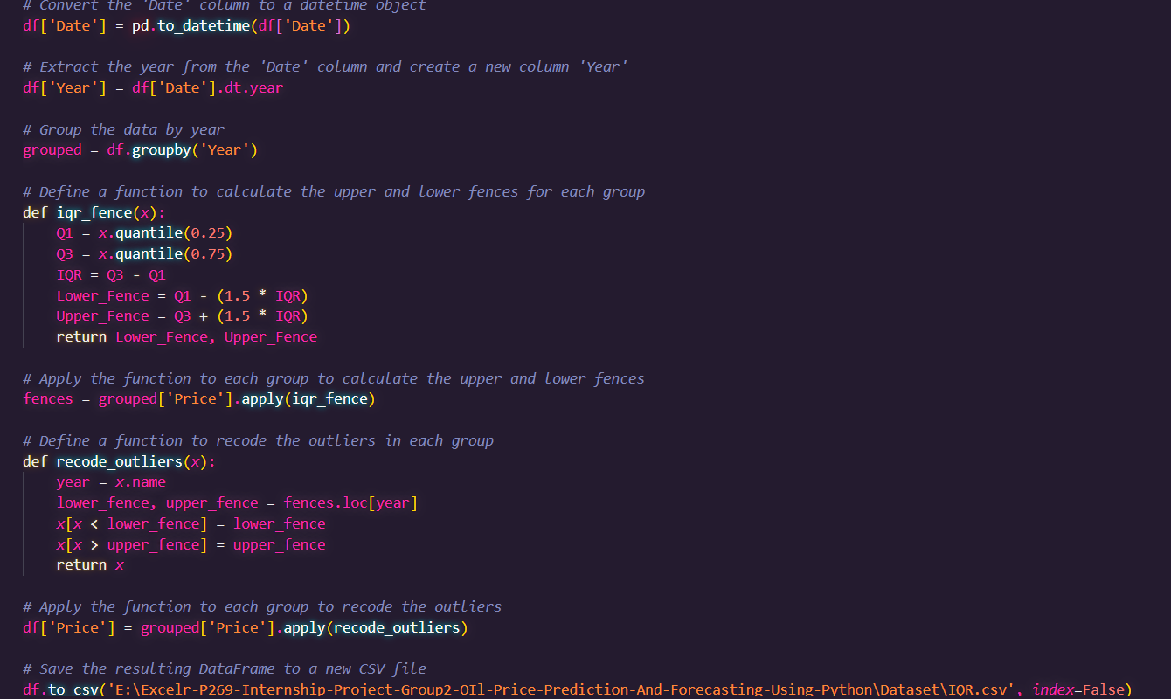
Outlier Recoding
We Used IQR-Capping Method for Recoding Outliers from the data

Slide 15
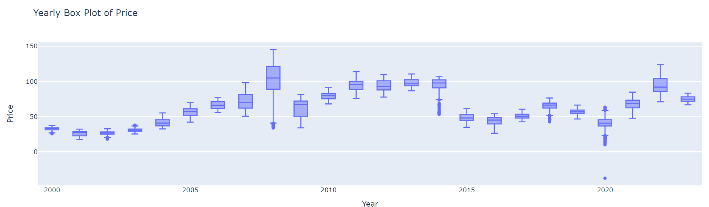
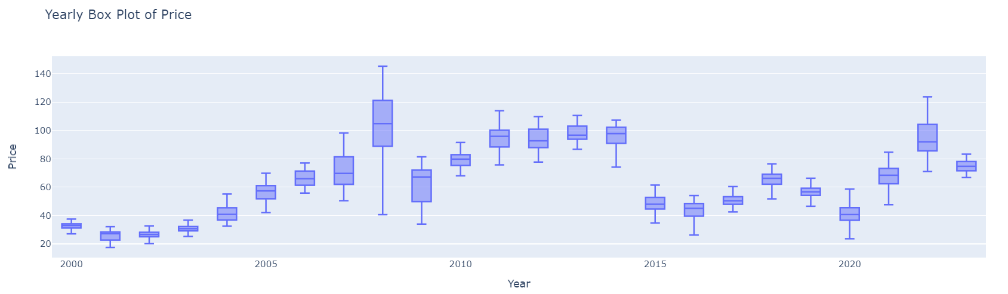
Data Visualization
Yearly Box Plot Before IQR capping and After IQR capping

Slide 16
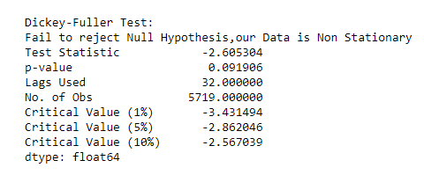
Check for the Stationary of data
Hypothesis testing using :- Augmented Dickey-Fuller Test
Result of ADF Test
Augmented Dickey Fuller test (ADF Test) is a common statistical test used to test whether a given Time series is stationary or not. It is one of the most commonly used statistical test when it comes to analyzing the stationary of a series.
The ADF test is fundamentally a statistical significance test. That means, there is a hypothesis testing involved with a null and alternate hypothesis and as a result a test statistic is computed and p-values get reported.
It is from the test statistic and the p-value, you can make an inference as to whether a given series is stationary or not.

Slide 17
Time Series VISUALIZATION
Time Re -sampling
Lag Plot
ACF, PACF
Moving Average
TimeSeries Decomposition
To inspect how data behaves differently under different resolutions or frequency.
To inspect on Distribution ,outliers ,randomess ,stationarity ,seasonality of our data
To inspect on the P,Q values that we will use to build ARIMA Model
In order to analyze data points by creating a series of averages of different selections of the full data set
Visualizing the original data , trends, seasonality, residuals

Slide 18
Model Building Techniques
Autoregressive
Model for time series analysis.
Autoregressive integrated moving average
Model
Data driven models such as SES,Holts ,Holts and winter
Long
Short-Term Memory
Model
MA
AR
ARIMA
Data Driven
LSTM
Prophet
Started From Moving Average Model for time series analysis.
Ended With prophet as the final model for the project.

Slide 19
Model Evaluation
Results for Evaluation
Model Evaluation
S.NO | Model | RMSE
1 | SARIMAX | 2.042651653
2 | ARIMA | 2.042596482
3 | AR | 2.042549865
4 | MA | 2.042513928
5 | Exponential Smooting | 2.102133669
6 | Holt's Method | 2.115841724
7 | Holts winter | 2.043976702
8 | LSTM | 2.221213193
9 | Prophet | 1.615251254
Model Evaluation is done using evaluation metrics such as MSE and RMSE

Slide 20
Model Evaluation – Model Selection – Model loading
Evaluation
Selection
Loading
After seeing all the metrics of different models we have lowest rmse with Prophet
Prophet has the lowest rmse, hence the predictions are more accurate than other models
Model Loading was done using joblib with over 11k data points.

Slide 21
Why Prophet Model?
Introduction: The Prophet model, developed by Facebook, is a powerful tool that simplifies time series forecasting, making it accessible and effective for various applications.
Key Components:
Trend: Adaptable linear or logistic functions capture short-term fluctuations and long-term trends.
Seasonality: Fourier series incorporates diverse seasonal patterns with different periodicities.
Holidays: Custom holiday effects account for special events or holidays in forecasts
Benefits:
User-Friendly: Minimal parameter tuning is required, complex tasks are automated.
Adaptable: Suitable for diverse time series data, from daily sales to financial reports.
Interpretable: Insights into trend, seasonality, and holidays are offered by components.
Conclusion: The Prophet model simplifies time series forecasting with automated features, flexibility, and interpretability. Utilize it to make accurate predictions and aid data-driven decisions in various industries.

Slide 22
Dash App UI
Page 2
Page 4
Oil-Price
Prediction
Yearly
Presentations
Oil-Price
Prediction
Date
Graphs and Charts
Page 1
Page 3

Slide 23
Dash Application
Users can select future year predictions and download specific months trends
Our Dash app is already loaded with prophet model
Users can avail access to the presentation files
Page 1
Page 3
Users can choose any date from calendar and get the price on that date.
Users can see the graphs and other project timeline events
DASH APP
Page 2
Page 4

Slide 24
THANK YOU
P269 - Group2
Looking forward to further conversations and collaborations.
FactDetective (syedshahidnazeer.pythonanywhere.com)

