Slide 1

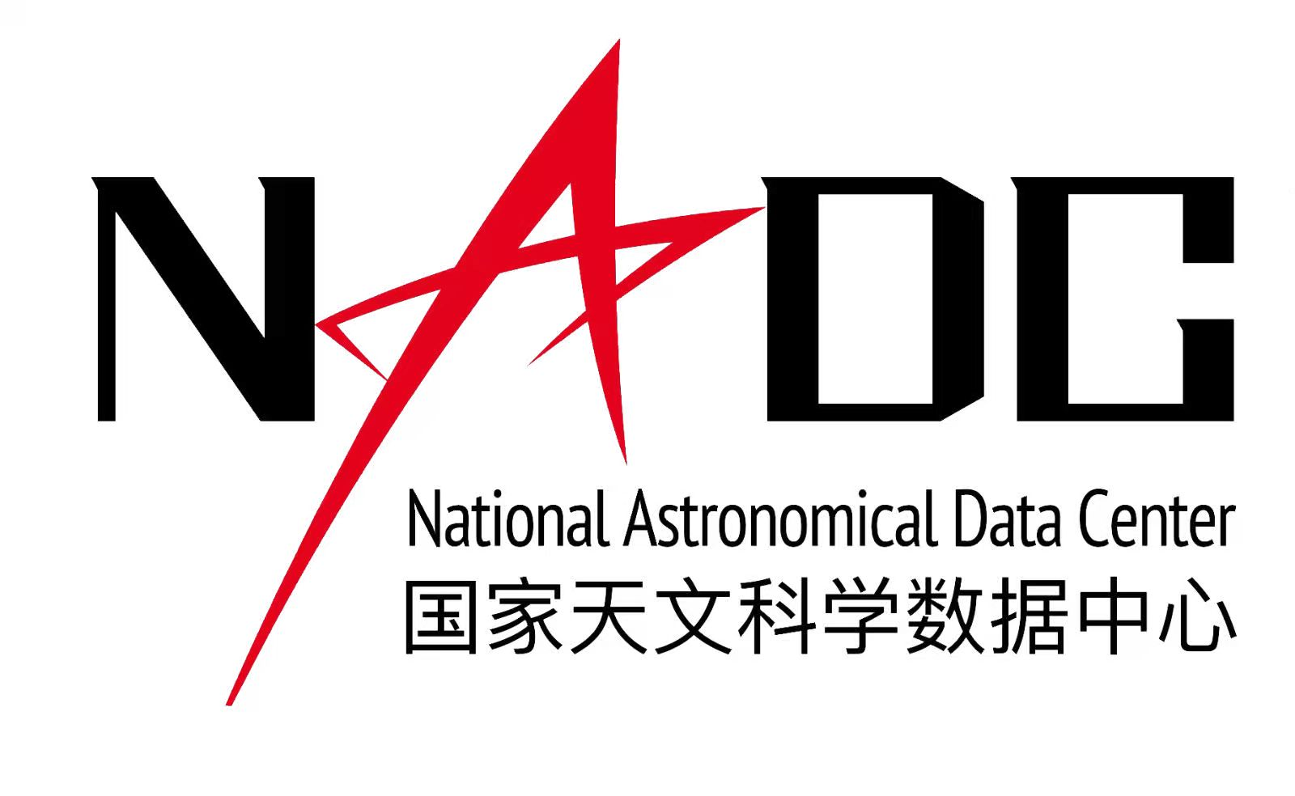

2026 BRICS Astronomy Data Analytics & AI Training Programme
Programming with Python – The Introduction
Feng Wang (Guangzhou University, China) | Week 1
Notes:
Good morning everyone, and welcome to the first week of BRICS Astronomy Data Analytics & AI Training Programme. Today I want to start from astronomy, not from computer science. The reason is simple: we do not learn Python because Python itself is the goal. We learn Python because modern astronomy now produces data in a form and at a scale that cannot be handled only by looking, clicking, or manually copying numbers.
In this first hour, I will explain why programming has become a basic skill for astronomers, especially in the current AI era. Then in the second hour we will open Jupyter notebooks and make these ideas concrete. You will see variables, lists, strings, loops, functions, files, and modules. These may sound like programming vocabulary, but I want you to hear them as scientific vocabulary: they are tools for describing data and analysis clearly enough that a computer, another scientist, and your future self can reproduce what you did.
One important message for today is that AI does not remove the need to learn programming. It changes how we write code, but it does not remove our responsibility to understand the data, the assumptions, and the result.
A useful opening sentence is: "By the end of today, I do not expect you to be a Python expert, but I do expect you to understand why Python belongs in an astronomy classroom." This sets a realistic expectation and lowers anxiety for beginners.

Slide 2
ROADMAP
02
Today: astronomy first, code second, Jupyter next
Hot topics
>
BRICS facilities
>
Data problem
>
AI context
>
Python basics
>
Jupyter demo
First hour: concepts
Second hour: practice
Take-home message
Why current astronomy is data-driven
Why programming is now a basic research skill
What algorithms and Python concepts mean
Open Week 1 notebooks
Run and modify cells
Read small star and exoplanet catalogs
Programming is a language for scientific reasoning
AI can help, but understanding remains yours
Notes:
Here is the structure of the next two hours. The first hour is a conceptual map. We will begin with the astronomy context: current hot topics, BRICS facilities, and the kinds of data they produce. Then we will move to the data problem: why images, spectra, catalogs, time series, and simulations force us to use computational methods.
After that, I will briefly discuss AI and vibe coding. This is important because many students now ask, very reasonably, if AI can write code, why should we learn programming? My answer is that AI makes programming literacy more valuable. If you understand code, AI becomes a useful assistant. If you do not understand code, AI can very quickly produce something that looks convincing but answers the wrong scientific question.
The second hour is practical. We will open the Week 1 Jupyter notebooks. I do not expect you to memorize every command today. I want you to learn how to read a notebook, run a cell, change a value, inspect output, and understand error messages. That is the beginning of real computational astronomy.
The slides and notebooks are meant to work together. The slides give them a mental map; the notebook gives them muscle memory. If they feel lost during the demo, they can return to this map.

Slide 3
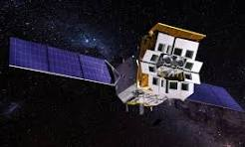
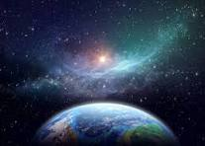
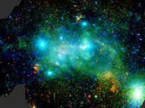
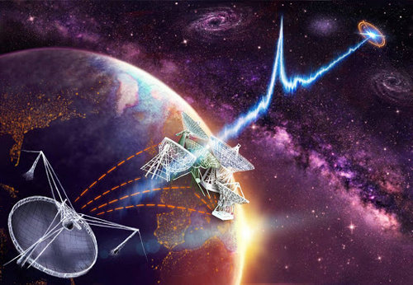
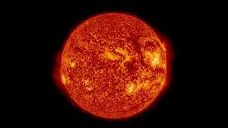
ASTRONOMY NOW
03
Current hot topics are also data challenges
Time-domain sky
Exoplanets
Cosmology
Transient alerts
Variable stars
Multi-messenger follow-up
Transit light curves
Radial velocities
Atmospheric spectra
Weak lensing
Galaxy clustering
Large simulations
Radio universe
Solar physics
AI for discovery
Classification
Anomaly search
Simulation acceleration
Pulsars
HI surveys
FRBs and interferometry
Space weather
High-cadence images
Magnetic fields
Modern astronomy asks physical questions through data pipelines, catalogs, images, spectra, and simulations.
Notes:
Let us first look at the science. Many of the most exciting topics in astronomy today are also data challenges. Time-domain astronomy is a good example. When surveys repeatedly observe the sky, they generate alerts for supernovae, variable stars, asteroids, tidal disruption events, and many other phenomena. The scientific question may be physical, but the first practical problem is computational: how do we filter, classify, and prioritize so many events?
Exoplanet studies are another example. A planet may reveal itself through a tiny dip in a light curve, a radial velocity signal, or atmospheric absorption features. Cosmology uses enormous galaxy catalogs, weak-lensing measurements, and simulations. Radio astronomy deals with interferometric data, pulsars, fast radio bursts, and spectral-line cubes. Solar physics has high-cadence imaging and space-weather monitoring.
So, the common pattern is this: modern astronomy asks physical questions through complex data. Programming is the tool that lets us translate a scientific question into a sequence of reproducible operations on that data.
A good transition is to ask: "What do all these hot topics have in common?" Let students answer mentally. Then say: they all require us to move from physical intuition to structured data operations. That is the bridge to programming.

Slide 4
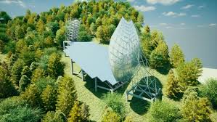
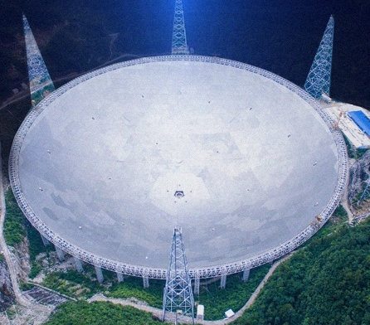
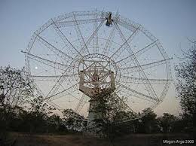
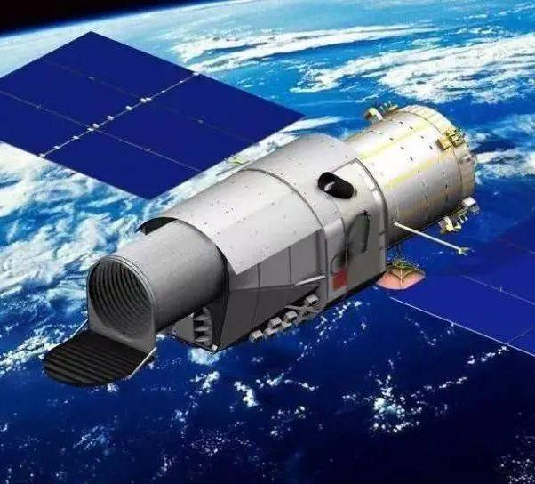

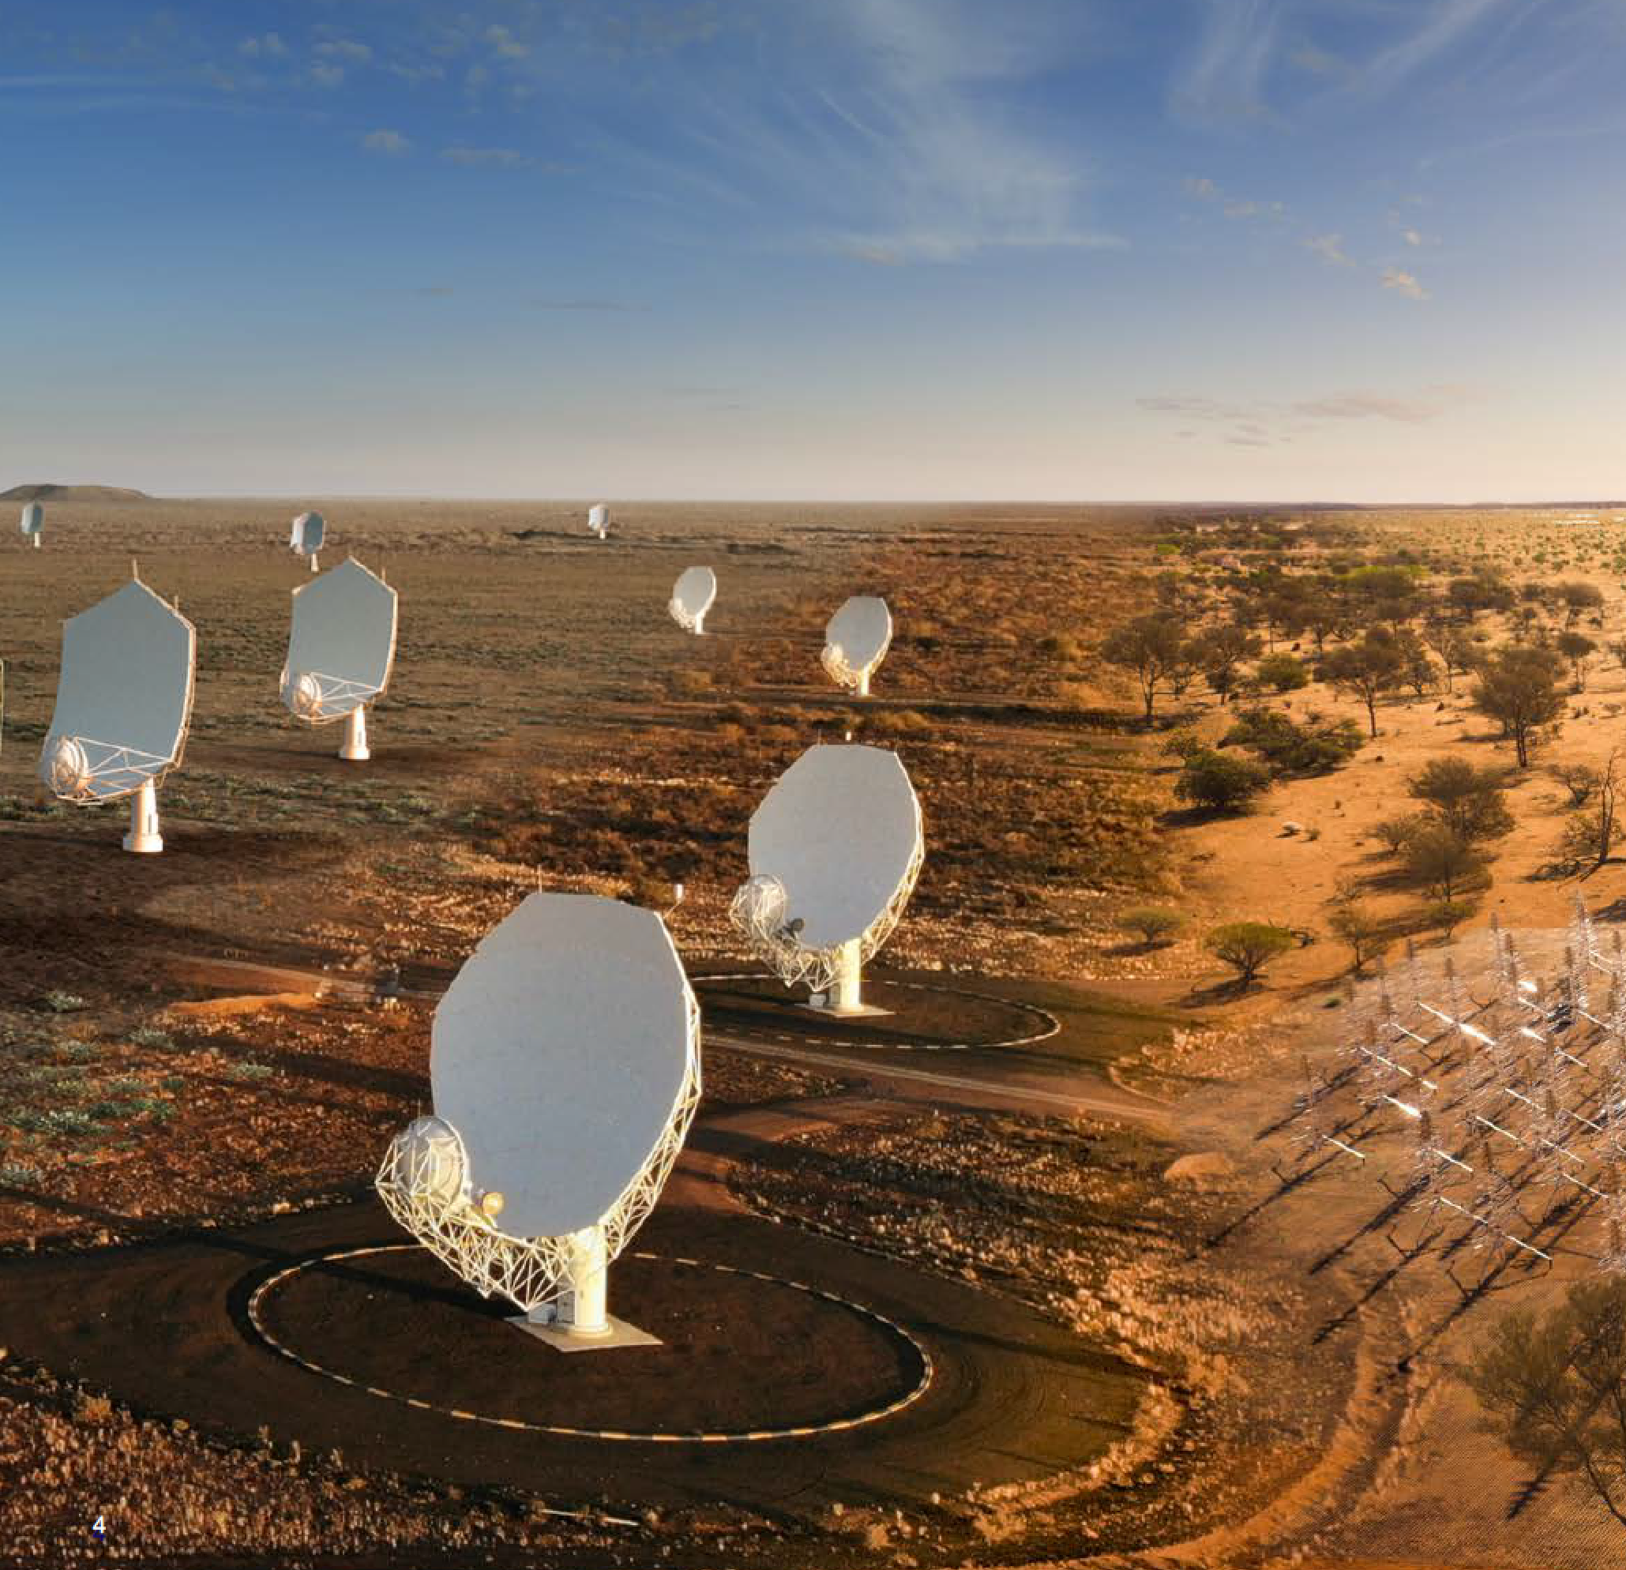
BRICS ASTRONOMY
04
BRICS astronomy is broad, multi-wavelength, and international
🇨🇳 China
FAST (radio) – world’s largest single-dish radio telescope
LAMOST (optical spectroscopy survey)
Solar & low-frequency arrays: CSRH, 21CMA
🇿🇦 South Africa
Southern African Large Telescope (optical, 10-m class)
MeerKAT (radio array, SKA precursor)
Core host of SKA
🇮🇳 India
Giant Metrewave Radio Telescope / uGMRT (radio)
AstroSat (space-based multi-wavelength)
SKA partner
🇷🇺 Russia
RATAN-600 (radio ring telescope)
BTA-6 (6-m optical)
Strong heritage in radio and VLBI
🇧🇷 Brazil
BINGO Telescope (radio, under construction)
مشار مشار (international collaborations):
SOAR Telescope
Gemini Observatory
Notes:
BRICS astronomy is especially interesting because it is broad, multi-wavelength, and international. We should not think of BRICS astronomy as one telescope or one narrow field. It includes optical and infrared observations, radio astronomy, space missions, theory and simulations, data archives, and training programs.
This slide gives a few examples of major BRICS-related facilities and data products. It is not meant to be complete. It is a representative sample to help us see the connection between facilities and computation.
For China, we can think of FAST, one of the world's most important single-dish radio telescopes, and LAMOST, a large spectroscopic survey facility. These produce radio signals, spectra, catalogs, and survey data. India has AstroSat, Aditya-L1, and GMRT or uGMRT, leading to multi-wavelength archives, solar observations, and radio interferometric data. South Africa has MeerKAT and SALT, connected to radio imaging, optical spectroscopy, and transient follow-up. Brazil, Russia, and other BRICS partners bring additional observatories, archives, simulations, and monitoring networks.
Notice how different these facilities are. A radio telescope, an optical spectrograph, a solar space mission, and a simulation code do not produce identical data. But for the student analyst, the workflow has common pieces: read data, understand metadata, clean problems, select objects, measure quantities, visualize results, and communicate the method. That shared workflow is what we are learning.
You can pause here and say that every facility is also a promise and a responsibility. The promise is discovery. The responsibility is that we must be able to reduce, analyze, validate, and share the data, otherwise the facility cannot reach its scientific potential.

Slide 5
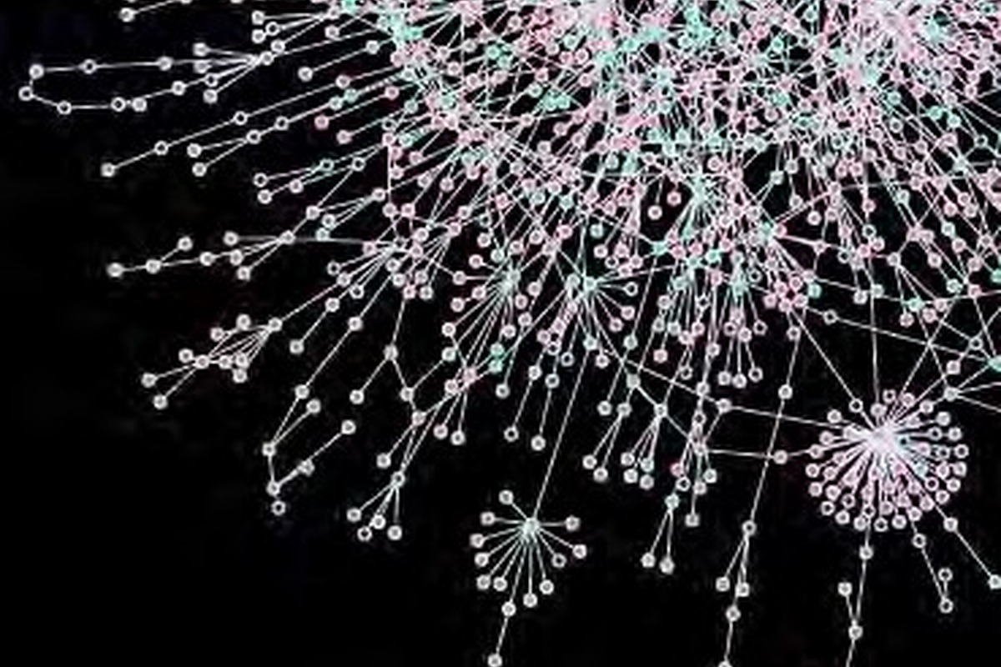
DATA GROWTH
06
Facilities produce streams, not just pictures
From single observations to repeated surveys
From local files to distributed archives
From static datasets to alert streams
From hand inspection to automated pipelines
From one wavelength to multi-messenger context
A modern astronomer often studies a physical object through many data products created by many instruments.
Notes:
A useful way to think about modern facilities is that they do not simply produce beautiful pictures. They produce streams of data products. A telescope may create raw exposures, calibrated images, catalogs, quality flags, alerts, spectra, and derived measurements. A survey may repeat this process every night or every observing cycle.
This changes the role of the astronomer. In older examples, a scientist might inspect a small number of images or spectra by hand. That still happens, and human judgment is still important. But at large scale, the first layer of work is usually a pipeline. The pipeline calibrates, detects, measures, filters, and stores. Then the scientist asks questions through the pipeline outputs.
This is why programming is not an optional extra. If the data arrive as tables, arrays, files, and streams, then our scientific reasoning must also be able to operate on tables, arrays, files, and streams. Programming gives us the ability to repeat the same analysis consistently, to scale from one object to thousands, and to document exactly what was done.
A helpful phrase is: "A telescope gives us photons, but science comes from a chain of decisions." Calibration, detection, selection, plotting, and interpretation are all decisions. Programming makes those decisions visible and repeatable.

Slide 6

DATA COMPLEXITY
07
The challenge is not only volume; it is complexity
Heterogeneous
Noisy
images + spectra + catalogs + simulations
calibration errors, artifacts, missing values
High-dimensional
Time-dependent
many measured quantities per object
alerts, light curves, changing sky
Programming gives us a repeatable way to clean, combine, select, visualize, and test complex data.
Notes:
The challenge is not only that there is more data. Volume matters, but complexity is just as important. Astronomical data are heterogeneous: we combine images, spectra, catalogs, time series, and simulations. They are noisy: we have calibration errors, bad pixels, cosmic rays, artifacts, missing values, and selection effects. They are high-dimensional: a single object may have many measured quantities, and those quantities may be correlated. They are time-dependent: the sky changes, instruments change, and observations have time stamps, cadences, and sometimes urgent alerts.
This complexity is where many scientific mistakes can enter. For example, mixing units, using the wrong coordinate system, ignoring missing values, or applying a selection cut incorrectly can change the result. These are not just coding mistakes; they become astronomy mistakes.
Programming helps because it forces us to make the steps explicit. What file did we read? Which rows did we keep? What units did we convert? What threshold did we use? A good program is a record of a scientific decision process.
This is a good place to warn students gently that real data are rarely clean. The purpose of programming is not only to calculate quickly. It is also to keep track of messy details carefully enough that the final scientific statement is trustworthy.

Slide 7

ASTROINFORMATICS
08
Astroinformatics connects astronomy with data science
Data access
Data analysis
archives
queries
catalog services
pipelines
statistics
visualization
Discovery
Reproducibility
classification
outliers
physical inference
notebooks
versioning
shared workflows
Python is one of the practical languages of astroinformatics.
Notes:
The word astroinformatics is useful here. It means the intersection of astronomy, data science, databases, statistics, visualization, machine learning, and computational infrastructure. It does not replace astronomy. It supports astronomy in a world where the data are too large and too complex to handle informally.
Virtual observatories, archives, catalog services, databases, and pipelines are all part of astroinformatics. When we query a catalog, cross-match sources, download a FITS file, plot a color-magnitude diagram, or classify a transient, we are already participating in this ecosystem.
Python is one of the practical languages of astroinformatics. It connects very naturally to notebooks, data tables, arrays, plots, and astronomy-specific packages such as Astropy. That is why we start here. We are not trying to turn everyone into a software engineer in one week. We are giving you enough programming vocabulary to interact with astronomical data systems intelligently and reproducibly. Later, when you use more advanced tools, this foundation will help you understand what those tools are doing.
You can transition by saying that astroinformatics is the name for this larger ecosystem. The student may begin with simple Python variables today, but those variables are the first step toward participating in archives, surveys, pipelines, and AI-enabled discovery.

Slide 8
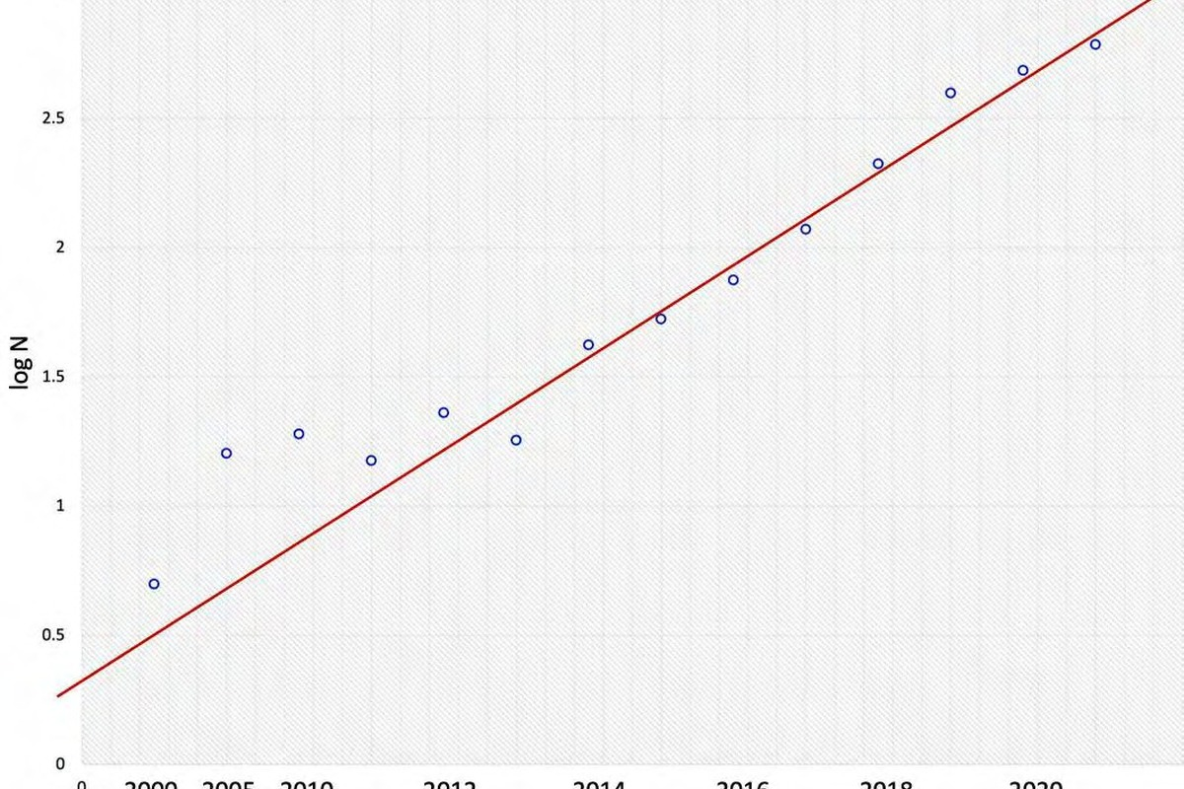
AI CONTEXT
09
AI/ML is now widely recognized in astronomy
AI/ML methods appear in survey pipelines, catalogs, simulations, and classification tasks.
The Rubin/LSST era makes automation unavoidable.
Community discussions increasingly focus on reliability, uncertainty, and interpretability.
Programming literacy is what lets us audit and adapt AI tools.
Example reference: LSST DESC, Opportunities in AI/ML for Rubin LSST, arXiv:2601.14235.
Notes:
Now let us talk about AI. In astronomy, AI and machine learning are no longer exotic or marginal. They are widely used in large surveys, image classification, photometric redshift estimation, transient filtering, simulation acceleration, anomaly detection, and many other tasks. The literature has grown rapidly because the data demand it.
The Rubin Observatory and LSST era is a good example. When a survey produces enormous catalogs and alert streams, automation is unavoidable. We need algorithms to prioritize events, estimate properties, reject artifacts, and identify unusual objects. AI can help with many of these tasks.
But I want to be careful: AI is not magic. It depends on training data, assumptions, validation, uncertainty estimates, and interpretation. An AI system may produce a label or a number, but the astronomer still has to ask whether the result is reliable, biased, physically meaningful, and appropriate for the scientific question. This is why programming literacy matters. If you understand the workflow, you can use AI critically instead of passively accepting its output.
If students are excited by AI, acknowledge that excitement. Then immediately connect it to responsibility: an AI model in astronomy is only as good as the data, labels, assumptions, and validation behind it. Programming helps us examine those ingredients.

Slide 9
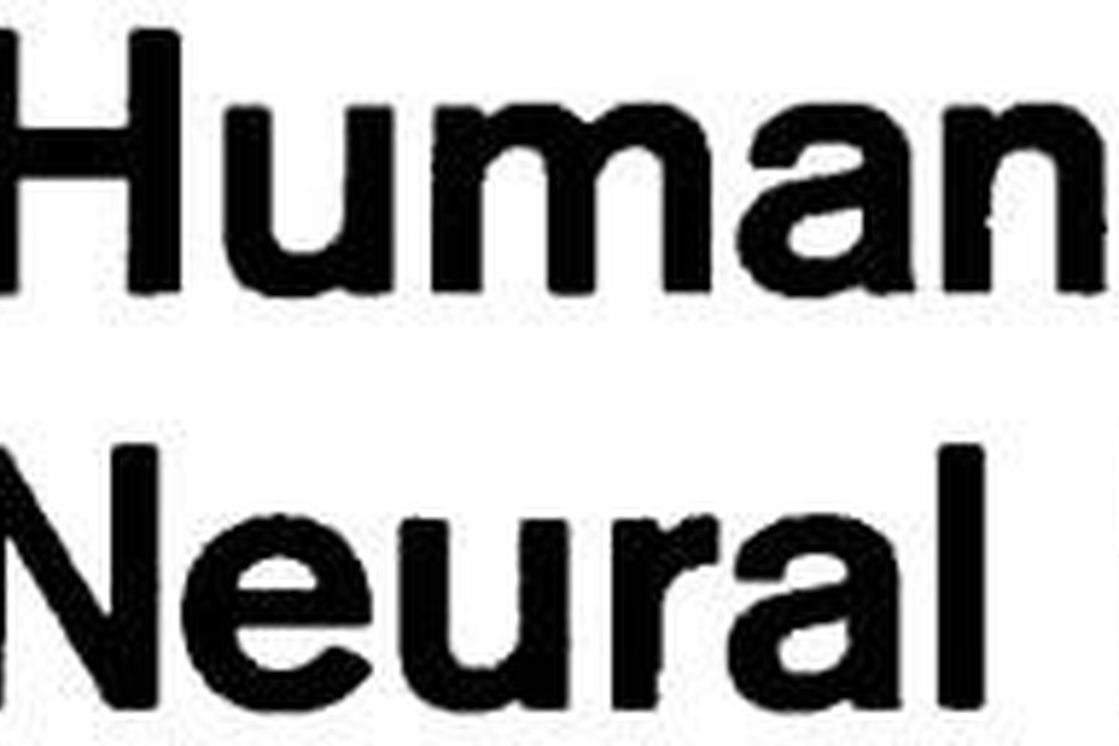
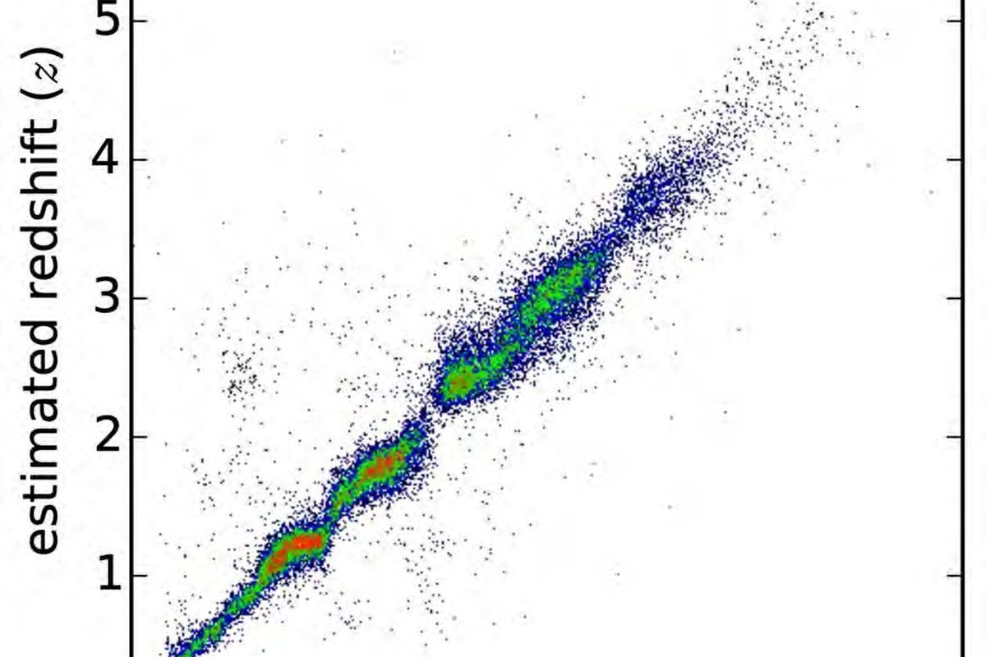
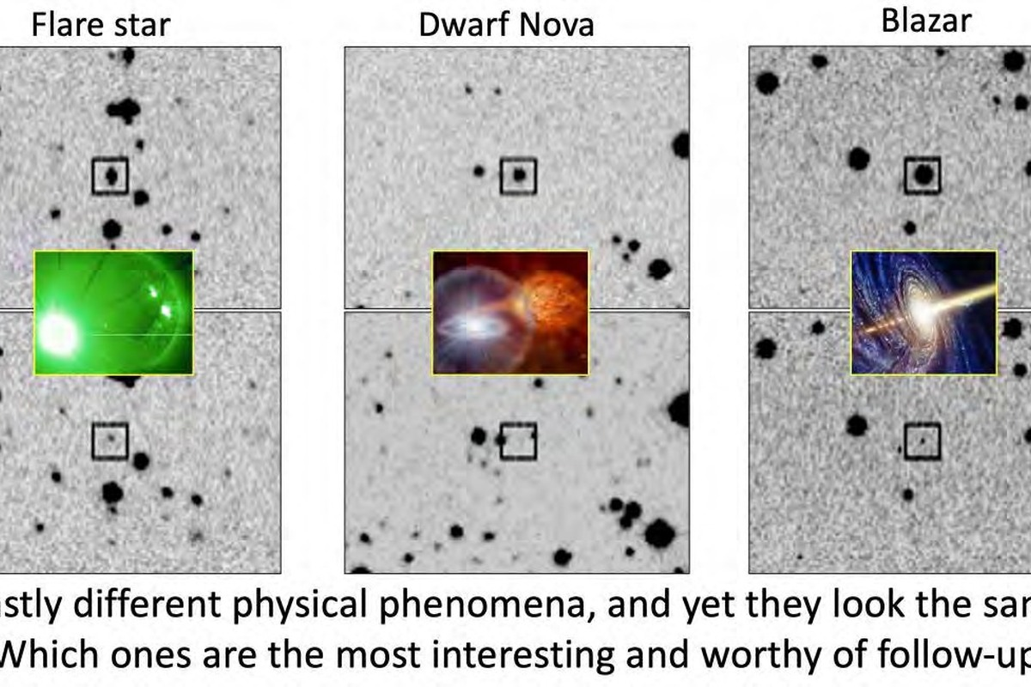
AI EXAMPLES
10
AI methods appear across the astronomical workflow
AI helps scale analysis. It does not remove scientific judgment.
Morphology
Photo-z
Time domain
galaxy classification
image features
estimate redshifts
represent uncertainty
filter alerts
classify variables
Notes:
Here are a few concrete examples of AI across the astronomical workflow. Galaxy morphology classification is a classic example: instead of asking humans to classify enormous numbers of galaxies by eye, machine-learning models can learn visual features and apply them consistently at large scale. Photometric redshifts are another example: when spectroscopy is expensive or unavailable, models can use multi-band photometry to estimate redshift distributions. Time-domain astronomy also relies heavily on classification and filtering, for example distinguishing real astrophysical transients from image-subtraction artifacts.
These examples show why AI is attractive: it helps scale analysis. It can process many objects, identify patterns, and support rapid decision-making. But each example also shows why scientific understanding is necessary. What labels were used for training? What objects are missing from the training set? How are uncertainties represented? What happens when the model sees a rare object?
So AI is part of the toolkit, but it sits on top of data processing, validation, and interpretation. Those foundations are what we begin learning with Python.
A nice way to end this slide is to say: "These examples are not here to make Python look old-fashioned. They are here to show that AI itself depends on programming, data structures, testing, and reproducibility." That leads naturally to the vibe-coding discussion.

Slide 10
VIBE CODING
11
Vibe coding is hot, but it is not a shortcut around understanding
Describe
>
Generate
>
Run
>
Inspect
>
Revise
>
Explain
What AI can help with
What you must still own
Therefore
syntax examples
debugging hints
boilerplate code
explaining error messages
the scientific question
the data selection
units and assumptions
whether the result is meaningful
Learn programming basics
Use AI as a collaborator
Never outsource understanding
Vibe coding without fundamentals is fast but fragile. Vibe coding with fundamentals can be powerful.
Context: Collins selected 'vibe coding' as its 2025 Word of the Year.
Notes:
You may have heard the term vibe coding. In simple terms, it means using natural-language prompts to ask an AI system to help write code. For example, you might type, please write Python code to read a CSV catalog and select objects brighter than magnitude one. The AI may generate something useful very quickly.
This is a real change in how people write code. It can help beginners get unstuck, help experienced programmers move faster, and help researchers explore unfamiliar libraries. But it is not a shortcut around understanding. The generated code may run and still be wrong. It may assume the wrong column name, ignore units, mishandle missing values, or use a selection rule that is not what you intended.
So our attitude should be balanced. Use AI. Ask it questions. Let it help with syntax and debugging. But do not outsource the scientific responsibility. You must be able to read the code, test it on a small example, and explain why the output answers your astronomical question.
You may want to tell students that using AI is acceptable in learning, but hiding behind AI is not. In this course, a good AI-assisted answer should still be explainable by the student. If they cannot explain it, they have not yet learned it.

Slide 11
THESIS
12
AI changes the workflow, not the responsibility
We do not learn programming only to type code.
We learn programming to express scientific ideas precisely.
Understand
Verify
Communicate
What data represent
What assumptions enter
Whether code is correct
Whether outputs make sense
Show your method
Share reproducible work
Notes:
This is the central message of the lecture: AI changes the workflow, not the responsibility. We do not learn programming only because we expect to type every line of code by hand for the rest of our careers. That is not the point. We learn programming because it teaches us how to express scientific ideas precisely.
When you write code, you are forced to specify the data, the variables, the operations, the selection criteria, and the output. That precision is valuable even if an AI assistant helps generate part of the syntax. In fact, the better you understand programming, the better prompts you can write, and the better you can judge the generated code.
There are three responsibilities I want you to remember. First, understand what the data represent. Second, verify whether the code is correct and whether the output makes sense. Third, communicate the method so others can reproduce and critique it. These responsibilities remain with the scientist, not with the machine.
This slide can be delivered slowly. It is the philosophical center of the lecture. The phrase to emphasize is: "The responsibility remains with the scientist." Let that sentence sit for a moment before moving into programming definitions.

Slide 12
PROGRAMMING
13
What is a program?
A program is a precise set of instructions that transforms input data into output results.
Input
>
Operations
>
Control flow
>
Output
Input
Operations
Control
Output
catalogs, images, spectra
compute, compare, convert
repeat, branch, stop
numbers, plots, files
Notes:
Now we can define programming more directly. A program is a precise set of instructions that transforms input data into output results. In astronomy, the input might be a catalog, an image, a spectrum, a light curve, or a simulation output. The operations might include unit conversion, filtering, averaging, fitting, plotting, or classification. Control flow tells the computer when to repeat an operation, when to choose between alternatives, and when to stop. The output might be a number, a table, a figure, or a new file.
This input-operation-control-output structure appears everywhere. If you measure the brightness of stars in an image, you are transforming image data into a table of source properties. If you select exoplanets by radius and orbital period, you are transforming a catalog into a scientific sample. If you plot a light curve, you are transforming time and flux into a visual diagnostic.
So programming is not separate from analysis. Programming is one way to make analysis explicit.
If students have no programming background, reassure them that this definition is enough for today. They do not need to know advanced syntax yet. They only need to recognize that code is a sequence of precise instructions applied to data.

Slide 13
ALGORITHMS
14
An algorithm is a recipe for solving a problem
Algorithm: select bright stars
1. Open a star catalog
2. Read each star's magnitude
3. Keep stars with magnitude < 1.0
4. Print the selected names
5. Check if the result makes sense
Algorithms are independent of any one programming language.
A good algorithm is clear enough to explain to another person.
Scientific algorithms must include checks, not only calculations.
Before writing code, ask: What is the input? What are the steps? What should the output mean?
Notes:
Before we write Python, we should talk about algorithms. An algorithm is a recipe for solving a problem. It does not have to be written in a programming language at first. A good algorithm can be explained in ordinary language.
For example, suppose our question is: which stars in a catalog are bright? One possible algorithm is: open the catalog, read each star's magnitude, keep the stars with magnitude less than one, print the selected names, and then check whether the result makes sense. This is simple, but it already contains the important structure of many scientific analyses.
There are two lessons here. First, the algorithm is independent of Python. You could implement the same idea in another language. Second, scientific algorithms should include checks. We do not only calculate. We also inspect, compare, and ask whether the result is plausible. When we move to Jupyter, I want you to think this way: what is the input, what are the steps, what is the output, and how do I check it?
You can ask students to imagine doing this task by hand in a spreadsheet. Then ask what would happen if the catalog had ten million rows. The same idea is still simple, but manual work no longer scales. That is why algorithms matter.

Slide 14
PYTHON
15
The same algorithm becomes Python
catalog = [
{'name': 'Sirius A', 'mag': -1.46},
{'name': 'Alpha Centauri A', 'mag': 0.01},
]
for star in catalog:
if star['mag'] < 1.0:
print(star['name'])
What appears here?
variables, data structures, strings, loops, conditions
What is the science?
define a selection rule
apply it consistently
inspect the selected sample
What can AI help with?
syntax and variations
but you must judge the rule and result
Notes:
Here the same algorithm becomes Python. Do not worry if you cannot write this code from memory yet. The purpose of this slide is to recognize the pieces.
The first part creates a catalog. In real research, the catalog would usually come from a file or database, but here we use a small example. Each star is represented by a dictionary with a name and a magnitude. Then the for loop says: repeat the following operation for each star in the catalog. Inside the loop, the if statement applies the scientific selection rule: if the magnitude is less than one, print the star's name.
This tiny example already includes several Week 1 concepts: variables, data structures, strings, loops, and conditions. It also contains a scientific idea: define a selection rule and apply it consistently. AI could help write this code, but you must still understand what magnitude means, why the threshold was chosen, and whether the selected stars make sense.
A useful teaching move is to point to each line and name it: this is data, this is repetition, this is a condition, this is output. Even before they can write code, students can learn to read code as structured scientific language.

Slide 15
WHY PYTHON
16
Why Python is a practical choice for astronomy
Readable
Interactive
Scientific ecosystem
Good for beginners
Close to pseudocode
Easy to discuss in groups
Jupyter notebooks
Run small steps
Plot while exploring
NumPy
pandas
matplotlib
Astropy
scikit-learn
Python lets us connect data access, numerical analysis, visualization, statistics, machine learning, and documentation.
It is also a good language for working with AI coding assistants, because the code is usually readable enough to inspect.
Notes:
Why do we use Python in astronomy? Python is not the only language, and it is not perfect for every task. But it has several advantages that make it very practical for teaching and research.
First, Python is readable. The code often looks close to the scientific idea, which makes it easier for beginners to learn and easier for collaborators to discuss. Second, Python is interactive. In Jupyter notebooks, we can run one small step, inspect the output, change a parameter, and run again. That is very useful for exploratory data analysis. Third, Python has a strong scientific ecosystem: NumPy for arrays, pandas for tables, matplotlib for plotting, Astropy for astronomy, and scikit-learn for machine learning.
Another important point in the AI era is that Python code is usually readable enough to inspect. If an AI assistant generates Python, you can often understand and test it line by line. That makes Python a good language for human-AI collaboration, provided you learn the fundamentals.
You can briefly mention that professional astronomers may use many languages, including C, C++, Fortran, Julia, R, SQL, and shell scripting. We start with Python because it is beginner-friendly and connects very well to notebooks and astronomy packages.

Slide 16
JUPYTER
17
Jupyter is a lab notebook that can run code
Markdown cells
Code cells
Outputs
write the question
record assumptions
explain the result
run one step
change one parameter
see errors immediately
tables
numbers
plots
error messages
# Change one value, run the cell, inspect the result
radius_earth = 1.11
print(radius_earth * 6371, 'km')
Notes:
Jupyter is the environment we will use in the second hour. Think of it as a scientific lab notebook that can run code. A notebook combines three things. Markdown cells contain text, explanations, equations, and notes. Code cells contain executable Python. Outputs show numbers, tables, plots, images, or error messages.
This structure is excellent for learning because you can move in small steps. You do not need to write a complete program before seeing anything happen. You can run one cell, look at the output, change one value, and run again. That style is close to how scientists explore data.
But Jupyter also requires discipline. A notebook can become confusing if cells are run out of order or if results are not explained. So when we use notebooks, we should ask: what question is this cell answering? What input does it use? What output does it produce? If there is an error, what does the error message tell us? This is the habit I want you to practice.
Before the demo, remind students that notebook order matters. If they run cells out of order, they may get confusing results. This is not a failure; it is part of learning how computational notebooks remember state.

Slide 17
WEEK 1 MAP
18
Week 1 concepts: the vocabulary of programming
01 Getting started
02 Variables
03 Data structures
Week 1 notebook
Week 1 notebook
Week 1 notebook
04 Strings
05 Loops
06 Functions
Week 1 notebook
Week 1 notebook
Week 1 notebook
07 Classes
08 Files
09 Modules
Week 1 notebook
Week 1 notebook
Week 1 notebook
In the Jupyter hour, we will run these ideas rather than only define them.
Notes:
This slide is the map of Week 1. The topics may look like separate programming lessons, but they are really pieces of one language for describing analysis.
Getting started is about the environment: how to open a notebook and run code. Variables give names to values. Data structures organize many values. Strings handle names, filenames, labels, and text. Loops repeat an operation over many objects. Functions package a repeated idea so we can reuse it. Classes let us group data and behavior into custom objects. Files connect the notebook to data outside the notebook. Modules let us use code written by others.
During the Jupyter hour, we will not treat these as abstract definitions. We will connect them to small astronomical examples: star names, magnitudes, exoplanet radii, orbital periods, and catalog files. If you leave today able to read a simple notebook and explain what each piece is doing, that is already a strong start.
This slide is also useful as a checklist. During the live session, if time becomes short, focus on variables, data structures, loops, functions, files, and modules. Classes can be introduced lightly or postponed without damaging the main learning goal.

Slide 18
PYTHON BASICS
19
Variables: names for values
star_name = 'Sirius A'
magnitude = -1.46
spectral_type = 'A1V'
Core idea
Variables let us reuse values and make code readable.
In astronomy, variable names should remind us of physical meaning.
Astronomy use
catalog filtering
file naming
measurement pipelines
reproducible analysis
Basic Syntax Rules
Must start with a letter (a–z, A–Z) or underscore (_)
Cannot start with a digit (0–9)
Can contain letters, digits, and underscores only
Case-sensitive (value, Value, and VALUE are different)
Cannot use Python keywords (e.g., if, for, class)
Syntax matters, but the deeper goal is to make the analysis explicit and repeatable.
Notes:
Variables are names for values. This sounds simple, but it is one of the most important ideas in programming. In the example, star_name stores the string Sirius A. magnitude stores the number minus 1.46. spectral_type stores the string A1V. Once we give these values names, we can reuse them, print them, compare them, pass them to functions, and build more complex calculations.
In astronomy, good variable names matter because they carry physical meaning. A variable called x may be fine for a tiny example, but in real analysis, names like magnitude, orbital_period, flux, wavelength, or redshift help us understand what the code is doing. Clear names also help when you return to your notebook weeks later.
AI assistants can generate code with variables, but they may choose names that are too generic or misleading. If you understand variables, you can rewrite the code into something scientifically readable. Good code is not only code that runs; it is code that communicates.
You can ask students to suggest better variable names. For example, m is shorter, but magnitude is clearer. This helps them see that readable code is not only for computers. It is for humans reading the analysis.

Slide 19
PYTHON BASICS
20
Data types: what kind of value is this?
magnitude = -1.46 # float
star_name = 'Sirius A' # string
is_bright = True # boolean
Core idea
Different types support different operations.
You can average magnitudes, but not object names.
Astronomy use
catalog filtering
file naming
measurement pipelines
reproducible analysis
Basic (Built-in) Data Types
int – Integer numbers (e.g., 1, -10, 100)
float – Floating-point numbers (e.g., 3.14, -0.001)
complex – Complex numbers (e.g., 2 + 3j)
bool – Boolean values (True, False)
Syntax matters, but the deeper goal is to make the analysis explicit and repeatable.
Notes:
Data types tell Python what kind of value something is. In the example, magnitude is a floating-point number, star_name is a string, and is_bright is a boolean value, either True or False. This matters because different types support different operations.
For example, you can subtract or average magnitudes if they are numbers. But if a magnitude is accidentally read as text, the calculation may fail or produce strange behavior. You can join strings to create filenames, but you cannot treat a filename like a number. Boolean values are useful for conditions, such as whether an object passes a selection cut.
In real astronomical data analysis, many problems begin with data types. A catalog column may look numeric but be stored as text. Missing values may appear as blanks, NaN, or special flags. Dates and times may require careful handling. So when code behaves strangely, one of the first questions is: what type is this value? Understanding types is a debugging skill and a scientific safety skill.
A practical demonstration later is to read a value from a text file and then convert it to a number. That moment shows why types matter: the characters '1.11' and the number 1.11 look similar to us, but they behave differently in Python.

Slide 20
PYTHON BASICS
21
Data structures: organizing many objects
stars = ['Sirius A', 'Alpha Cen A']
position = (ra, dec)
star = {'name': 'Sirius A', 'mag': -1.46}
Core idea
Lists, tuples, sets, and dictionaries organize collections.
Catalog rows often behave like dictionaries: named quantities for one object.
Astronomy use
catalog filtering
file naming
measurement pipelines
reproducible analysis
Data Structures
list – Ordered, mutable collection, e.g., [1, 2, 3]
tuple – Ordered, immutable collection, e.g., (1, 2, 3)
dict – Key-value pairs, e.g., {"a": 1, "b": 2}
set – Unordered collection of unique elements, e.g., {1, 2, 3}
Syntax matters, but the deeper goal is to make the analysis explicit and repeatable.
Notes:
Data structures let us organize many values. A list is useful for an ordered collection, such as several star names. A tuple can store a fixed pair of values, such as right ascension and declination. A set stores unique items, such as the different spectral types that appear in a catalog. A dictionary stores named fields, such as name and magnitude for one star.
Astronomy is full of structured data. A catalog is not just one number; it is many objects, each with many properties. A spectrum is a sequence of wavelength and flux values. A light curve is a sequence of times and brightness measurements. A simulation output may contain positions, velocities, masses, and many other quantities.
Choosing the right structure helps us think clearly. If every object has named properties, a dictionary may be natural. If order matters, a list may be useful. Later, we will use more powerful structures such as NumPy arrays, pandas DataFrames, and Astropy Tables. But the Week 1 structures are the foundation.
You can connect this to future tools by saying that pandas DataFrames and Astropy Tables are more advanced structures, but they are built on the same idea: organize many values so that we can ask questions systematically.

Slide 21
PYTHON BASICS
22
Strings: astronomy has many names
planet = 'TRAPPIST-1e'
filename = planet + '_lightcurve.csv'
print(planet.lower())
Core idea
Strings handle object names, file names, filters, column labels, and logs.
Many practical bugs are string and filename bugs.
Astronomy use
catalog filtering
file naming
measurement pipelines
reproducible analysis
Syntax matters, but the deeper goal is to make the analysis explicit and repeatable.
Notes:
Strings are text values, and astronomy uses them constantly. Object names are strings: TRAPPIST-1e, Kepler-186f, Sirius A. File names are strings. Catalog column names are strings. Filter names, observing logs, coordinate labels, and metadata often appear as strings.
In the example, we create a planet name and then build a filename by joining text. We also use a string method, lower, to convert the name to lowercase. These simple operations become very useful when managing many files or cleaning inconsistent catalog entries.
String mistakes are common in real work. A filename may have a capital letter in one place and not another. A catalog may contain extra spaces. An object name may use a different convention. A path may point to the wrong directory. These are not glamorous problems, but they can stop an analysis completely. Learning string operations makes you more effective at handling the practical side of data analysis.
This is a good slide for practical humor: many real research problems are not deep physics at first; they are file names, paths, spaces, capitalization, and column labels. Mastering strings saves enormous time.

Slide 22
PYTHON BASICS
23
Loops: repeat without copying
for planet in planets:
print(planet.upper())
Core idea
A loop is the difference between one object and a catalog.
Loops also multiply mistakes, so inspect small examples first.
Astronomy use
catalog filtering
file naming
measurement pipelines
reproducible analysis
Syntax matters, but the deeper goal is to make the analysis explicit and repeatable.
Notes:
Loops allow us to repeat an operation without copying code. This is one of the moments when programming becomes obviously useful for astronomy. If you can analyze one planet, a loop lets you apply the same step to many planets. If you can process one file, a loop can process a directory of files. If you can compute one measurement, a loop can compute it for a whole catalog.
In the example, the for loop goes through each planet in the list and prints the name in uppercase. The example is simple, but the structure is powerful: for each object, do something.
However, loops also multiply mistakes. If the operation inside the loop is wrong, the wrong operation is repeated many times. That is why we often test loops on a small sample first. Print intermediate results. Check the first few objects. Make sure the loop is doing what you think. In scientific programming, a loop is a tool for scale, but it also requires careful checking.
When demonstrating loops, start with three objects, not three thousand. If the loop works for three and the output is understandable, then scaling up becomes safer. This is a habit students can use immediately.

Slide 23
PYTHON BASICS
24
Conditions: choose what to keep
if magnitude < 1.0:
print('bright')
else:
print('faint')
Core idea
A condition is often a scientific selection rule.
Changing a threshold can change the sample and the conclusion.
Astronomy use
catalog filtering
file naming
measurement pipelines
reproducible analysis
Syntax matters, but the deeper goal is to make the analysis explicit and repeatable.
Notes:
Conditions allow a program to choose what to do. In astronomy, conditions often represent selection rules. If the magnitude is less than one, call the object bright. If the orbital period is shorter than ten days, select it as a short-period planet. If the signal-to-noise ratio is too low, reject the measurement.
This is where programming connects very directly to scientific judgment. A threshold is not just a programming detail. It defines your sample. If you change the threshold, you may change the population you study, the plot you make, and the conclusion you reach.
So when you see an if statement, ask two questions. First, what does the code do technically? Second, what scientific decision does this represent? AI can write if statements easily, but it cannot automatically know whether your selection rule is scientifically appropriate. That responsibility belongs to you. Conditions are small pieces of code, but they often carry large scientific meaning.
You can make the scientific point stronger by saying that every catalog paper has selection criteria. In code, those criteria often appear as conditions. Therefore, reading conditions is part of reading the scientific method.

Slide 24
PYTHON BASICS
25
Functions: package a reusable idea
def earth_radius_to_km(radius):
return radius * 6371
print(earth_radius_to_km(1.11))
Core idea
Functions give names to repeated analysis steps.
They make code shorter, clearer, and easier to test.
Astronomy use
catalog filtering
file naming
measurement pipelines
reproducible analysis
Syntax matters, but the deeper goal is to make the analysis explicit and repeatable.
Notes:
Functions package a reusable idea. In the example, earth_radius_to_km converts a radius measured in Earth radii into kilometers. The function has a name, takes an input, performs a calculation, and returns an output.
Functions are useful because scientific analysis often repeats the same step many times. If you write the same calculation in five different places, it is easy to make inconsistent changes. If you put the calculation in one function, you can test it once and reuse it. Functions also make code easier to read because the function name tells us the purpose of the calculation.
A good function should usually do one clear thing. It should have meaningful input names and a meaningful output. When you use AI to generate code, asking for a small function is often better than asking for a whole analysis pipeline. A small function can be read, tested, and explained. That is exactly the kind of code we want in scientific notebooks.
A good example is unit conversion. If the same conversion appears repeatedly, it should probably become a function. This reduces copy-paste errors and makes the notebook easier to audit.

Slide 25
PYTHON BASICS
26
Classes: data plus behavior
class Planet:
def __init__(self, name, radius):
self.name = name
self.radius = radius
Core idea
Classes are a way to define custom scientific objects.
Do not worry if this feels abstract today; recognize the purpose.
Astronomy use
catalog filtering
file naming
measurement pipelines
reproducible analysis
Syntax matters, but the deeper goal is to make the analysis explicit and repeatable.
Notes:
Classes are a more advanced idea, so do not worry if they feel abstract today. A class lets us define a custom object that combines data and behavior. In the example, a Planet has a name and a radius. We could also add methods that compute the radius in kilometers, estimate density, or format the planet for printing.
Why would this matter in astronomy? Because we often think in terms of scientific objects: stars, galaxies, spectra, images, observations, detectors, and simulations. Each object has properties, and there are actions we may want to perform on it. A class is one way to organize that relationship in code.
For this introductory course, the most important thing is not to become an expert in object-oriented programming immediately. The important thing is to recognize the idea: sometimes we want to group related information and functions together. Later, when you use astronomy packages, many tools will be built around objects and methods, so this concept will become familiar.
If students look worried, tell them that many researchers use classes for years before fully understanding all object-oriented details. For today, it is enough to understand the intuition: a class is a template for a scientific object.

Slide 26
PYTHON BASICS
27
Files: data live outside the notebook
with open('star_catalog.txt') as f:
for line in f:
print(line.strip())
Core idea
Real analysis begins when we read data from files.
Week 1 includes star_catalog.txt and exoplanet_catalog.txt.
Astronomy use
catalog filtering
file naming
measurement pipelines
reproducible analysis
Syntax matters, but the deeper goal is to make the analysis explicit and repeatable.
Notes:
Files connect our notebook to data outside the notebook. In real astronomy, data usually live in files, archives, or databases. A notebook that only contains numbers typed by hand is useful for learning, but research analysis must read external data.
The example opens a file called star_catalog.txt and prints each line. This is a simple first step, but it introduces several important ideas. We need to know where the file is. We need to open it safely. We need to read lines, remove extra spaces, split values, and sometimes convert text into numbers. Later, we will use specialized tools to read CSV files, FITS files, tables, and images.
File handling is also where many practical errors occur. The file path may be wrong. The file may have unexpected columns. A number may be stored as text. The data may have missing values. So when reading files, always inspect the first few lines and ask whether the data look like what you expected.
During the live demo, show the first few lines of the catalog before analyzing it. This simple habit is powerful. It prevents many mistakes because students can compare what the code expects with what the file actually contains.

Slide 27
PYTHON BASICS
28
Modules: use community-built tools
import math
print(math.sqrt(129.9))
# later: numpy, pandas, astropy
Core idea
Modules let us reuse tested code.
Astronomy in Python depends heavily on community packages.
Astronomy use
catalog filtering
file naming
measurement pipelines
reproducible analysis
Syntax matters, but the deeper goal is to make the analysis explicit and repeatable.
Notes:
Modules let us use code written by other people. This is one of the reasons Python is so powerful for astronomy. Instead of writing every mathematical function, plotting routine, or table parser ourselves, we import modules and packages.
In the example, we import math and use square root. Later, we will import much more powerful scientific packages. NumPy helps with arrays and numerical operations. pandas helps with tables. matplotlib helps with plots. Astropy provides astronomy-specific tools for units, coordinates, times, FITS files, and more. scikit-learn provides machine-learning methods.
Using modules is not cheating. Science depends on shared tools. But using a package responsibly means understanding enough to know what function you are calling, what inputs it expects, what output it returns, and what assumptions it makes. AI assistants can suggest packages and functions, but you should still check documentation and test small examples. Modules give power, and fundamentals give control.
You can mention that importing a module is also a trust relationship. We trust community packages because they are tested and documented, but we still need to understand how to call them and how to interpret their outputs.

Slide 28
SCIENTIFIC HABITS
29
Programming mistakes can become scientific mistakes
Wrong type
Wrong loop
Wrong file
a number read as text
a date treated as a string
skipping rows
double-counting objects
old data path
wrong catalog version
Good coding practice is not just about elegance. It is a way to protect scientific conclusions.
Check small examples, print intermediate values, plot diagnostics, and question surprising outputs.
Notes:
Programming mistakes can become scientific mistakes. This is why we care about good habits from the beginning. A wrong type can make a number behave like text. A wrong loop can skip rows or double-count objects. A wrong file path can make you analyze yesterday's catalog while thinking you are analyzing today's data.
These mistakes are normal. Every programmer makes errors. The goal is not to become a person who never makes mistakes. The goal is to build a workflow that exposes mistakes early. Print intermediate values. Plot diagnostic figures. Test on a small example where you know the answer. Read error messages carefully. Check units. Check shapes of arrays. Check whether the number of selected objects is plausible.
This is also important when using AI. AI-generated code may look clean, but you still need to test it. A beautiful plot can still be based on the wrong column. A program that runs without errors can still answer the wrong question. Scientific coding is about verification.
This slide is important for research culture. Students should not feel embarrassed by errors. A visible error is often better than a silent mistake. Silent mistakes are dangerous because they can produce clean-looking but wrong results.

Slide 29
SCIENTIFIC HABITS
30
A good notebook learning loop
Read
>
Predict
>
Run
>
Change
>
Break
>
Explain
Do not only watch code run. Change one line, predict the result, run it, and explain what happened.
When code works
When code fails
When AI helps
ask why
try another input
read the error
find the first wrong assumption
inspect the suggestion
test before trusting
Notes:
Here is the learning loop I want you to practice in the Jupyter hour. First, read the cell. Do not run it immediately without looking. Ask what the code is supposed to do. Second, predict the output. Even a rough prediction is useful. Third, run the cell. Fourth, change one thing: a number, a string, a threshold, or a list element. Fifth, sometimes break the code on purpose. Errors are part of learning. Finally, explain what happened.
This loop is much more effective than passively watching code run. If the code works, ask why it works. If it fails, read the error message and identify the first wrong assumption. If AI helps you fix it, inspect the suggestion before trusting it.
In research, this loop never disappears. Advanced analysis is still built from reading, predicting, running, changing, debugging, and explaining. Today we practice it with simple notebooks so that later we can apply it to real astronomical datasets.
Before moving to the demo plan, tell students that active learning may feel slower at first. But predicting and explaining outputs builds real understanding. Simply copying working code does not.

Slide 30
DEMO PLAN
31
Jupyter hour: a realistic route through Week 1
0-10 min: 01 Getting started
10-25 min: 02-04 Basics
25-45 min: 05-06 Logic
open notebook
run cells
edit a cell
variables
data structures
strings
loops
conditions
functions
45-55 min: 08-09 Data
optional: 07 Classes
files
modules
small catalogs
if the room is ready
The goal is not to finish every cell. The goal is to understand how to learn from a notebook.
Notes:
For the Jupyter hour, this is a realistic route. We probably cannot study every notebook deeply in one hour, and that is fine. The goal is not to complete every cell. The goal is to learn how to use a notebook actively.
We will start with 01 Getting Started: opening the notebook, running cells, editing a cell, and seeing outputs. Then we move to variables, data structures, and strings. These are the basic ways to represent information. Next we look at loops, conditions, and functions. These are the basic ways to describe actions and logic. Near the end, we connect to files and modules, because real data live outside the notebook and real analysis uses shared packages.
Classes are optional today. If the room is comfortable, we can discuss them briefly. If not, it is better to spend time on variables, loops, functions, and files, because those are immediately useful. Remember: understanding a few concepts well is better than rushing through many concepts superficially.
You can adjust this schedule depending on the room. If students are very new, spend more time on variables and loops. If they move quickly, use the file examples to show a more realistic astronomy workflow.

Slide 31
DEMO PLAN
32
Mini workflow: from catalog to selection
Open file
>
Read rows
>
Parse values
>
Select objects
>
Print result
>
Check
Question: Which objects meet our selection rule?
Data: Week 1/star_catalog.txt or Week 1/exoplanet_catalog.txt
Output: a short list, table, or diagnostic plot
Good live-demo move
Good AI-era move
change the selection threshold and ask students to predict what changes
ask AI for help, then inspect whether the code really matches the question
Notes:
This mini workflow is a small version of real astronomical analysis. We begin with a question: which objects meet our selection rule? The data may be star_catalog.txt or exoplanet_catalog.txt. The output may be a short list of selected objects, a small table, or eventually a plot.
The workflow has several steps. Open the file. Read the rows. Parse values from text into useful variables. Select objects using a rule. Print or plot the result. Then check whether the result makes sense. Each step corresponds to a programming concept from Week 1.
A good live exercise is to change the selection threshold. For example, what happens if the magnitude limit changes? Which objects are selected now? Before running the code, students should predict the result. Another good AI-era exercise is to ask an AI assistant for code to read the file, then inspect whether the code matches the actual file format. This teaches both programming and critical AI use.
This workflow is deliberately small. Small workflows are good teaching tools because students can see the whole chain from question to data to result. Later, the same chain becomes larger, but the logic remains recognizable.

Slide 32
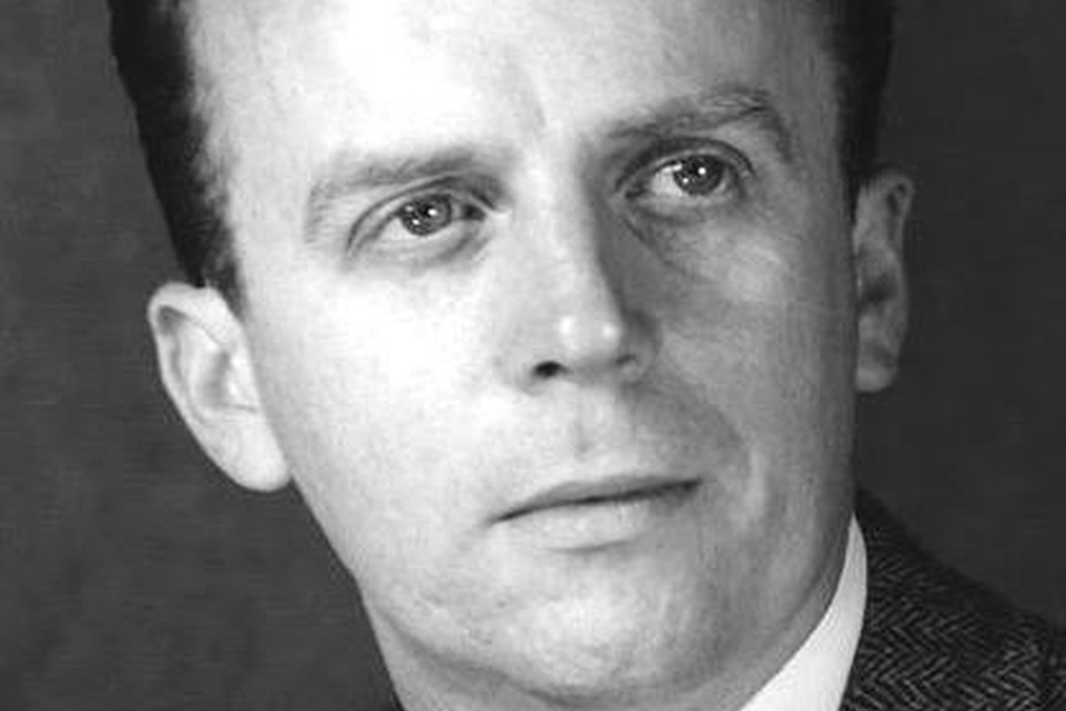
AI PRACTICE
33
How to use AI coding assistants responsibly
Ask
>
Read
>
Run
>
Test
>
Explain
Ask for small pieces of code, not a whole scientific conclusion.
Read the generated code before running it.
Test on a tiny example where you know the answer.
Explain the result in astronomical terms.
Notes:
Let us return to AI one more time before the live demo. A responsible workflow for AI coding assistants is: ask, read, run, test, and explain. Ask for a small piece of code, not for an entire scientific conclusion. Read the code before running it. Run it on a small example. Test it against a case where you know the answer. Then explain the result in astronomical terms.
This is a healthier relationship with AI. The AI assistant can help with syntax, common patterns, and debugging hints. It can also explain error messages. But it does not know your scientific context unless you provide it, and even then it can misunderstand. It may generate code that is plausible but not appropriate.
So when you use AI, treat it like a fast collaborator whose work must be checked. Programming fundamentals are what allow you to check. If you can read variables, loops, functions, and file operations, you can turn AI from a black box into a useful partner.
A strong final AI point is: "AI can help you get code, but programming helps you know whether the code deserves your trust." That sentence connects the AI discussion back to the entire Week 1 curriculum.

Slide 33
TAKE HOME
34
What programming gives an astronomer
Scale
Memory
Collaboration
do one analysis for many objects
automate repeated work
record methods
rerun when data change
share notebooks
work with classmates
work with AI tools
Programming is not separate from astronomy. It is how many astronomical ideas become measurable.
Notes:
Let us summarize what programming gives an astronomer. First, scale. Programming lets you apply one analysis to many objects, many files, many images, or many simulations. Second, memory. Code records what you did, so you can rerun the analysis when data change or when someone asks how a figure was made. Third, collaboration. A notebook can be shared with classmates, collaborators, supervisors, and AI tools.
Most importantly, programming turns an astronomical idea into something measurable. A question like which stars are bright becomes a selection rule. A question like how large is this exoplanet becomes a calculation. A question like is this signal periodic becomes an algorithm and a plot.
So programming is not separate from astronomy. It is one of the modern languages of astronomy. Today we have only introduced the vocabulary. Now we will use Jupyter to practice speaking that language with small examples.
End with confidence. Tell students that the first steps may feel mechanical, but every expert began by learning names, values, loops, and files. These simple ideas are the foundation of much more sophisticated astronomical analysis.

Slide 34
Q&A
Week 1/01_getting_started.ipynb
Run, change, inspect, explain.
Notes:
Now we switch from slides to Jupyter. Please open Week 1/01_getting_started.ipynb. The goal is not to type perfectly or to finish everything quickly. The goal is to learn the workflow: run a cell, read the output, change something, run again, and explain what happened.
As we go through the notebook, keep connecting the code to the concepts from the slides. When you see a name assigned to a value, call it a variable. When you see a list or dictionary, ask what information it organizes. When you see a loop, ask what is being repeated. When you see a function, ask what idea is being packaged. When you read a file, ask where the data live and what format they have.
If something breaks, that is useful. We will read the error message together. Debugging is not a failure of programming; debugging is one of the main ways we learn how the computer understood our instructions.
Let’s switch screens to have a practical exercise: keep the slides in mind, but focus on doing.

Slide 35
Now open Jupyter
Week 1/01_getting_started.ipynb
Run, change, inspect, explain.
Notes:
Now we switch from slides to Jupyter. Please open Week 1/01_getting_started.ipynb. The goal is not to type perfectly or to finish everything quickly. The goal is to learn the workflow: run a cell, read the output, change something, run again, and explain what happened.
As we go through the notebook, keep connecting the code to the concepts from the slides. When you see a name assigned to a value, call it a variable. When you see a list or dictionary, ask what information it organizes. When you see a loop, ask what is being repeated. When you see a function, ask what idea is being packaged. When you read a file, ask where the data live and what format they have.
If something breaks, that is useful. We will read the error message together. Debugging is not a failure of programming; debugging is one of the main ways we learn how the computer understood our instructions.
As you switch screens, give students a practical instruction: keep the slides in mind, but focus on doing. The notebook hour is successful if they run code, make at least one change, and understand at least one error message.

