Slide 1
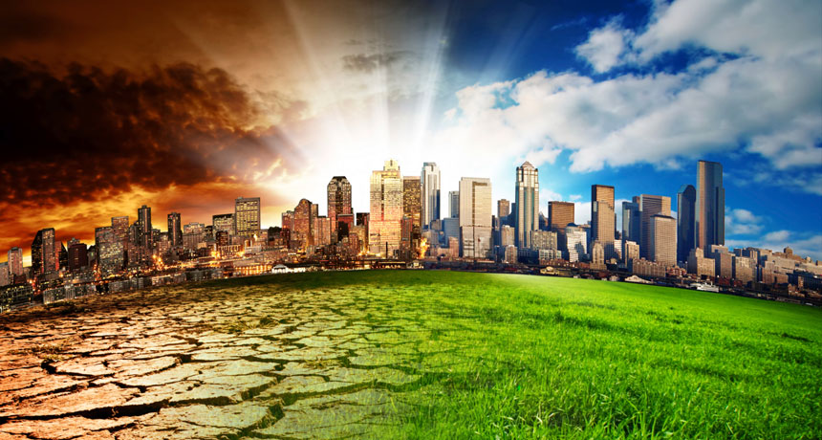
Global Warming

Slide 2
What is Global Warming?
More recenGlobal Warming is when the earth heats up and the temperature increases
More recently, the temperature have been rising, causing more dangers for people, animals , plants and our environment.

Slide 3
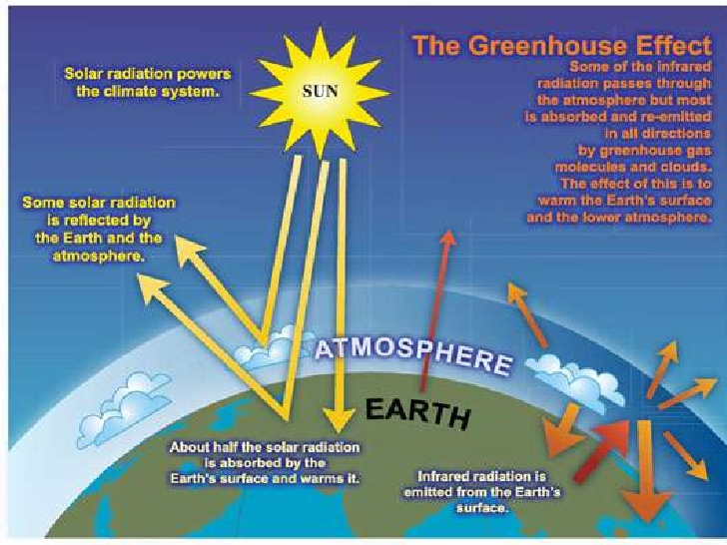


Slide 4
Causes of Global Warming
Electrical pollution is a main cause for Global Warming .Mostly ,fossil fuels are burned to create electricity and are made of dead plants and animals .Some examples of fossil fuels are oil and petroleum. Many the air when fossil fuels are burned. Some of these chemicals are called greenhouse gasses.
petroleum one of the source of energy, is used a lot. It is used for transportation, making electricity, and making many other things. Although this source of energy gives off a lot of population, it is used for 38% of the United States’s energy.

Slide 5
When we throw our garbage away, the garbage goes to landfills. They are full of garbage. The garbage is then sometimes burned. This sends an enormous amount of greenhouse gasses into the air and makes global warming even worse.
Another factor that makes global warming worse is when trees are cut down. Trees and other plants collect and absorb carbon dioxide(CO₂), which is a greenhouse gas.

Slide 6
Results of Global Warming
Global Warming is affecting many parts of the world, including melting glaciers, creating the sea rise even more, and when that happens, the water covers many low land islands.
Global Warming also destroy many huge forests. The pollution that causes global warming is linked to acid rain. Acid rain gradually destroys almost everything it touches. Global Warming is also causing many more fires that wipe out whole forests. This happens because global warming can make the earth very hot. In forests, some plants and trees leaves can be so dry that can catch on fire.

Slide 7
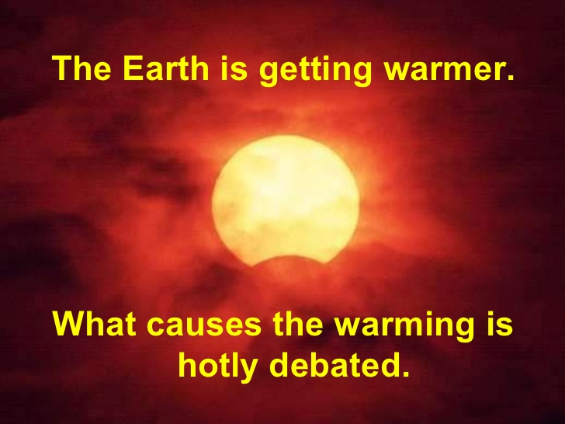
Some Facts
From 1971 to 2005 CO2 vehicle emissions rose from 1.8 billion tons year to 4.6 billion tons per year.
The average global air temperature rose between .05 and 0.74 degrees C during the past century.
An average 2 degrees C warming is predicted by 2100.
Sea level has risen between 10 to 25cm in the last 100 years.

Slide 8
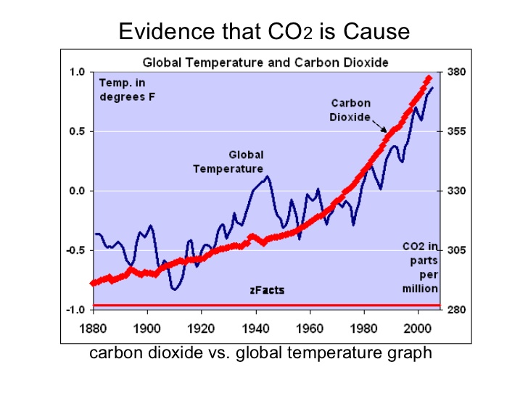
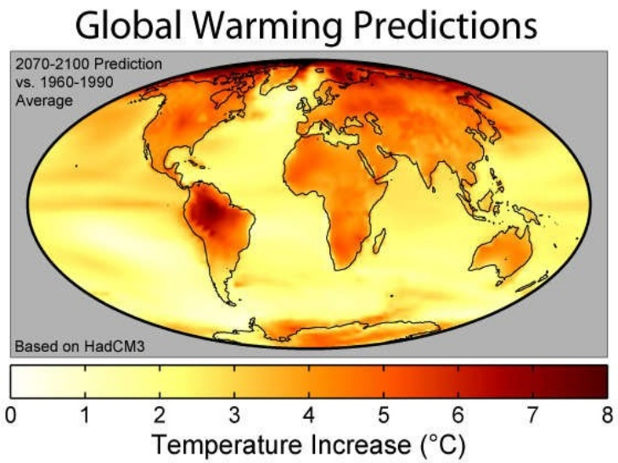

Slide 9
What are people doing to stop global warming?
Carpooling => is driving with someone to a place that you are both going to. This minimizes the amount of greenhouse gases put into the air by a car.
Another thing that people are doing is being more careful about leaving things turned on like the television, computers and the lights.

Slide 10
The Clean Air Act is making many companies changes their products to decrease these problems. Part of the law says that you may not put a certain amount of pollutants in the air.
The clean Air Act has also made car companies change some of things inside of the cars. Cars pollute a lot. While cars make more than half of the world’s smog.
Reducing cars, buses and trucks which are also responsible for over 50%of dangerous chemicals let into the air.
Ozone – Ozone is produced when other pollution chemicals combine. It is the basic element of smog.
It causes many different kinds of health issues dealing with the lungs.
It can damages plants and limit sight. It can also cause a lot of property damage.

Slide 11
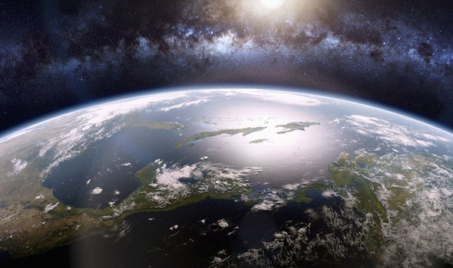
If we want to live longer, to be safer and in good health we must protect our environment

Slide 12
Thank You
UWU/IIT/16/023
O.W.T.Y.Jayathilake

